Slide 1
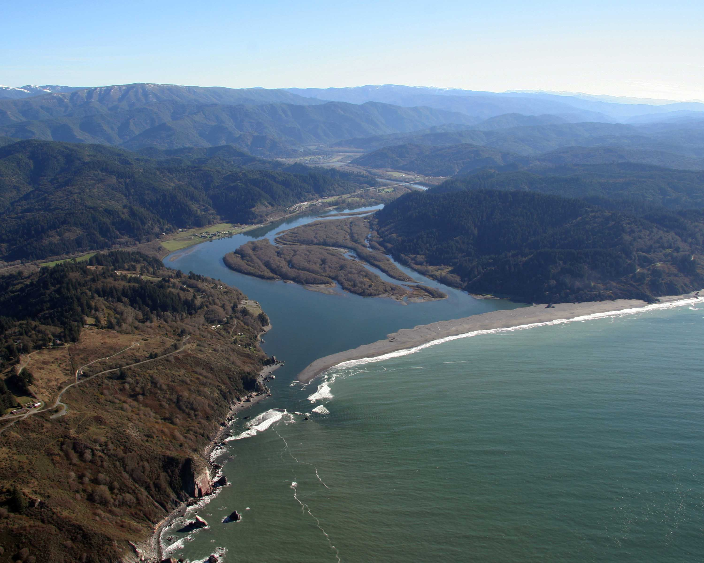

The Yurok Tribe’s 2017 Wildfire Disaster Response and Reintroduction of Prescribed Fire to Help Prevent Future Wildfires
Presentation by: Joe Hostler
Yurok Tribe Environmental Program-(YTEP)
ANTHC LEO Network
June 19th , 2018

Slide 2
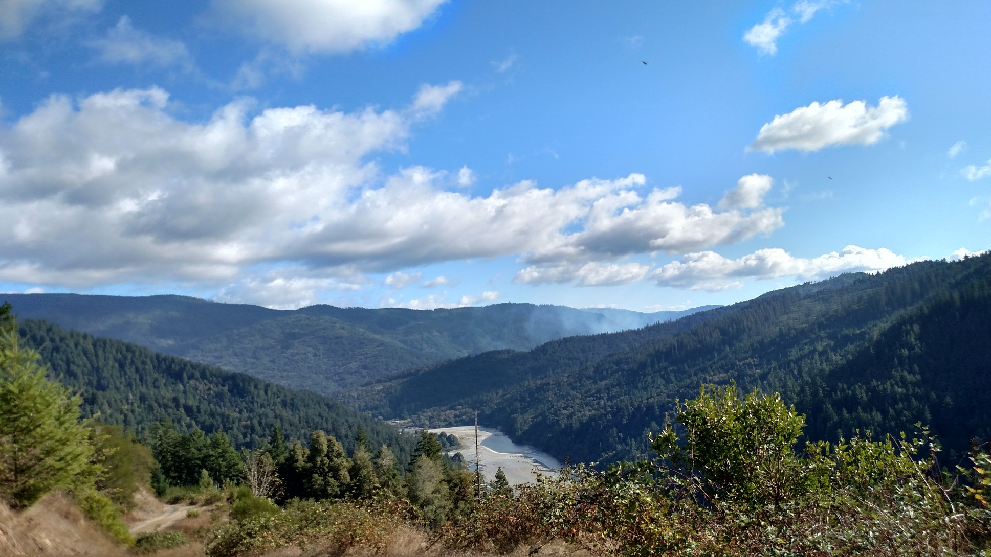
Yurok Tribe’s 2017 Wildfire Disaster Response
Presentation Overview
Background info on Yurok Tribe and landscape
2017 Wildfire Season response
Cultural Burning and Prescribed Fire to build ecosystem resiliency
Notes:
Smoke from prescribed fire

Slide 3
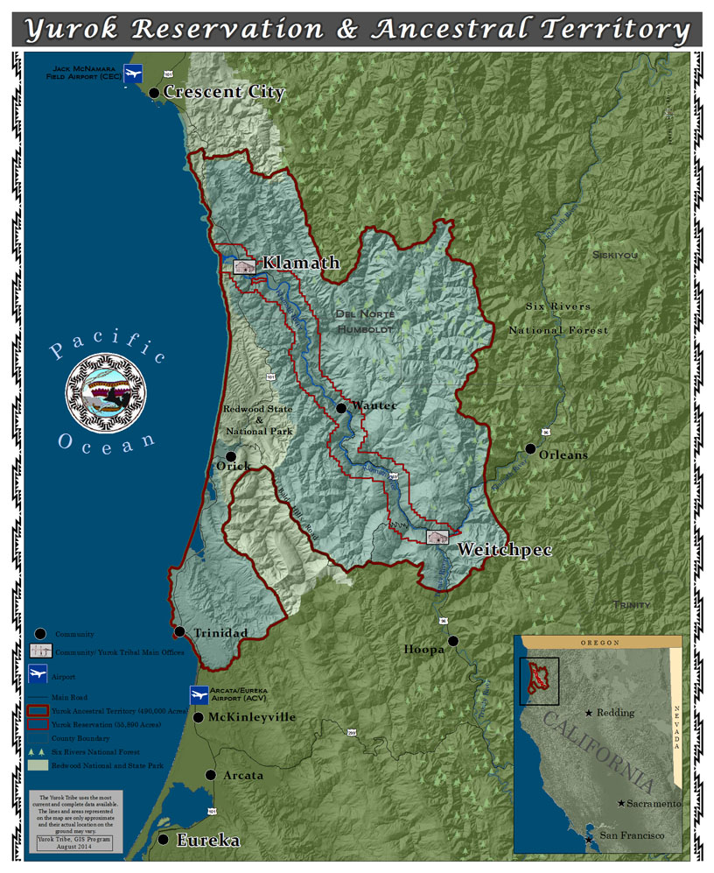
Tribal Background
Yurok People:
Pueleek-laa
(River Yurok)
Ner’er-nerh
(Coastal Yurok)
  California’s largest Tribe
  Over 6,000 members
  Yurok Indian Reservation is 1 mile each side of the lower 46 Miles of the Klamath River. = 56,000 acres. Recently acquired 47,000 ac of fee land adjacent to YIR.
Notes:
Yurok Indian Reservation surrounded by forested lands on Six Rivers Nat’l Forest, Hoopa Valley Indian Reservation, Redwood National and State Park, Green Diamond Resource Timber Company

Slide 4
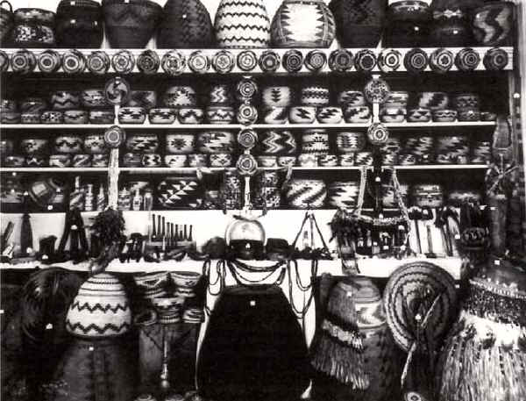
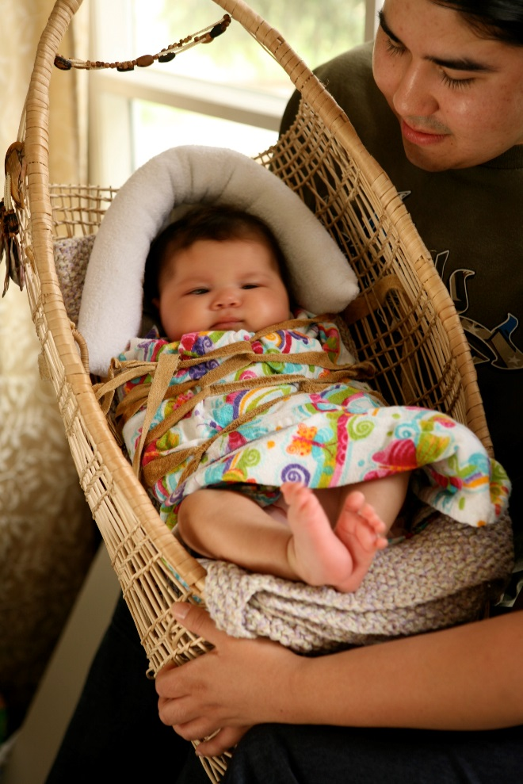
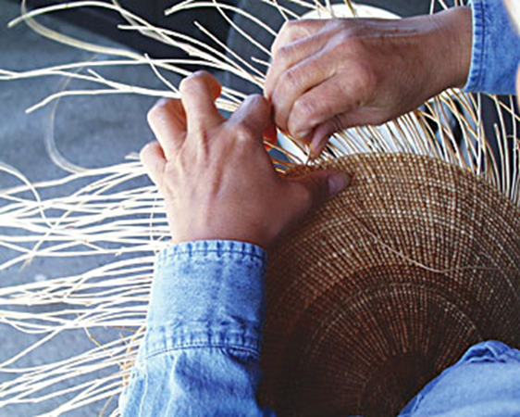
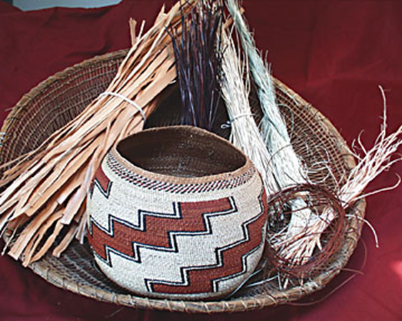
www.californiabaskets.com
Basket, materials and photo by Deborah McConnell
NW California Tribes
are world renowned
Basket weavers
Good materials
Require burning
Photo by Jen Kalt California Indian Basket weavers Association (CIBA)

Slide 5
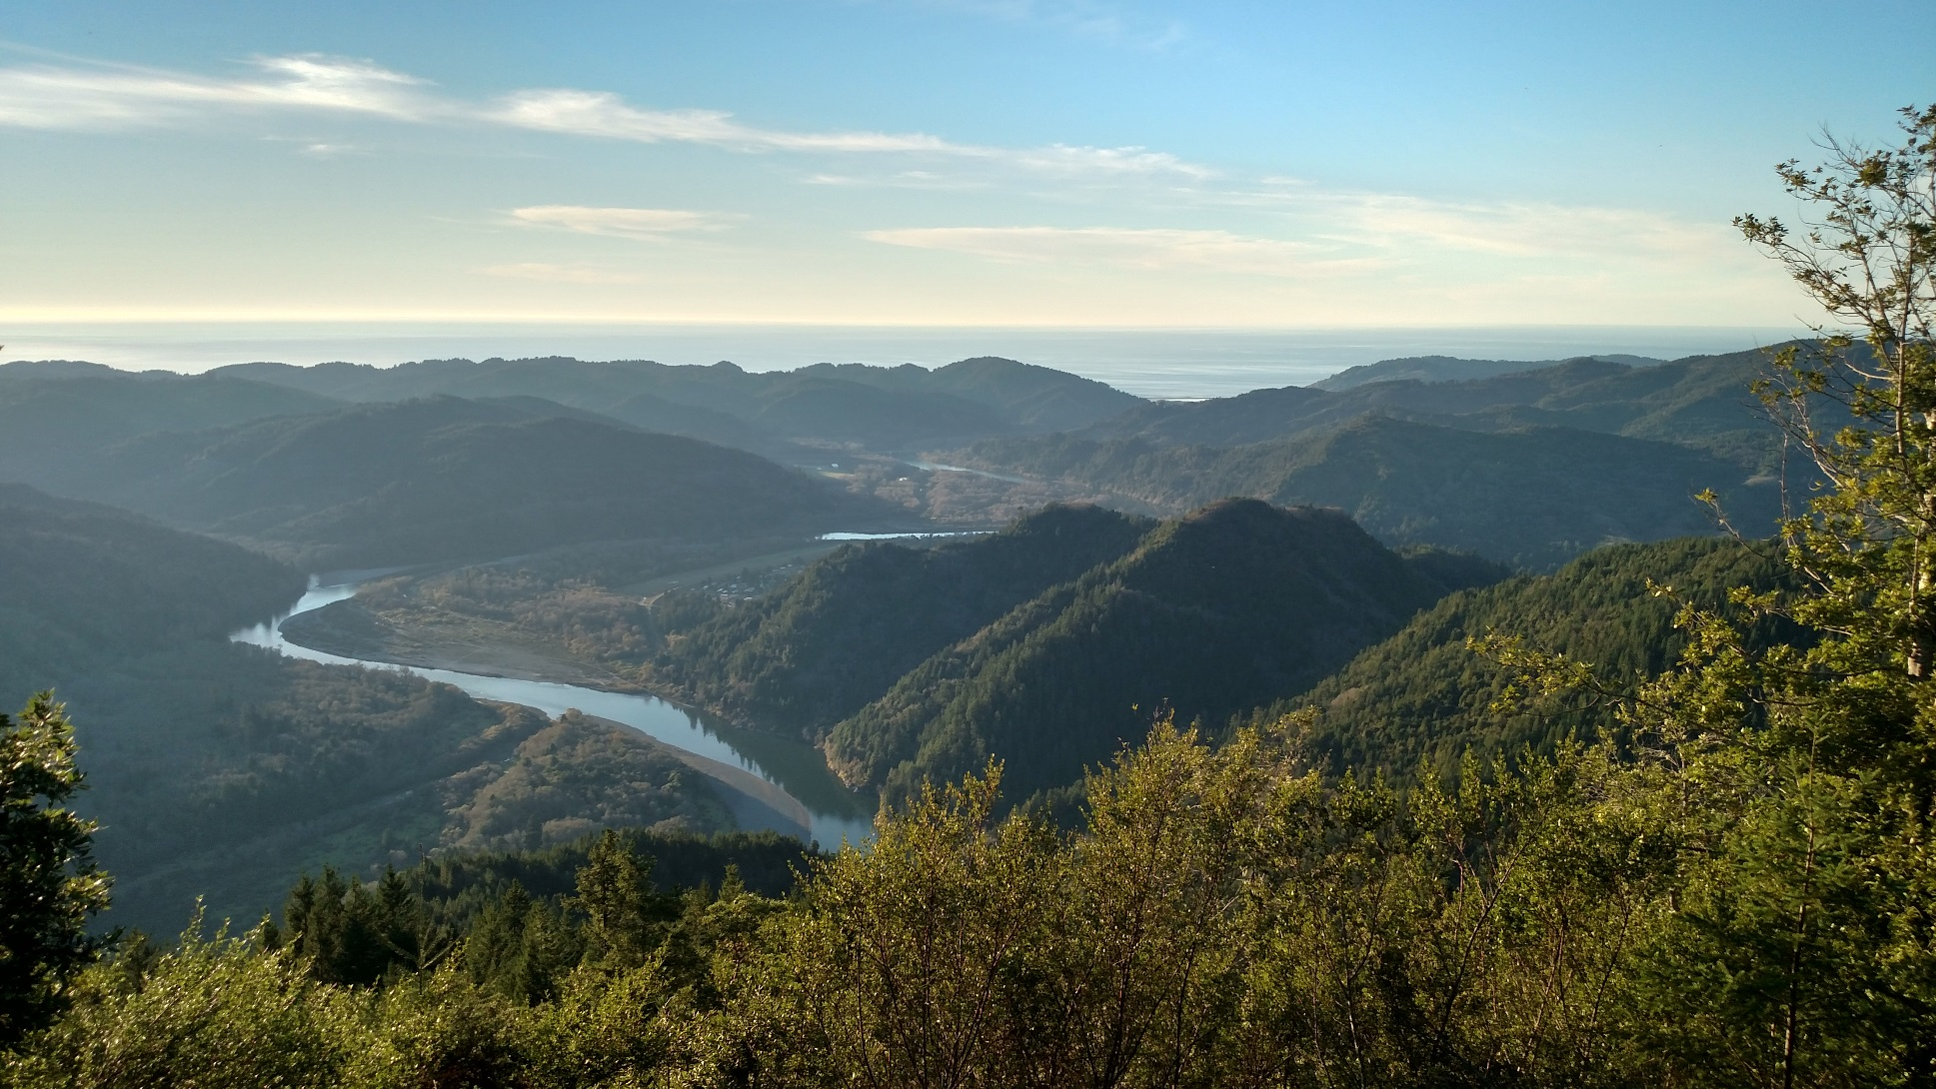
The Yurok Tribe’s 2017 Wildfire Disaster Response
Yurok Indian Reservation has pristine air for much of the year except during
Summer Wildfire season.
Yurok Indian Reservation is overlapped by the Redwood National Park
which is a congressionally designated Class 1 Air shed
Wildfire Smoke has impacted the Yurok Indian Reservation 13 of the past 19 years
Projected climate change impacts are becoming our reality
    increased wildfire season duration & intensity.
    Increased drought,
    Shorter & more intense wet season causes more plant growth which
dries out during summer dry season.
Dealing with wildfire smoke is now a regular occurrence

Slide 6
Study using tree cores near the Yurok Reservation in NW California
Note: Timing of Federal Fire suppression policies in early 1900’s
and reduction of acres burned.
Tribal members have been arrested for cultural burning
Notes:
Over 100 years of fire suppression has ceased Tribal Traditional Burning and led to overstocked forests that are highly vulnerable to catastrophic fire

Slide 7
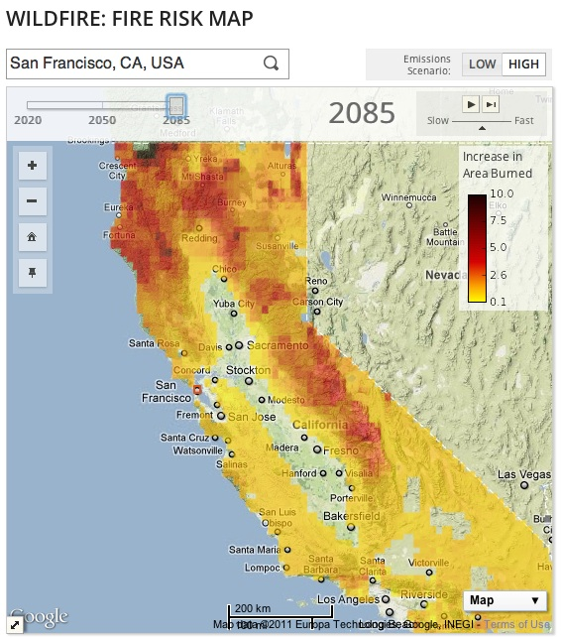
www.cal-adapt.org
Climate change expected to increase wildfire size and severity

Slide 8
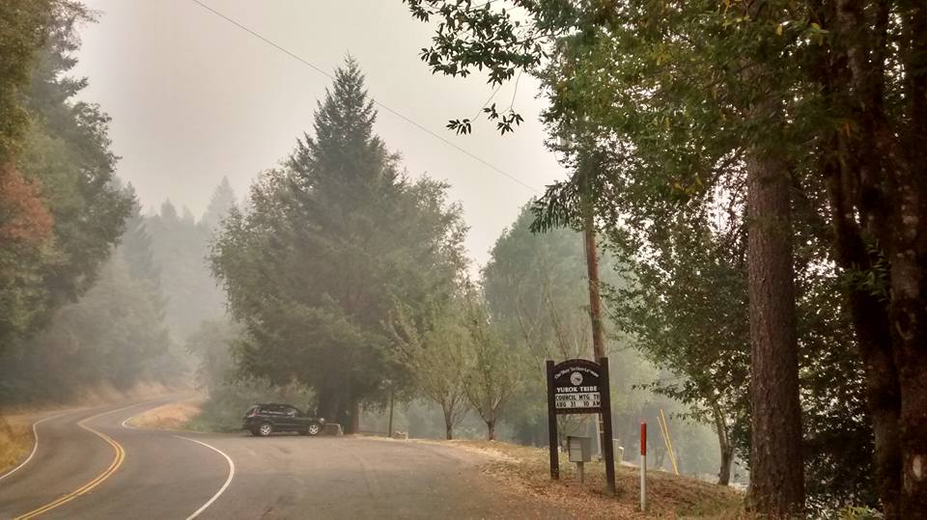
The Yurok Tribe’s 2017 Wildfire Disaster Response
Beginning in July of 2017 Lightning caused multiple wildfires on nearby U.S. Forest Service lands within 50 miles of YIR
68,000 acre Salmon-August Complex
100,00 acre Eclipse Complex
27,000 acre Orleans Complex
190,000 acre Chetco Bar complex
34,000 acre Miller Complex
Disclaimer
  I’m not an “expert.”
  Project wasn’t perfect
  Intention is to help show others one way to conduct TEK research
Photo By Elizabeth Azzuz

Slide 9
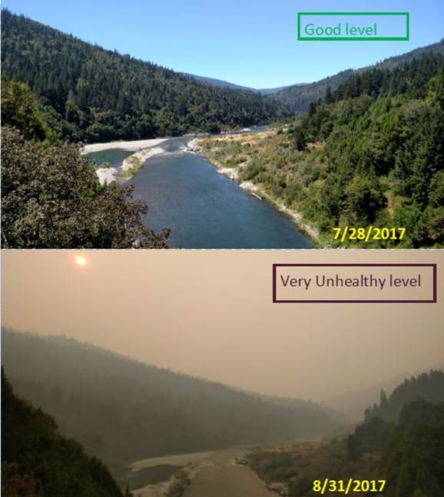
The Yurok Tribe’s 2017 Wildfire Disaster Response
From
Weitchpec
Bridge Looking
Downriver

Slide 10
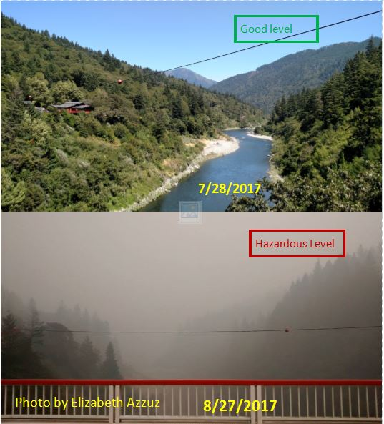
The Yurok Tribe’s 2017 Wildfire Disaster Response
From Weitchpec
Bridge Looking
Upriver

Slide 11
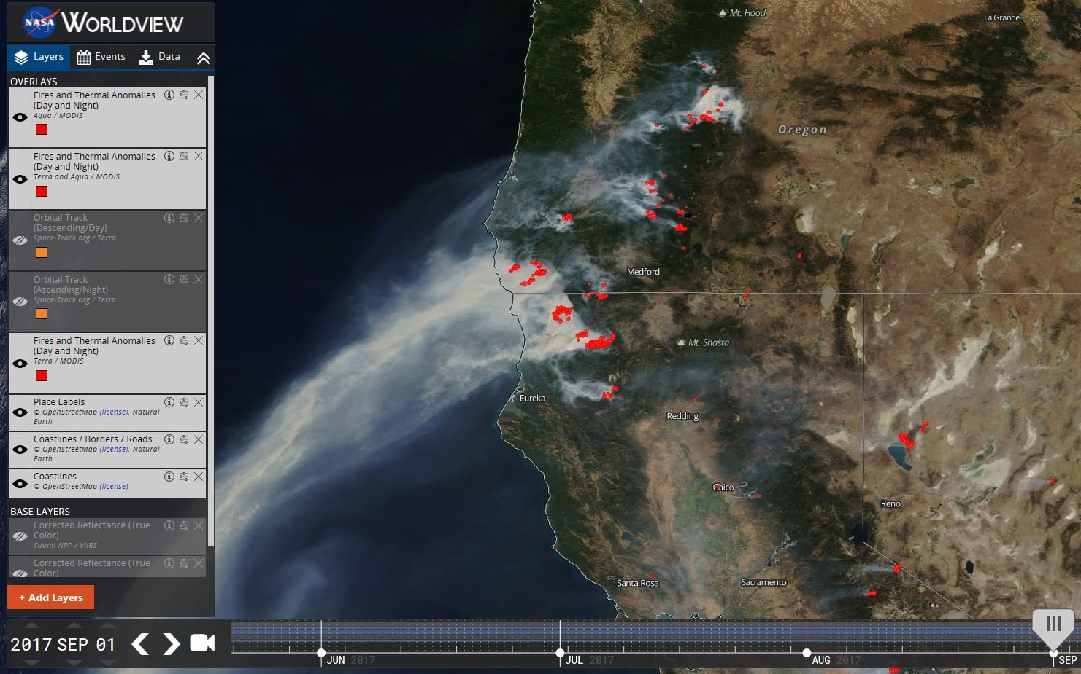
The Yurok Tribe’s 2017 Wildfire Disaster Response
https://earthdata.nasa.gov/labs/worldview/

Slide 12
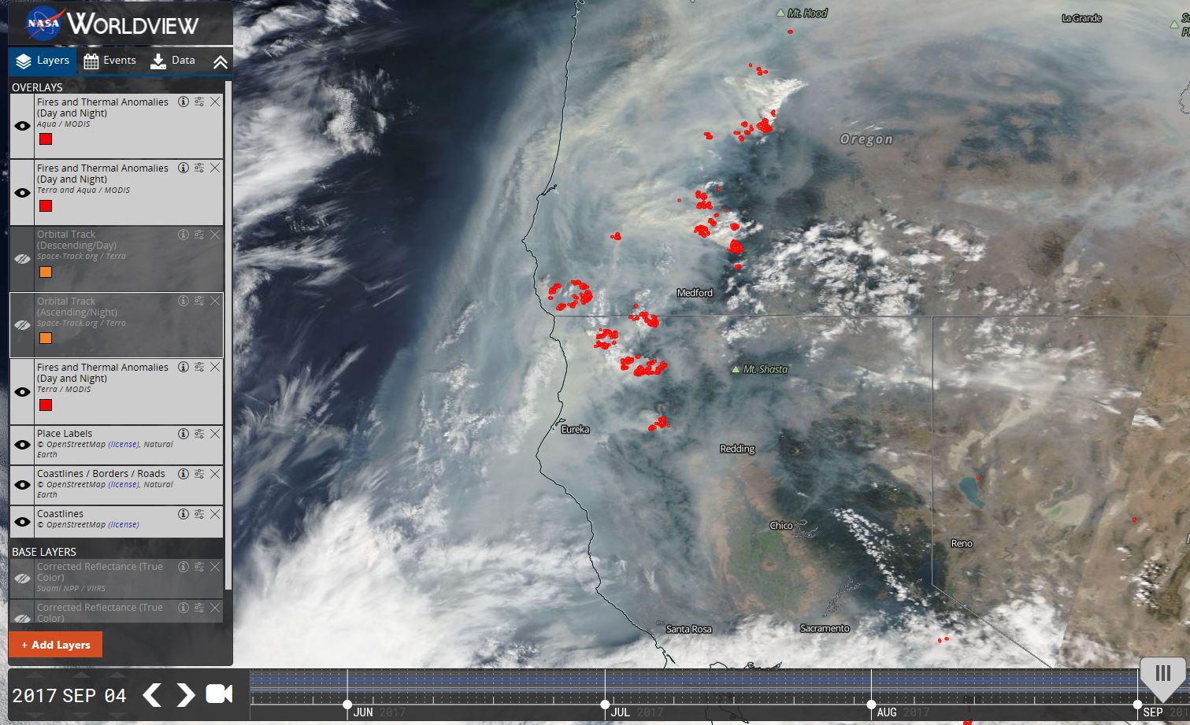
The Yurok Tribe’s 2017 Wildfire Disaster Response
https://earthdata.nasa.gov/labs/worldview/

Slide 13
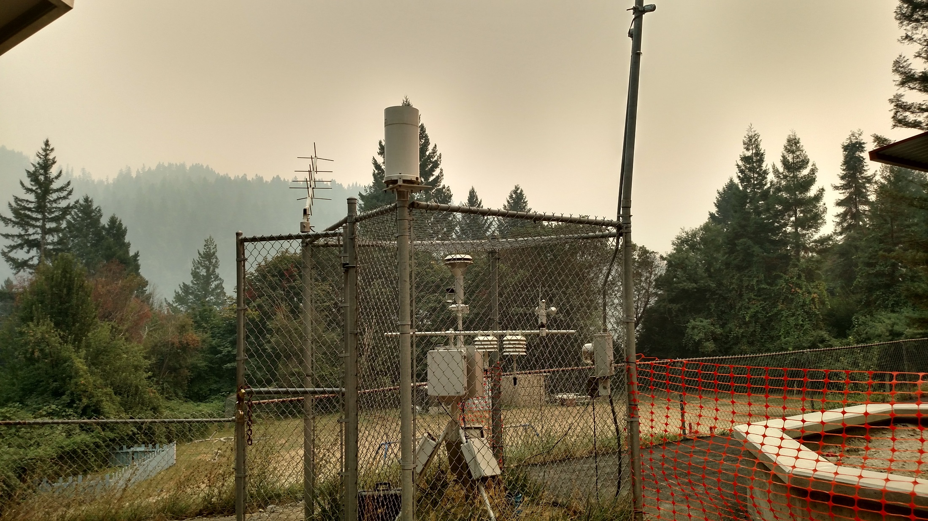
The Yurok Tribe’s 2017 Wildfire Disaster Response
Very Unhealthy
8/31/2017
Yurok Tribe
Weitchpec E-BAM
Looking south

Slide 14
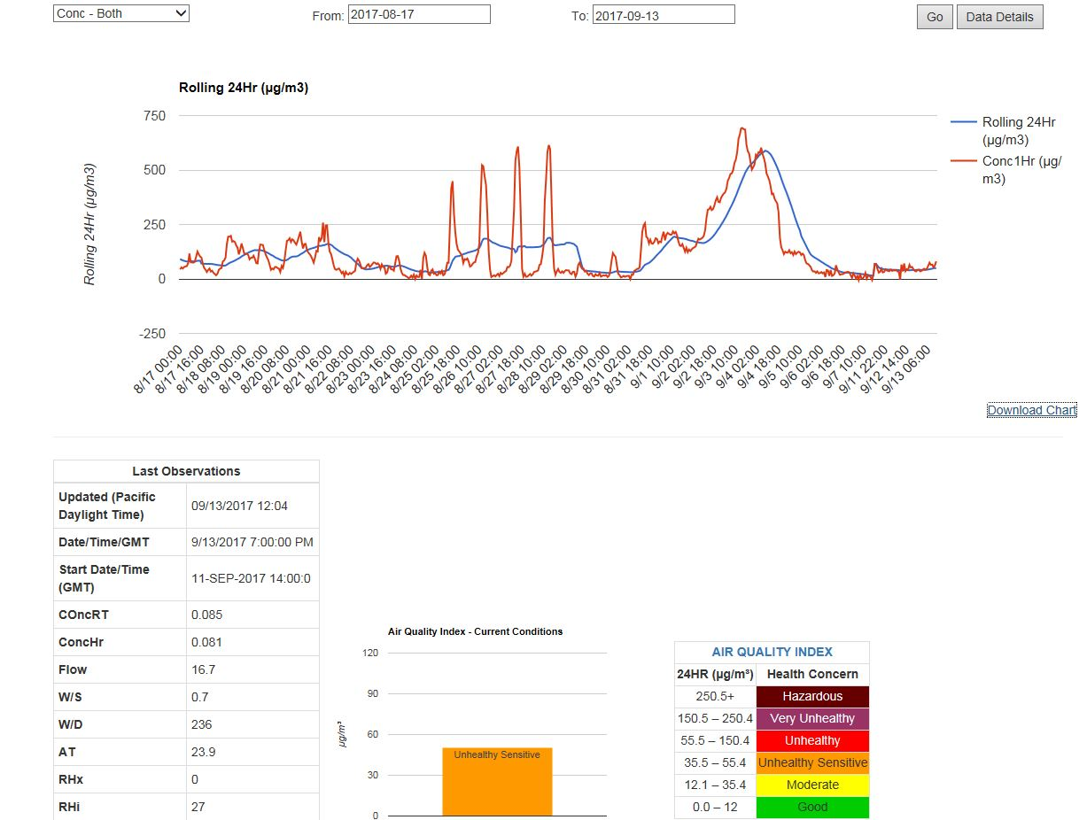

Slide 15
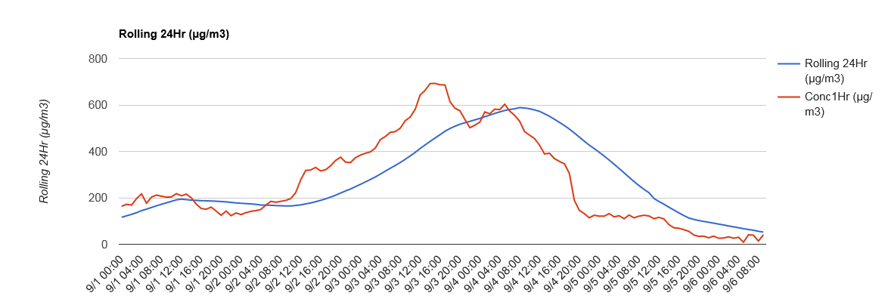
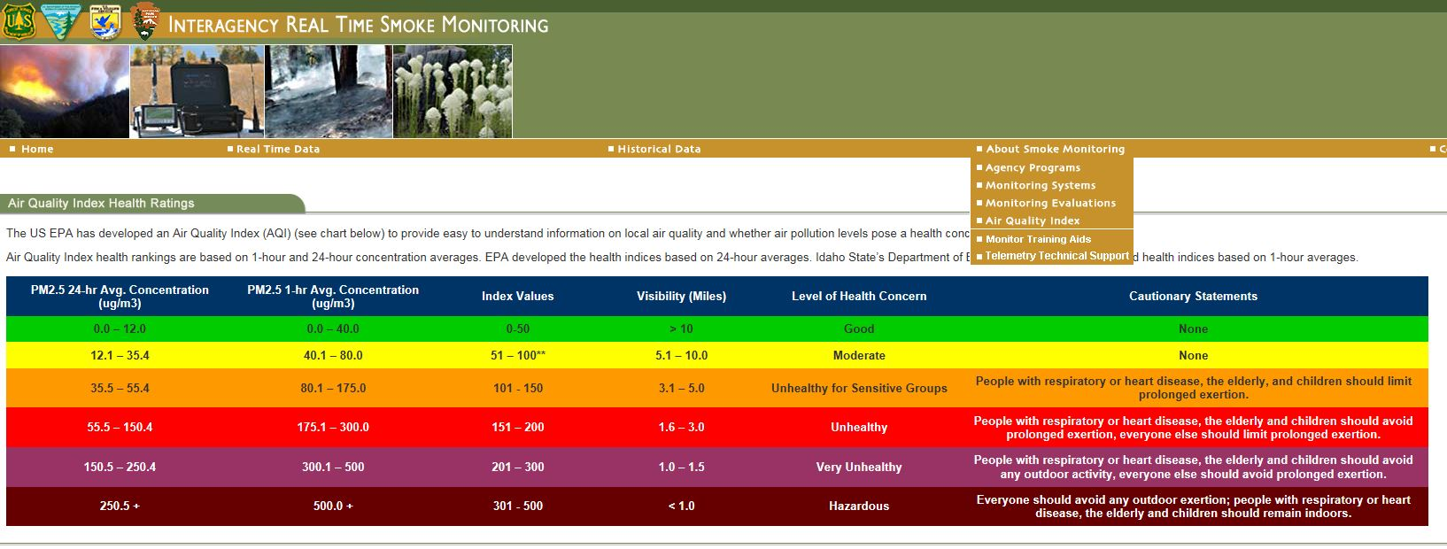
Notes:
Explaing 24 vs 1 hr vs visibility. Explain AQI

Slide 16
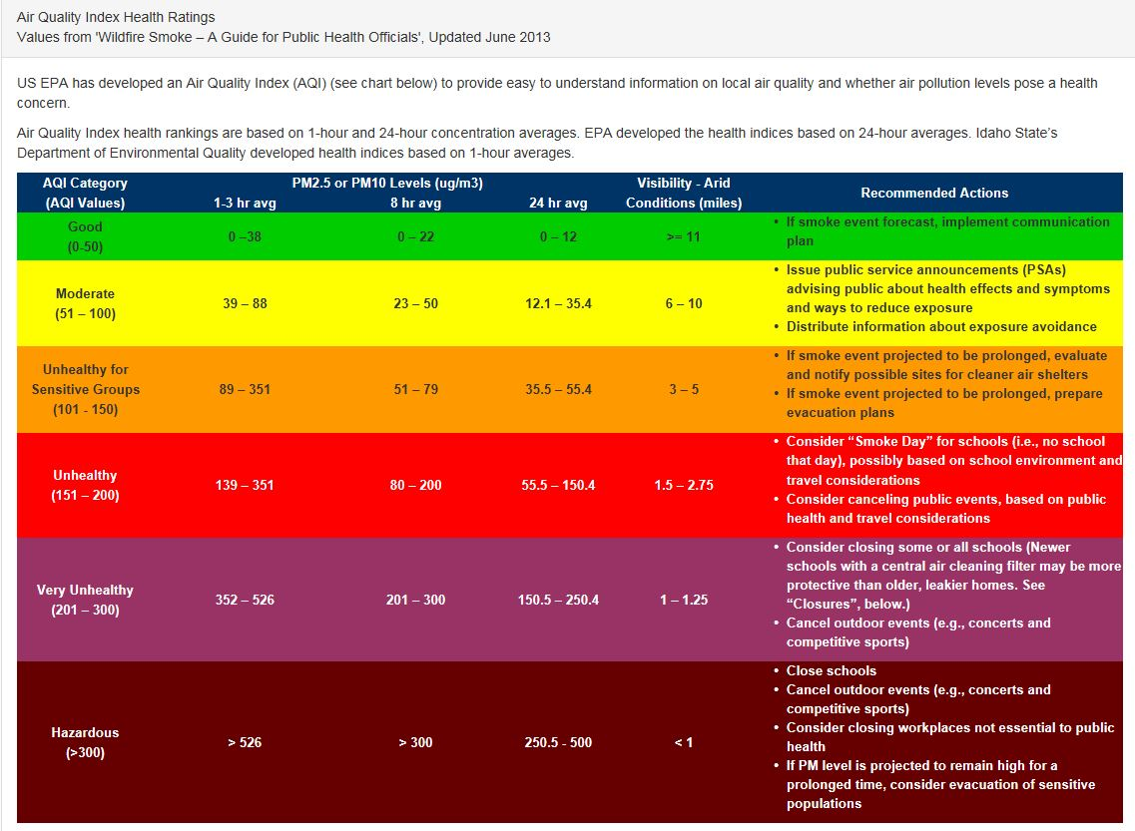

Slide 17
The Yurok Tribe’s 2017 Wildfire Disaster Response
On August 31rst 2017 Yurok Tribal Council Declares Disaster Due to Wildland Fire Conditions on the Yurok Reservation and Surrounding Regions
Opened breathing respite shelters
Distributed dozens of High Efficiency Particulate Air (HEPA) filters to vulnerable people – Need electricity
Distribute N-95 masks to public
Door to door welfare checks
Communicate with FEMA and Cal Office of Emergency Services (CalOES)
    Borrow 2 AirSIS radios to stream data real-time with existing Tribal AQ monitor equipment.

Slide 18
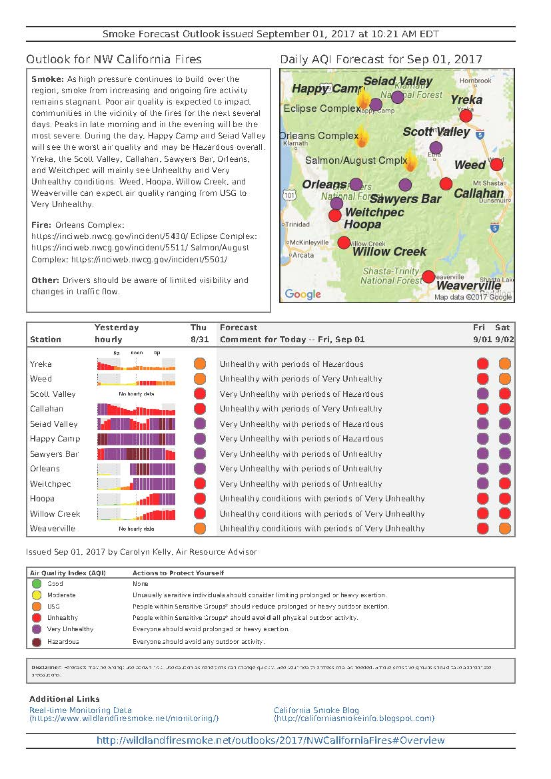
Notes:
Reached out to ARA’s to inform them of local conditions and coordinate outlook report.

Slide 19
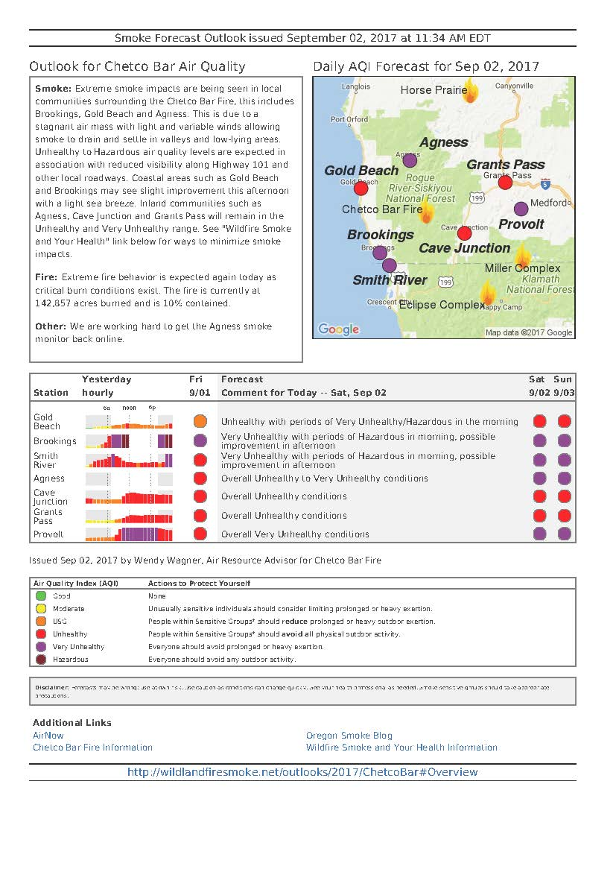

Slide 20
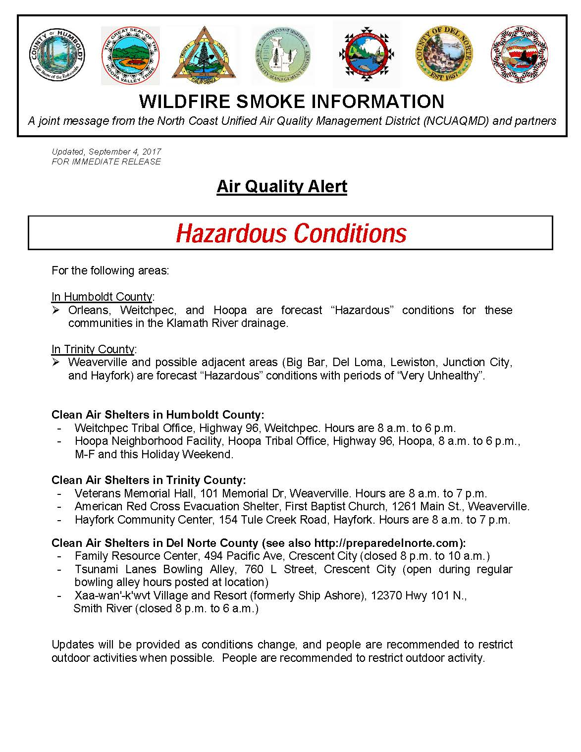

Slide 21
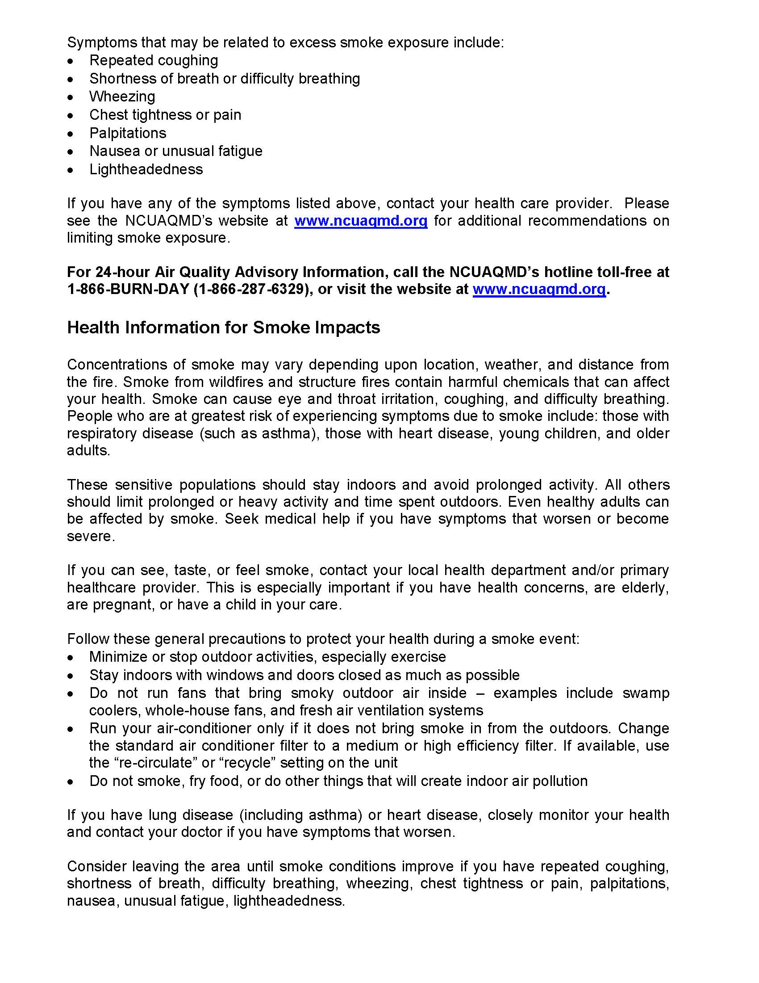

Slide 22
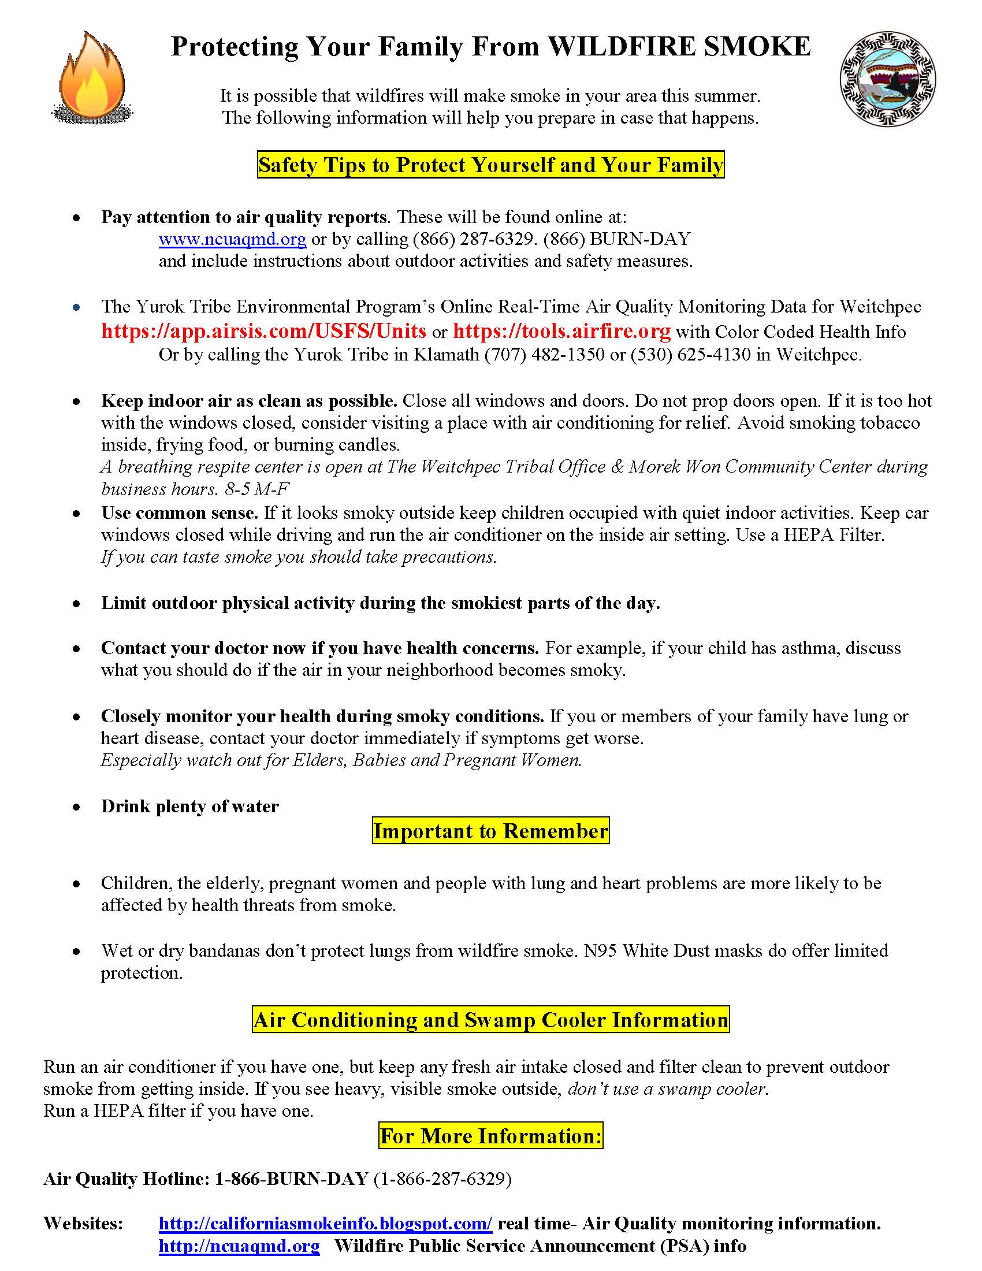

Slide 23
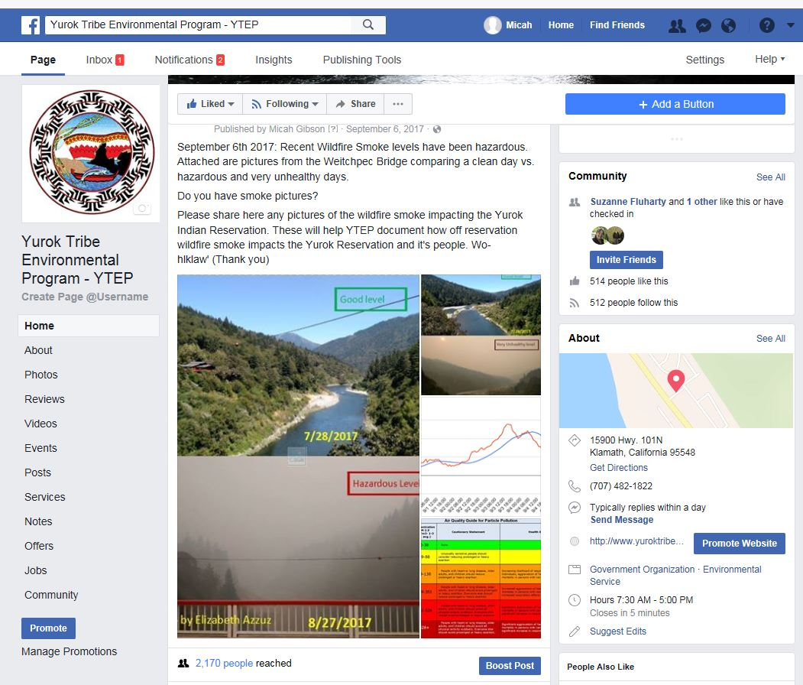

Slide 24
The Yurok Tribe’s 2017 Wildfire Disaster Response
Things to consider:
Prolonged fire season can cause fatigue and impatience by public. IE: cabin fever
May effect business IE: office closure, Admin Leave, School closure, sport events
Emergency personnel can easily get overworked

Slide 25
The Yurok Tribe’s 2017 Wildfire Disaster Response
Things to consider:
Need multiple forms of Public outreach
Advisory messaging important. Keep it simple
Use common sense.
If you can taste smoke its bad for you.
AQ Monitor data helpful
  Consider site location and site security

Slide 26
The Yurok Tribe’s 2017 Wildfire Disaster Response
  Things to Consider:
  Coordinate with Local Health Clinics
  (25-30 people came to clinic with respiratory concerns during wildfire episodes)
  Inadequate housing, no electricity to run HEPA filters
  outdoor ceremonial participation increases exposure.

Slide 27
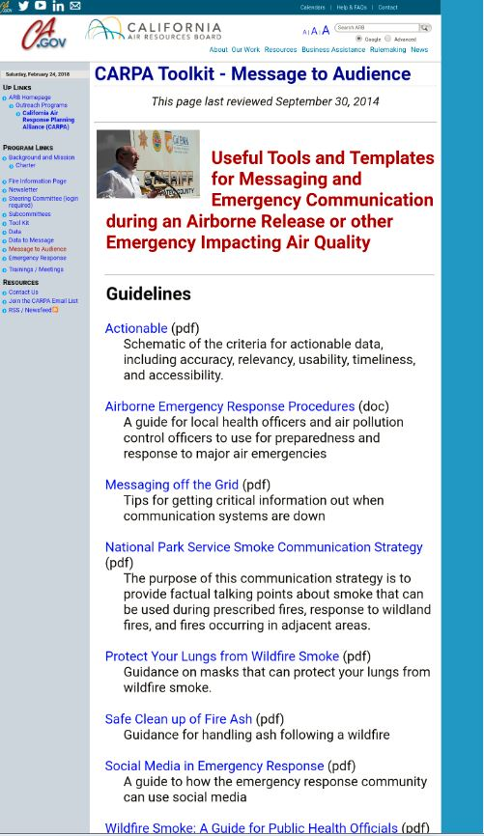
Further resources:
California Air Resources Board online toolkit
https://www.arb.ca.gov/carpa/toolkit/toolkit-intro.htm
http://californiasmokeinfo.blogspot.com/
www.cdc.gov/disasters/wildfires/smoke.html
Wildfire Smoke A Guide for Public Health Officials
-guidebook
www.Airnow.gov
wildfire data
https://tools.airfire.org
wildfire data

Slide 28
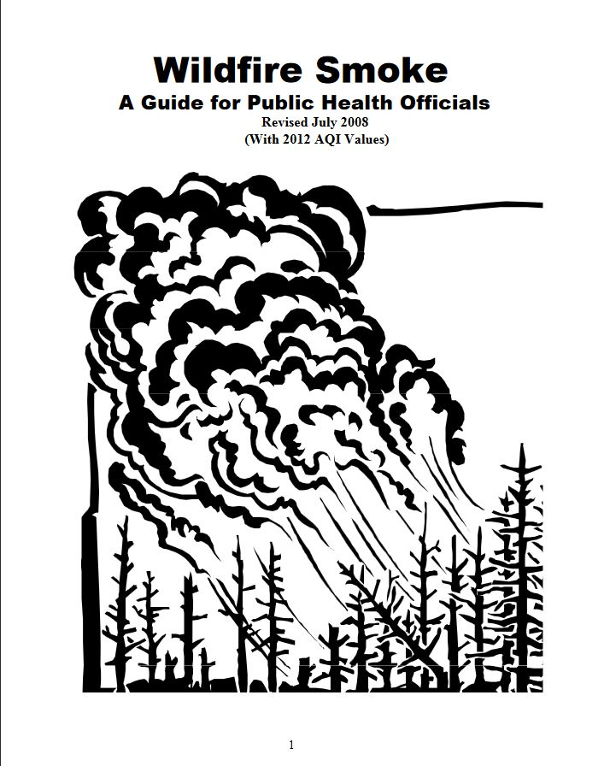
https://www3.epa.gov/airnow/
wildfire_may2016.pdf

Slide 29
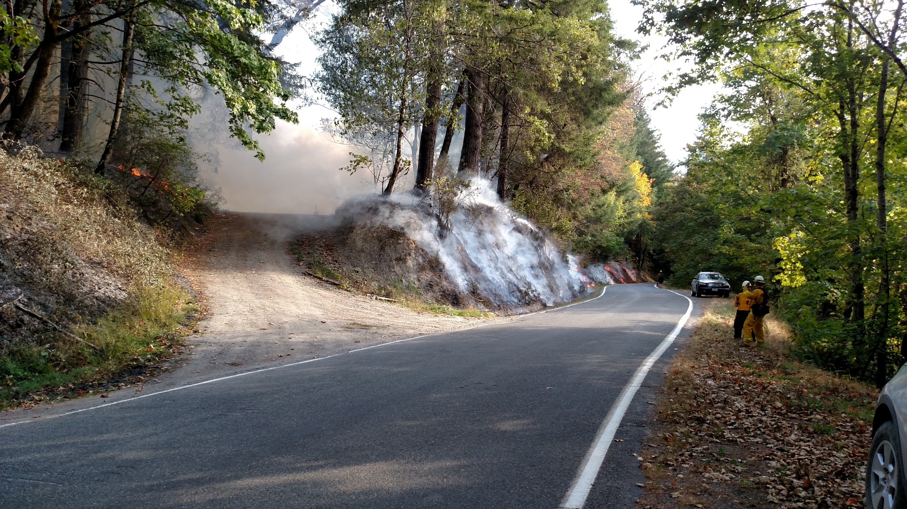
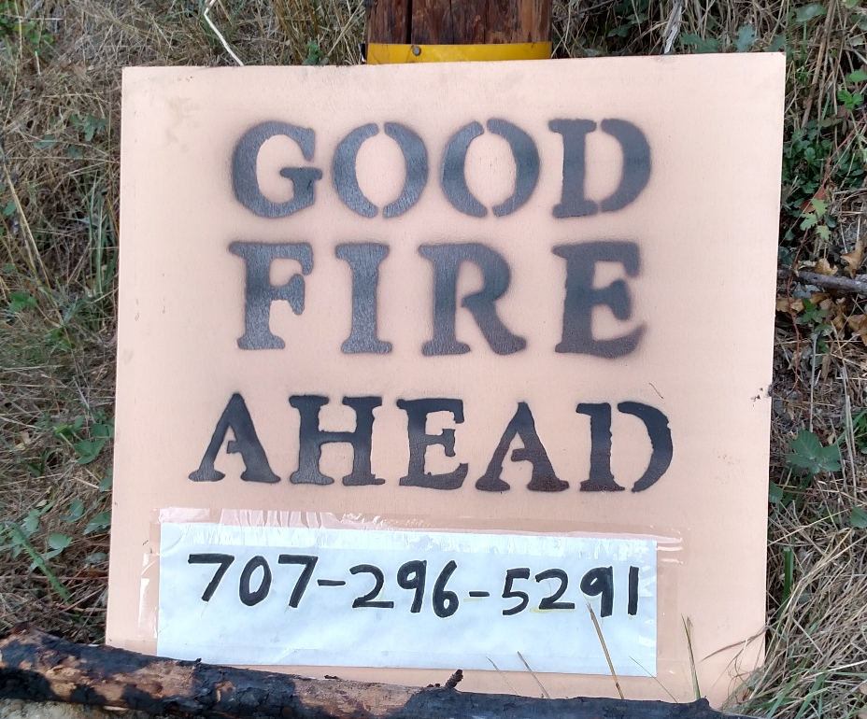
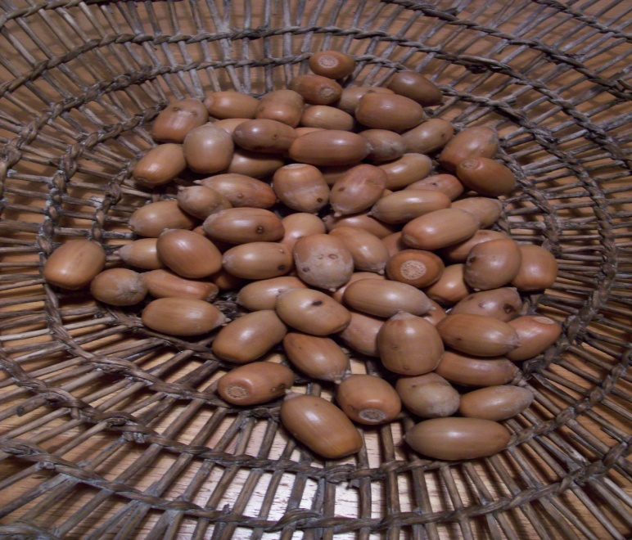
Yurok Tribe Reintroduction of Prescribed Fire to Help Prevent Future Wildfires
Reviving prescribed burning to restore ecosystem and build resiliency

Slide 30
Yurok Tribe’s Reintroduction of Prescribed Fire to Help Prevent Future Wildfires
Constitution of the Yurok Tribe
PREAMBLE October 22, 1993
From the beginning, we have followed all the laws of the Creator, which became the whole fabric of our tribal sovereignty. In times past and now Yurok people bless the deep river, the tall redwood trees, the rocks, the mounds, and the trails. We pray for the health of all the animals, and prudently harvest and manage the great salmon runs and herds of deer and elk. we never waste and use every bit of the salmon, deer, elk, sturgeon, eels, seaweed, mussels, candlefish, otters, sea lions, seals, whales, and other ocean and river animals.
We also have practiced our stewardship of the land in the prairies and forests through controlled burns that improve wildlife habitat and enhance the health and growth of the tan oak acorns, hazelnuts, pepperwood nuts, berries, grasses and bushes, all of which are used and provide materials for baskets, fabrics, and utensils.

Slide 31
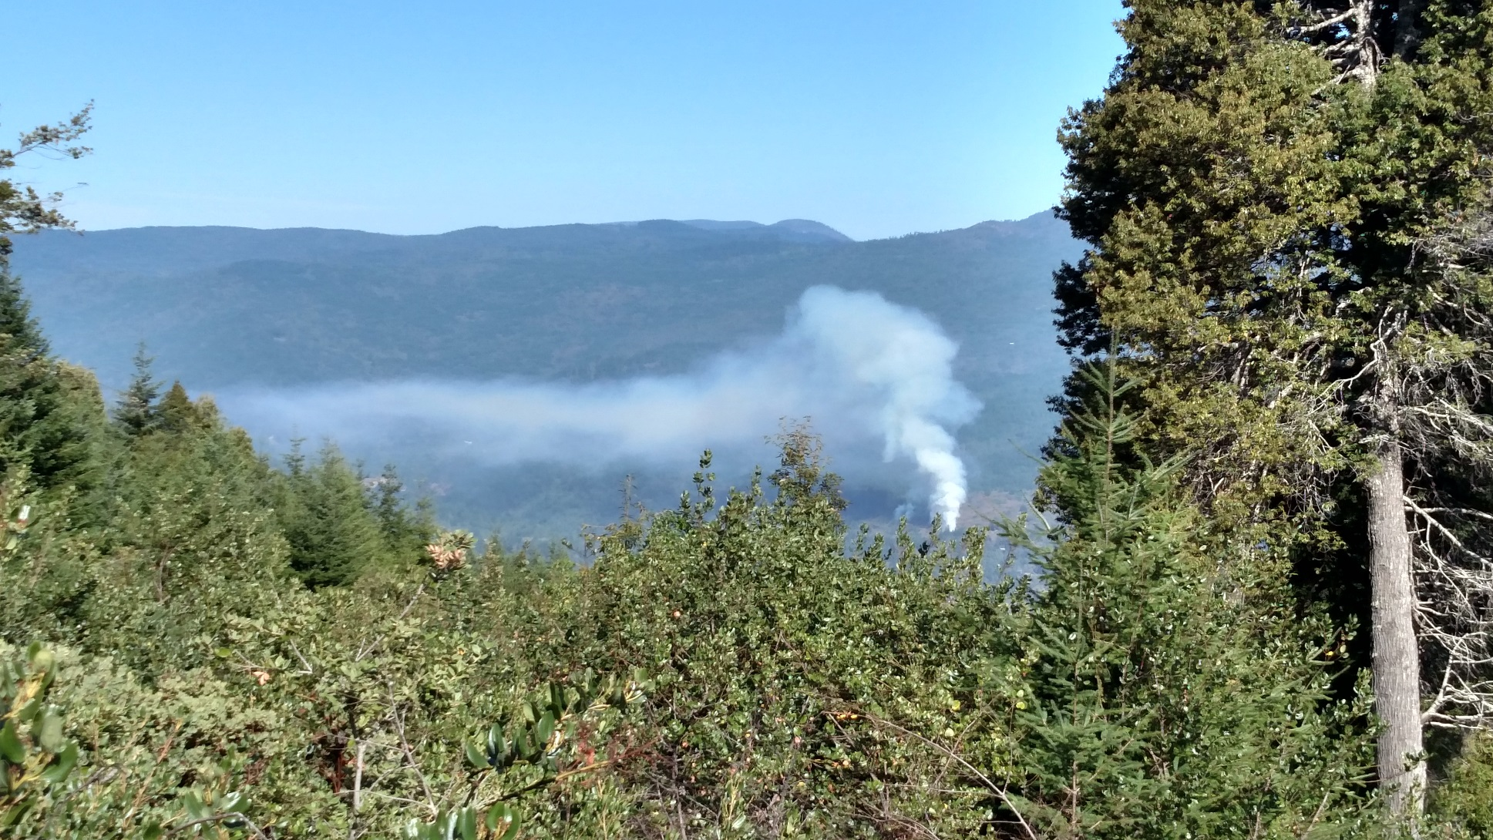
Yurok Tribe’s Reintroduction of Prescribed Fire to Help Prevent Future Wildfires
Through inherent authority under the Yurok Tribe’s
Air Quality Ordinance and Smoke Management Plan
YTEP issues burn permits on the YIR.
Tribal Member led Cultural Fire Management
Council conducting cultural burns on YIR. -TREX trainings
Beginning a process to scale up burned acres

Slide 32
Yurok Tribe’s Reintroduction of Prescribed Fire to Help Prevent Future Wildfires
Yurok Tribe Acquiring 47,000 acres of timberland on and adjacent to YIR.
  Management Planning includes prescribed burning
The Yurok Tribe's Landscape Level Traditional Management project
During this project, the primary resource concerns are to move away from revenue driven timber-oriented forest management and their legacy fragmentation on Yurok lands towards traditionally important native species, and reinstates a variety of land management techniques that include species conservation and water quality improvements. But also, the specific use of prescribed fire on the landscape as tree management for clearing underbrush, stimulating the type of vegetation growth that is useful for traditional gathering and limits the encroachment of Douglas fir on the open prairies.
Yurok Tribe Carbon Forest Project

Slide 33
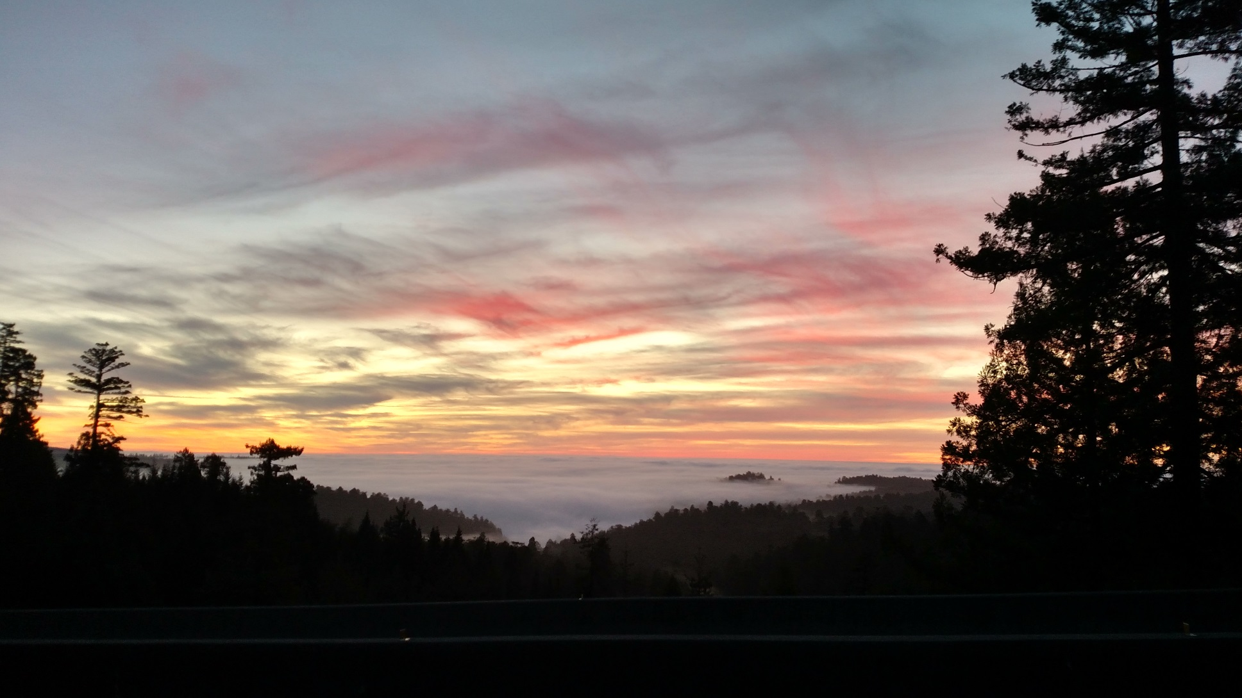
The Yurok Tribe’s 2017 Wildfire Disaster Response and Reintroduction of Prescribed Fire to Help Prevent Future Wildfires
Lessons Learned:
It’s not IF but WHEN wildfire will effect your community
Plan early
Partner with surrounding jurisdictions.
IE: Pre and Post wildfire season meetings
Prescribed fire can be beneficial in reducing wildfire intensity and smoke
Prescribed fire can be beneficial in restoring ecosystems & cultural resources

Slide 34
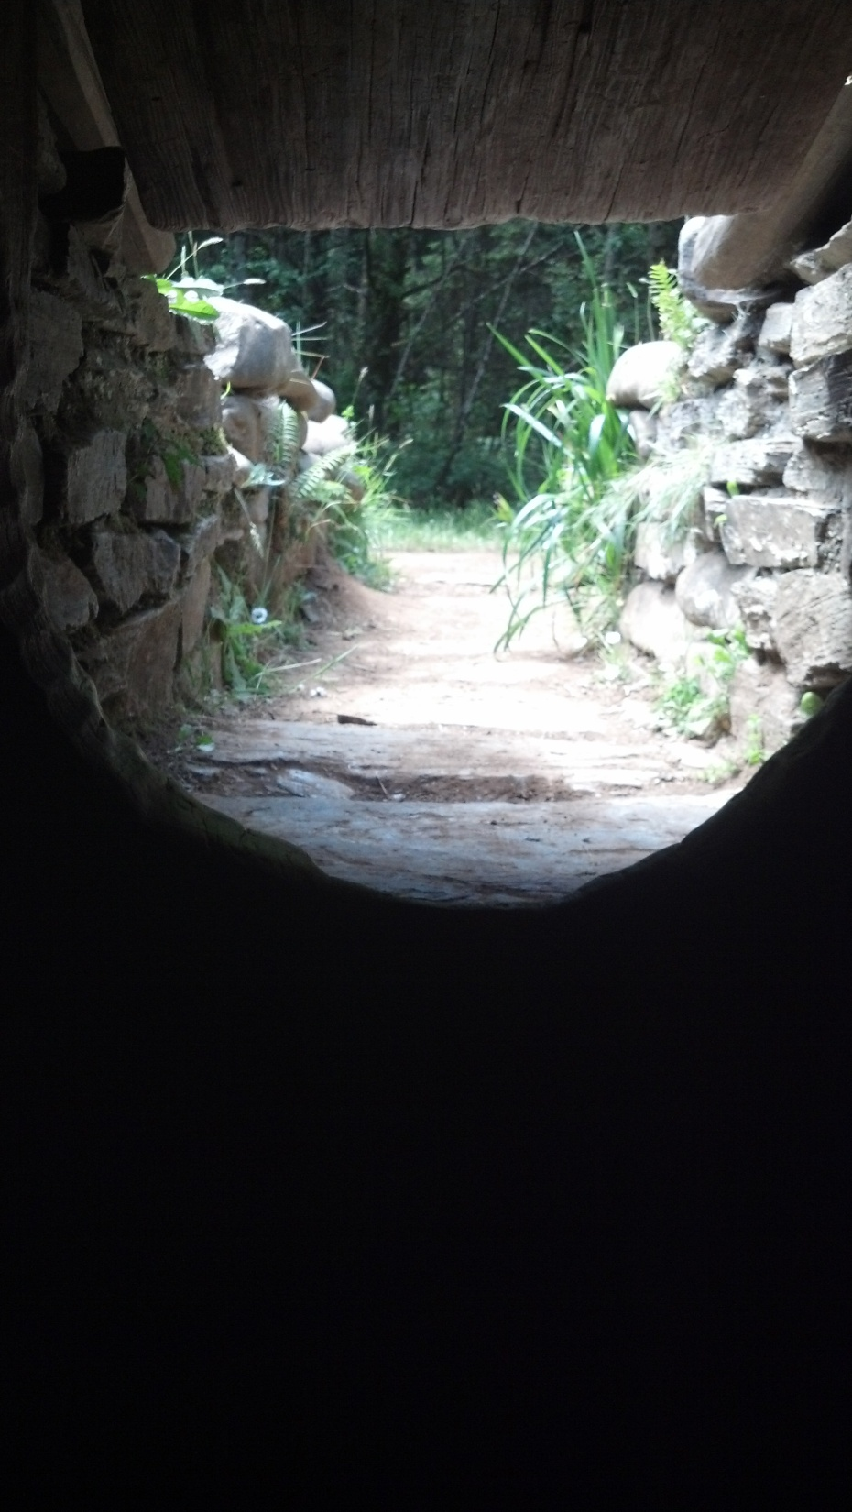
Wo-hlklaw’
Thank you
Joe Hostler
Yurok Tribe Environmental Program (YTEP)
jhostler@yuroktribe.nsn.us
(707)482-1822 x1010
www.yuroktribe.org

