Slide 1
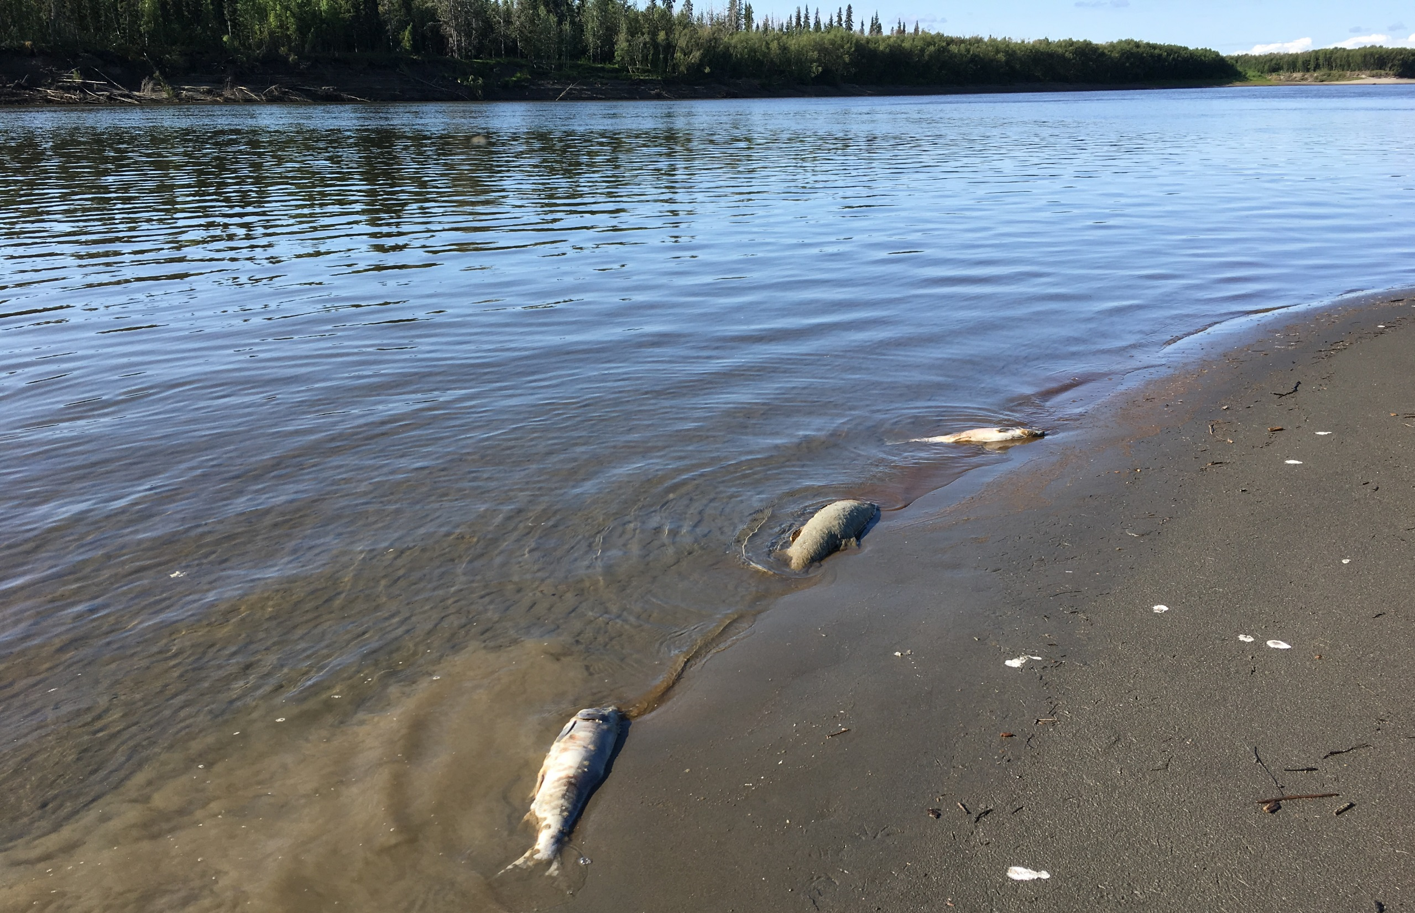

In the heat of summer: reporting on the chum salmon die-off on the Yukon River
Dr. Stephanie Quinn-Davidson
Director, Yukon River Inter-Tribal Fish Commission

Slide 2
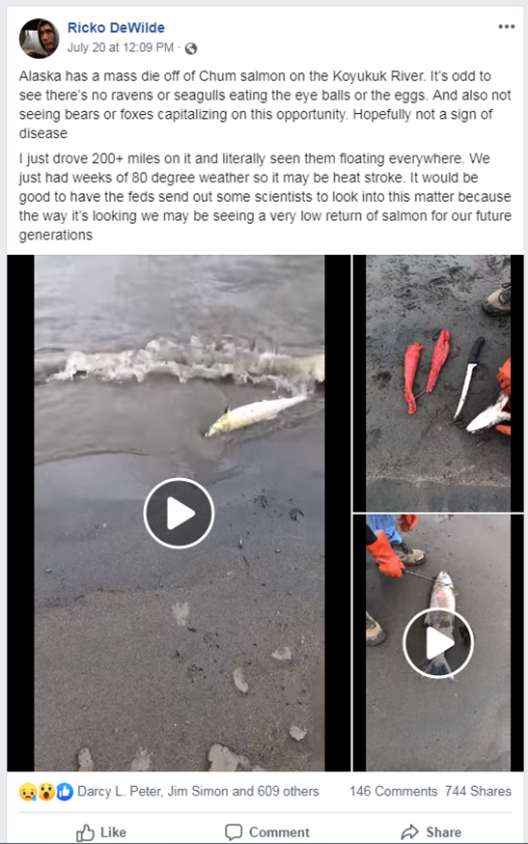
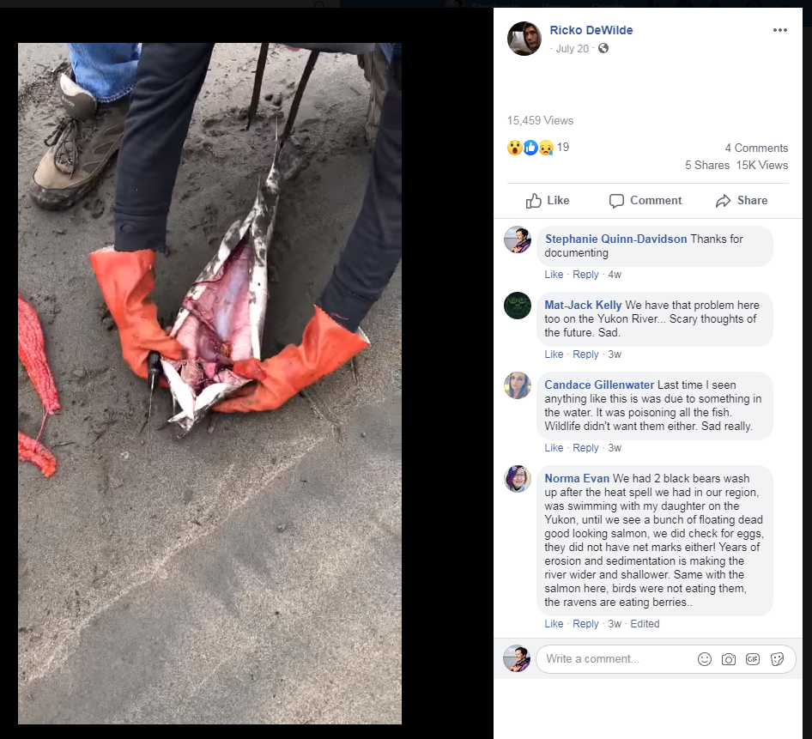
First reports

Slide 3
First reports

Slide 4
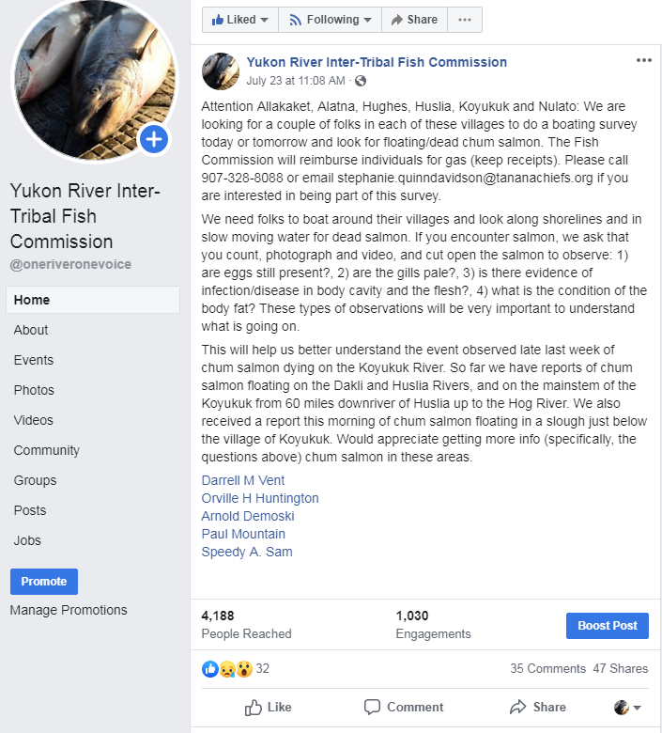
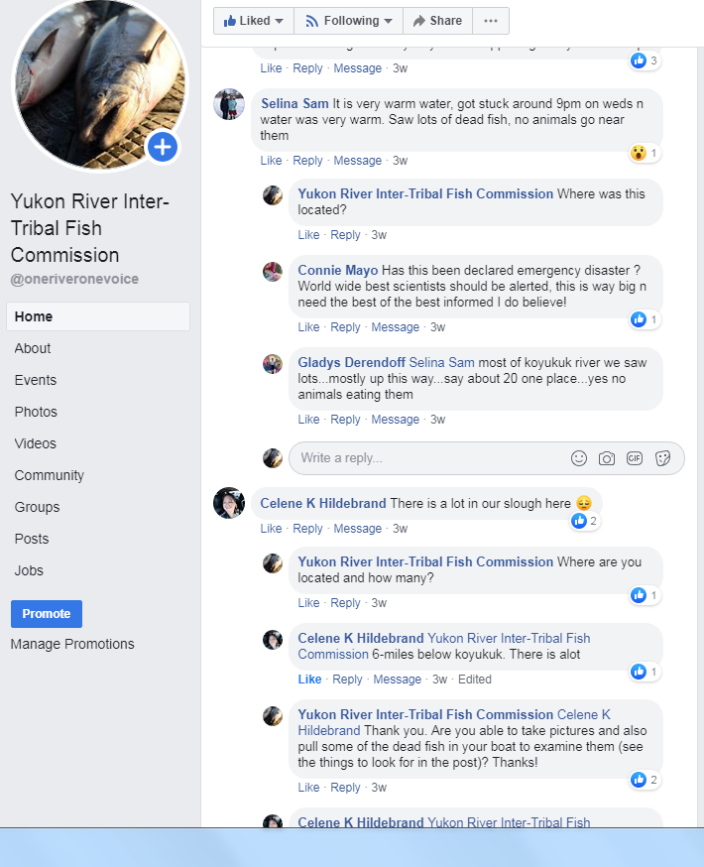
We activated our social media network…
✓
✓
✓
July 23

Slide 5
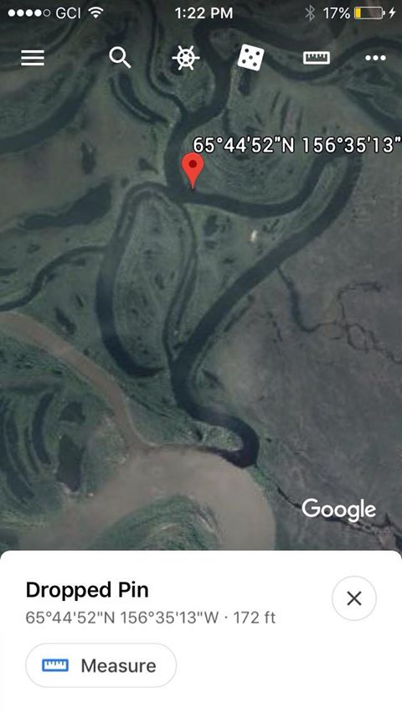
Hired a local fisherman to do a more formal survey
Document location
Count salmon and in how many miles of river
Take pictures
Cut open salmon and observe for eggs/milt
July 24

Slide 6
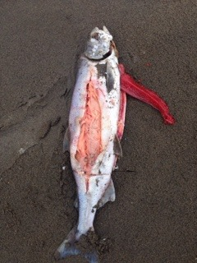
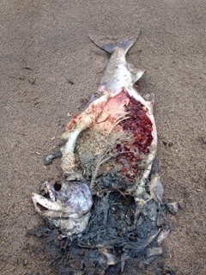
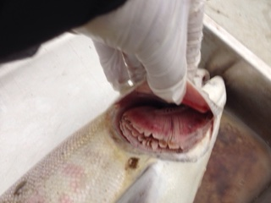
Hired a local fisherman to do a more formal survey
Document location
Count salmon and in how many miles of river
Take pictures
Cut open salmon and observe for eggs/milt
Reported 100+ dead salmon in one bend of river and over 250 overall in short survey
July 25

Slide 7
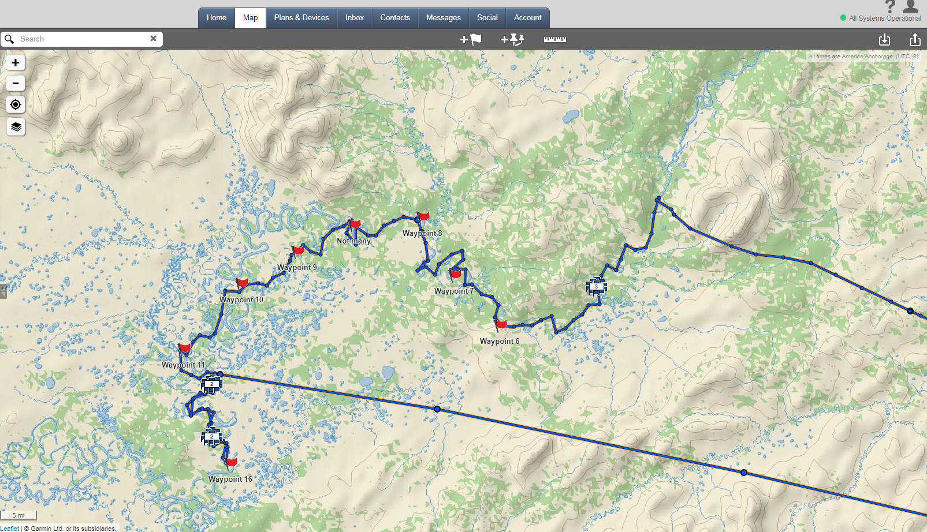
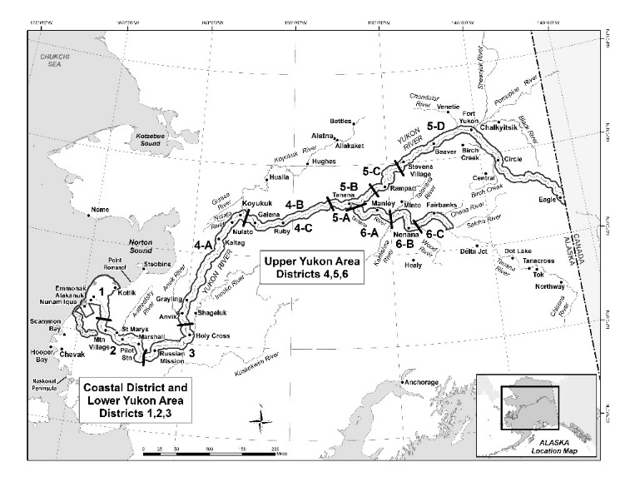
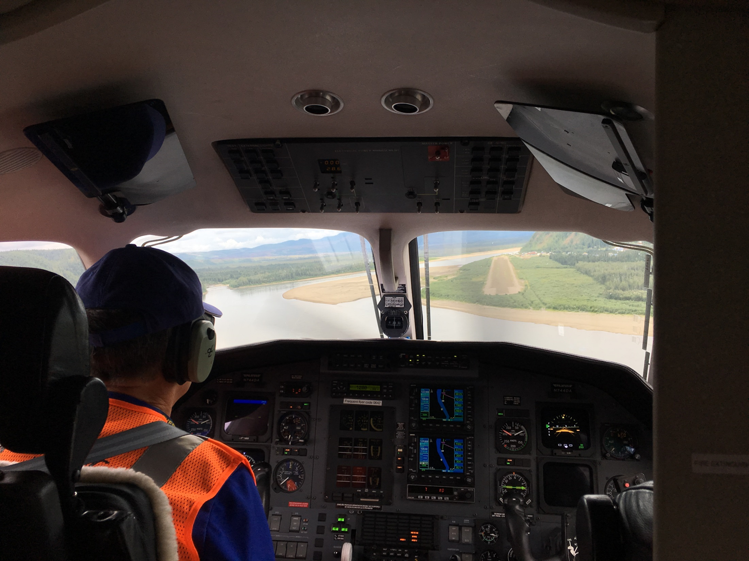
Decide to take delegation of scientists to document
Hughes
Huslia
July 26

Slide 8
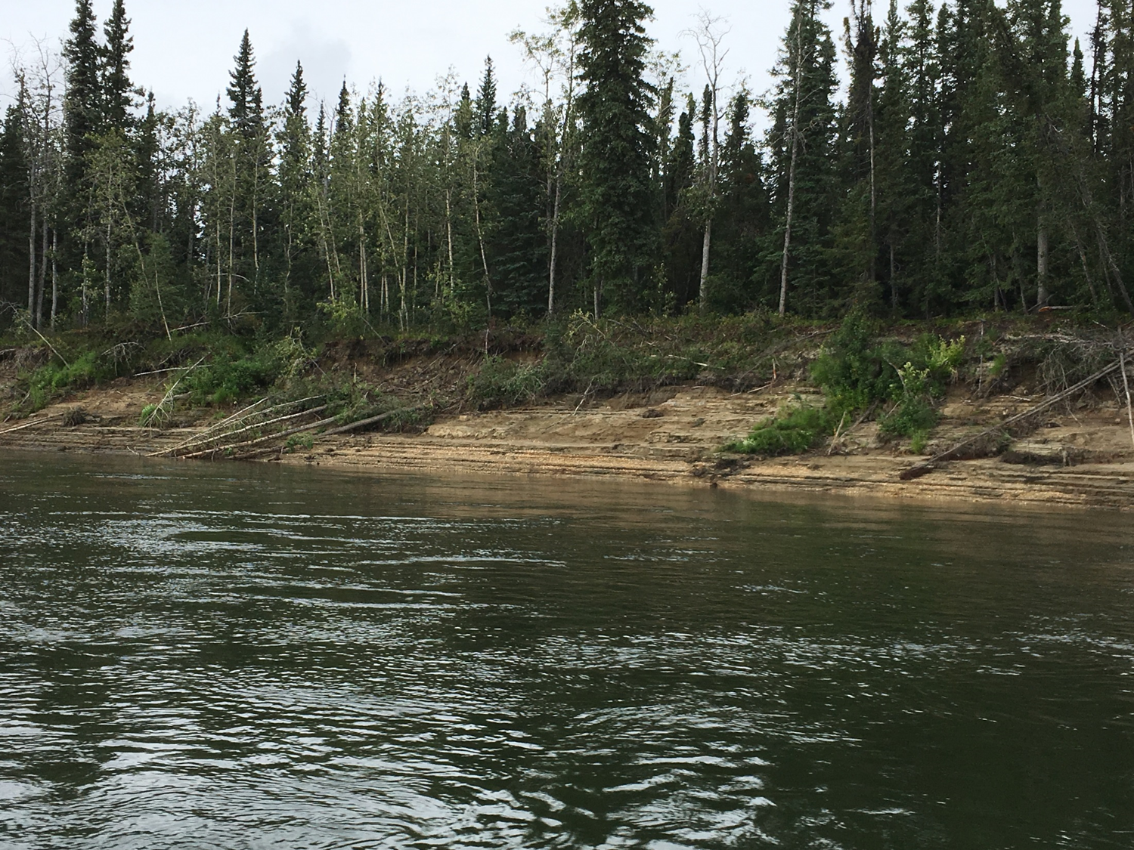

Slide 9
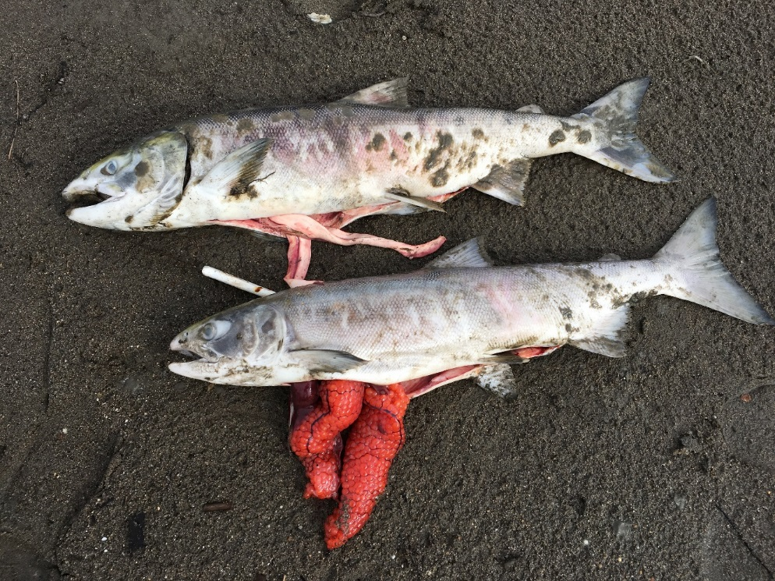
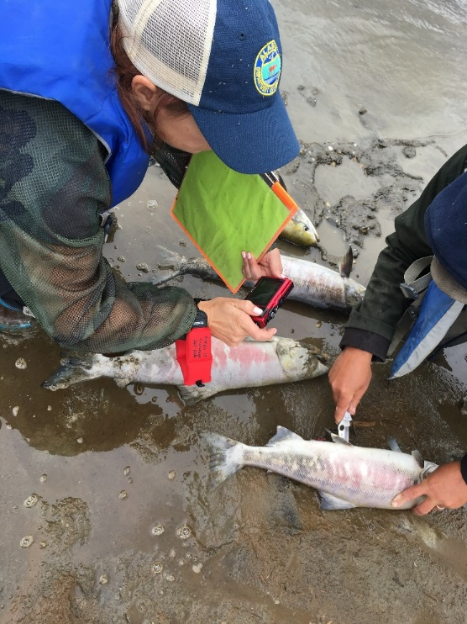
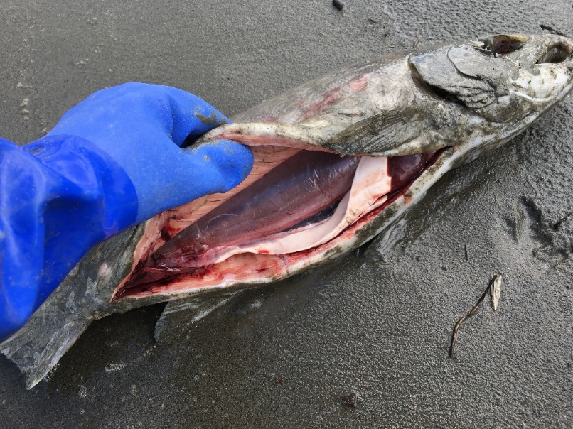
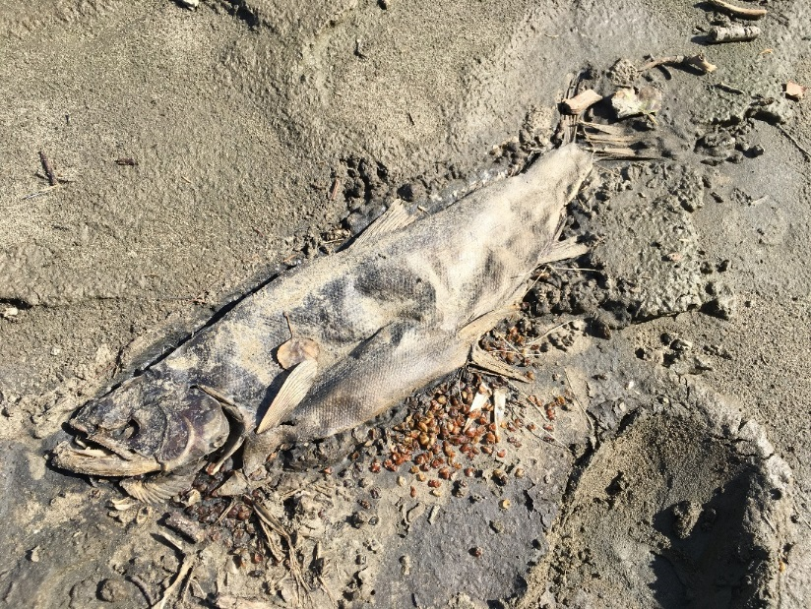

Slide 10
Our observations:
Extremely low water
Warm water, though not alarmingly high at the time (~60 degrees F)
Adequate dissolved oxygen
Almost immediately started seeing dead salmon
Counted dead salmon along 200 mile stretch = 850 salmon
  However, every time we stopped to do a foot survey, counted roughly 4 to 10 times as many than what we saw while boating past
  Die-off event is likely in the thousands, at least, on the Koyukuk River
Every salmon we were able to cut open had not yet spawned or looked close to spawning
  Even decayed salmon could tell they hadn’t spawned.
No signs of infections, disease, worms, parasites, lesions, tumors, etc. These salmon looked perfectly healthy.
Only two dead pike. No dead kings.

Slide 11
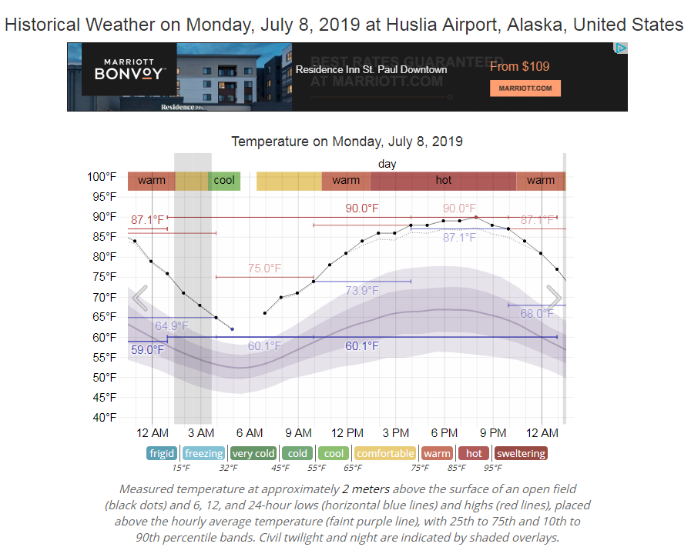
Record-setting temperatures in early July…
20+ degrees above average

Slide 12

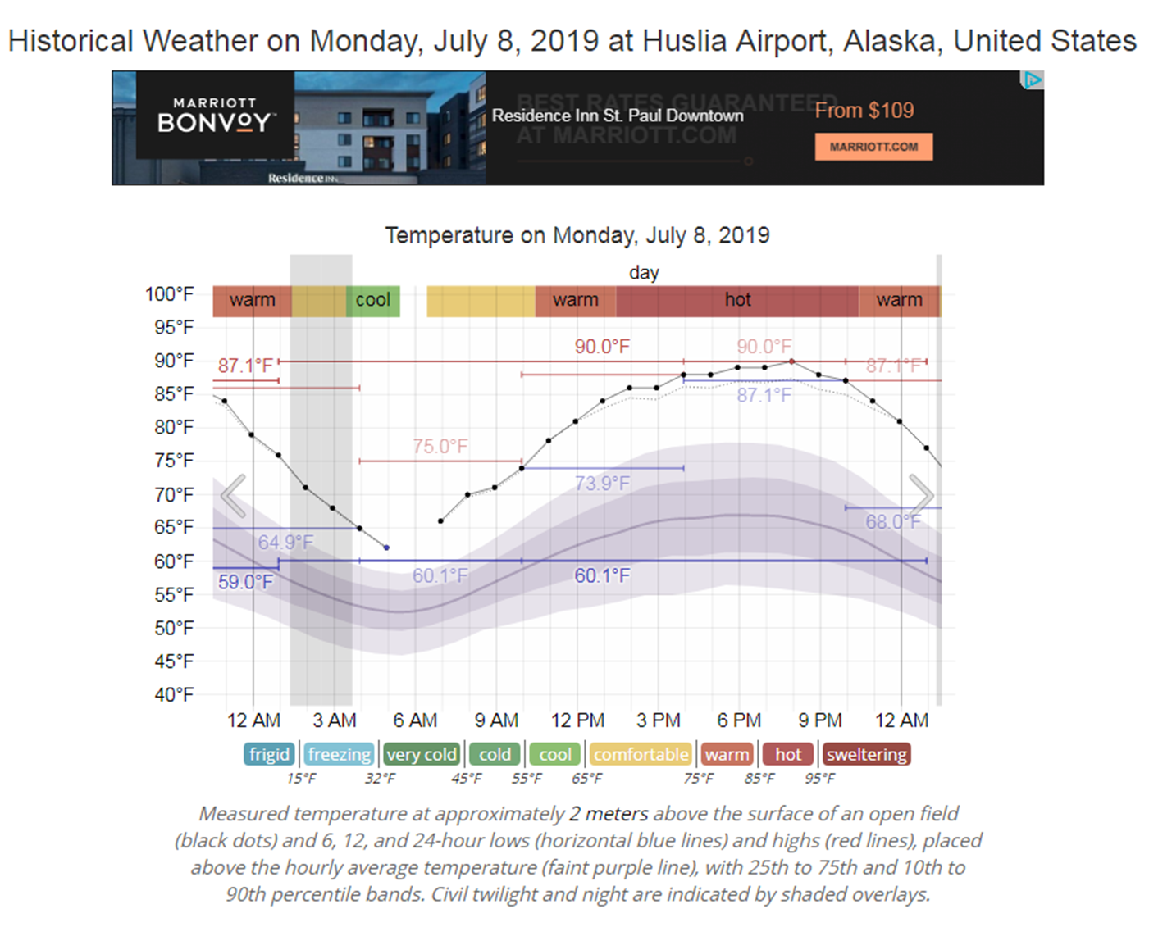

Likely theory…

Slide 13
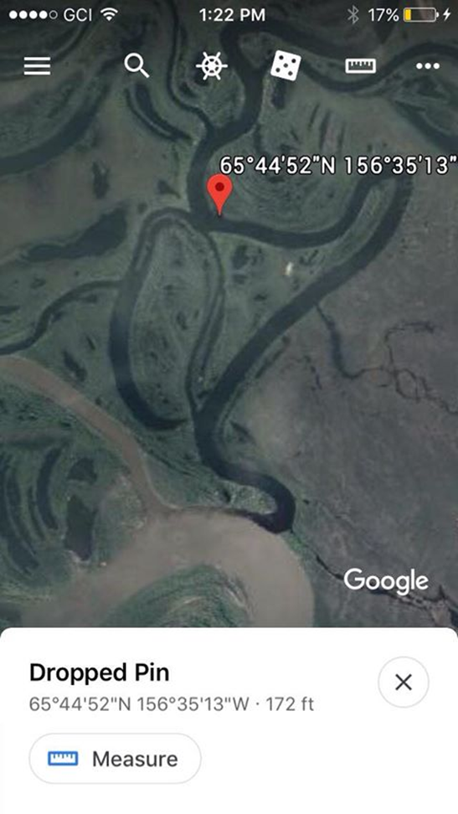
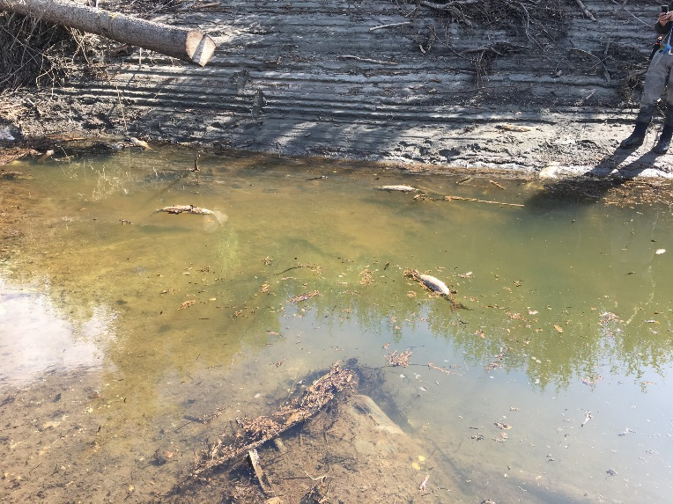
Moving forward…
We were about a week late by the time a team of scientists could get out there
The need for a coordinated monitoring network that we can activate quickly
  Will require local citizen participation
Temperature monitoring network to anticipate die-offs

Slide 14
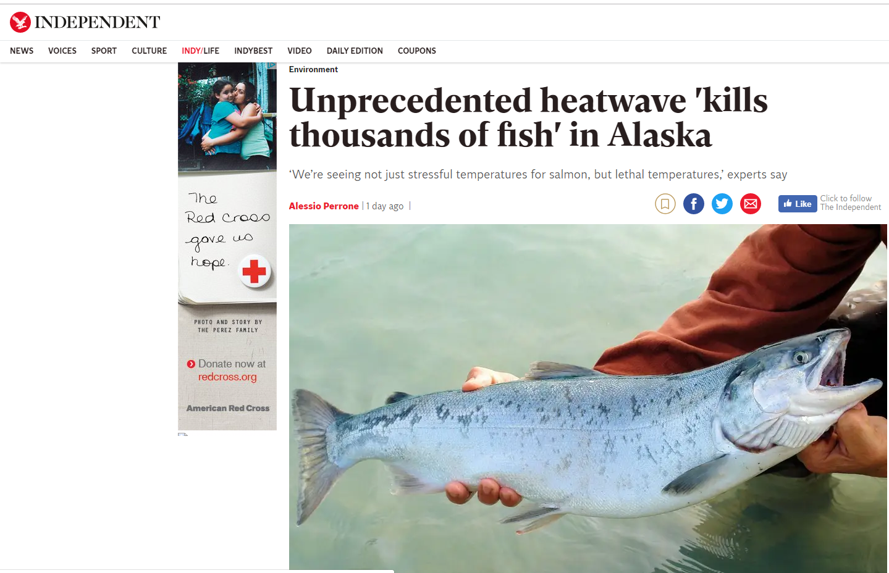
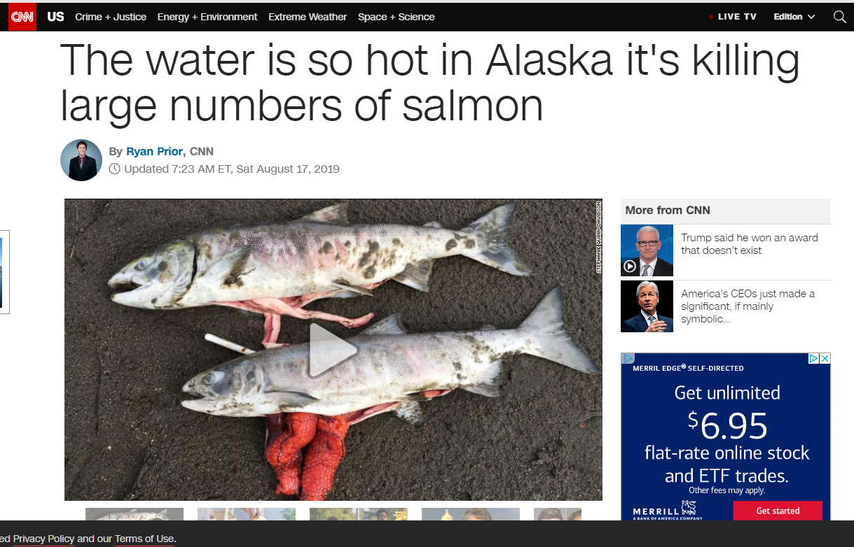
Media coverage…
Recently exploded on national media

