Slide 1
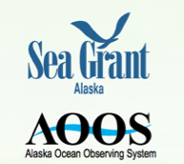
Ginny L. Eckert gleckert@alaska.edu
Darcy Dugan dugan@aoos.org
https://www.aoos.org/alaska-hab-network/

Slide 2
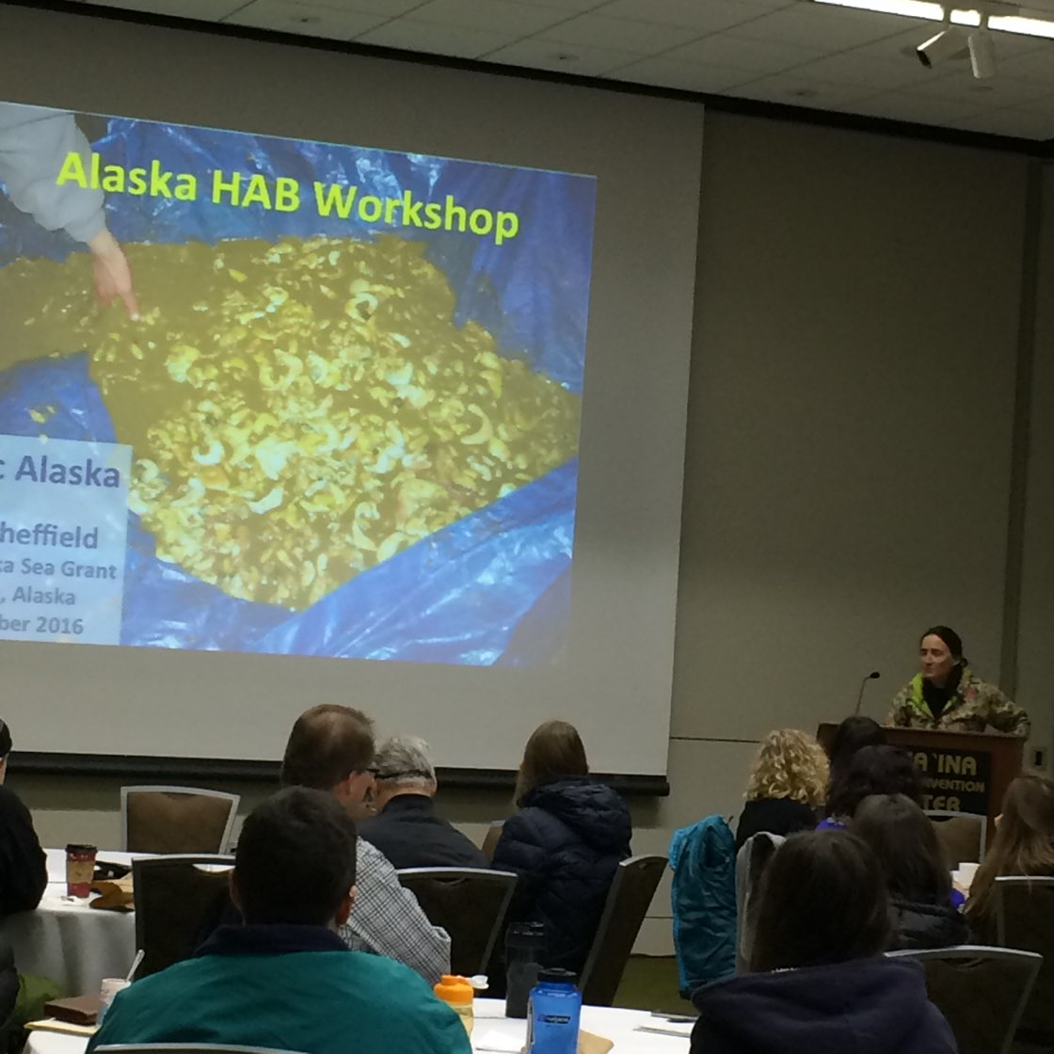
Alaska HAB Workshop
December 2016

Slide 3
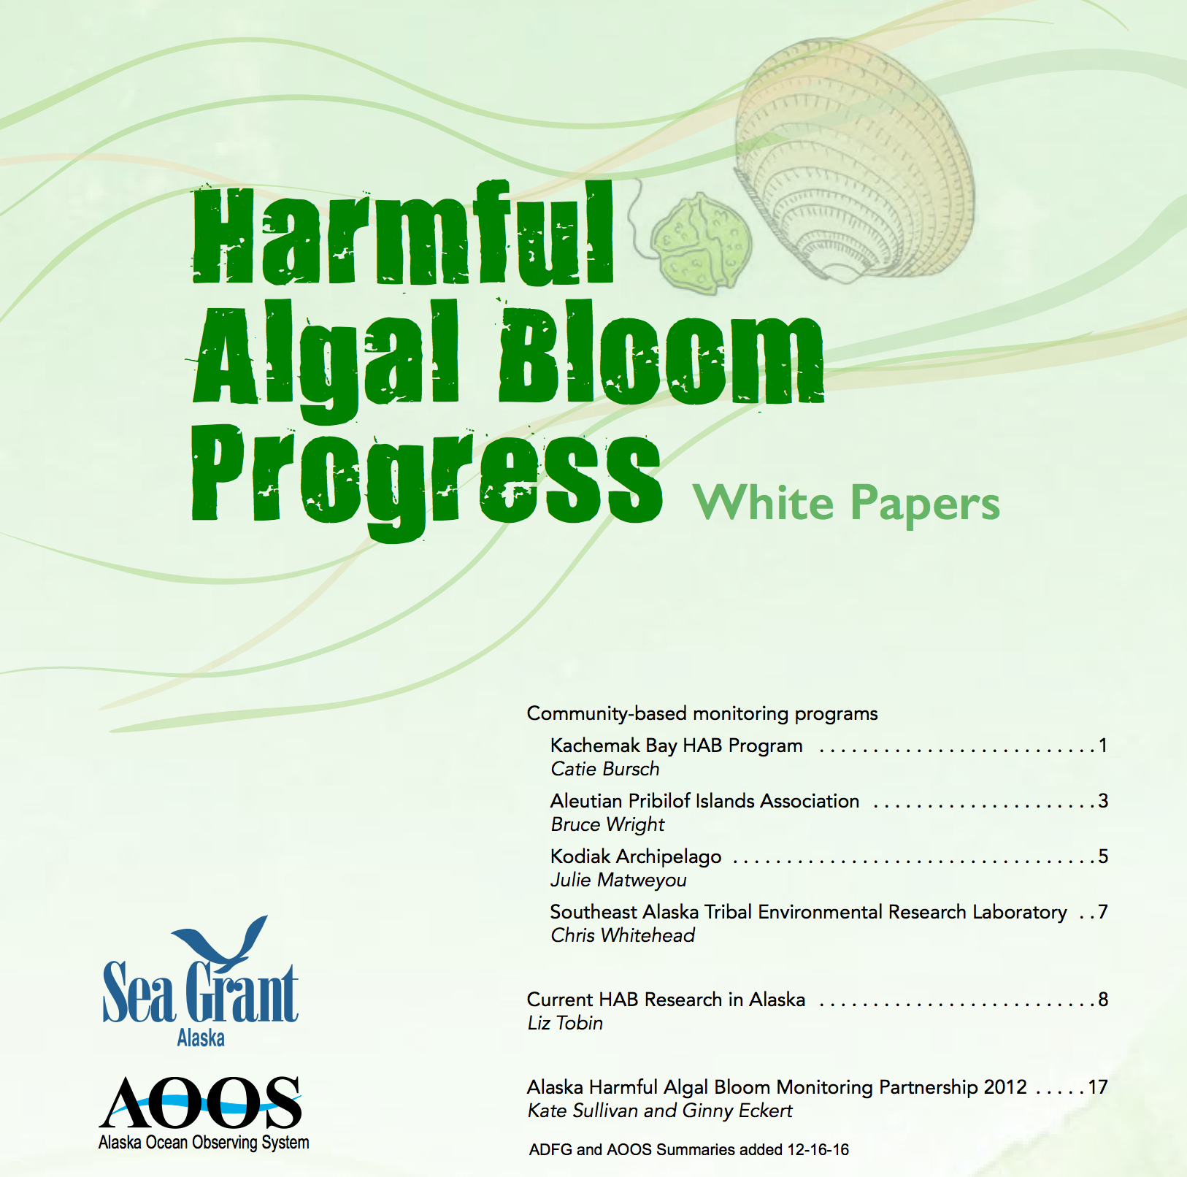

Slide 4
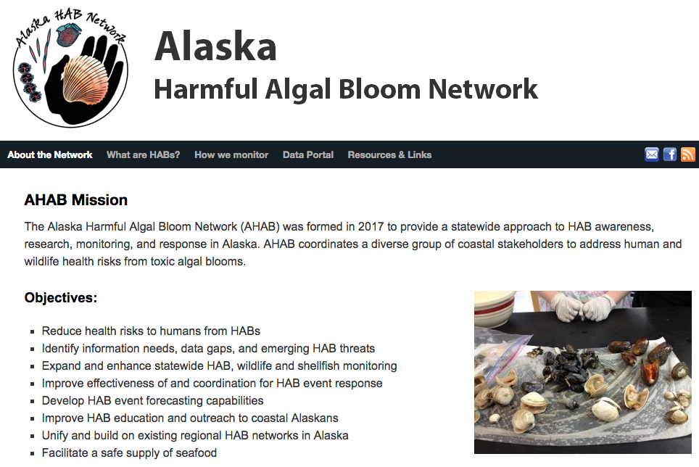
https://www.aoos.org/alaska-hab-network/

Slide 5
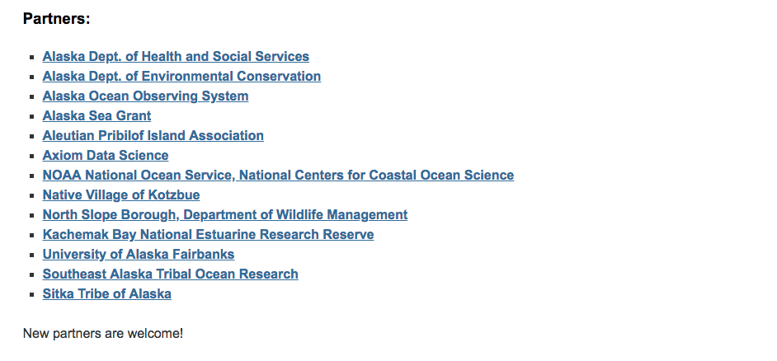
https://www.aoos.org/alaska-hab-network/

Slide 7
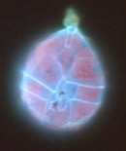
Harmful Algal Blooms
Toxic
Non-toxic
Marine Mammal Mortalities
Impact on Seabirds
Eutrophication
Larval fish, shellfish & copepods stop feeding
Human Health Syndromes
Clog/Irritate Fish Gills
Blocks Light
Diatom
Dinoflagellates
Fish Kills
ASP
Seagrass beds die
PSP
NSP
CFP
DSP

Slide 9
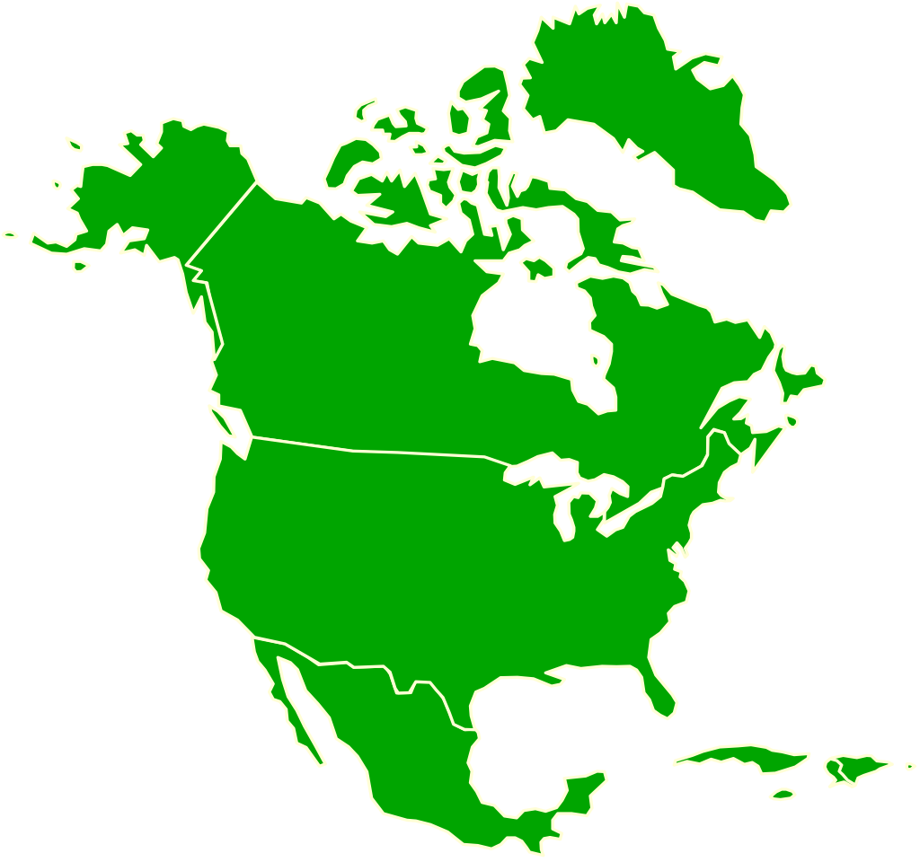
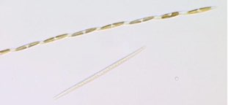
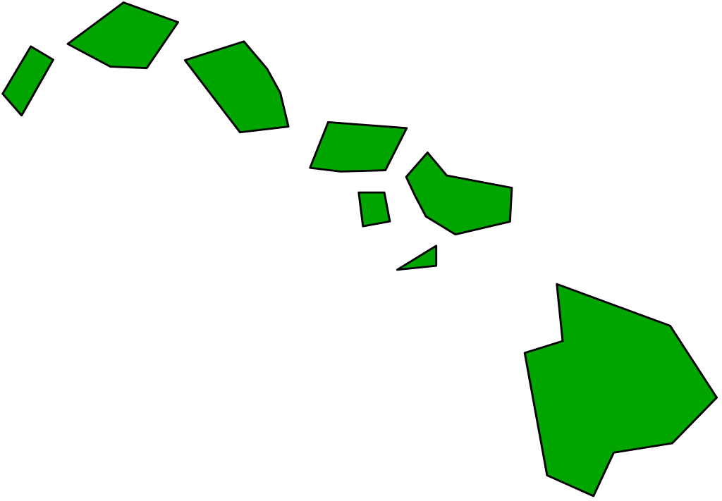
Human Health Syndromes
Amnesic Shellfish
Poisoning (ASP)
Ciguatera Fish
Poisoning (CFP)
Diarrhetic Shellfish
Poisoning (DSP)
Paralytic Shellfish
Poisoning (PSP)
Neurotoxic Shellfish
Poisoning (NSP)

Slide 14
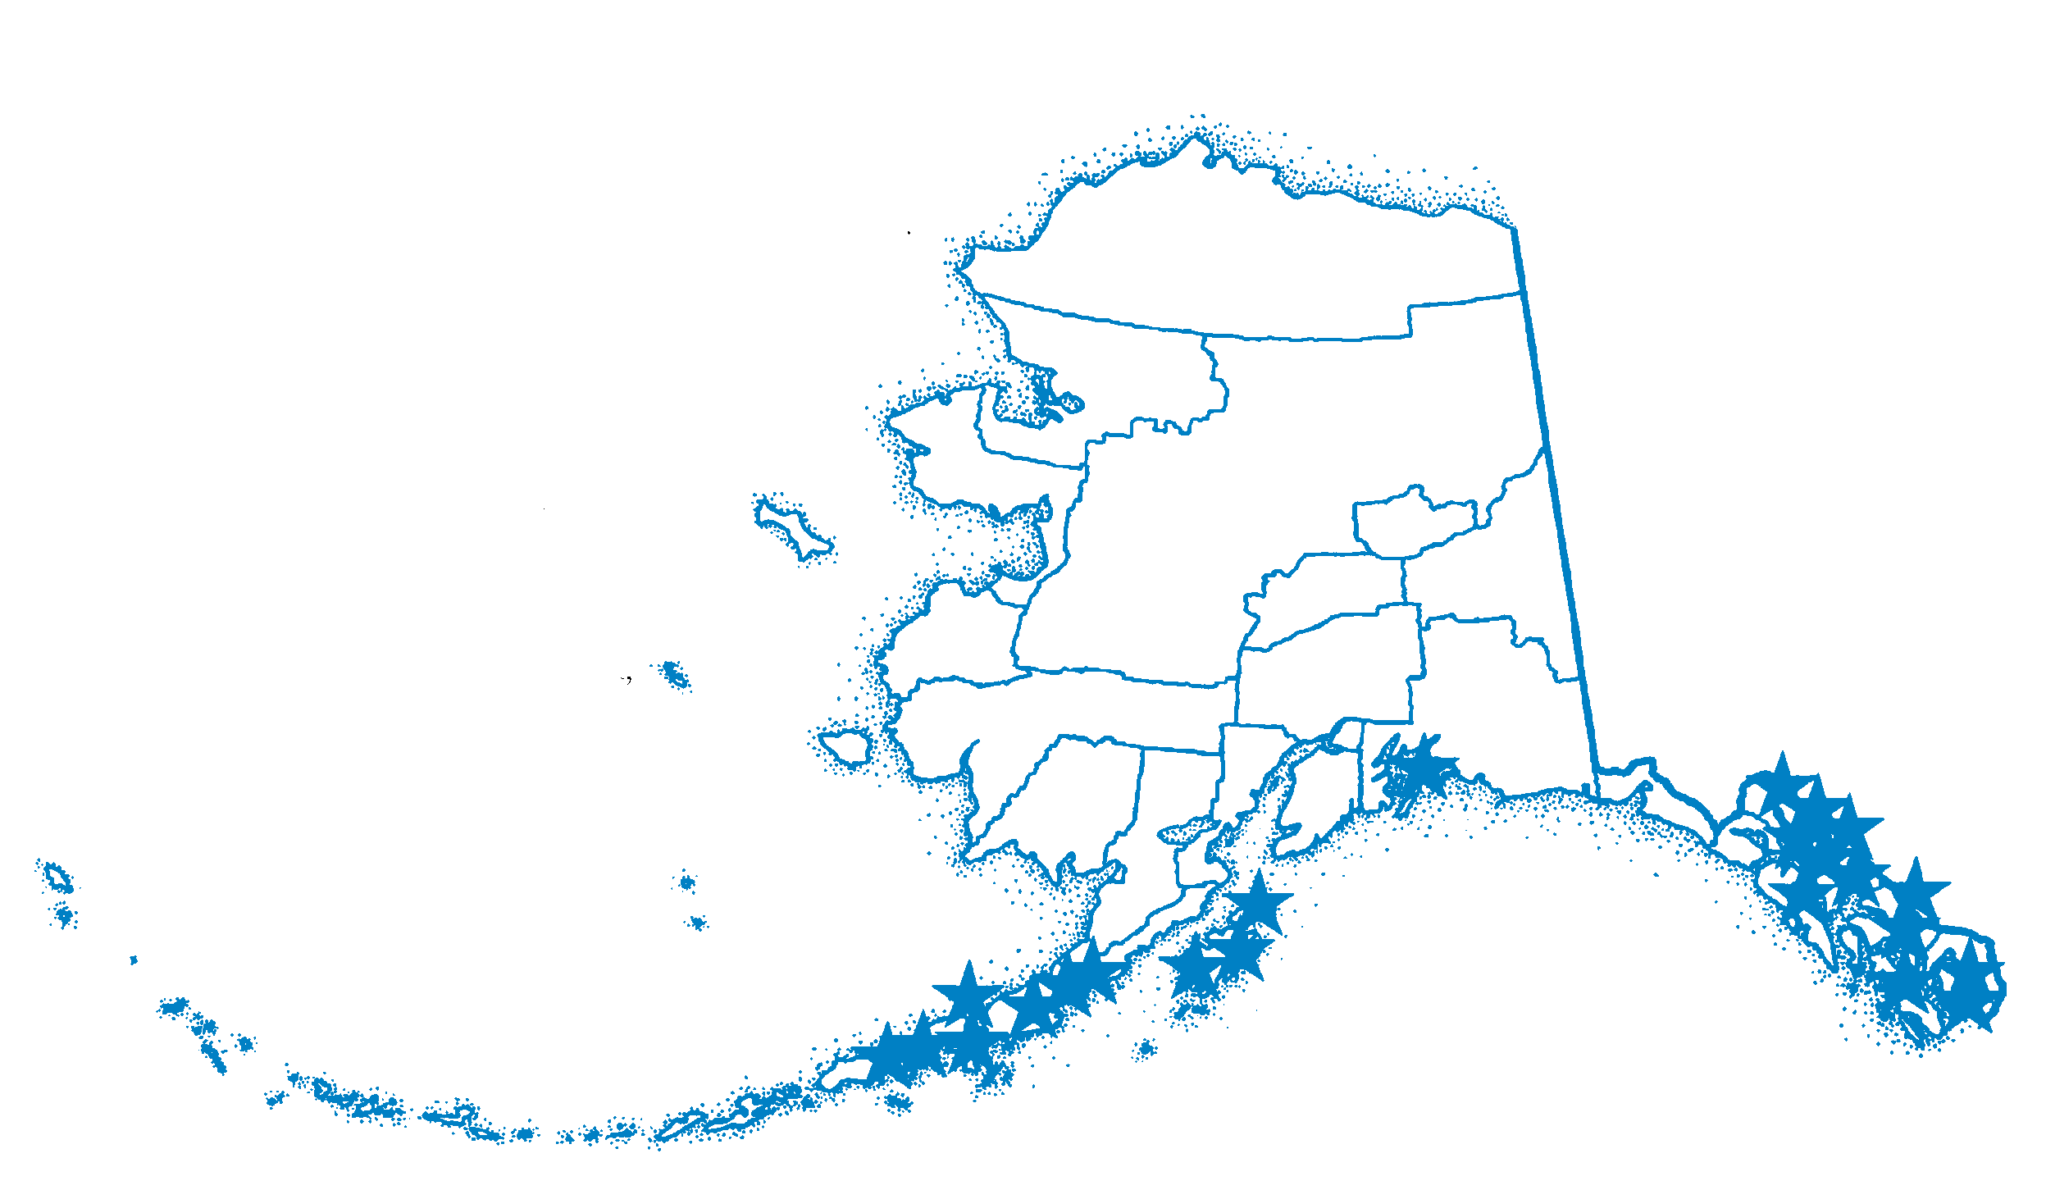
PSP Events in Alaska

Slide 16
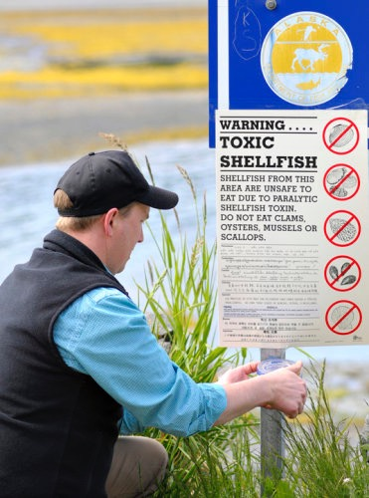
Five cases of PSP in Alaska in one week --
June 2010
57 year old woman died after eating cockles, presumably from PSP
PST measured 2,044 (80 ug per 100 g tissue is regulatory limit)
http://www.juneauempire.com/slideshows/062410/660849226/slide1.shtml

Slide 17
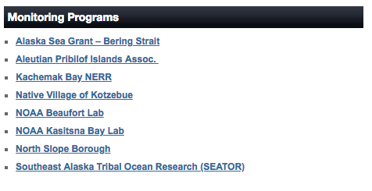
https://www.aoos.org/alaska-hab-network/

Slide 20
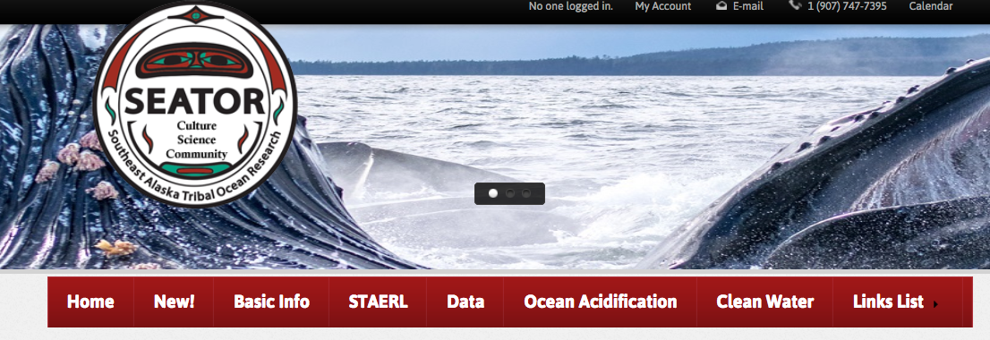

Slide 22
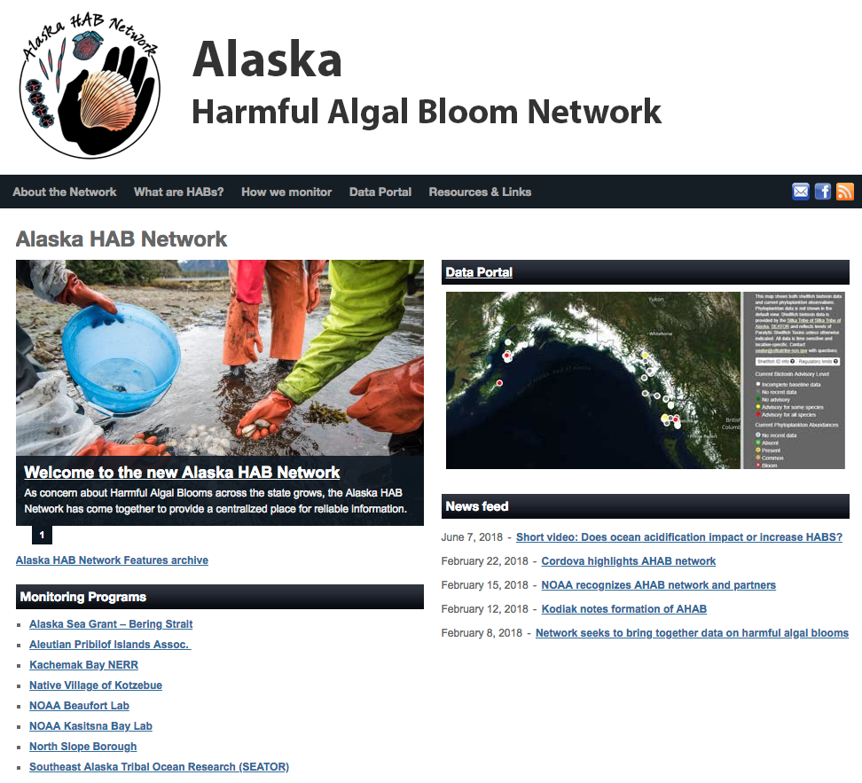
https://www.aoos.org/alaska-hab-network/

Slide 23
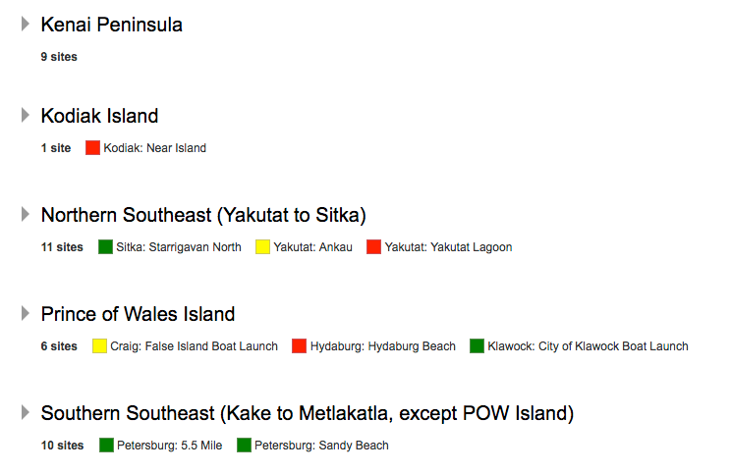
https://www.aoos.org/alaska-hab-network/

Slide 24
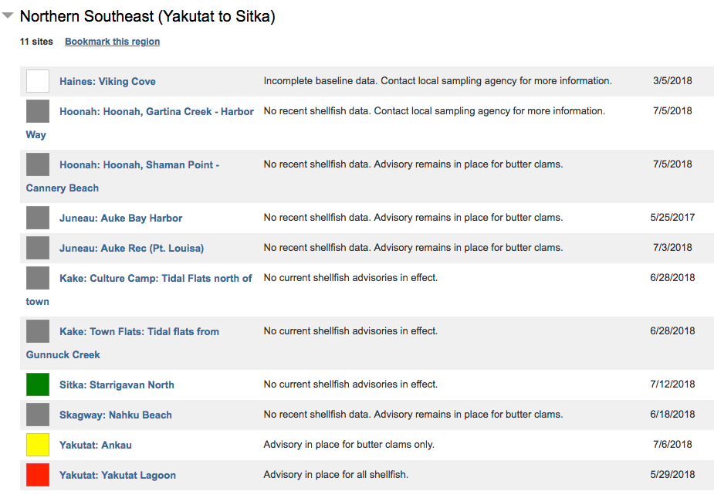
https://www.aoos.org/alaska-hab-network/

Slide 25
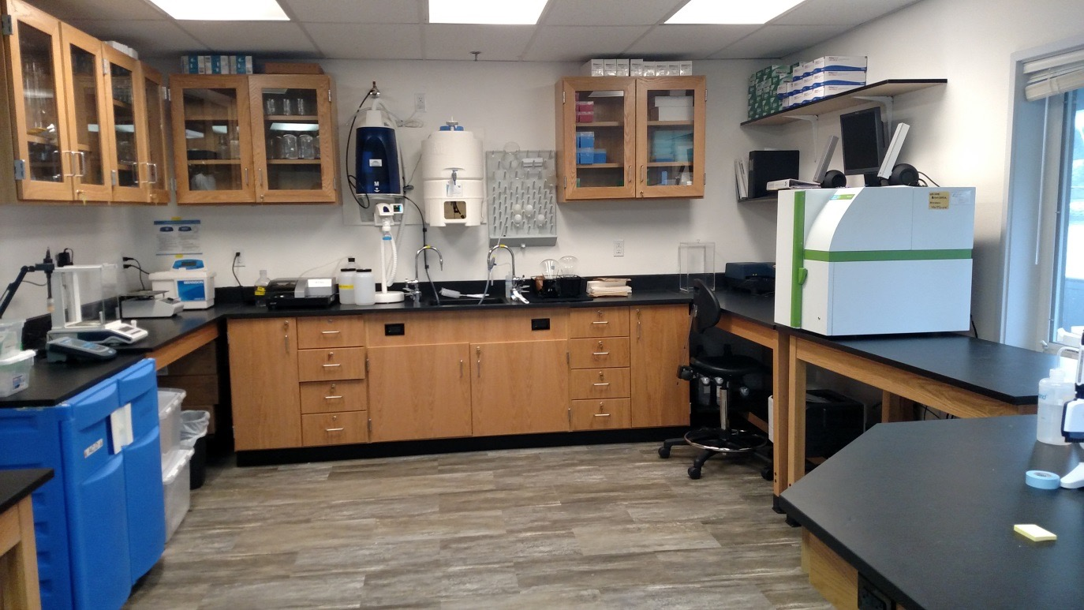
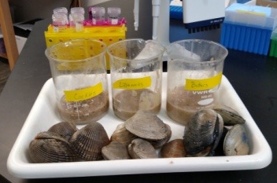
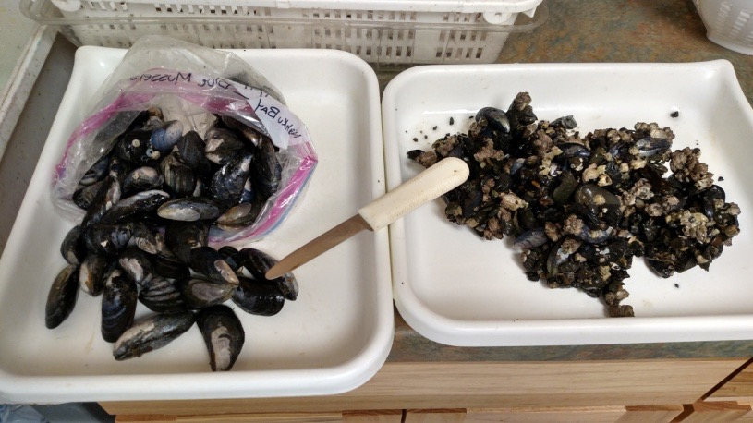
Sitka Tribe of Alaska Environmental Research Lab (STAERL)
48 Hour turnaround on results

Slide 26
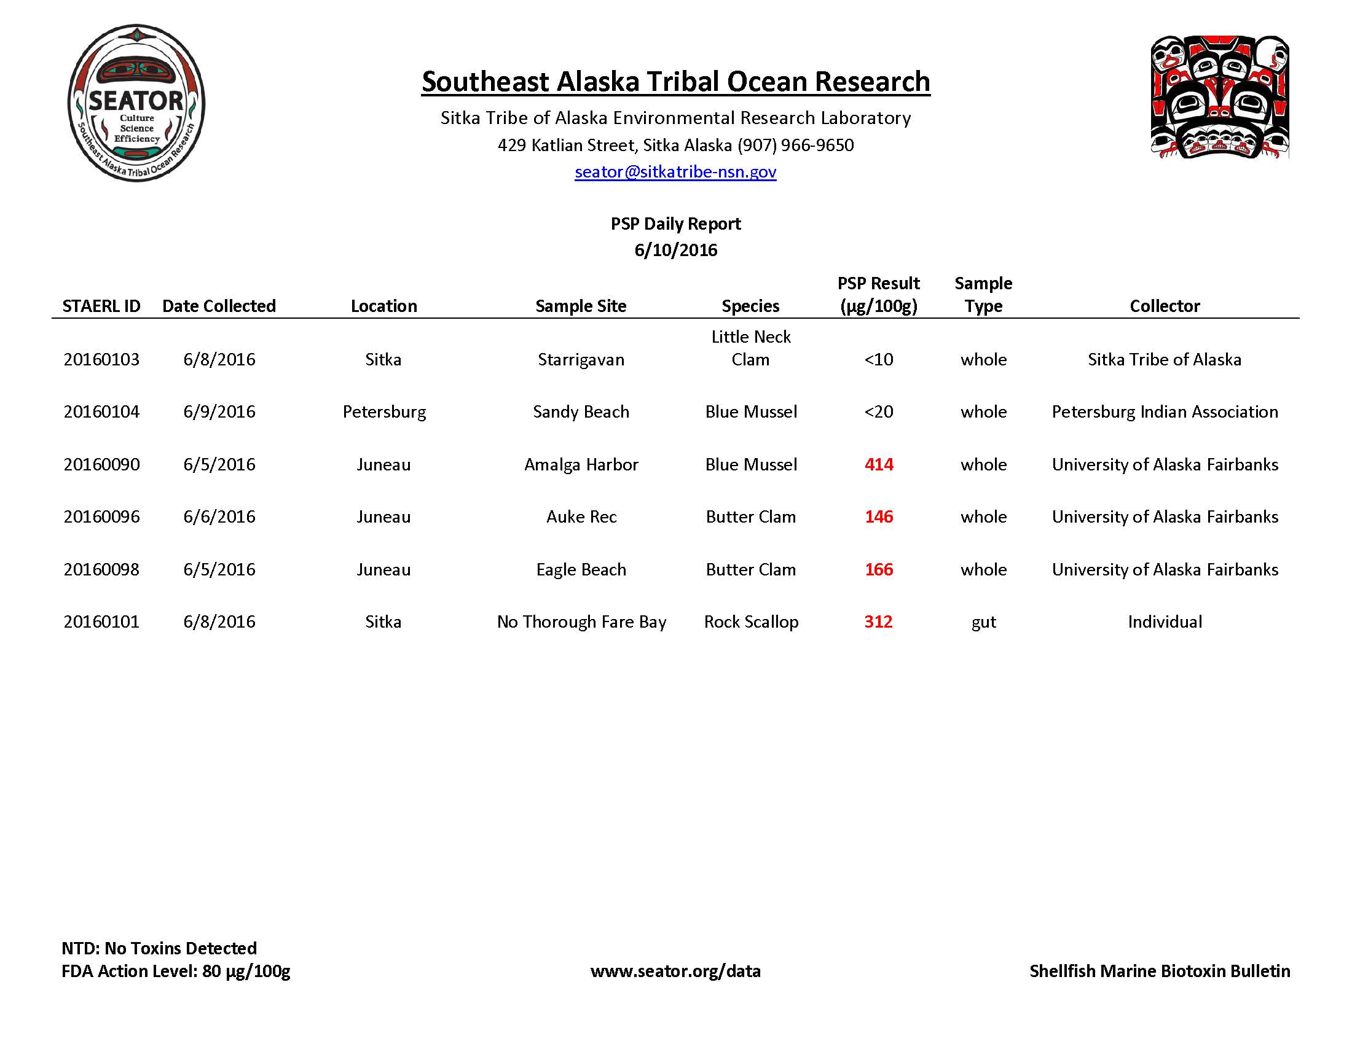
Data and Shellfish Advisories

Slide 27
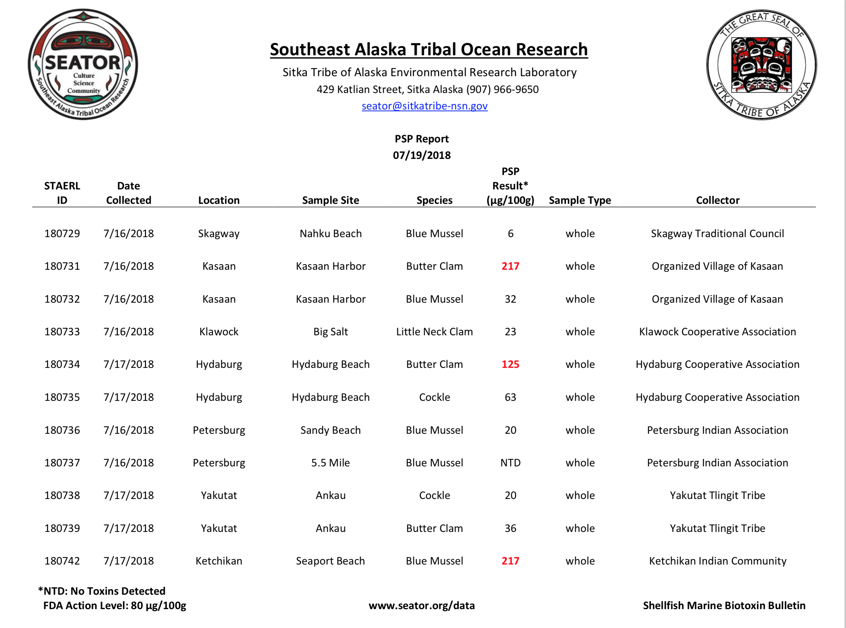

Slide 28
Data and Shellfish Advisories

Slide 29
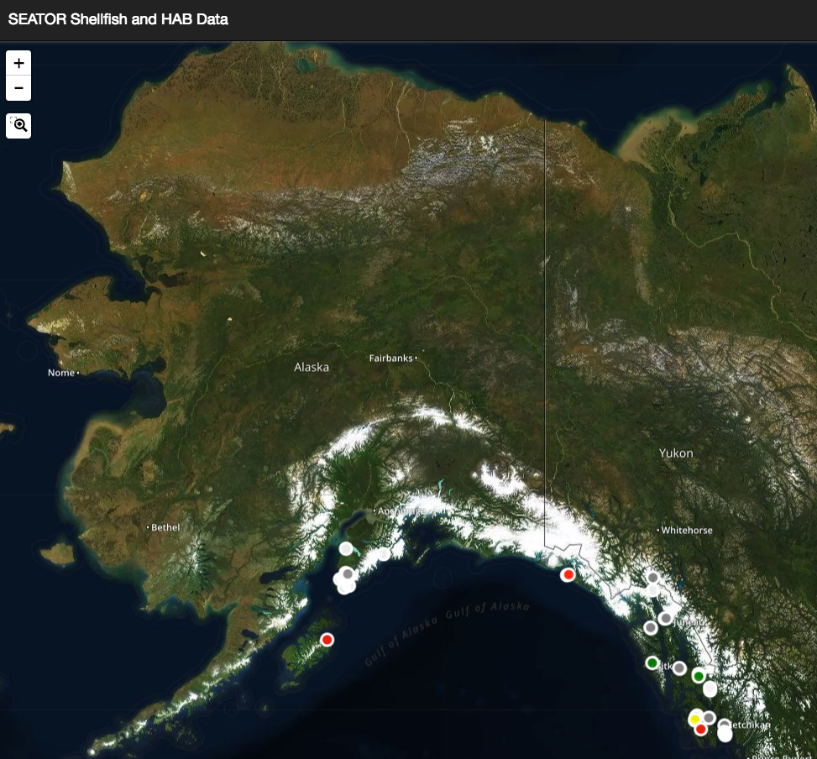

Slide 30
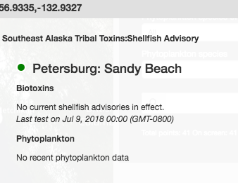

Slide 31
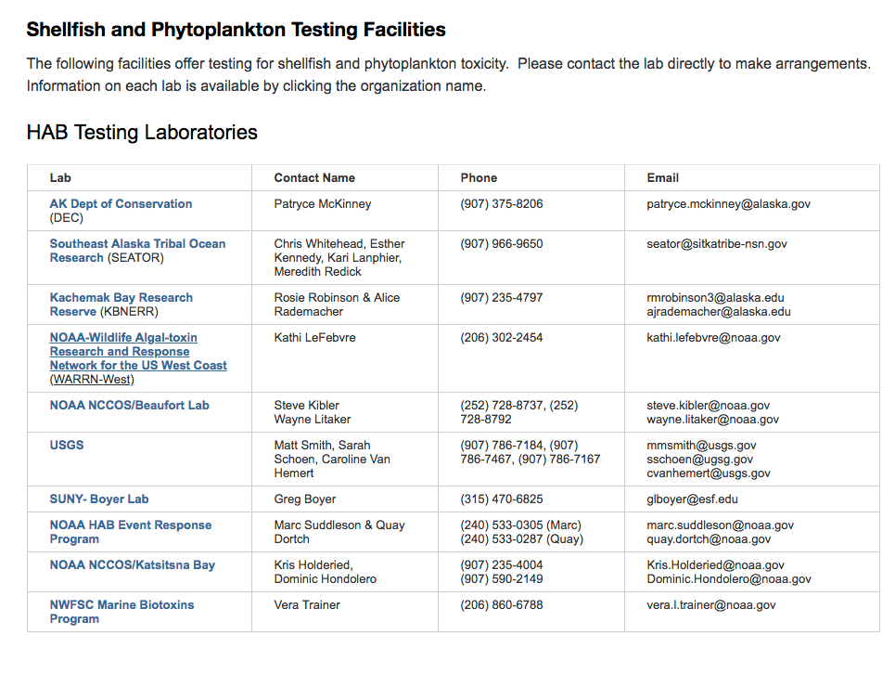
https://www.aoos.org/alaska-hab-network/

Slide 32
https://www.aoos.org/alaska-hab-network/

