Slide 1
Village of Wainwright
Personal Location Device Checkout Program
Alana Shaw, PhD
Village of Wainwright
Micah Hahn, PhD and Rebecca Van Wyck
ICHS, University of Alaska Anchorage

Slide 2
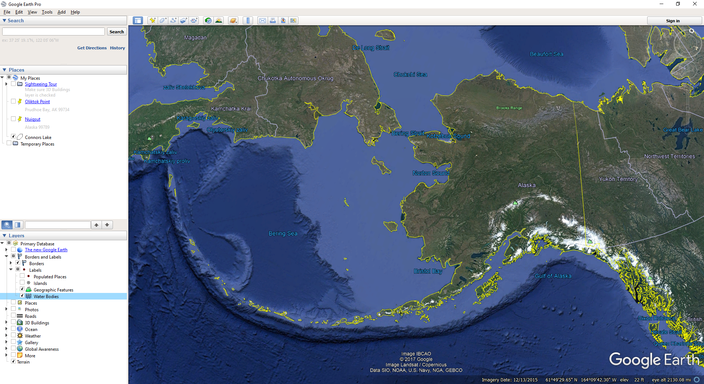
Wainwright
Notes:
In an area where people depend on cold winters, sea and river ice, and favorable environmental conditions for travel and subsistence activities, a rapidly changing environment is a big deal.
Our work takes place in Wainwright, Alaska, a community with around 600 people located on the Chuckchi Sea on the North Slope.
About 95% of the community is Inupiat, and 93% of households reported participating in the local subsistence economy. More than 2/3 of households acquire at least 50% of their diet from hunting, fishing, and gathering.

Slide 3
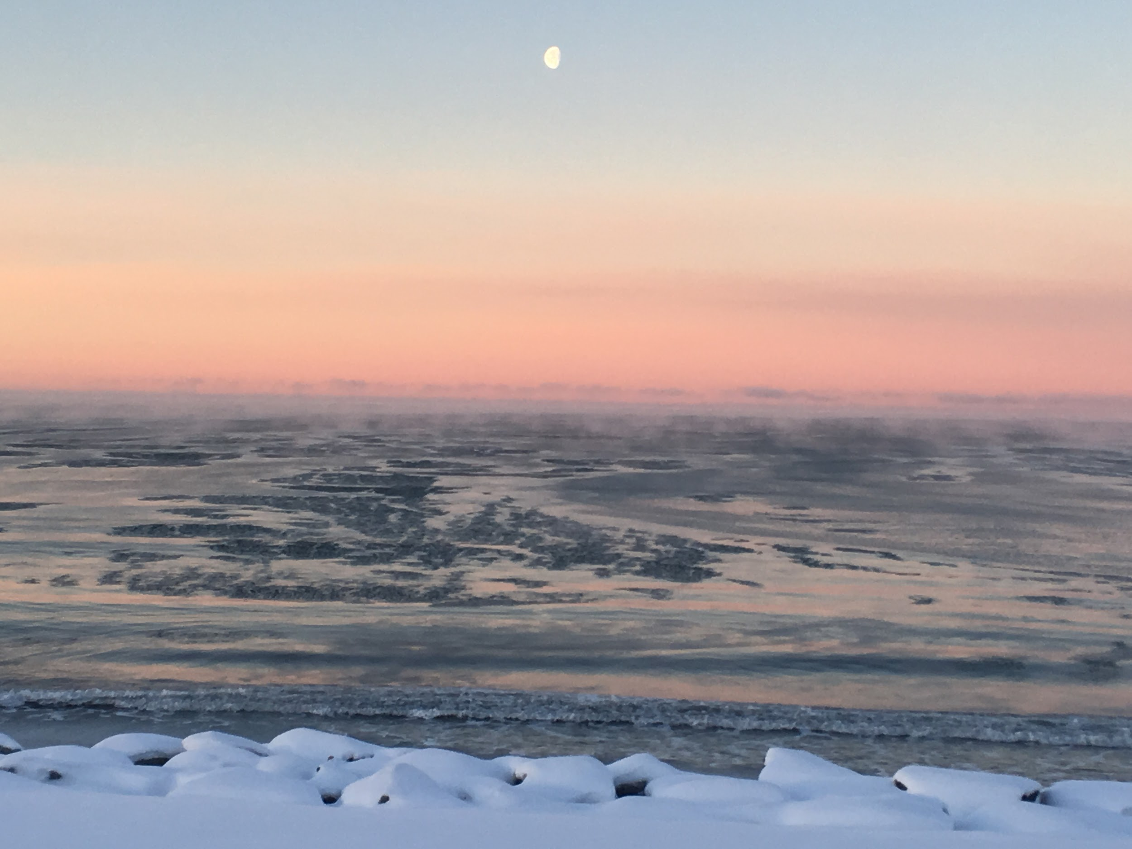
Wainwright on a good day...

Slide 4
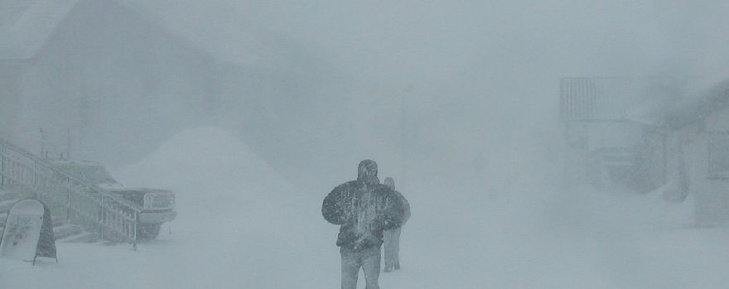
Wainwright on a bad day...

Slide 5
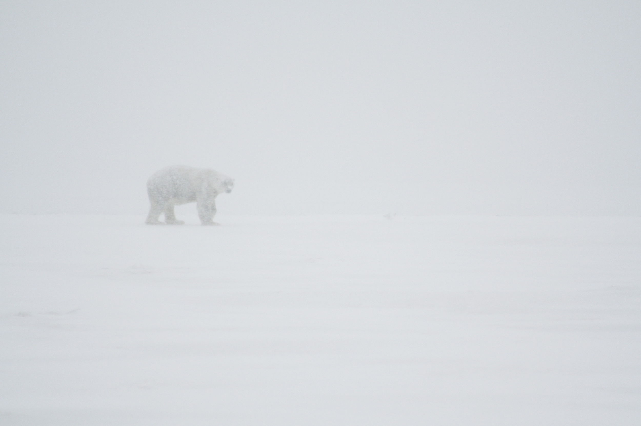
Or...

Slide 6
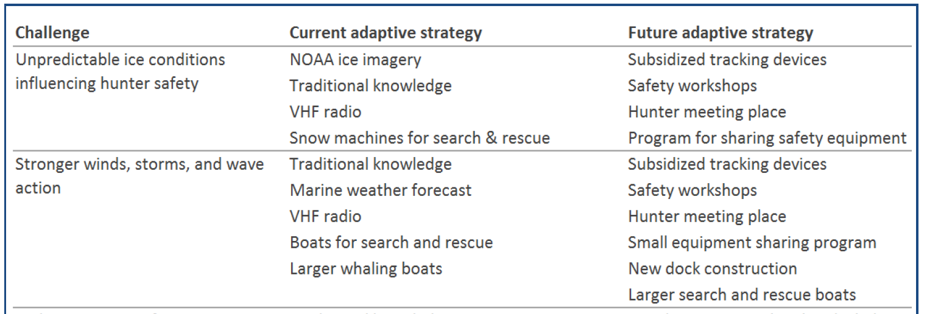
Subsistence Way of Life (Christie, Hollmen, Huntington, & Lovvorn, 2017)
Identified 5 Challenges to the subsistence way of life in Wainwright:

Slide 7
Hunter Safety (Christie & Huntington, 2017)
Fundamental goal: Maintaining a Subsistence Lifestyle
Key Component: Issue of Hunter Safety
7 Strategies to Address Hunter Safety:
1) A safety equipment sharing program (including Global Positioning Systems(GPS), Personal Locator Beacons (PLB), and immersion suits)
2) A program providing inReach and SPOT tracking devices to hunters
3) A financial aid program for the purchase of equipment such as larger, more sea-worthy boats or motors
4) Safety workshops
5) A hunter meeting place for equipment repair and information transfer
6) A new docking facility at the mouth of the local river that would facilitate safe access to hunting grounds
7) A more seaworthy search and rescue boat
Notes:
Fundamental goal established in first few workshops, participants had substantial concerns about maintaining the subsistence way of life in a rapidly changing environment
3 Safety Objectives: Prevent Accidents, Increase the Chance of Rescue, and Minimize Cost

Slide 8
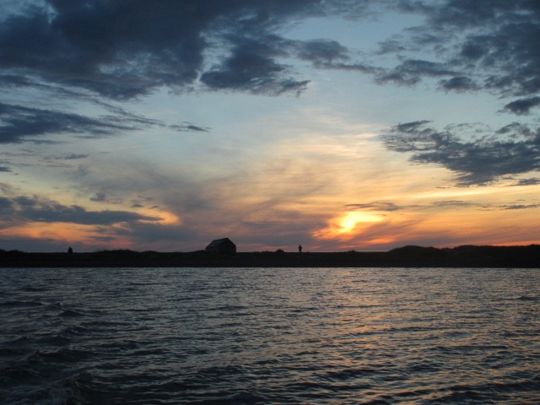
Village SAR
“Stand alert” and can be utilized 24/7
Local knowledge of terrain and conditions
Priority responders for cases within 30 miles of the villages
Limited medical assets
Due to weather limitations, typically first responders

Slide 9
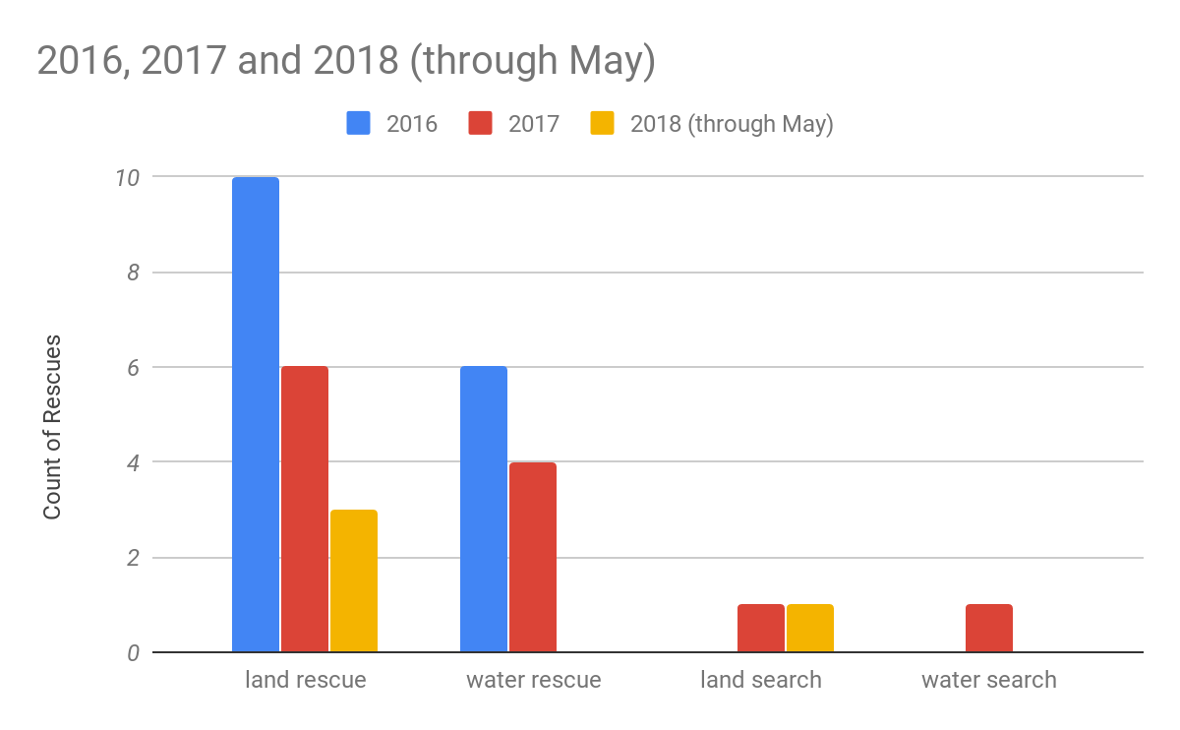
Number of Wainwright SAR Rescues and Searches
Notes:
Rescue = You have contact with the person you are helping
Search = You do not have contact with the person you are helping
Out of 34 missions between February 2016 and May 2018
Majority of missions were land rescues - helping community members with Snowmachine and ATV issue

Slide 10
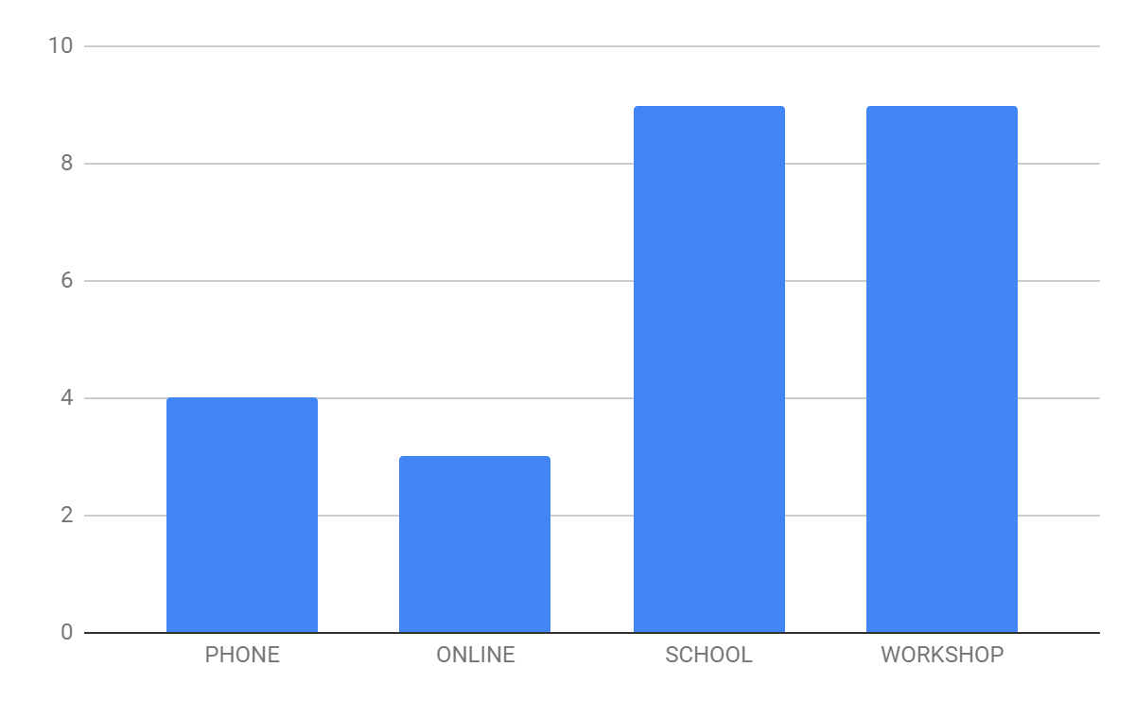
Promoting Adaptive Capacity Project
25 surveys were collected,
18 from the April 2018 school and community workshops
Notes:
N=25, Wainwright population = 584 (2017)
Think about this…. Talk about when? How? Why?

Slide 11
Why do you do remote travel outside of Wainwright?
Notes:
By far, most respondents (24) stated that they travel remotely for hunting.

Slide 12
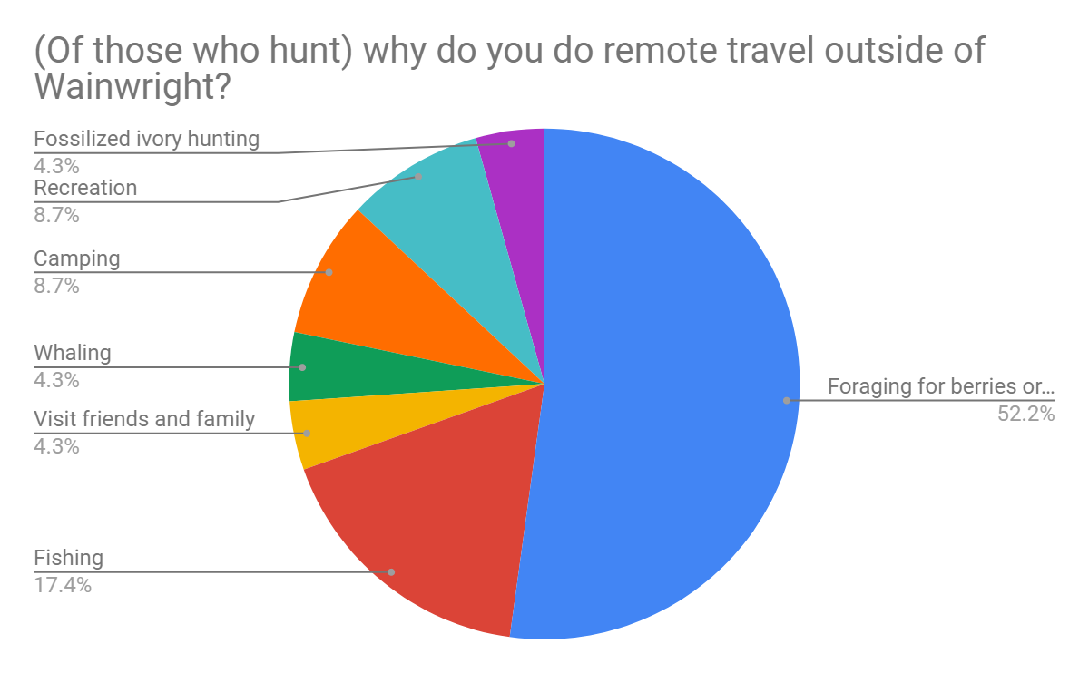
Notes:
One person mentioned exercise, but by far, hunting is the biggest reason people travel remotely in Wainwright.

Slide 13
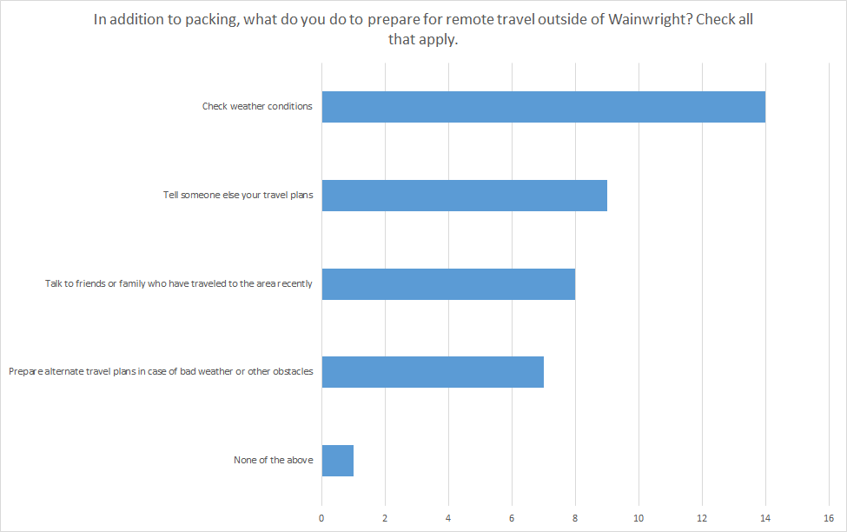
Notes:
Sharing travel plans is probably a conservative estimate. Familiarity with forecasts. NOAA weather website is often checked. Wind speed and direction is an important factor to check. N=17

Slide 14
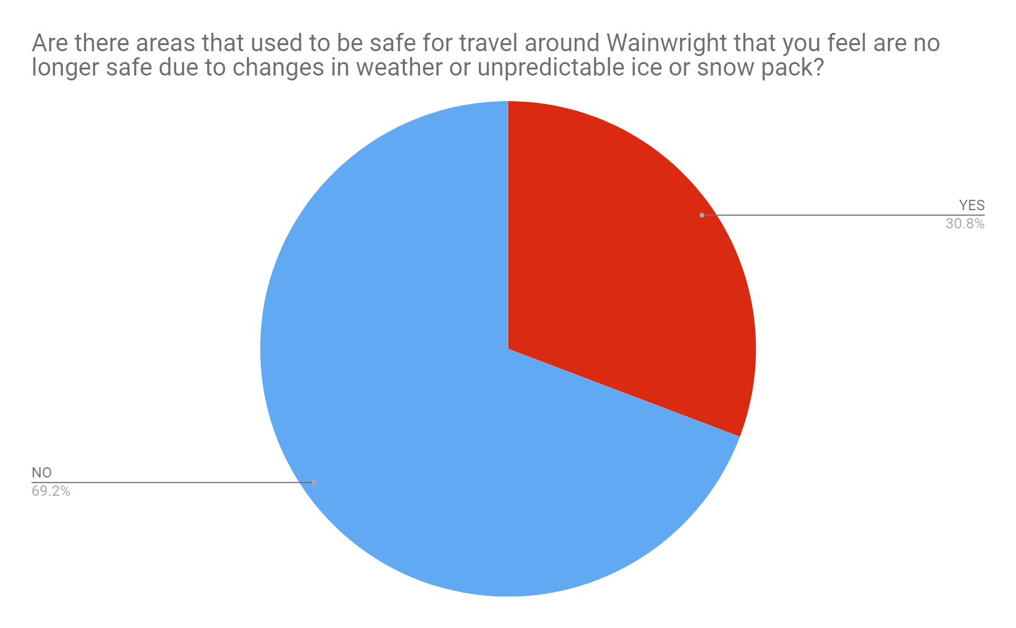
Notes:
About two-thirds of folks feel routes around Wainwright are safe.
No perceived threat from rerouting.
N=13, Yes = 4, No = 9

Slide 15
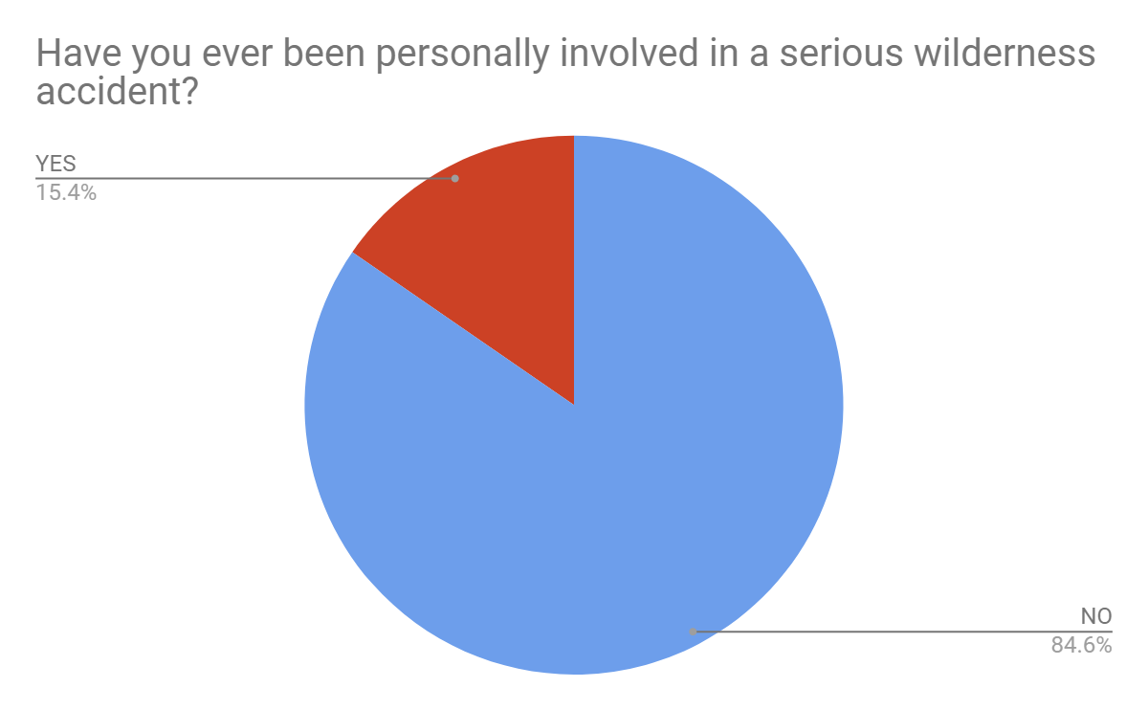
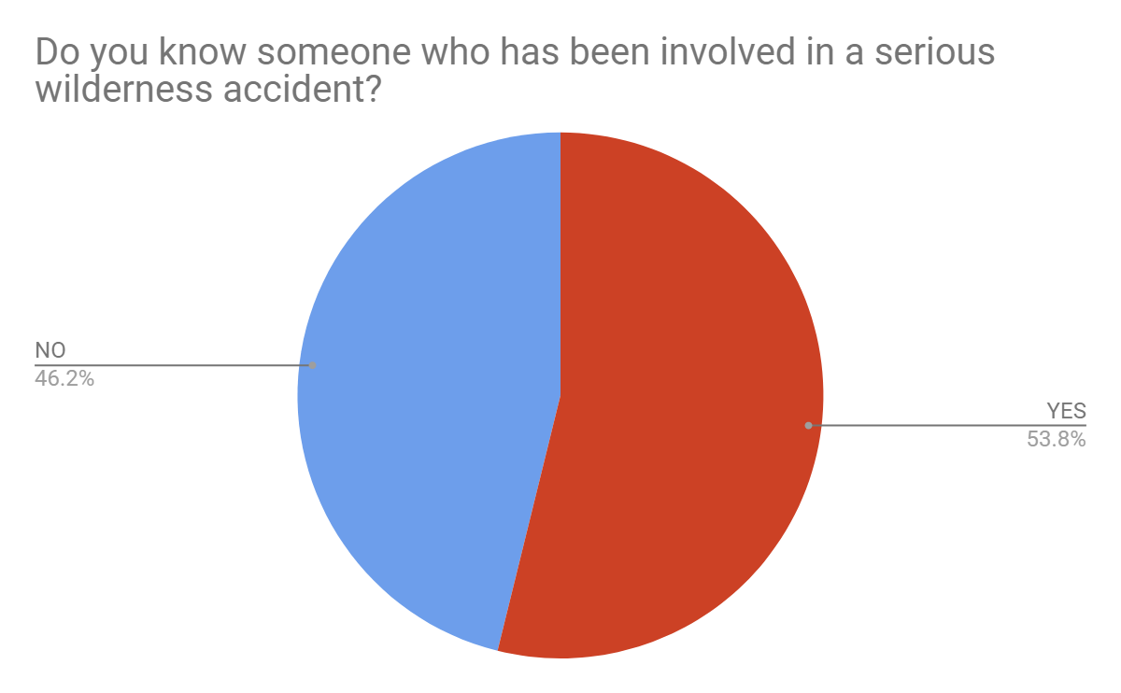
Notes:
2/13 involved in serious wilderness accident - N=13 2=Yes
and about half know of others [discuss definition of “serious”] Why we included this question. N=13 Yes =7
Are these people more likely to do something?

Slide 16
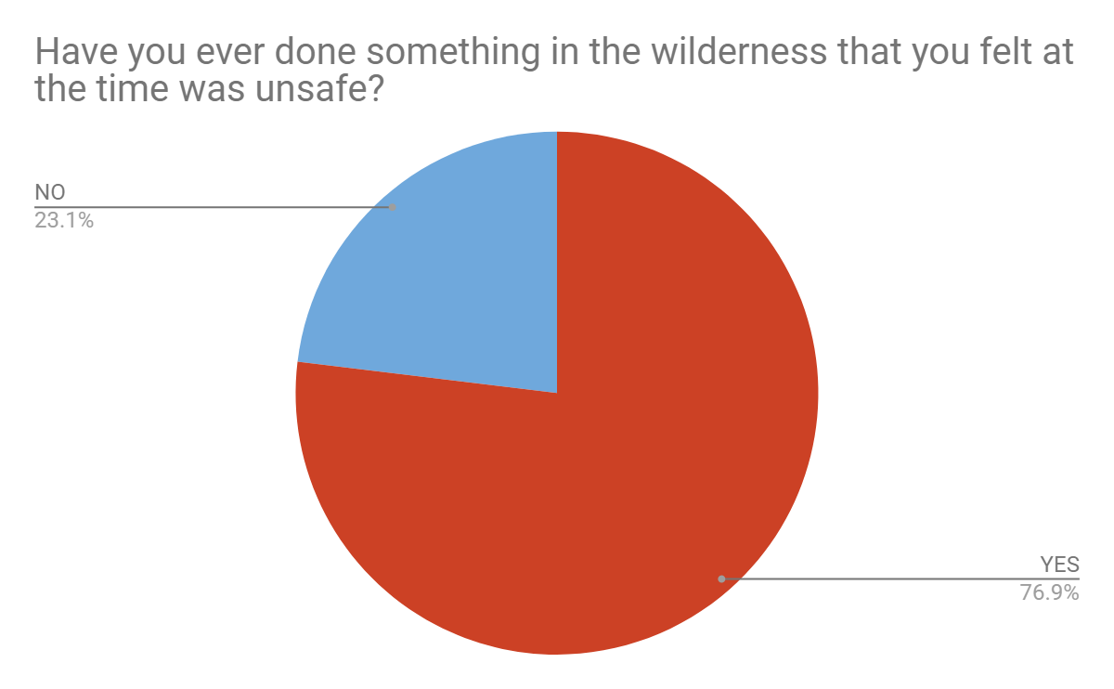
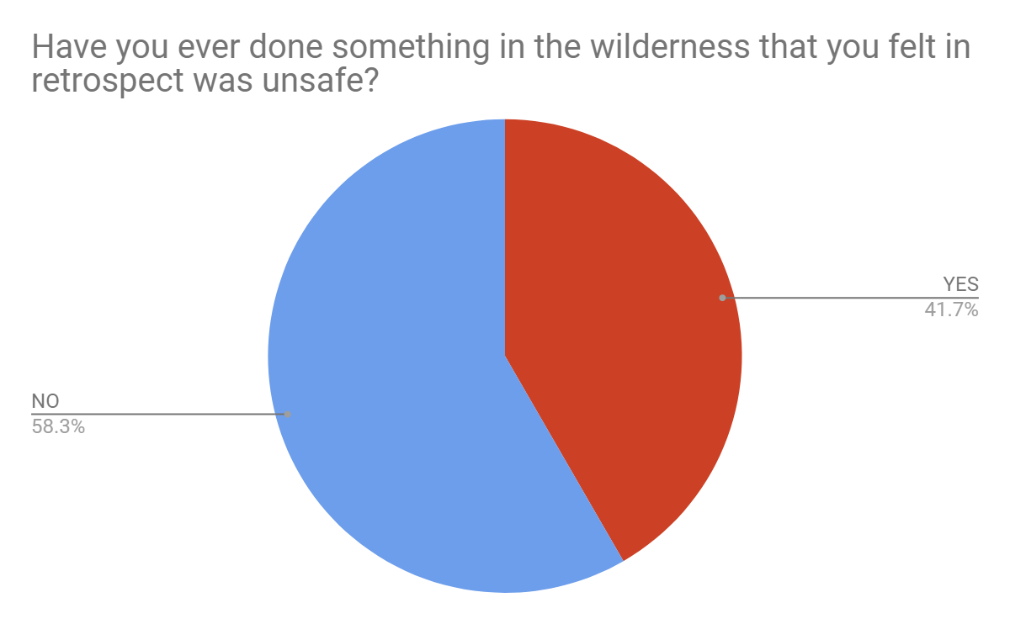
Notes:
Folks do know they take risks but in retrospect the guilt isn’t there. Risk is a given. But overall folks strive to be safe. What makes someone risk adverse?
N=13, Yes = 10, No = 3
N=12, Yes = 5, No = 7

Slide 17
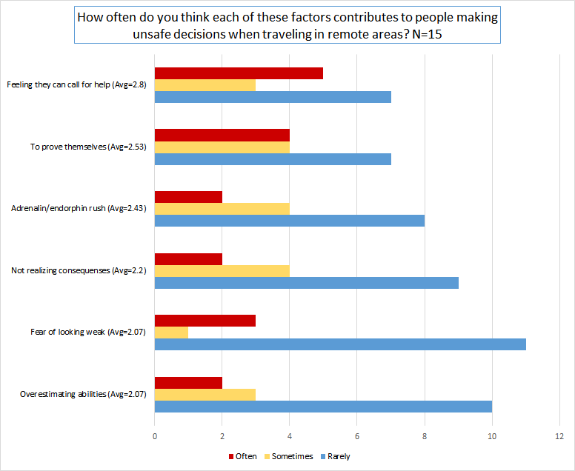
Notes:
Feeling they can call for help was ranked as the number one reason that respondents thought people made unsafe decisions while traveling remotely.
Less of a performance push. Present average of Likert scale.

Slide 18
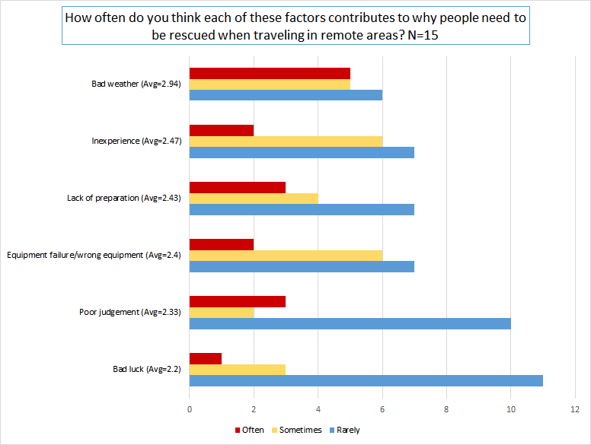
Notes:
By far, bad weather was considered the number one factor for why people had to be rescued. Do you agree?

Slide 19
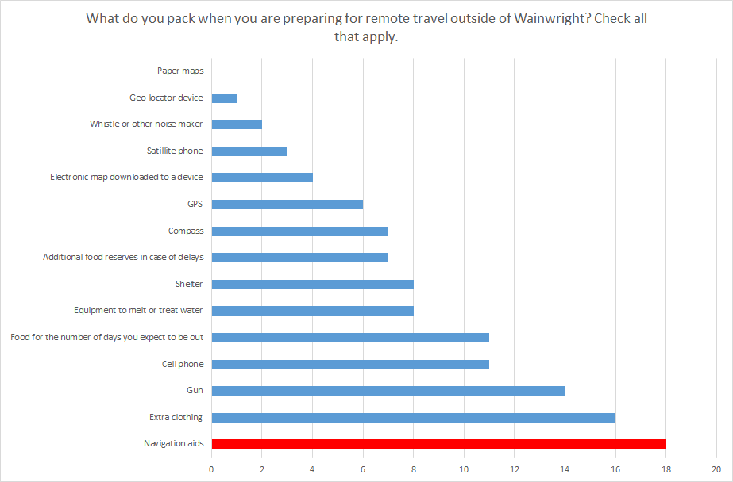
Notes:
Paper maps is zero percent! Surprisingly, only 1 person mentioned packing a geo-location device, 3 ticked satellite phone, and 6 marked packing some sort of GPS. After Extra clothing and a Gun, a cell phone was the third most cited item that is packed in respondent’s travel kit. Folks are taking cell phone on travel. Coastal travel have more service and in town. Camera… iPod.

Slide 20
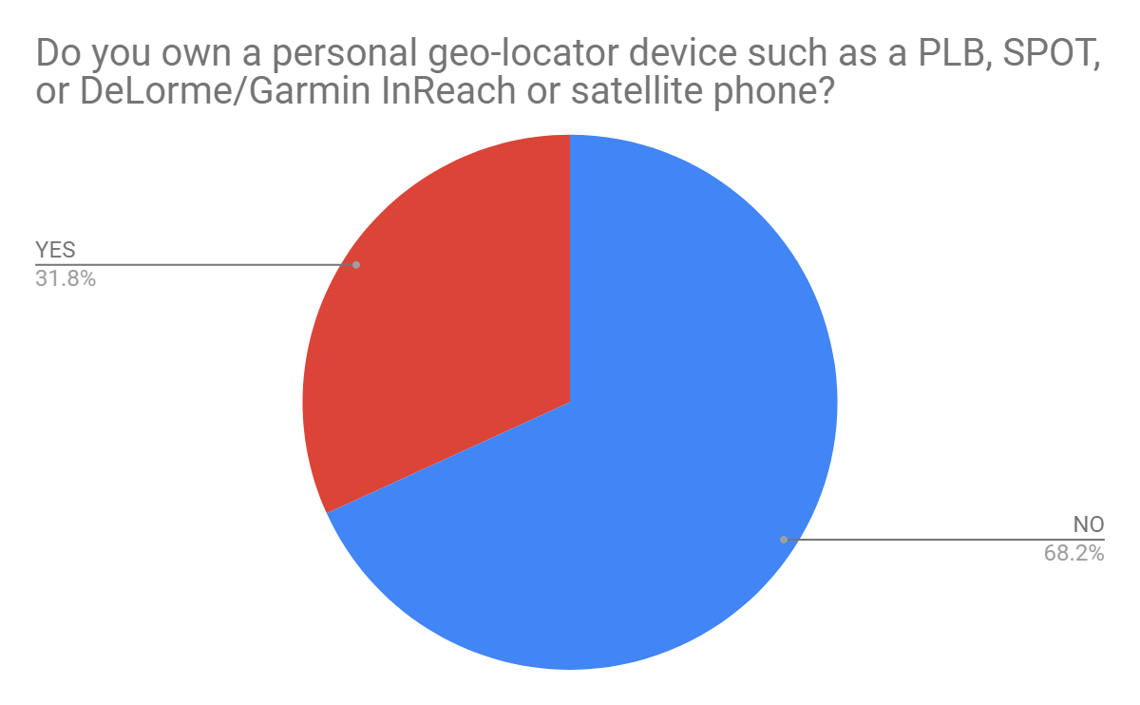
Notes:
About a third of respondents have devices at home. Not going to use program if they don’t need to.
N=20, yes=7, No=13

Slide 21
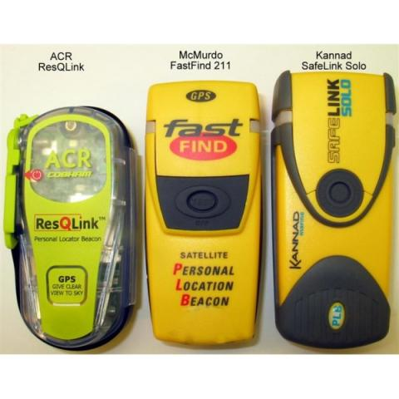
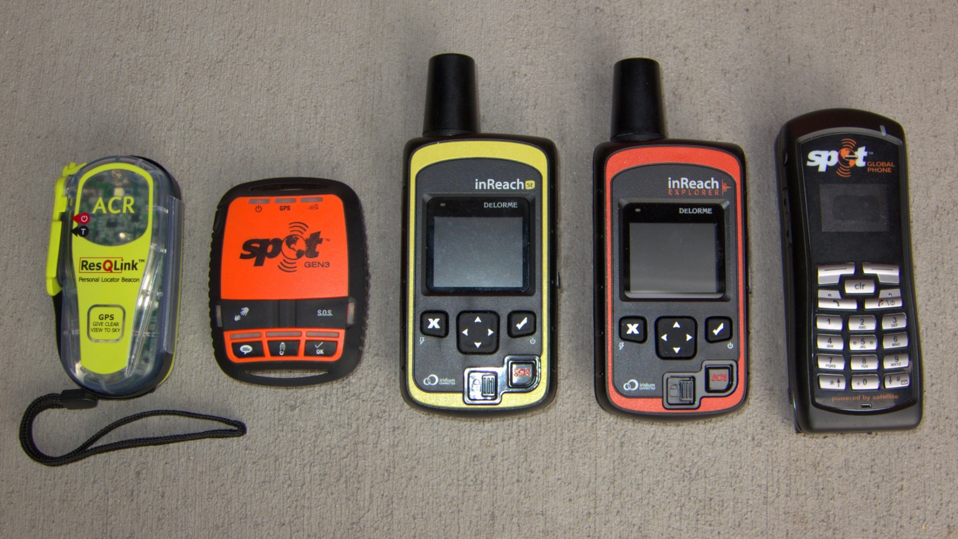
Personal Locator Devices (SOS)
Personal Locator Beacons
Best for SOS
No messaging
Satellite Emergency Notification Devices
Best for messaging (not an emergency)
Require a paid subscription
Notes:
In case you are wondering what we are talking about… the Wainwright SAR used the orange inReach SEND and other models of PLBs.

Slide 22
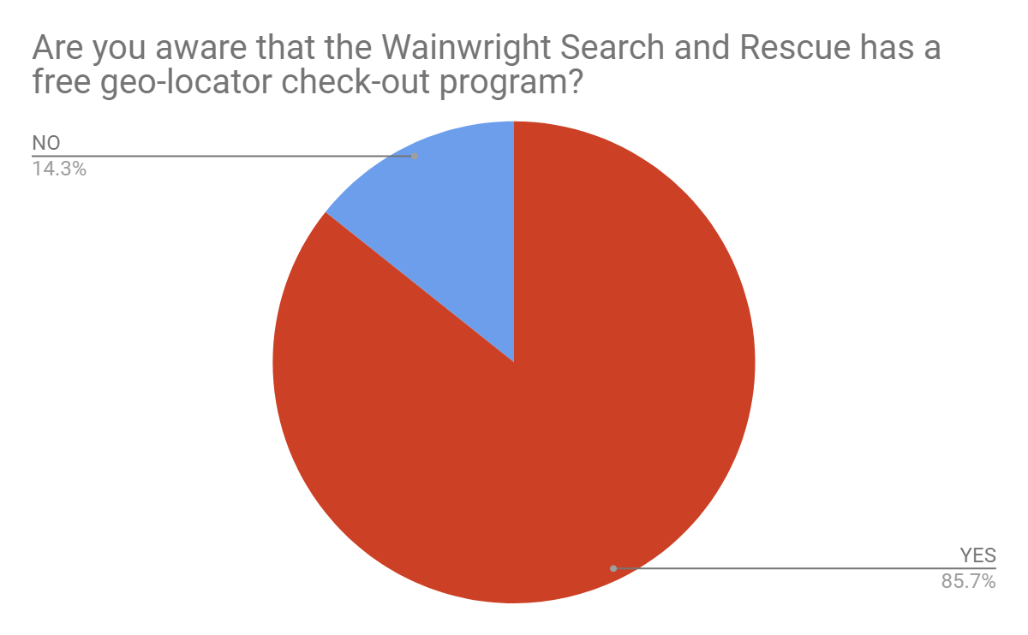
Notes:
Over 80% of reposndents know who to call for device check-out.
Before workshop 4 reported not knowing of check-out program out of 12
After workshop 2 still reported not knowing about check-out program out of 12

Slide 23
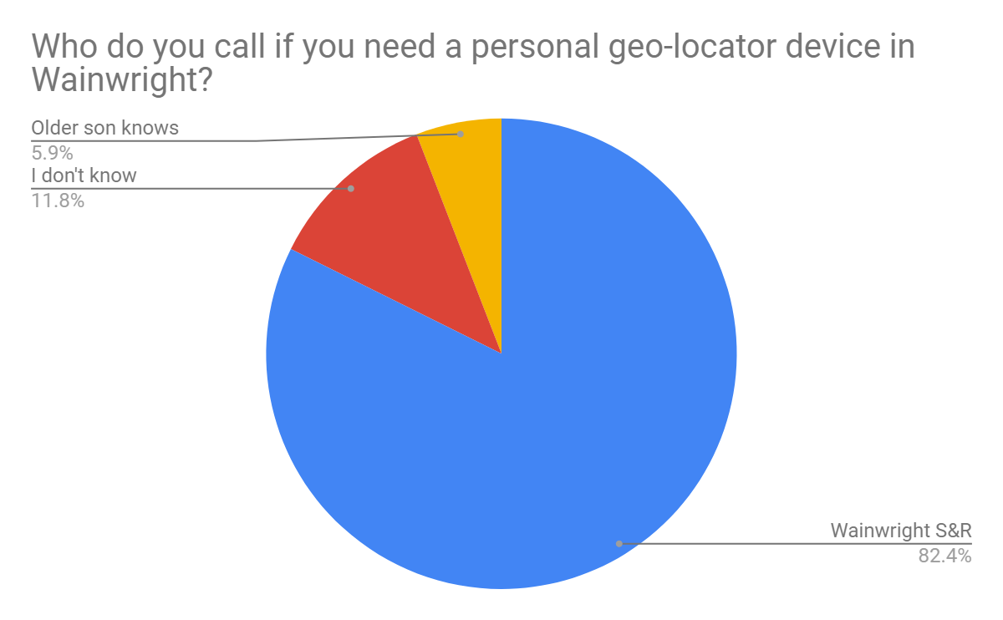
Notes:
Folks know who to call.
N=17, IDK = 2, Older son = 1

Slide 24
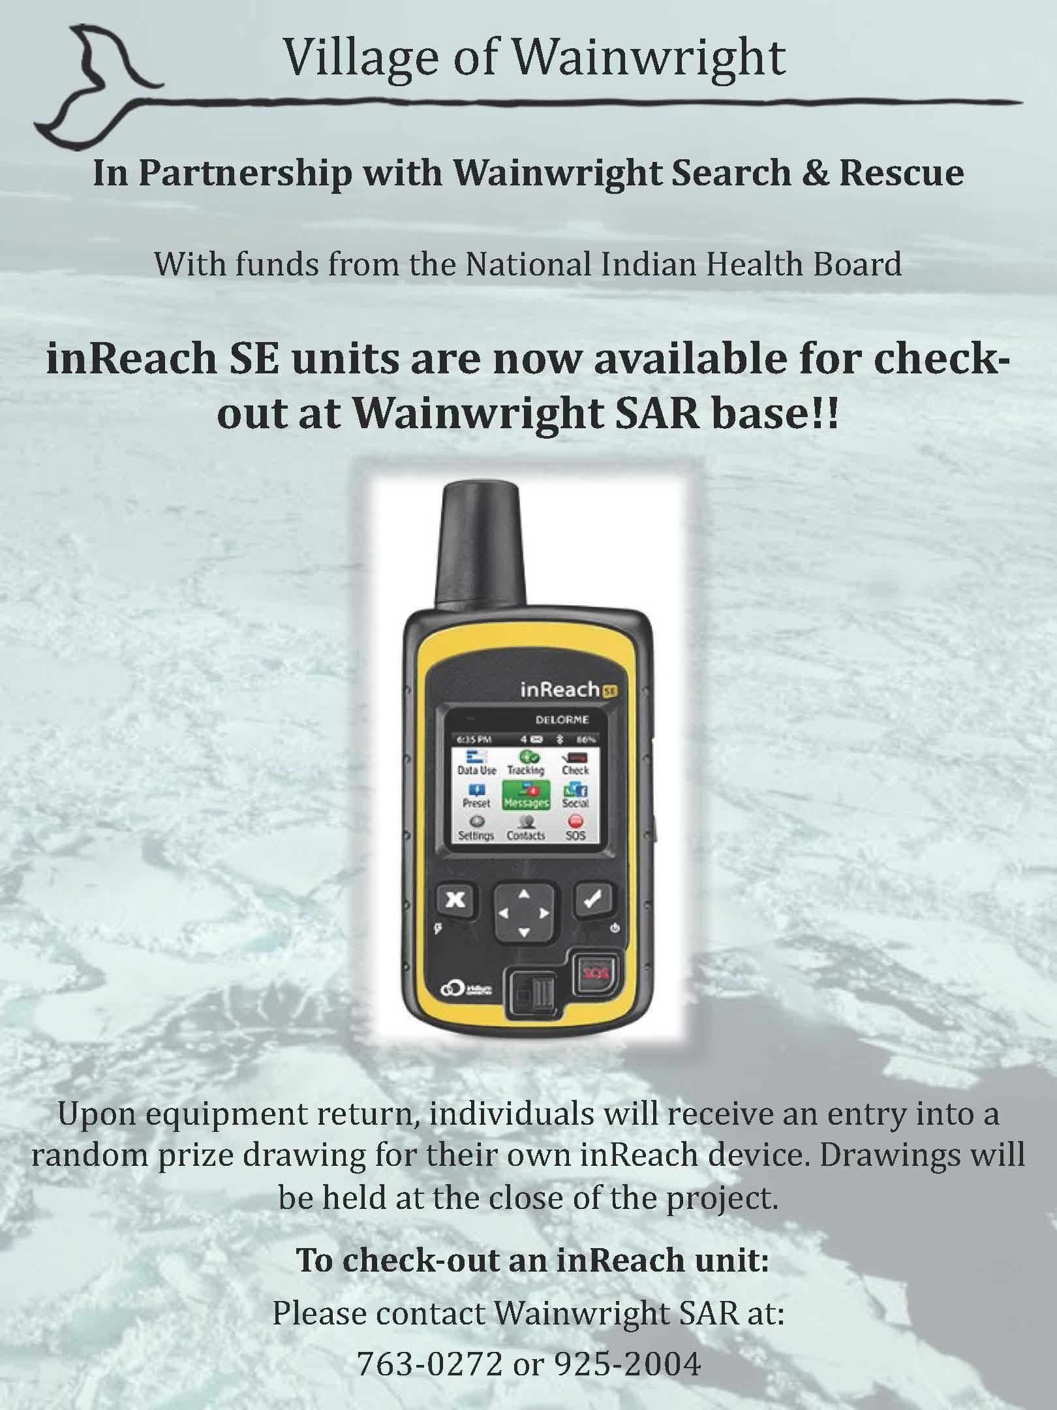

Slide 25
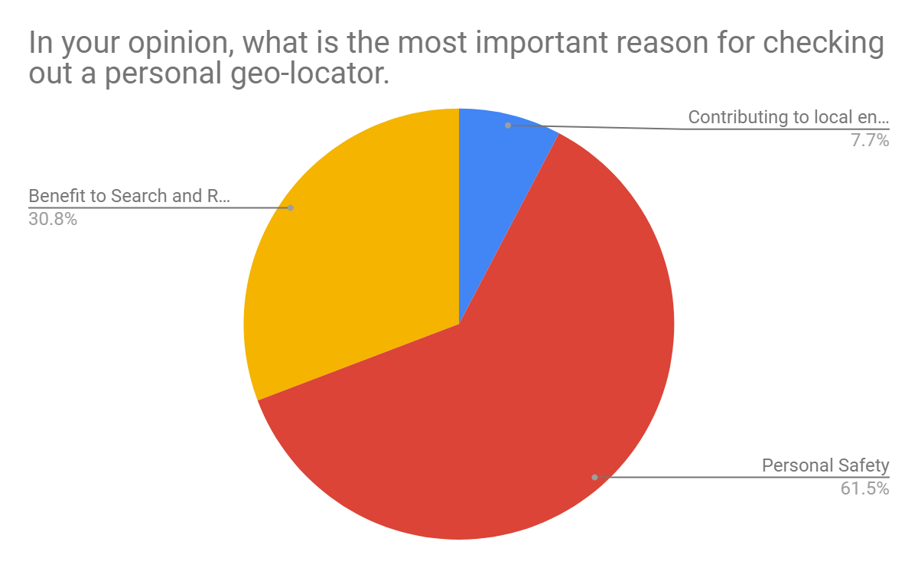
Contributing to local environmental observations and information on current remote travel hazards
Benefit to Search and Rescue
Notes:
People answered that safety is the most important reason to check-out a personal geo-locator . 1 respondent said that geo-locator contributes to taking observations, and 4 respondents recognized the benefit to SAR themselves.

Slide 26
Why?
I will, because what if we need help?
safety
So I can feel safe.
To send people message if in danger.
Never know if something will happen. So it's better to be prepared for anything.
Weather is changing never know when you get stuck 1 week
Notes:
Being prepared, uncertainty
N=13

Slide 27
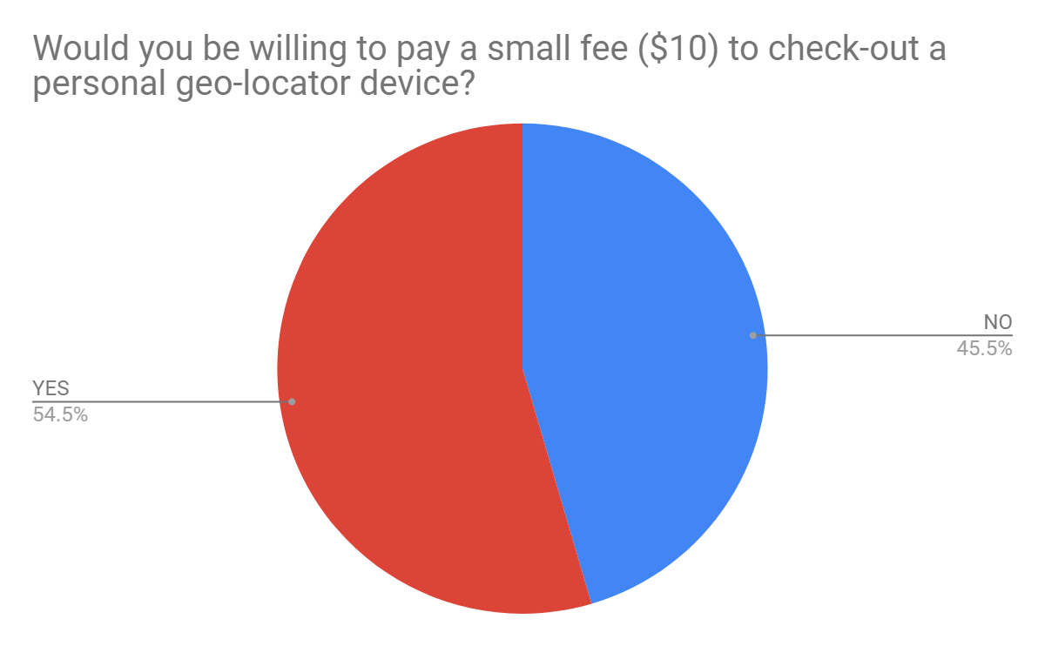
Notes:
May be barrier to acquiring device. $10 wouldn't make a difference to subscription rate. Currently during updates. ~$25/device/month 40 free texts
N=22 [12=Yes, 10=No]

Slide 28
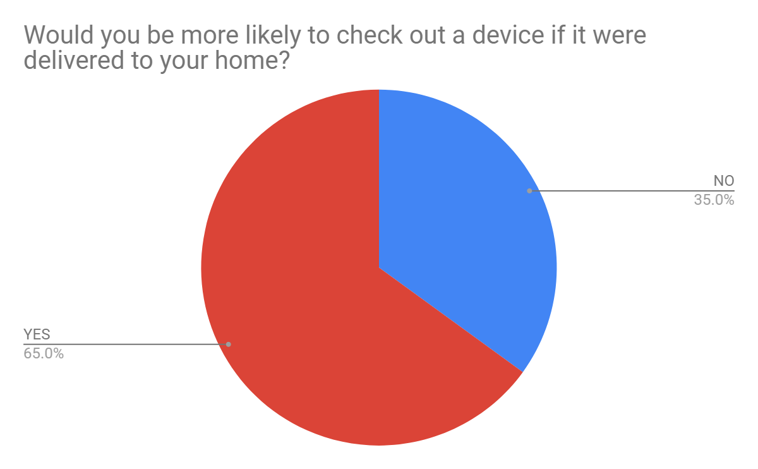
Notes:
N=20 [13=Yes, 7=No]

Slide 29
SAR Rescues and Searches
Before the check-out program SAR missions (9) averaged 8 hours. After the introduction of InReach devices the average length of SAR missions (15) was 6 hours and 20 minutes.
Notes:
Rescue = You have contact with the person you are helping
Search = You do not have contact with the person you are helping
Out of 34 missions between February 2016 and May 2018 Majority of missions were land rescues - helping community members with Snowmachine and ATV issue
Average times calucated from all missions that had a recorded begin and end time.

Slide 30
Statement from Wainwright Search and Rescue
“Every since we started the inReach checkout program, all 12 devices have been checked out. We are still providing PLB checkouts also. We have less searches due to people having an inReach. When people who go out hunting or driving in Atqasuk, Barrow, or Pt Lay we can direct them to safety cabins or the AIN ATQ BRW trail markings that we started about the same time as the inReach program. When ground crews leave to go to subjects in distress I can login and track my crew in the stormy winter weather. Also, when we had the Riley Kuwanna search we had communications with our SAR crews for about a 1.5- 2 month search without locating him. For the whole 2 months of Rescue search we have tracks logged. The devices also work out great doing my Search and Rescue report that I turn into NSB Search & Rescue and then they turn in reports to State Troopers who provide gas, grub, and gear. We are thankful to have found the funding for the inReach program through our Tribal Administration here in Wainwright.” - Ben Jr. Wainwright SAR

Slide 31
Challenges and Recommendations
Remote Travel Safety Workshop and the Weather!
Sample Size
Relatively Low Checkout Rates
Equipment delivery service?
Use in the field (once devices are checked out)
Getting people to turn them on!
Learning Curve
Explore other technology?
Advance Use of Cell phones?

Slide 32
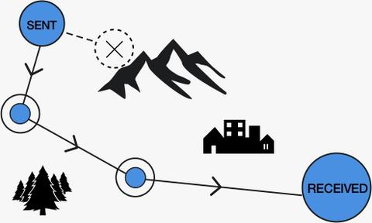
Other Technology:
VHF
Emerging
Gotenna (2 for $160)
Thuraya Satsleeve ($500)
Iridium Go! ($700)
Bivystick ($350)
Somewear ($350)
Cell phone Applications
GaiaEarth
[https://thingstolucat.com/2019/03/17/navigation-with-gaia-gps/]
Notes:
Thermal imaging cameras: https://www.frontiersman.com/news/game-changer-external-cameras-installed-on-helicopters-to-aid-in/article_c7aa4c42-46e6-11e9-8c6b-dff130ff7549.html

Slide 33
In your experience?
Where do you obtain your weather data?
Do you want/need specific data that is not being provided?
Is weather data accessible?
What technology have you used?
How useful is your technology?
Are there better solutions for SAR? Other villages?

Slide 34
Quyanakpak!

Slide 35
Quyanakpak!
Wainwright Search and Rescue
City of Wainwright and Olgoonik Corporation
Village of Wainwright Clinic
National Indian Health Board
North Slope Borough, Community Health Aide Program
Bethel Search and Rescue

