Slide 1
Rapid Change: 2019 in Northwest Alaska's Oceans and Impacts to Ecosystems
One Health Group
Gay Sheffield
UAF-CFOS Alaska Sea Grant (Nome)
December 2019

Slide 2
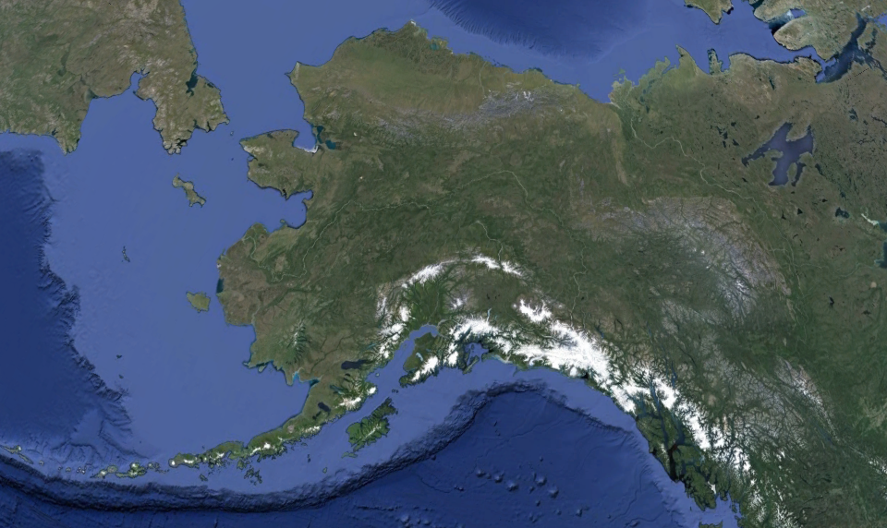
Chukotka
Alaska
Canada
Notes:
15 Regional communities – with 20 federally recognized tribal governments, 3 Alaska Native cultures, languages
YELLOW box

Slide 3


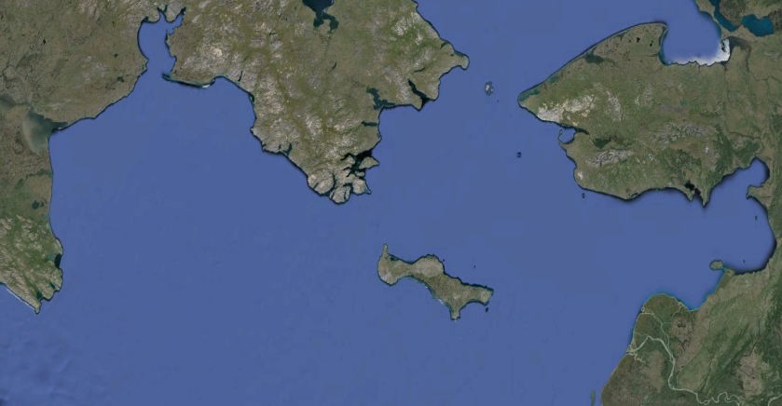
Bering Strait
CHUKOTKA
CHUKOTKA
ALASKA
ALASKA
Anadyr
Nome

Slide 4
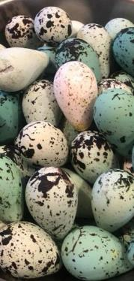
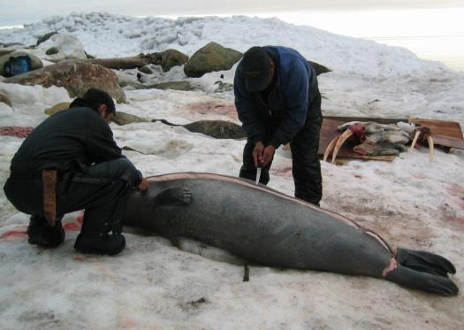
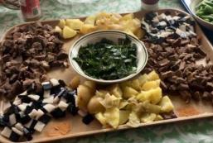
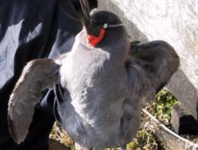
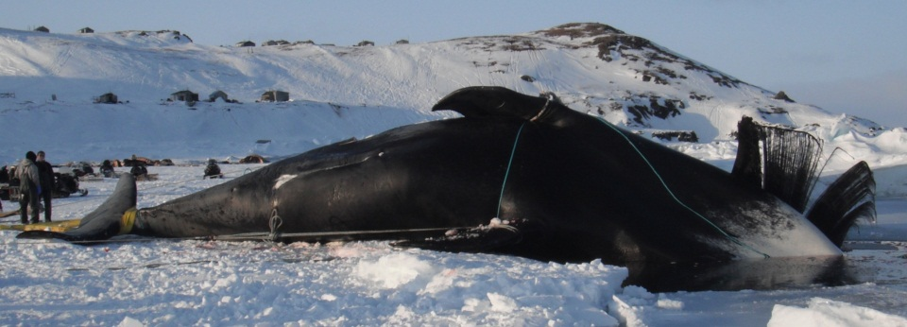
Photo: G. Kuunuka
Non-commercial acquisition of marine resources - essential
Photos: G. Sheffield
Notes:
Coastal communities throughout this remote region rely primarily on the non-commercial acquisition of marine wildlife resources (i.e. invertebrates, fishes, seabirds/eggs, for their nutritional, cultural, and economic needs.
Regional commercial fisheries are limited and local. People heavily engaged in the subsistence utilization of marine wildlife resources simultaneously are monitoring the marine environment.

Slide 5
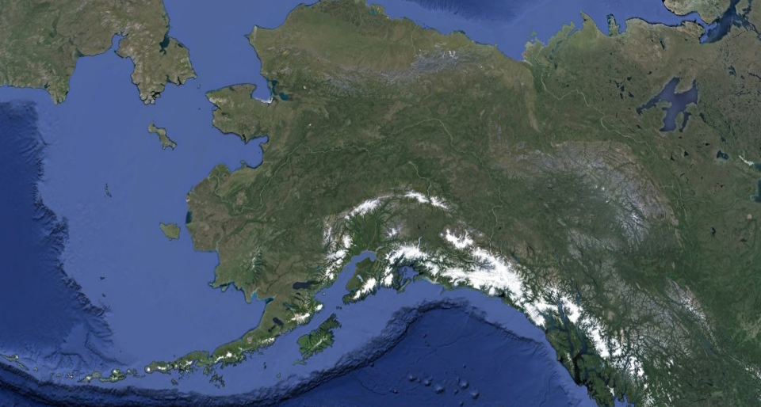
Sea ice
Chukotka
Alaska
Nome
N. Bering
Sea
S. Bering Sea
Thermal barrier - two ecosystems

Slide 6
Sea ice
Chukotka
Alaska
Nome
N. Bering
Sea
S. Bering Sea
Thermal barrier - two ecosystems

Slide 7
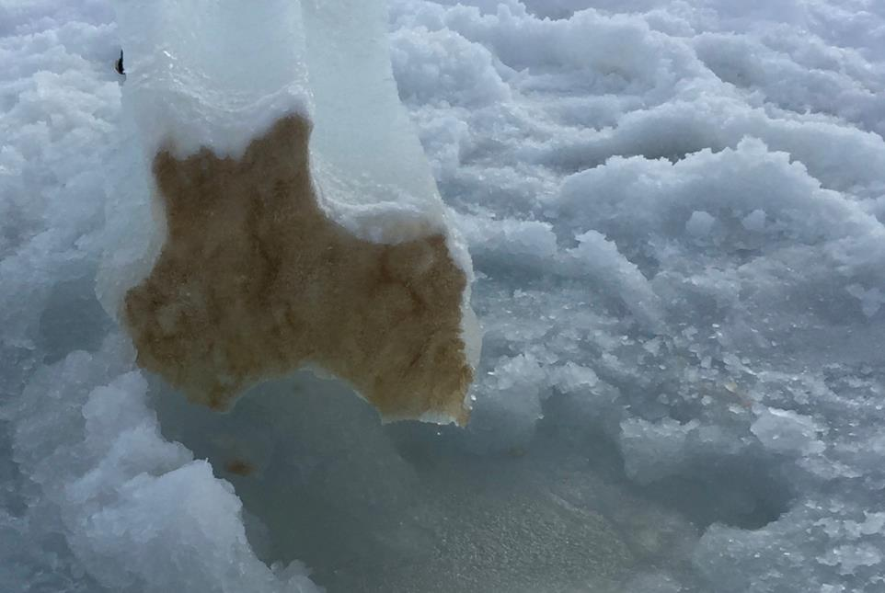
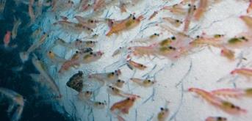
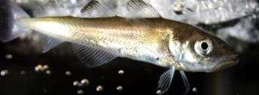
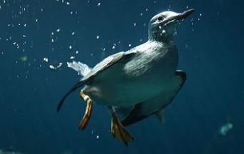
Sea Ice
Algae feeds the food chain

Slide 8
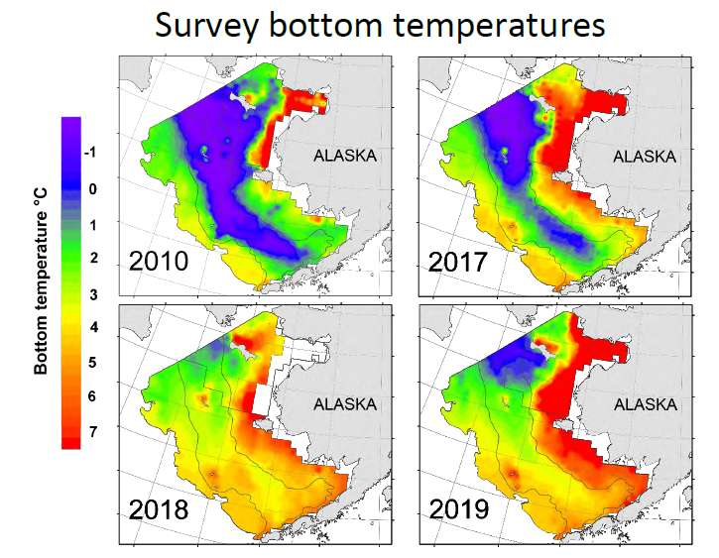
Bering Sea: Bottom Water Temperatures
Nome
Nome
ALASKA
ALASKA
2010
2017
Data NOAA-RACE

Slide 9
Bering Sea: Bottom Water Temperatures
Nome
Nome
ALASKA
ALASKA
2010
2017
Data NOAA-RACE

Slide 10
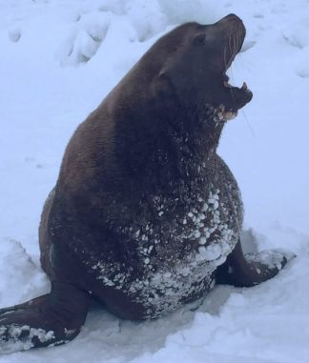
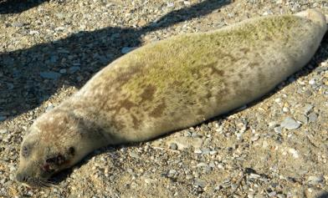
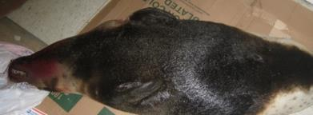
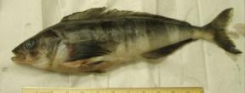
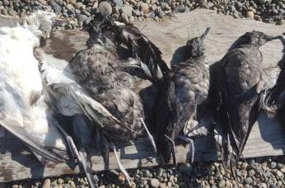
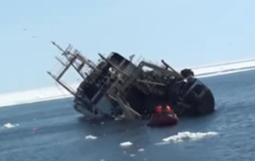
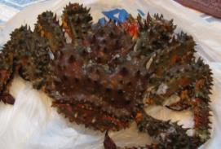
Bering Strait: 2010-2017…
EVENTS
Diseases
- Ice Seal UME
- Avian Cholera
- Saxitoxin..?
- Starvation
Invasive / Extension
Oil-Fouling / Debris
Photo: Public
Photo: T. Akeya
Photo: L. Tungiyan
Photo: G. Sheffield
Photo: M. James
Photo: G. Sheffield
Photo: G. Sheffield
F/V Kapitan Bulsinovski (2012)

Slide 11
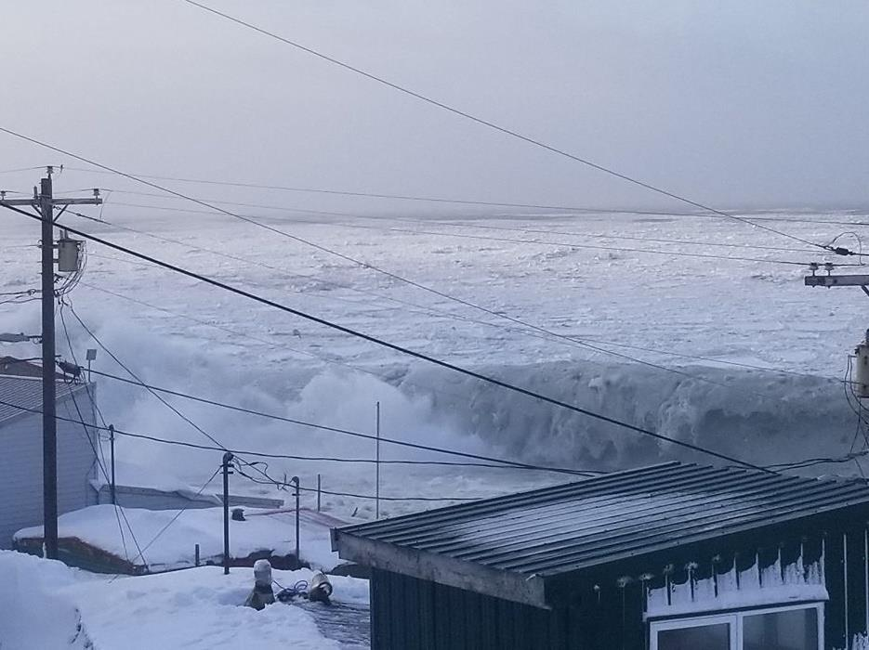
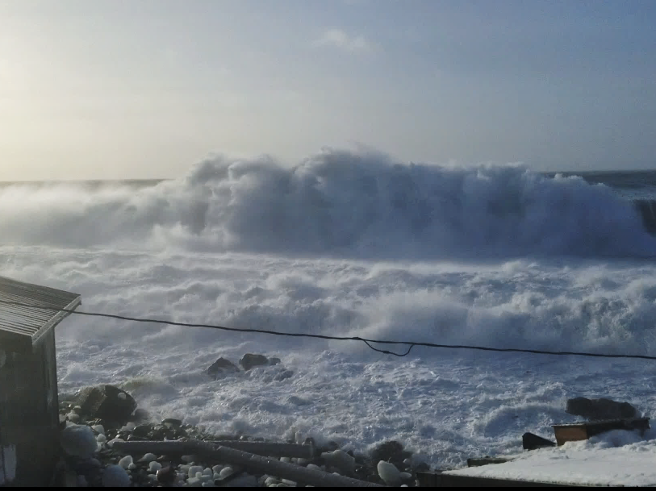
February 2018 happened…
Photo: C. Ahkvaluk

Slide 12
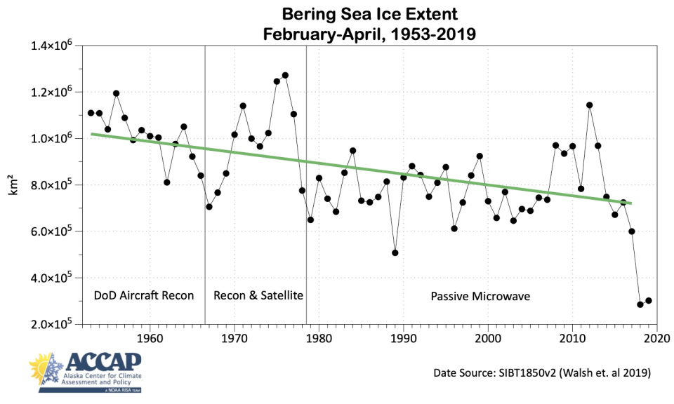
1953-2018
Loss of Sea Ice:: 1953-2019
February-April: Bering Sea Ice Extent

Slide 13
Bering Sea: Bottom Water Temperatures
Nome
Nome
ALASKA
ALASKA
2010
2017
Nome
ALASKA
2018
Data NOAA-RACE

Slide 14
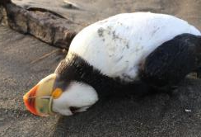
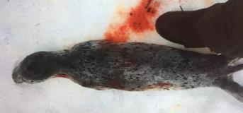
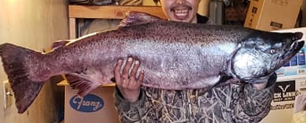
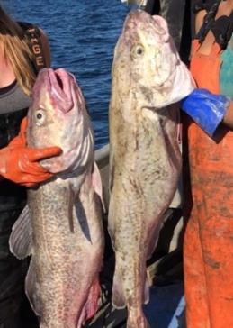

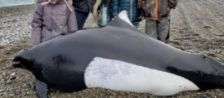
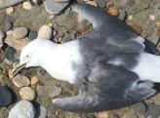
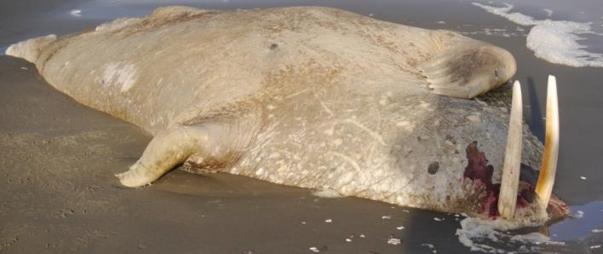
Bering Strait: 2018 Events
NO THERMAL BARRIER
- Massive ecological shifts
- Mass strandings (seals)
- Seabird die-off
- HAB concerns (walrus)
Photo: Public (Nome)
Photo: S. Komonaseak Jr.
Photo: A. Angqatenganwan
Photo: B. Ahmasuk
Photo: NOAA
Photo: E. Apassingok
Photo: M. Rauzon

Slide 15
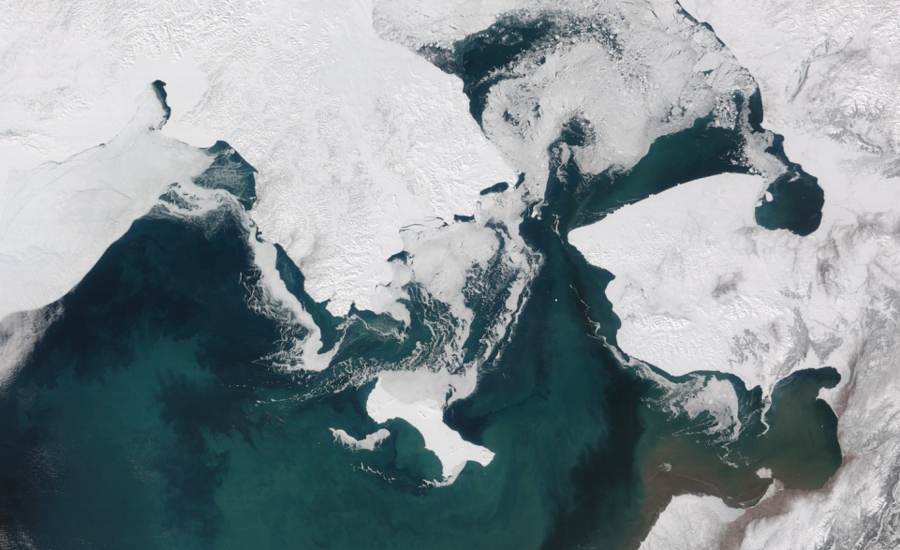
February 2019….Again?!
Chukotka
Alaska
Nome
.
April 4, 2019
Notes:
Massive environmental / industrial changes

Slide 16
Loss of Sea Ice: 1953-2019
February-April: Bering Sea Ice Extent

Slide 17
Bering Sea: Bottom Water Temperatures
Nome
Nome
ALASKA
ALASKA
2010
2017
Nome
Nome
ALASKA
ALASKA
2018
2019
Data NOAA-RACE

Slide 18
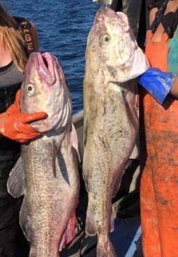

Bering Strait: 2018-2019 Events
NO THERMAL BARRIER
- Massive ecological shifts
NOAA – RACE Div.
NBS: Biomass (mt)
2010
21,141
29,124
16,377
37,861
2017
1,319,062
287,535
5,260
3,906
2019
1,167,099
364,982
4,891
47
Change
5,421%
1,153%
-70 %
-100 %
Pollock
Pacific Cod
Smelts
Arctic Cod
Photo: B. Ahmasuk
Photo: NOAA

Slide 19
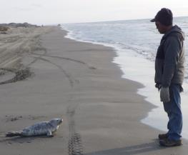
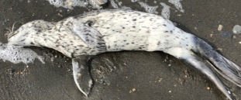
Bering Strait: 2018-2019 Events
NO THERMAL BARRIER
- Massive ecological shifts
- Mass strandings (UME)
Photo: G. Sheffield
Photo: USCG
Photo: M. Ahkinga Sr.
NOAA – RACE Div.
NBS: Biomass (mt)
2010
21,141
29,124
16,377
37,861
2017
1,319,062
287,535
5,260
3,906
2019
1,167,099
364,982
4,891
47
Change
5,421%
1,153%
-70 %
-100 %
Pollock
Pacific Cod
Smelts
Arctic Cod
Photo: B. Ahmasuk

Slide 20
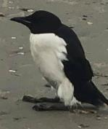
Bering Strait: 2018-2019 Events
NO THERMAL BARRIER
- Massive ecological shifts
- Mass strandings (UME)
- Seabird die-off
NBS: Biomass (mt)
Photo: V. Ongtowasruk
NOAA – RACE Div.
2010
21,141
29,124
16,377
37,861
2017
1,319,062
287,535
5,260
3,906
2019
1,167,099
364,982
4,891
47
Change
5,421%
1,153%
-70 %
-100 %
Pollock
Pacific Cod
Smelts
Arctic Cod
Photo: B. Ahmasuk

Slide 21
Bering Strait: 2018-2019 Events
NO THERMAL BARRIER
- Massive ecological shifts
- Mass strandings (UME)
- Seabird die-off
- HAB Events, “Hot” clams
NBS: Biomass (mt)
Photo: V. Ongtowasruk
NOAA – RACE Div.
2010
21,141
29,124
16,377
37,861
2017
1,319,062
287,535
5,260
3,906
2019
1,167,099
364,982
4,891
47
Change
5,421%
1,153%
-70 %
-100 %
Pollock
Pacific Cod
Smelts
Arctic Cod
Photo: B. Ahmasuk

Slide 22
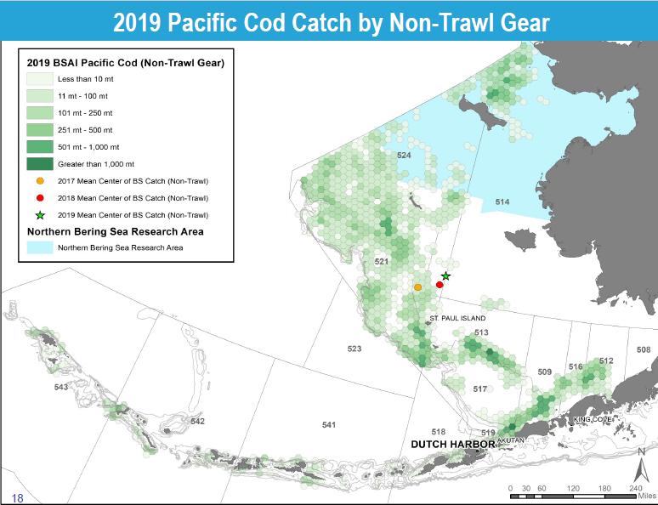

Slide 23
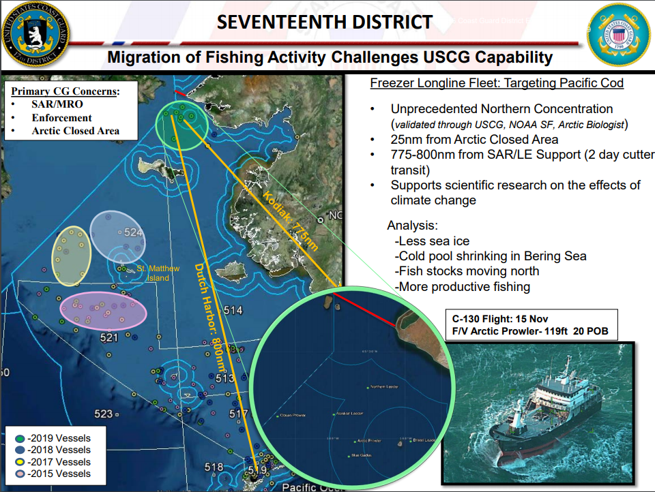
Nome

Slide 24


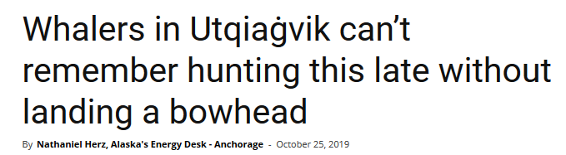
Bering Strait: 2018-2019 Events
NO THERMAL BARRIER
- Massive ecological shifts
- Mass strandings (UME)
- Seabird die-off
- HAB Events, “Hot” clams
- Bowhead movements…
Photo: G. Sheffield

Slide 25
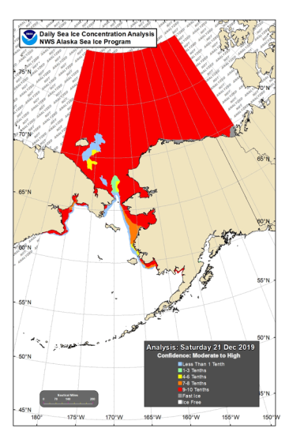
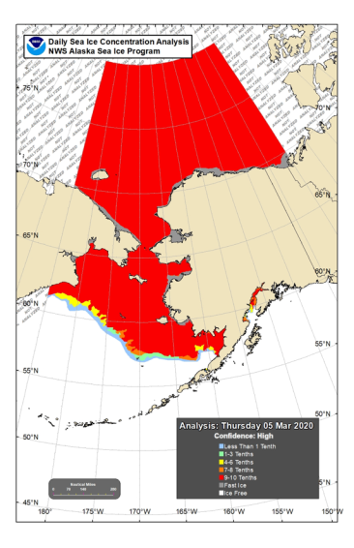

Notable Winter Sea Ice Dates
21-Dec-2019: Chukchi Sea Ice-over
5-Mar-2020: Maximum Extent
Nome
Nome

Slide 26
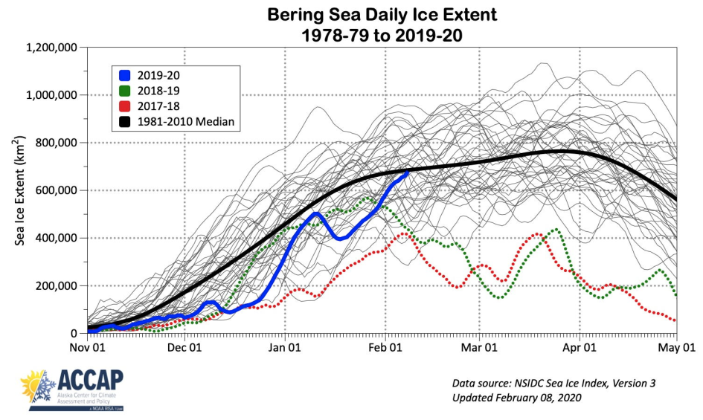

Slide 27
Notable Winter Sea Ice Dates
21-Dec-2019: Chukchi Sea Ice-over
5-Mar-2020: Maximum Extent
Nome
Nome

Slide 28
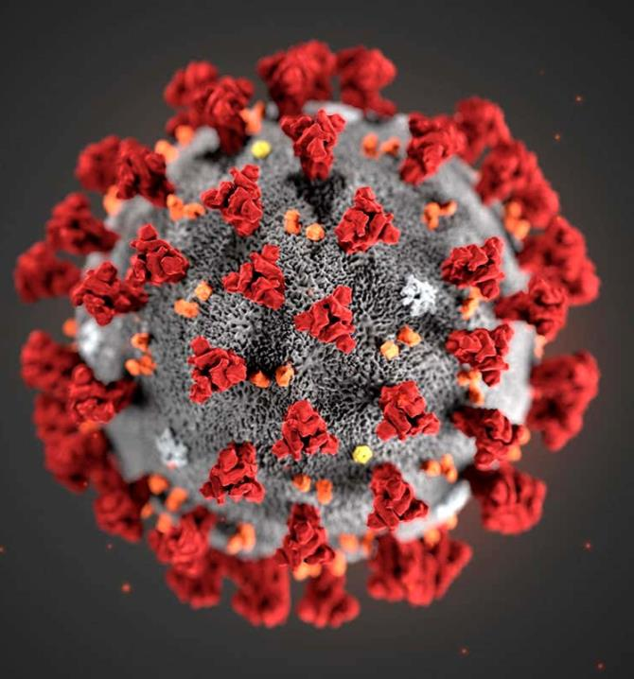
COVID-19
Safety/concerns
Travel restrictions
Quarantine / tests
- logistics
- costs
RESEARCH
- cancellations

Slide 29
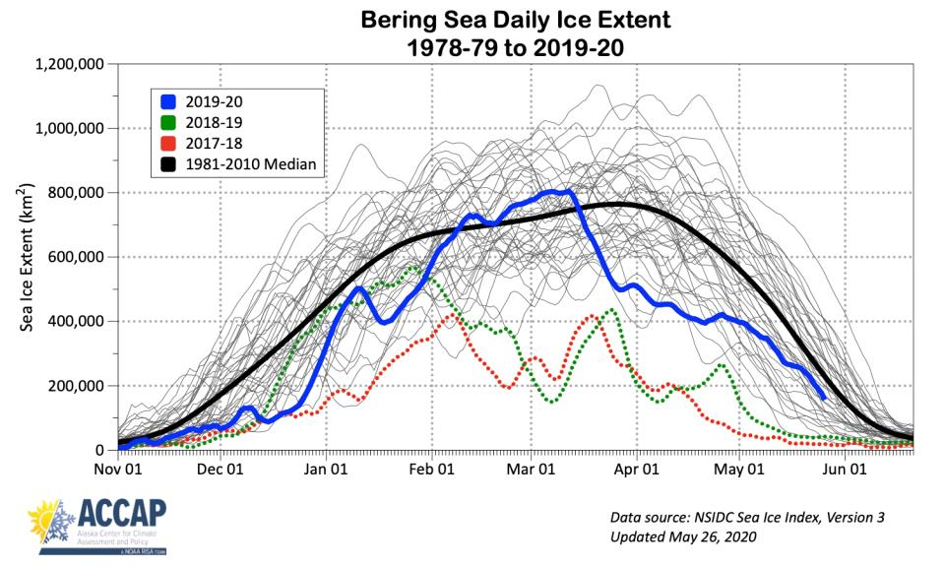
Bering Sea Ice Extent: 2020 not “Normal”

Slide 30
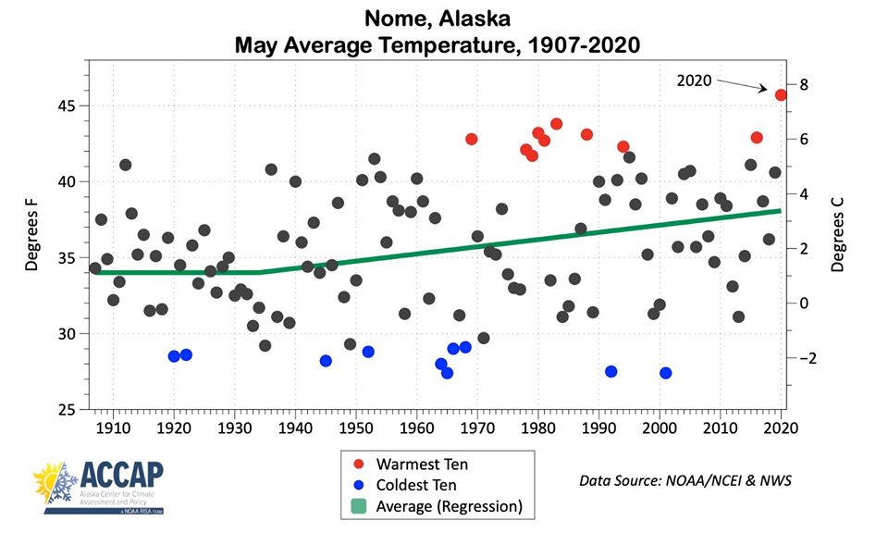

Slide 31
Loss of snow at elevation
Low river levels

Slide 32
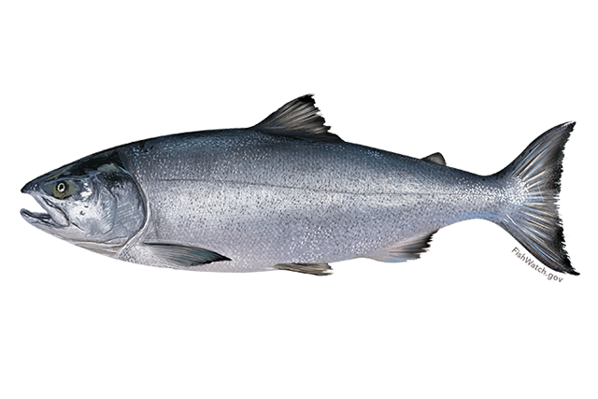
Loss of snow at elevation
Low river levels

Slide 33
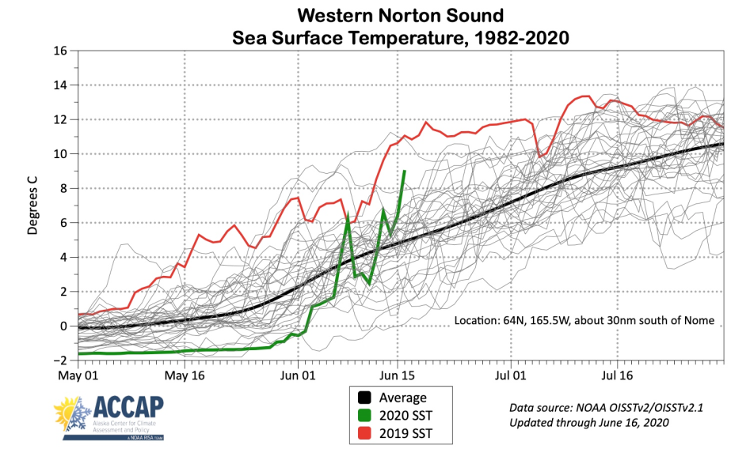

Slide 34
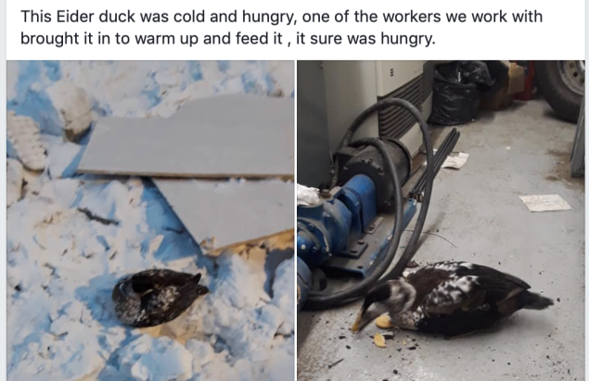
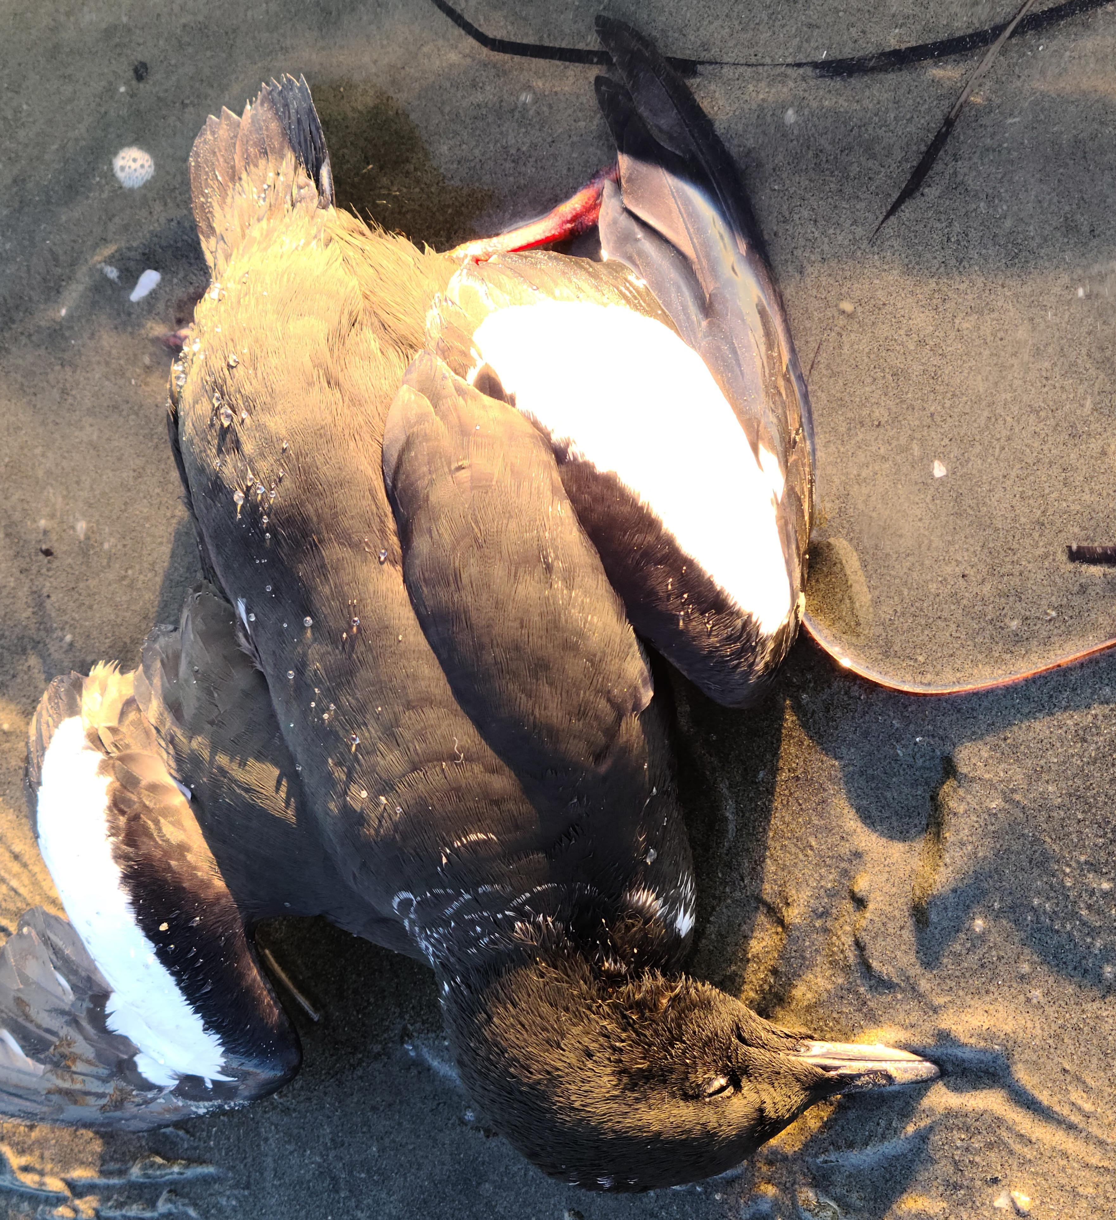
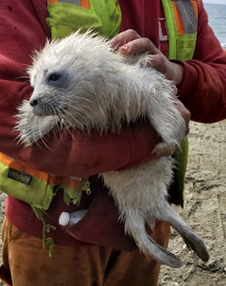
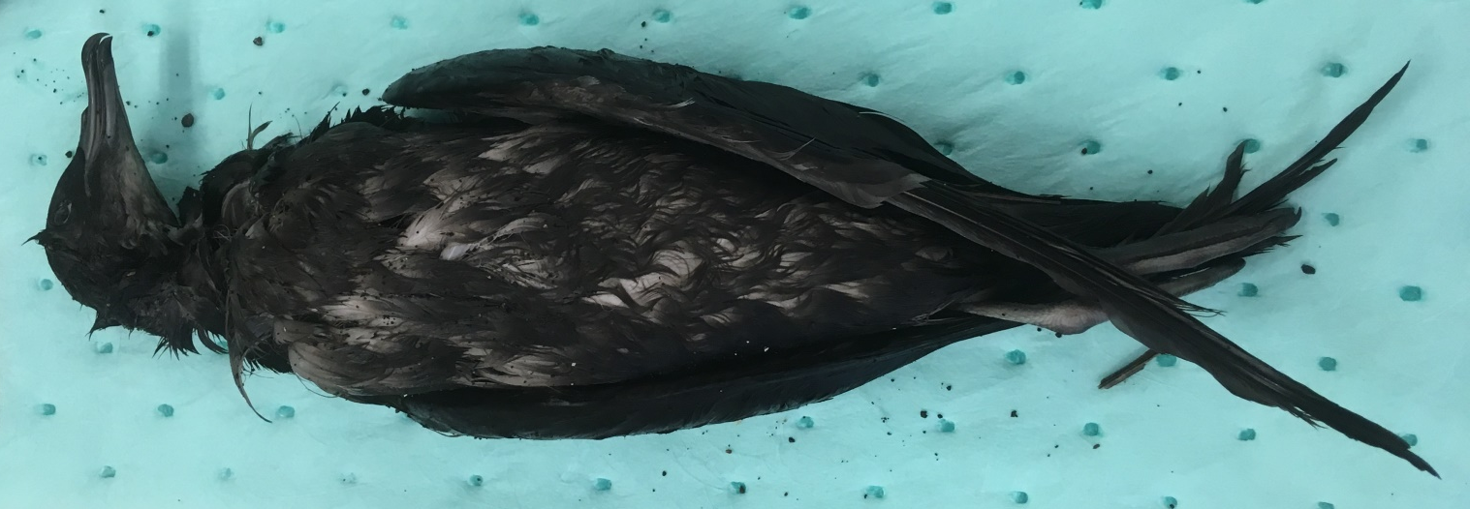

Photo: Stenek
STR-001-20:
Shishmaref, February 2020
STR-016-20:
Shishmaref, June 2020
STR-028-20:
Savoonga, June 2020
STR-011-20:
Nome, June 2020
Photo: Sheffield
STR-013-20:
Nome, June 2020
Photo: Nome public
Photo: Jones

Slide 35

Nome
Industrial ship traffic
23-June 2020

Slide 36
SUMMARY: Northern Bering Sea
Loss of sea ice = transitioning marine ecosystem
  Lack of thermal barrier
  Less ice algae…less primary production…
  Two entire ecosystems in flux
  Cascading responses (ex. unusual movements, body condition, etc.
  Food security / public health concerns
  Industry in transition…
Current conditions: Warm, dry, and…unfolding
  Your reports are essential!

