Slide 1
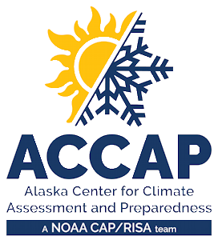

LEO Alaska Webinar
Winter 2025-26 Climate Review
Spring 2026 Climate Outlook
Rick Thoman
Alaska Center for Climate Assessment and Preparedness
Alaska and Arctic Climate Specialist
rthoman@alaska.edu
March 10, 2026

Slide 2
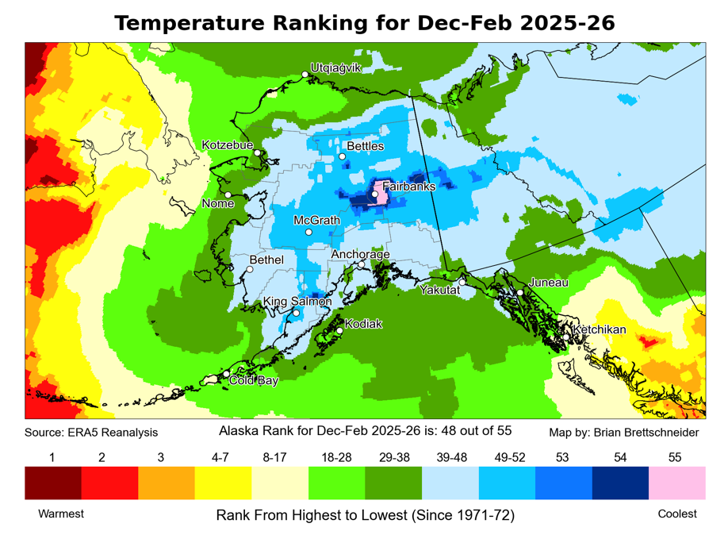

Winter 2025-26 Highlights
Alaska and NW Canada
Coldest winter since
  Fairbanks 1970-71
  Tanana: 1975-77
  Tok and King Salmon: 1998-99
  Anchorage: 2008-09
  Glennallen: 2016-17
  Nome and Bethel: 2019-20
  Kotzebue: 2021-22

Slide 3
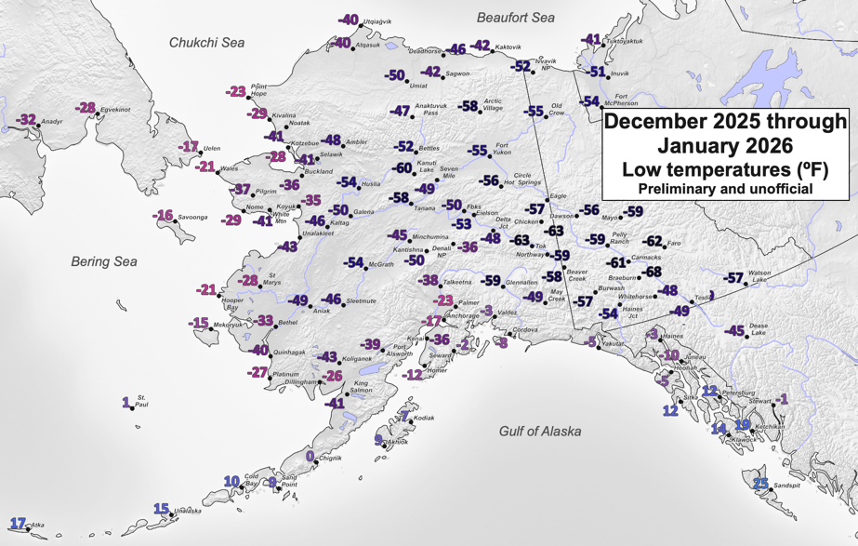
Winter 2025-26 Highlights
Alaska and NW Canada
Lots of snow in the population centers
  Juneau: 82 inches snow in December
  Anchorage: 40 inches snow in January
  Fairbanks: 39 inches snow in February
Cold highlights
  Fairbanks: 32 straight days high temp 0F or lower (second longest)
  Anchorage: 40 straight days with high temp 25F or lower (second longest)
  Juneau: -10F (Airport) Dec 22 and 23, lowest in 30 years.

Slide 4
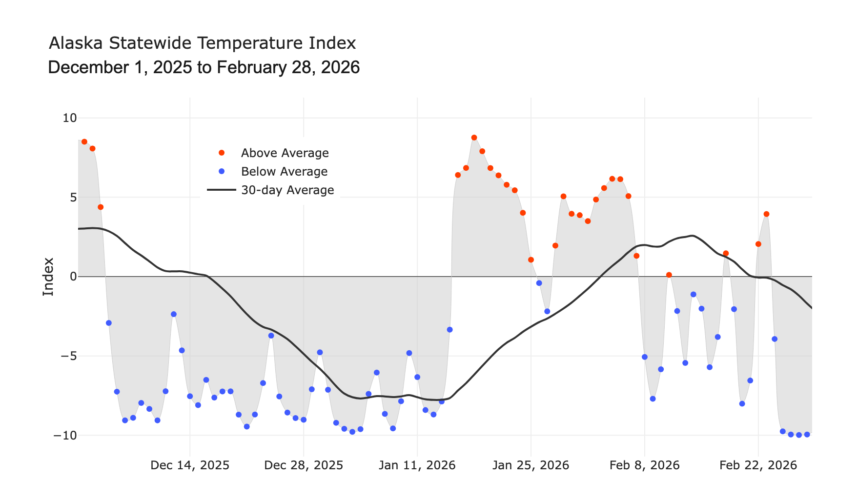
Alaska Daily Temperature Index

Slide 5
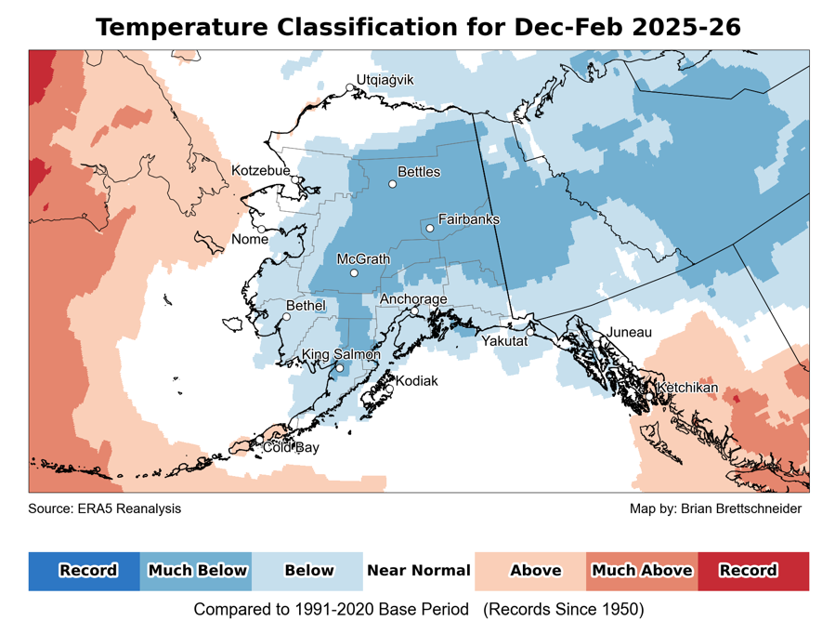
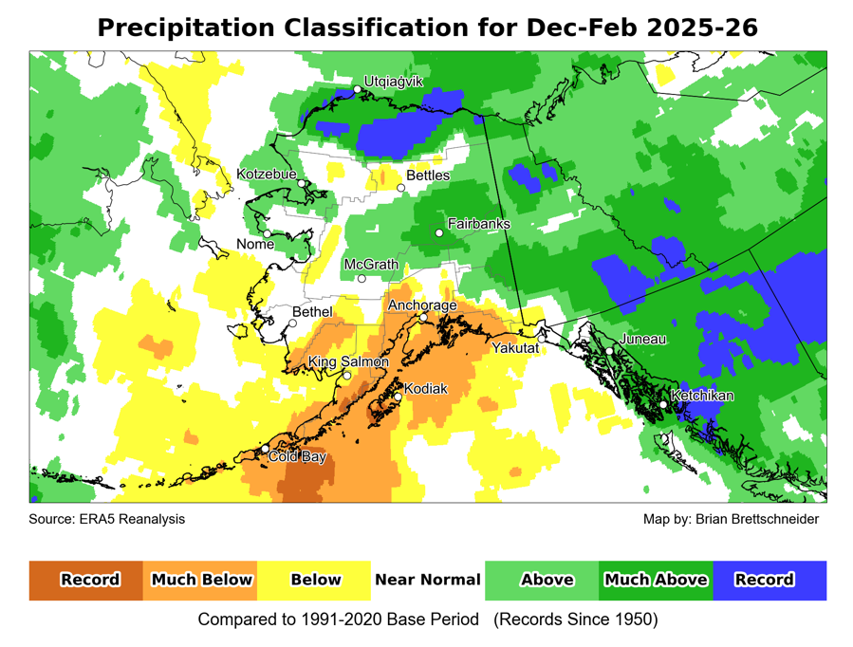
Winter 2025-26
Temperature and precipitation
Data: ERA5 courtesy of EMCWF/Copernicus
1991-2020 Baseline
Notes:
AK Summer: 45% of Alaska land area temp above normal, first summer since 2014 with less than half of the state warmer than normal
YT Summer: 4th summer in a row 100% above normal
NWT Summer: 99% above normal but lowest since 2021
AK Summer: 83% of Alaska land area above normal precipitation. Highest since 1998

Slide 6
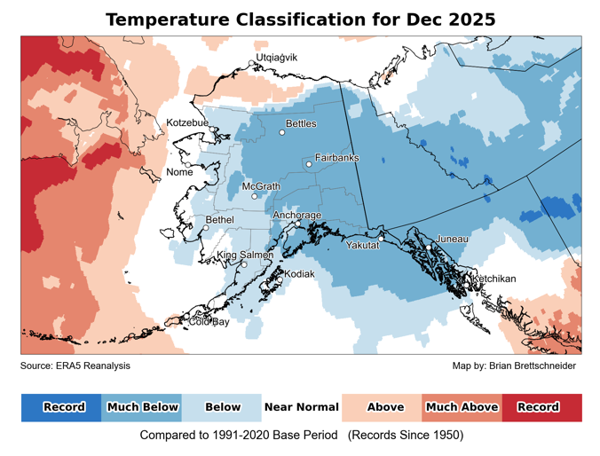
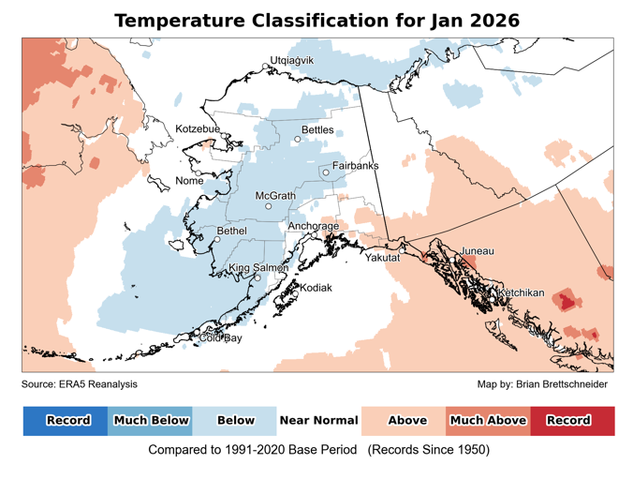
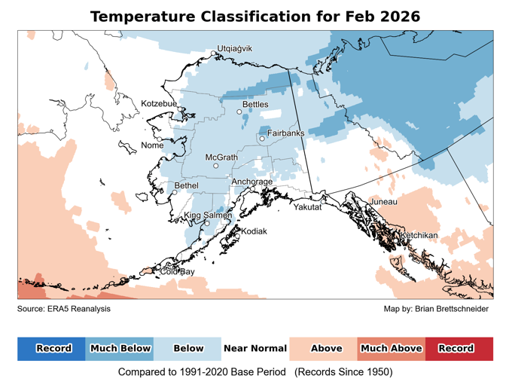
Monthly temperatures
December
January
February
Data: ERA5 courtesy of EMCWF/Copernicus
1991-2020 Baseline
Notes:
AK Summer: 45% of Alaska land area temp above normal, first summer since 2014 with less than half of the state warmer than normal
YT Summer: 4th summer in a row 100% above normal
NWT Summer: 99% above normal but lowest since 2021
AK Summer: 83% of Alaska land area above normal precipitation. Highest since 1998

Slide 7
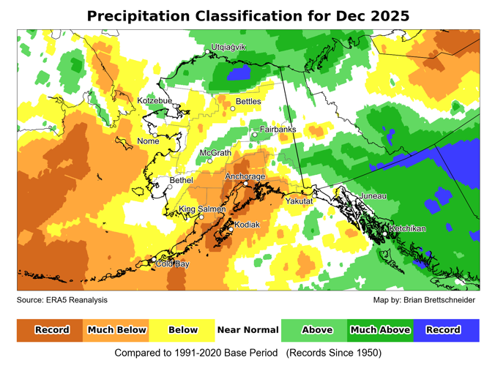
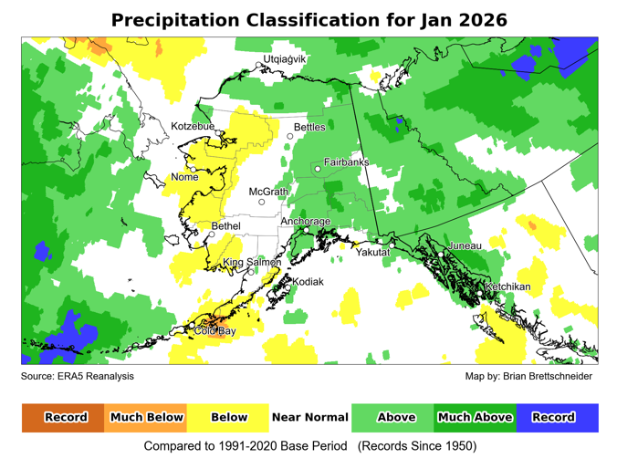
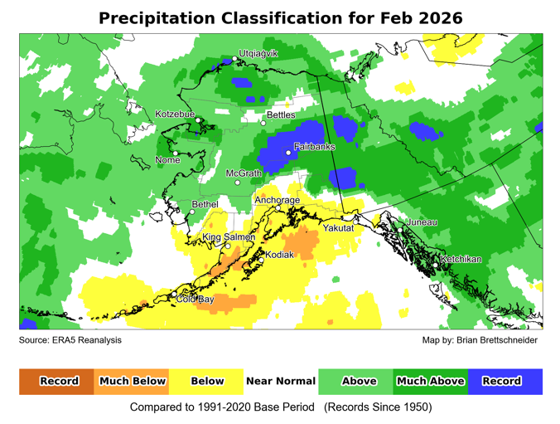
Monthly precipitation
December
January
February
Data: ERA5 courtesy of EMCWF/Copernicus
1991-2020 Baseline
Notes:
AK Summer: 45% of Alaska land area temp above normal, first summer since 2014 with less than half of the state warmer than normal
YT Summer: 4th summer in a row 100% above normal
NWT Summer: 99% above normal but lowest since 2021
AK Summer: 83% of Alaska land area above normal precipitation. Highest since 1998

Slide 8
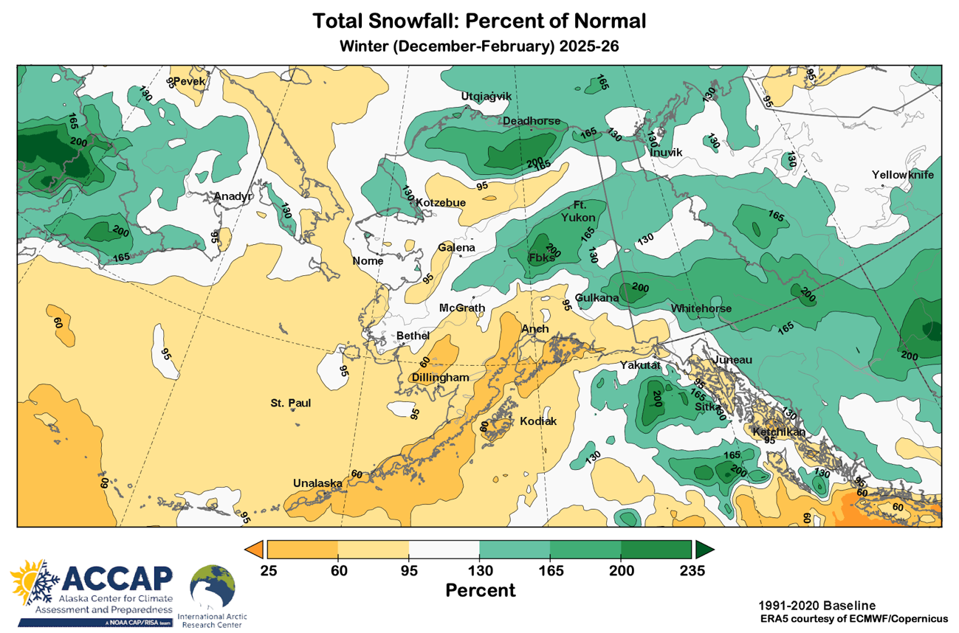
Winter 2025-26 snowfall

Slide 9
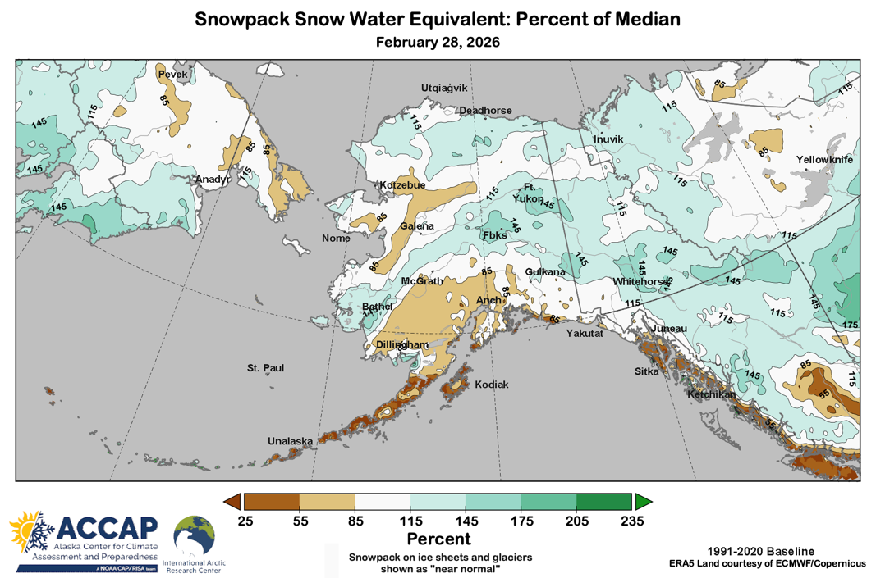
Late February 2026 Snowpack
Statewide
Above normal: North Slope, eastern Interior, lower Kusko
Below normal: much of SW Alaska, parts of western Alaska

Slide 10
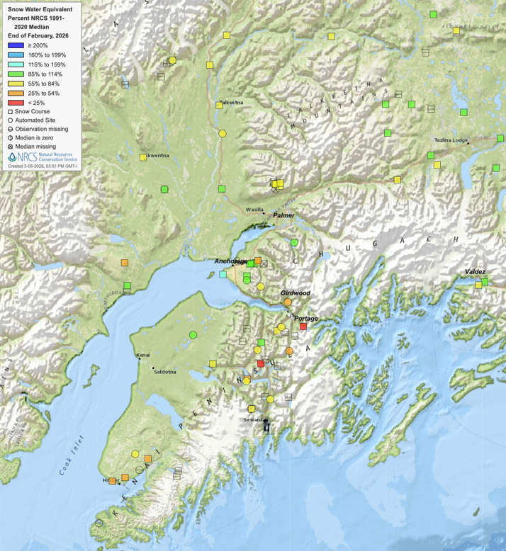
February 2026 Snowpack
Southcentral Focus
Anchorage area: near to above normal
Lower Susitna and northwest Kenai Peninsula: near normal
Mountains and middle Susitna: below normal
End of February snowpack
Source: NRCS

Slide 11
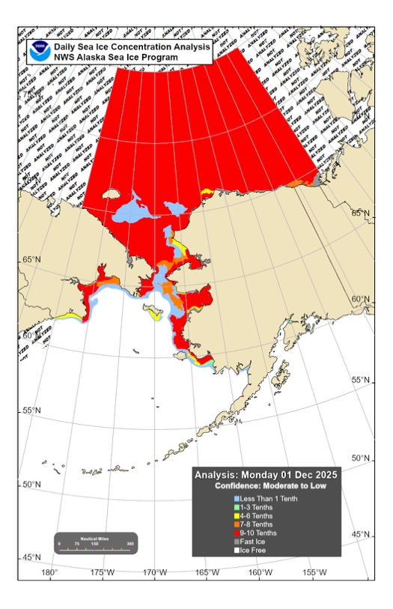
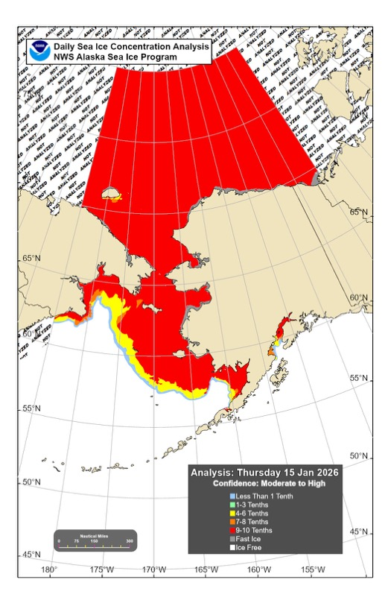

Ice near Alaska thru winter 2025-26
December 01
January 15
February 28

Slide 12
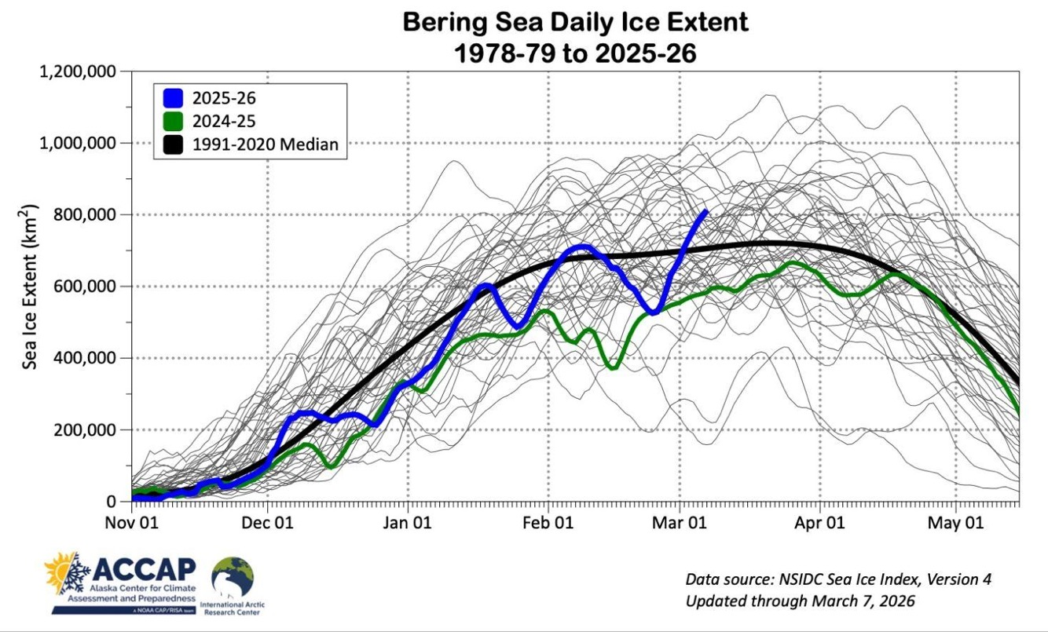
Bering Sea ice extent

Slide 13


Spring 2026 Outlooks
Arctic Sea Ice Experimental Outlook
Autumn surface temperatures
Autumn temperature and precipitation

Slide 14
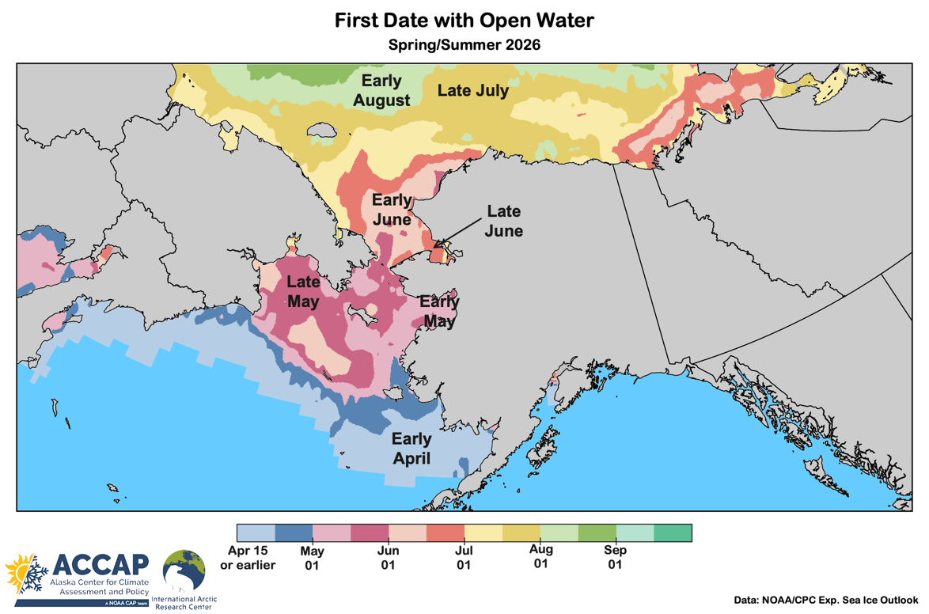
Sea ice outlook: Spring/Summer 2026
Data: NOAA/Climate Prediction Center Exp. Sea Ice Outlook
Outlook created from late February 2026 data

Slide 15
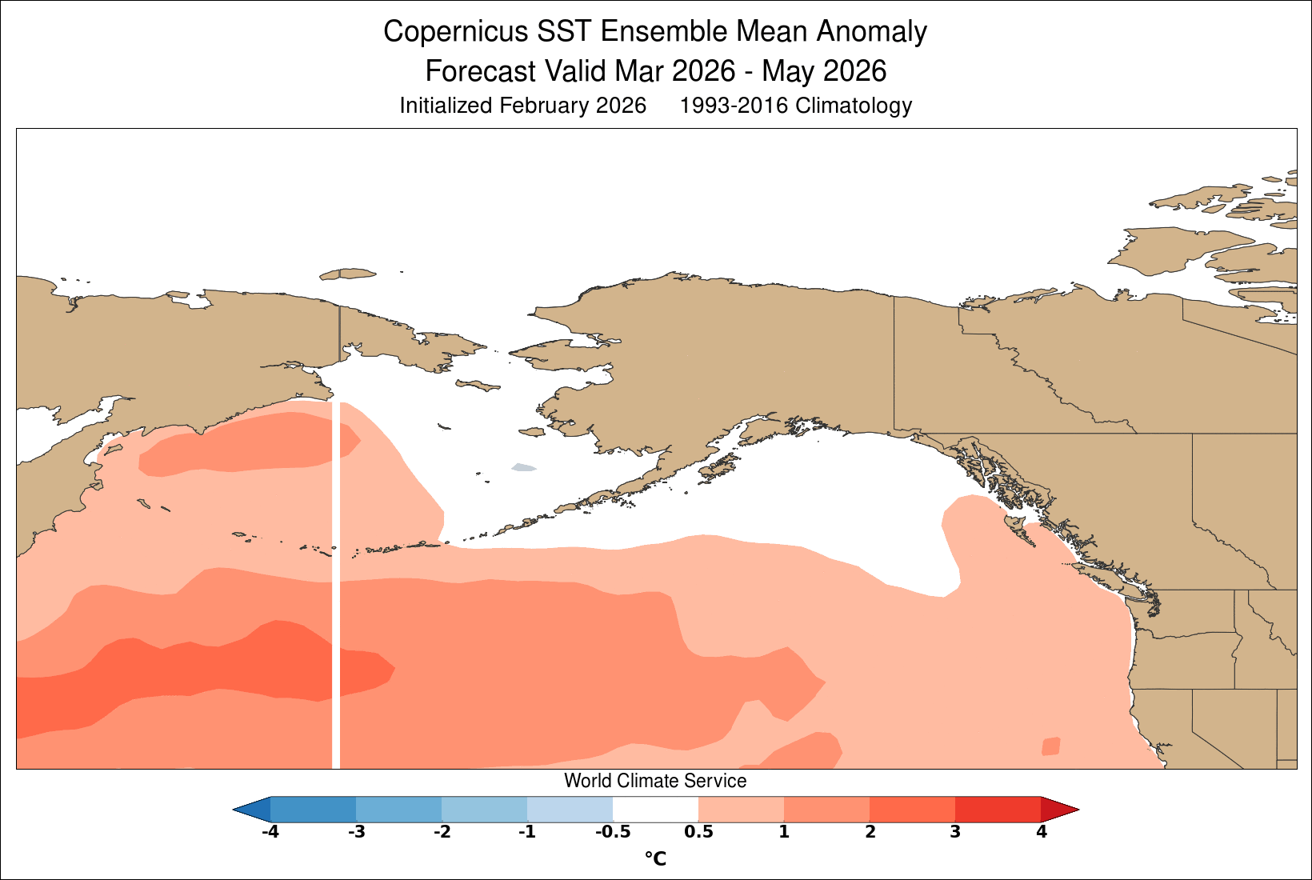
Sea surface temperature: spring 2026
Graphic courtesy World Climate Service

Slide 16
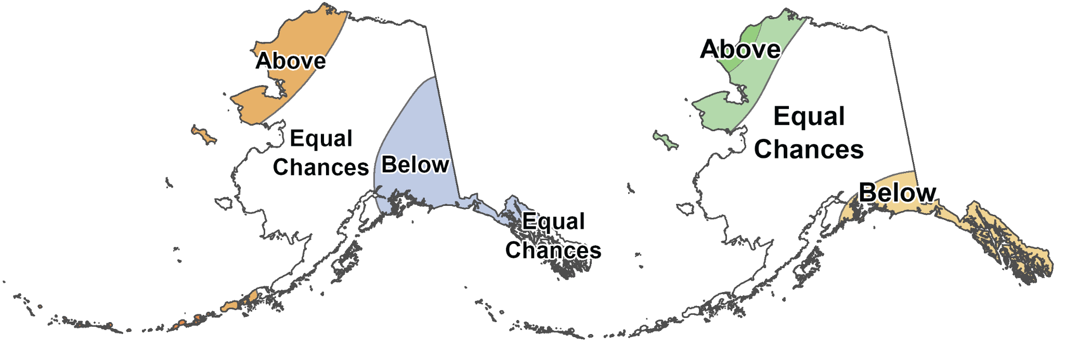
March through May 2026
NOAA Climate Prediction Center outlooks
Average Temperature
Total Precipitation
Outlook made in mid-November

Slide 17
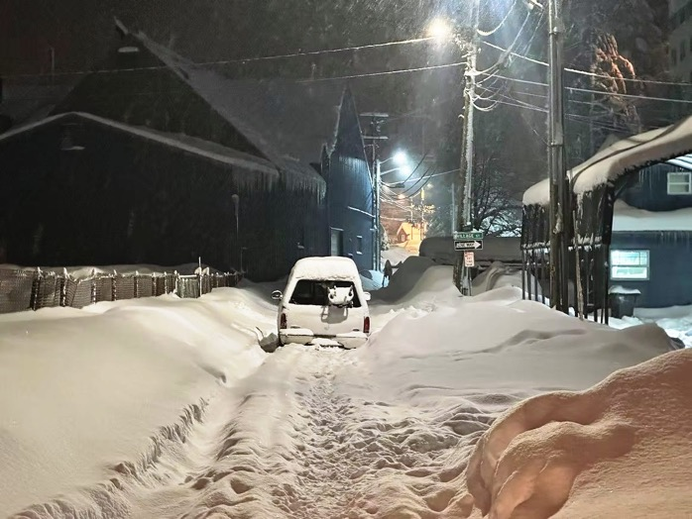
Thanks very much
Questions?
Unplowed street in Juneau
December 30, 2025
Photo credit: (Mark Sabbatini / Juneau Independent)

