Slide 1
The Extreme Sea Ice Season: 2017-18
Rick Thoman
Alaska Center for Climate Assessment and Policy
Alaska Tribal Conference on Environmental Management
Anchorage, Alaska
November 28, 2018

Slide 2
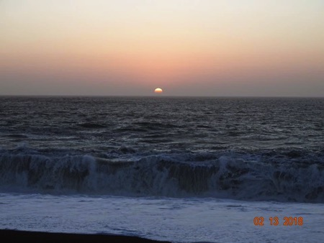
Sea Ice Highlights
Winter-Spring 2017-18
Latest ice-over of Chukchi Sea
Lowest Bering Sea Ice extent (by any measure)
Spring-Summer 2018
Earliest melt-out of Bering Sea ice
Very early meltout of southern Chukchi Sea ice
Kotzebue Sound open by Memorial Day
Slower melt than recent years northern Chukchi and Beaufort
Beaufort Sea ice minimum greatest since 2002
Gambell: Feb. 13, 2018
Photo: C. Irrigoo Jr.

Slide 3
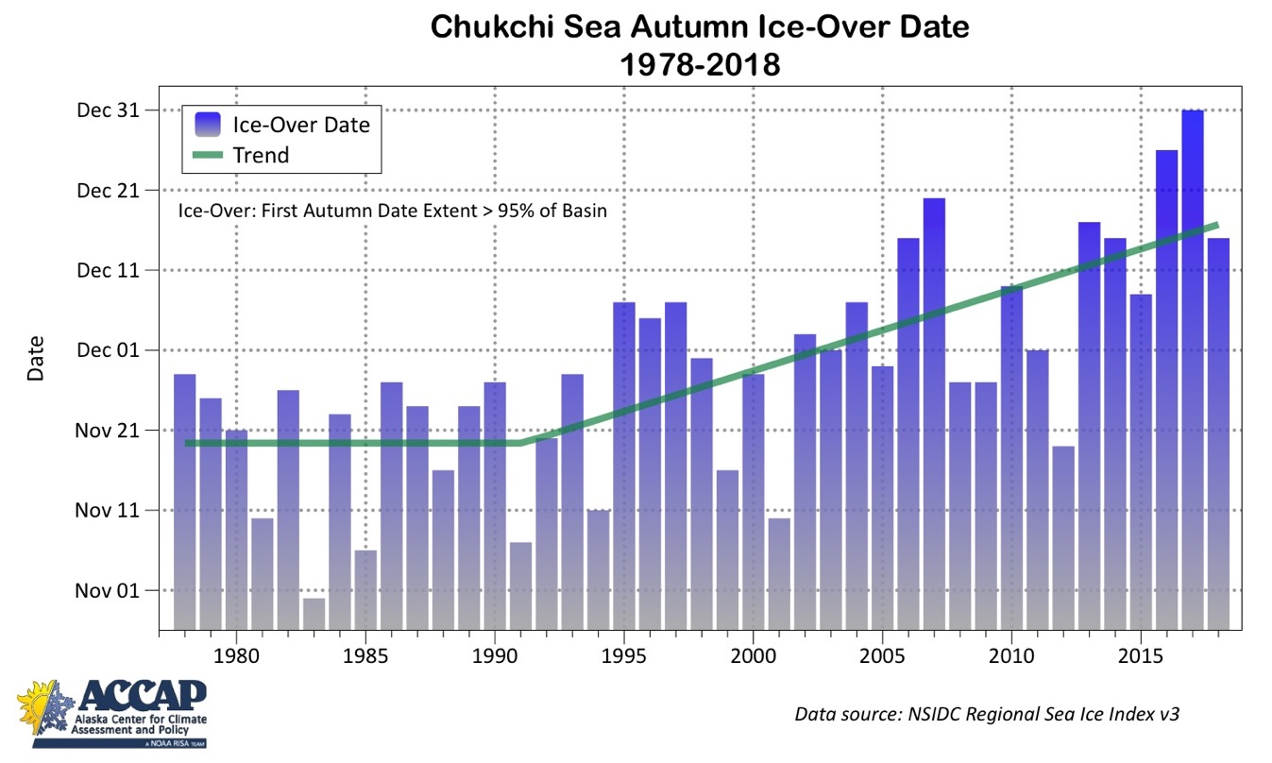
Chukchi Sea ice-over Coming much later

Slide 4
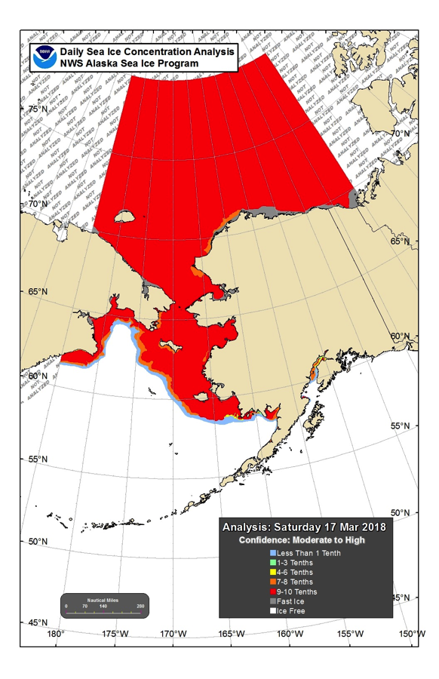
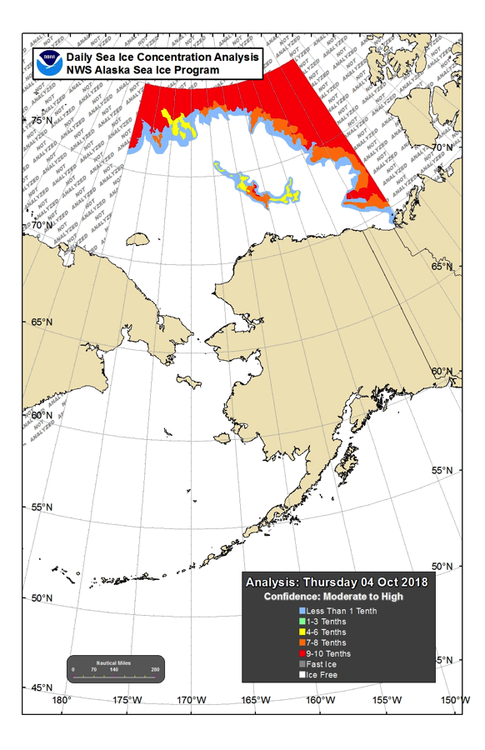
2018 near-Alaska Sea Ice Extent Extremes
March 17th
October 4th

Slide 5
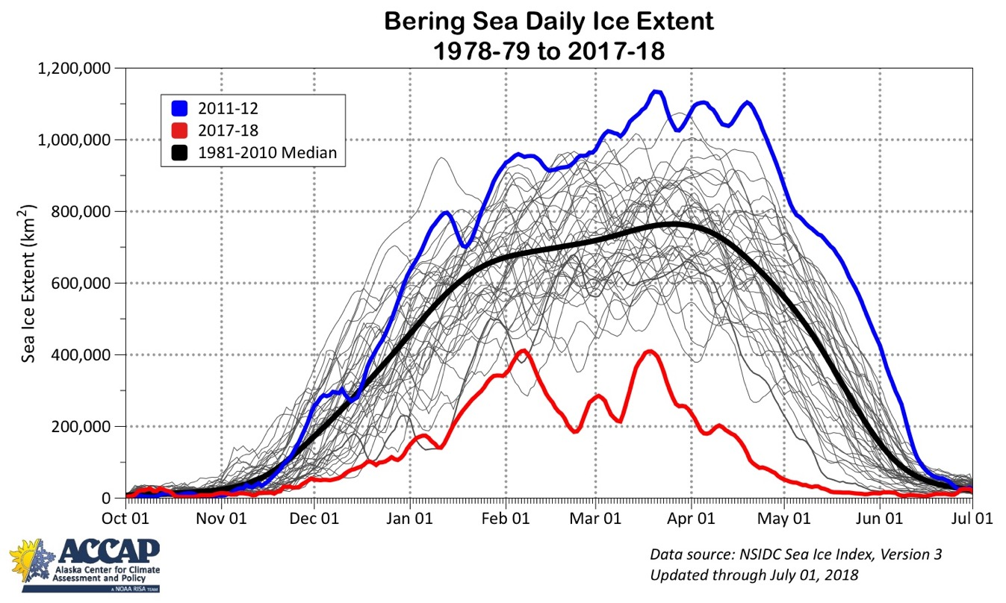
Bering Sea Daily Ice Extent 2017-18

Slide 6
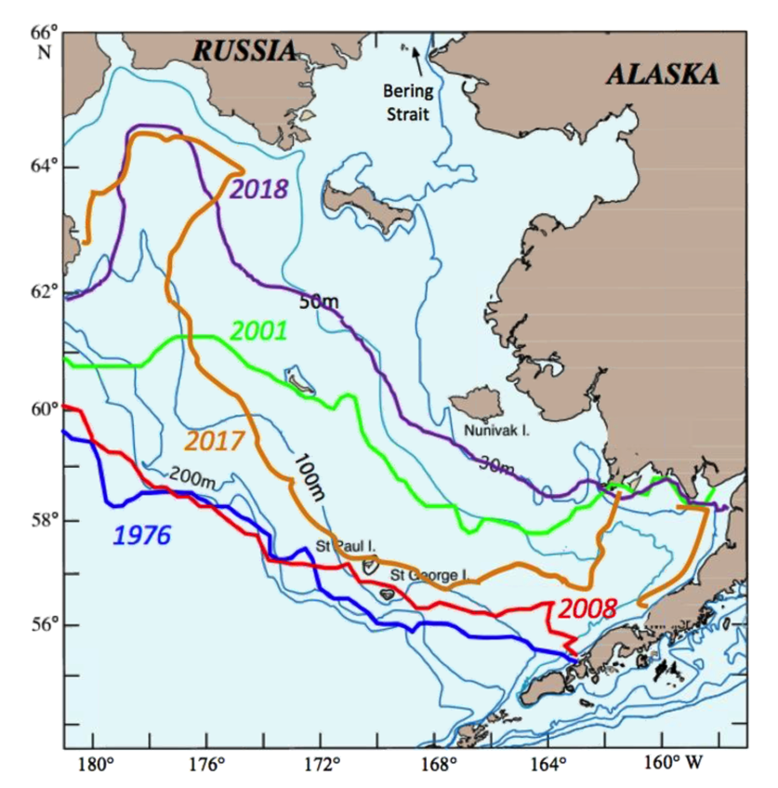
Seasonal Maximum Ice Extent: High vs. low Years
No ice both 2017 & 2018
Nome
Gambell
1976
2001
2008
2017
2018
Bethel
Courtesy P. Stabeno/NOAA
Cold Bay

Slide 7
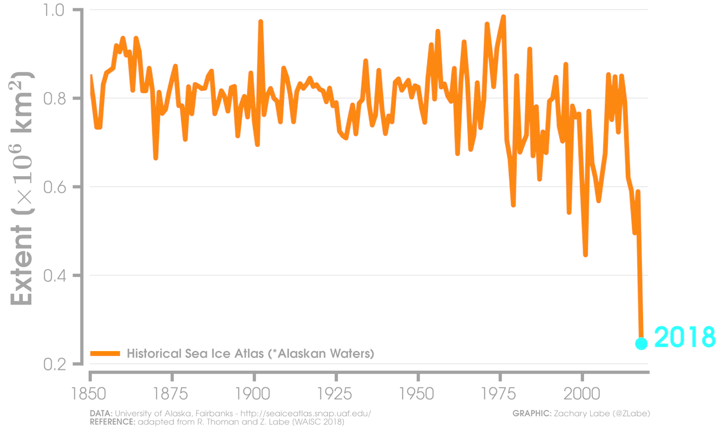
Feb-Mar: Bering Sea Ice extent
1850-2018
2018

Slide 8
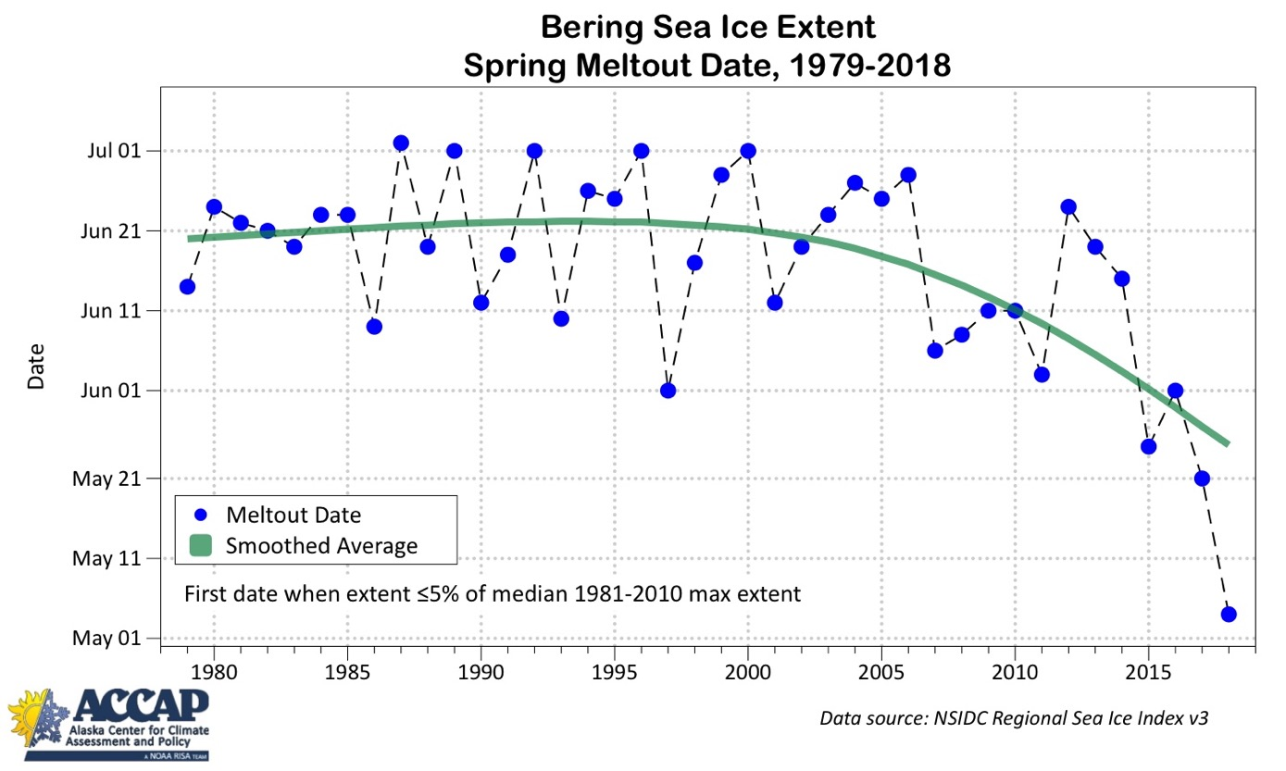
Record Early Bering Sea Ice Loss

Slide 9
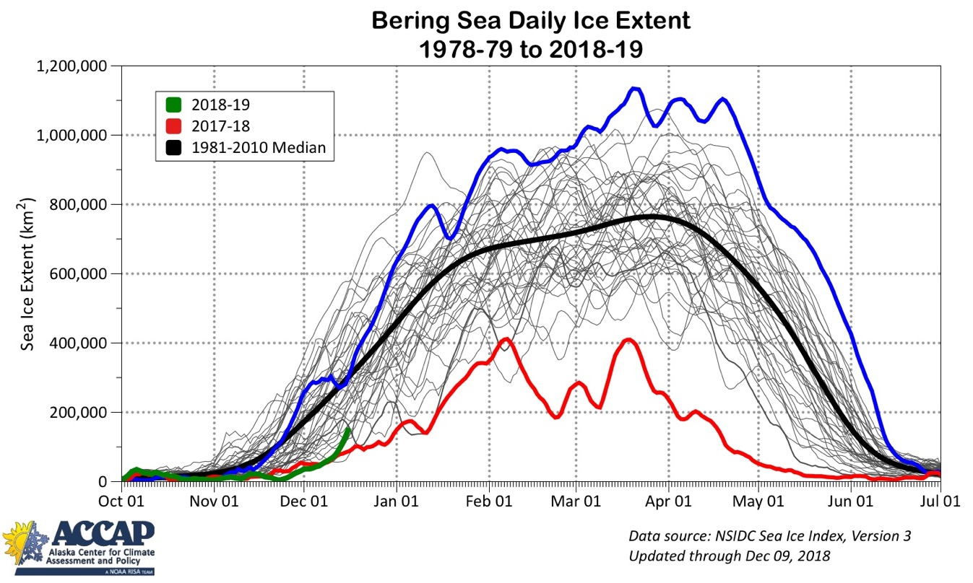
Bering Sea Daily Ice Extent 2018-19

Slide 10
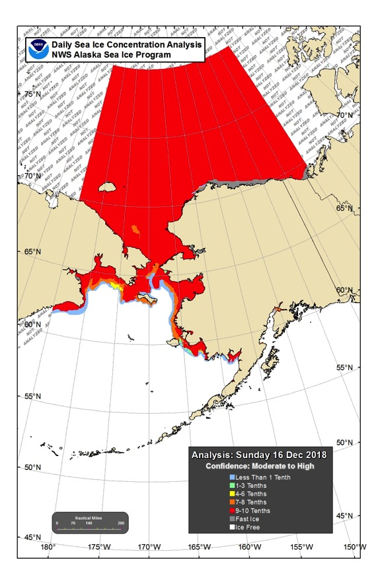
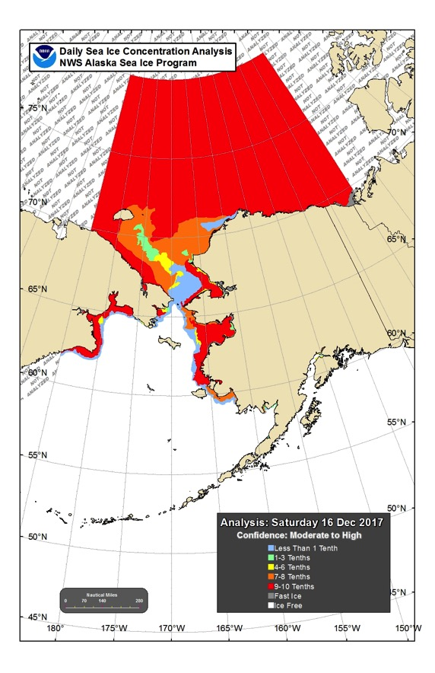
Current Sea Ice Concentration
Dec 16, 2018
Dec 16, 2017

