Slide 1
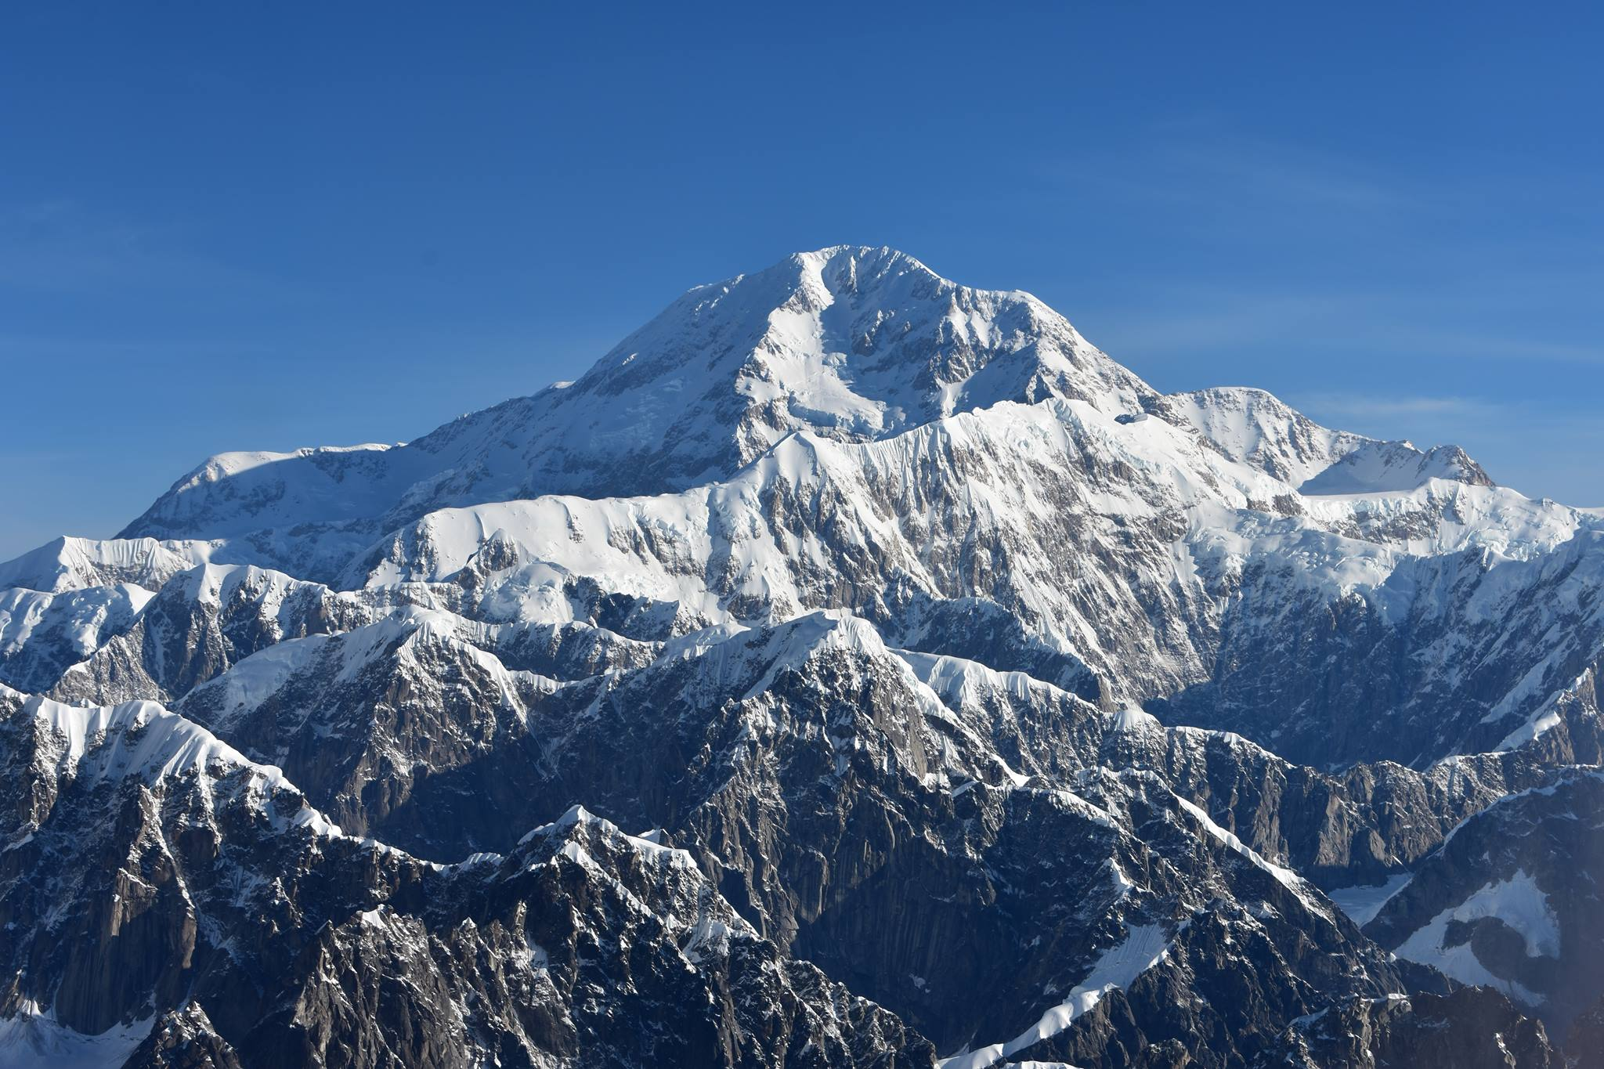
The State of Alaska’s
2020 River Watch Brief
April 21, 2020
Claude Denver, Response Manager
Alaska Division of Homeland Security and Emergency Management

Slide 2
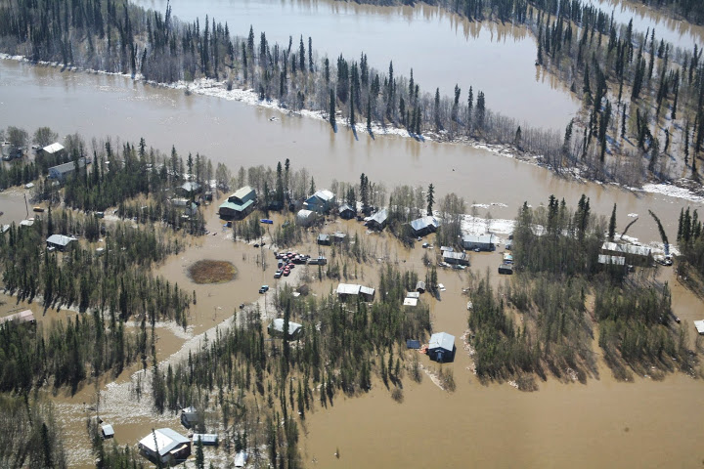
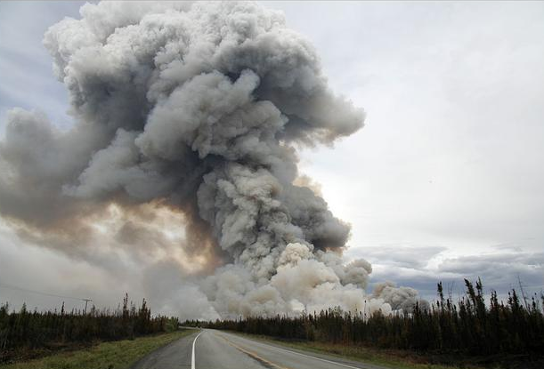
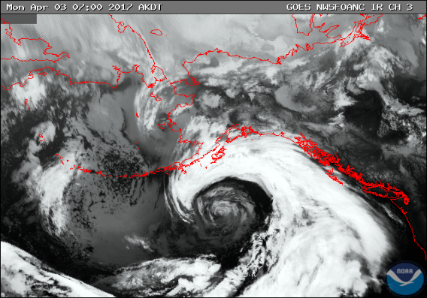
Introduction
The State of Alaska faces three major seasonal events each year:
    Spring Breakup Flooding (April – June)
    Wildfire (April – July)
    Fall Sea Storms (August – December)
This year, the ongoing response to the novel coronavirus (COVID 19) pandemic will be a challenge.
ready.alaska.gov
1-855-445-7131
disasterassistance.gov
1-800-621-3362

Slide 3
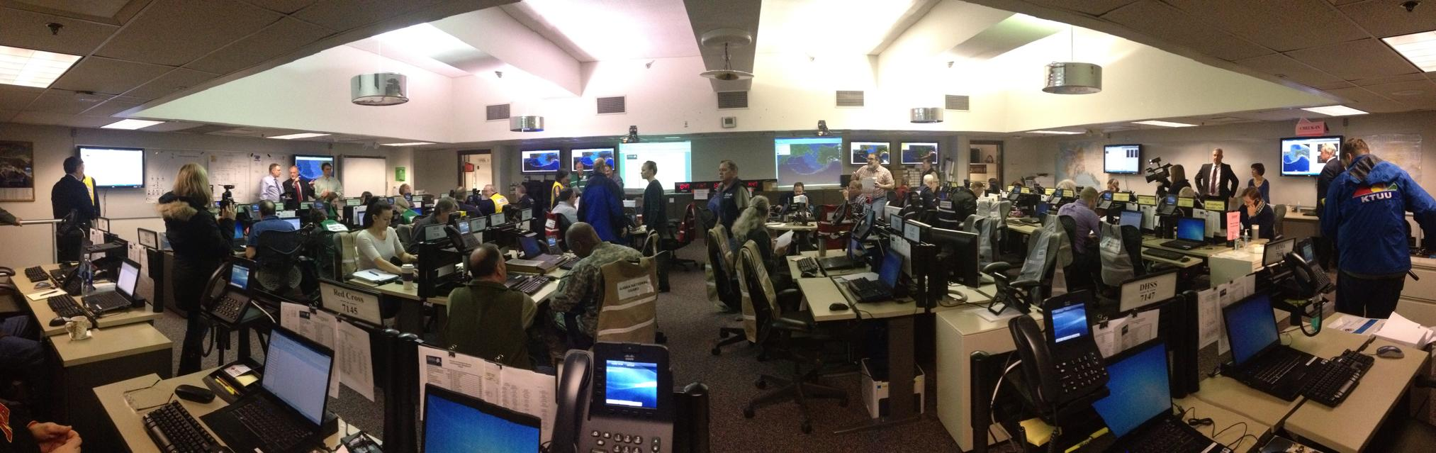
The Normal Disaster Situation in Alaska
DHS&EM has 60+ employees grouped in six sections (operations, plans, preparedness, disaster assistance, grants, and administration).
The State Emergency Operations Center responds to approximately 70 incidents a year.
Since the formation of FEMA in 1979, there have been around 265 declared state and/or federal disasters in the State of Alaska. That averages about six declared events per year.
  Spring Ice Jam flooding and seasonal storms and flooding constitute approximately half of all declared disasters since 1978.
Notes:
Disaster Breakdown (~250 declared events since 1978).
Ice jam floods
Fall sea storms and flooding
Building fires
Winter storms and flooding
Summer storms and flooding
Extreme cold/community utility freeze-ups
Wildfires
Generator/community power problems
Facility damage
All other, e.g., erosion, economic, Haz Mat releases, windstorms, landslide/avalanches, earthquakes, volcanic eruptions, communication problems, etc.

Slide 4
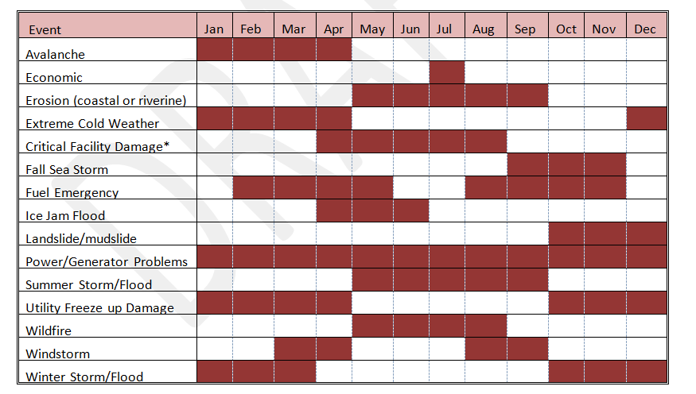
Alaska Disasters Timing
When They Typically Occur

Slide 5
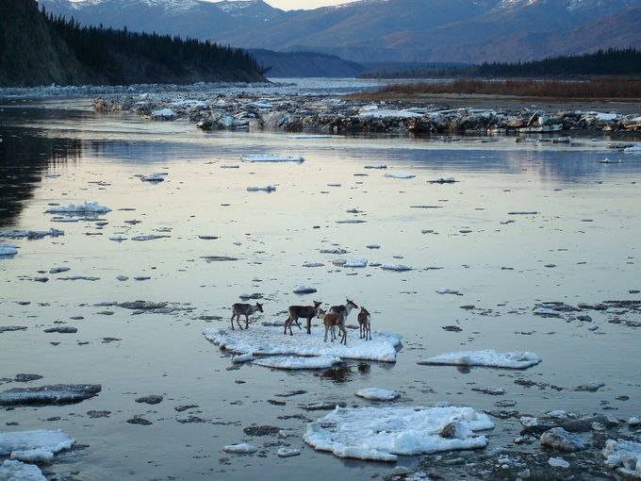

Slide 6
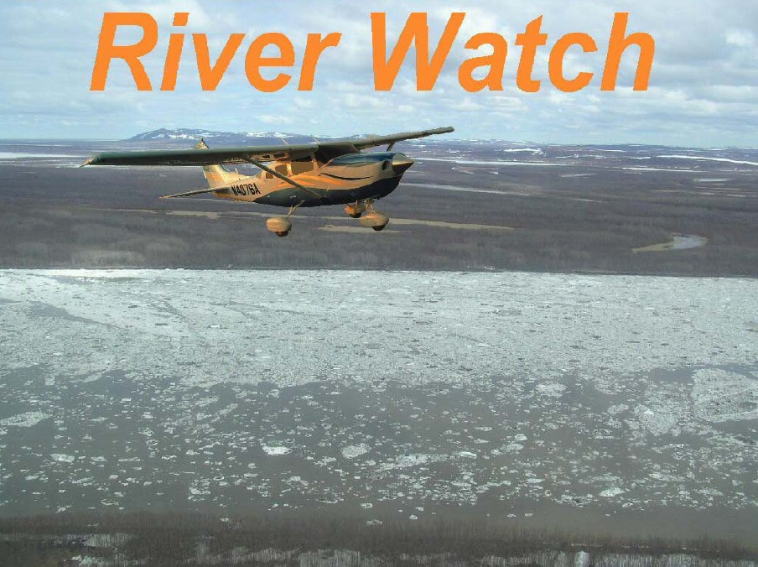
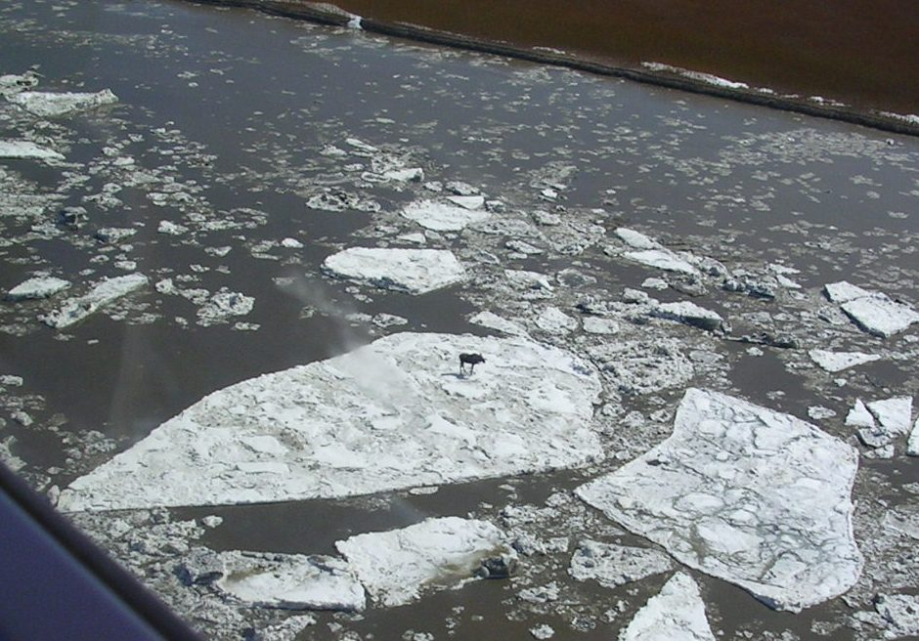
What is River Watch?
Each year, the State of Alaska DHS&EM and the National Weather Service (NWS) separately fund a joint program known as River Watch.
This program provides advance and emergency notification of imminent snowmelt and ice jam flooding to 75 Alaska villages, boroughs, and tribal councils.
The River Watch program generally began in the late 1960s with reconnaissance of the breakup process.
Seasonal river sanding of river stretches prone to ice jam formation in early 1980s.
By 1989, the program transitioned to the current aerial observation and early warning program.

Slide 7
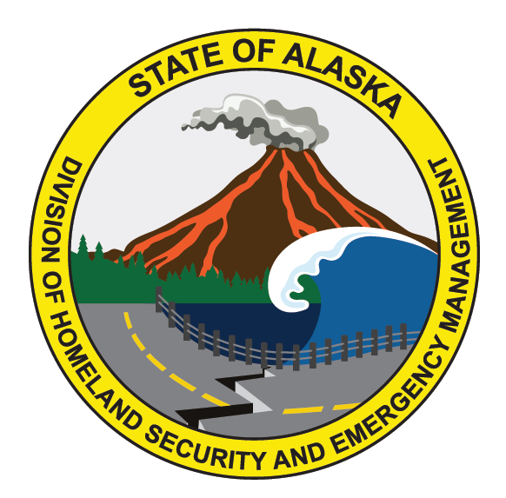
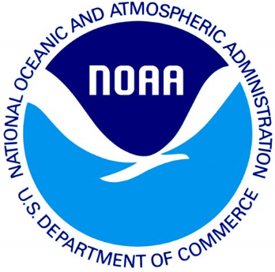
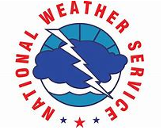
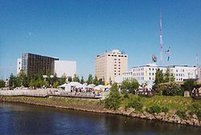
Who are the Major Participants in River Watch?
The Division of Homeland Security & Emergency Management (DHS&EM) the primary agency for statewide emergency management .
Alaska-Pacific River Forecast Center (APRFC) of the National Weather Service responsible for the scientific study, evaluation of weather, hydrology, and climate data, and information sharing.
River Neighbors are riverine communities that collect data before, during, and after flooding occurs. Local Pilots are also essential to the River Watch field program.
Notes:
Local Pilots are also essential to the River Watch team.

Slide 8
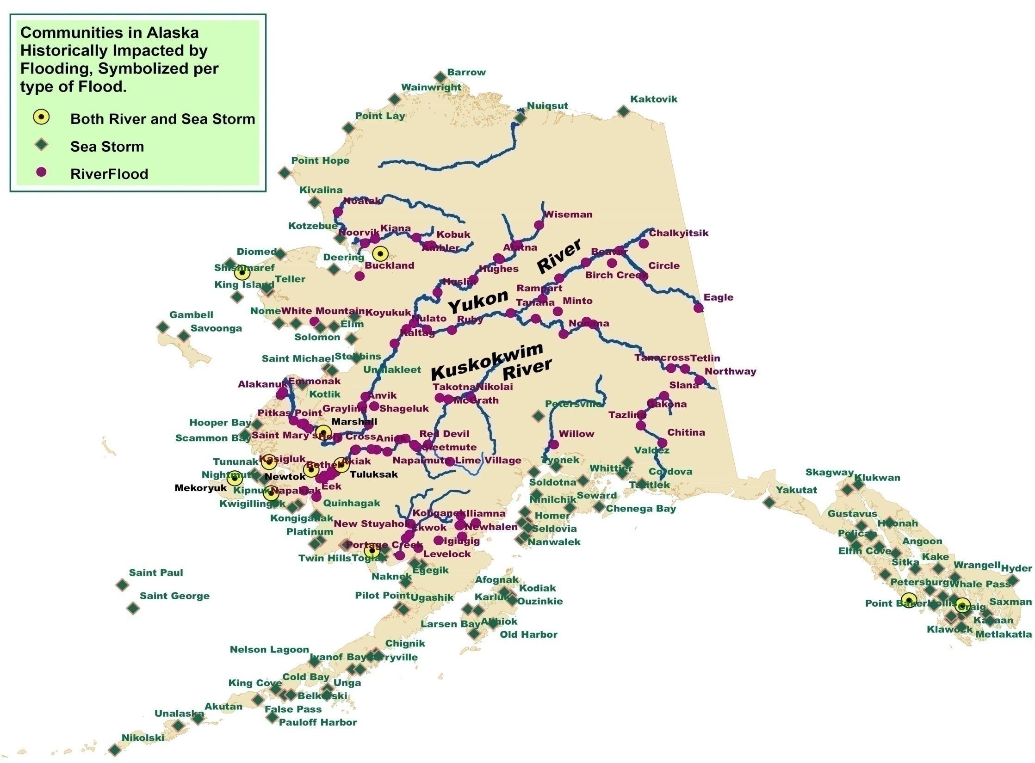

Slide 9
Ice Jam Flooding in Alaska Since 1978
Major ice jam events happen frequently; generally every 2 – 3 years.
Most common locally-declared disaster
42 state- and/or or federal-declarations over this timeframe
Most events involve more than one community:
  Over ten communities were included in state and/or federal declarations in 1989, 1991, 2002, and 2009.
  Five or more communities were included in state and/or federal declarations in 1992, 1994, 2006, and 2013.
  47 different communities have experienced significant ice jam damages.
These events are extremely costly.
  The State of Alaska also has provided tens of millions in public and individual disaster assistance funding due to ice jam flooding events.
Notes:
Communities most flood prone producing state/fed declarations include: Emmonak (9), Alakanuk (8), Aniak (7), Red Devil (6), plus nine other communities have had 3 – 4 decs each. Between 1982 – 1995, major flood happened every year except two (1986 and 1993). Between 2001 – 2013, major flood in eight years.
The total amount of State disaster assistance provided for the 2013 Spring Floods alone exceeded $25M.

Slide 10
Significant Ice Jam Flooding Events Since 2001
Year | Significance of Flooding
2001 | 2001 Middle Yukon Flood – State disaster.
2002 | 2002 Interior Floods – State and Federal disaster.
2003 | 2003 Salcha Flood – State disaster.
2005 | 2005 Spring Floods – State disaster.
2006 | 2006 Spring Floods – State and Federal disaster.
2008 | No disasters declared; minor to moderate flooding occurred in Salcha, Gakona, Old Minto, Tolovano, Quinhagak, Buckland, Kobuk, Alakanuk, and Emmonak.
2009 | 2009 Spring Floods – State and Federal disaster.
2010 | 2010 Buckland Flood – three days of flooding, but no disaster declared.
2011 | 2011 Spring Floods – State and Federal disaster.
2012 | No disasters declared; moderate flooding in Salcha and Minto and local declarations for response actions at Kwethluk, Napaskiak, and Mountain Village.
2013 | 2013 Spring Floods – State and Federal disaster
2014 | Low statewide flood threat, but there was some moderate flooding in Circle.
2015 | Low statewide flood threat, but minor flooding reported in Ft. Yukon and Noorvik
Notes:
In the past 15 years or so, the State of Alaska has experienced an almost continuous sequence of declared ice-jam flood disasters. With the exception of 2000, 2004, 2007, 2016, and 2017.

Slide 11
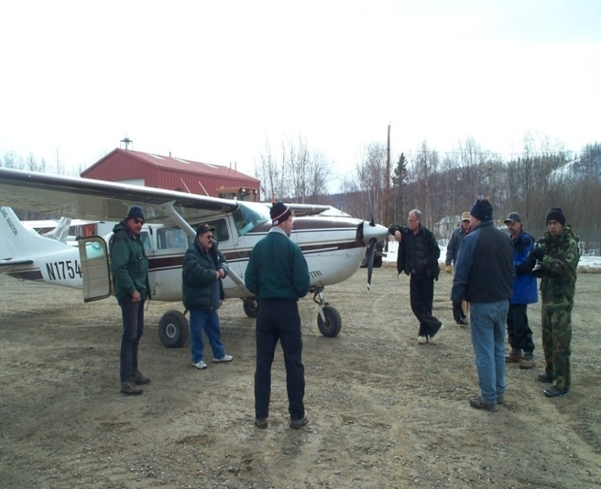
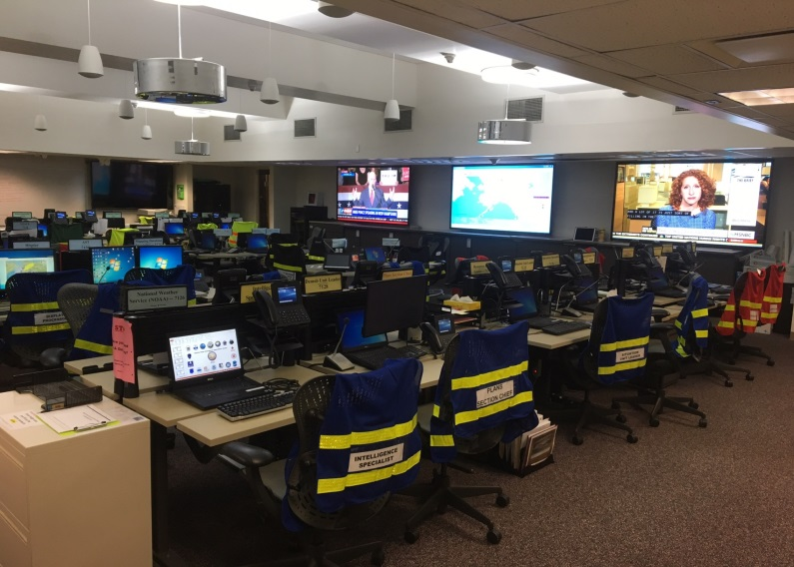
River Watch Field Team
River Watch teams deploy based on:
  National Weather Service’s reports and forecasts.
  Historical data.
The Team is normally comprised of:
  DHS&EM emergency management specialist.
  NWS/APRFC hydrologist.
  Local pilot with experience in River Watch operations.
Deployed teams are supported by the State Emergency Operations Center.

Slide 12
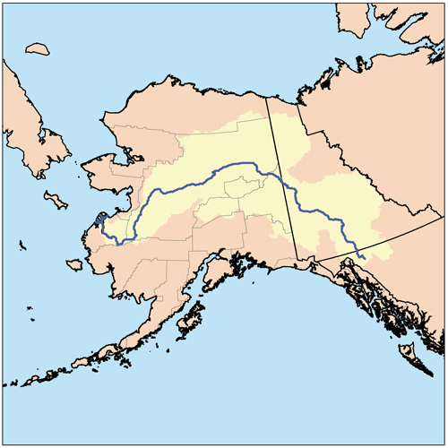
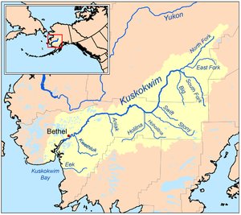
Primary Areas of Operation
The Yukon River (1,980 total miles long/ 1,210 miles long in Alaska) is divided into three segments that are flown as the river breaks up;
  Upper Yukon/Tanana - based out of Fairbanks and/or Eagle
  Middle Yukon/Koyukuk – based out of Galena
  Lower Yukon – based out St. Mary’s
The Kuskokwim River (702 total miles long but <500 miles are typically flown) is the longest free-flowing river in the United States, and is divided into two segments:
  Upper Kuskokwim – based out of Aniak
  Lower Kuskokwim – based out of Bethel.
Notes:
Upper Yukon Segment (Eagle to Tanana) – 520 river miles; Middle Yukon Segment (Tanana to Holy Cross) – 420 river miles; Lower Yukon Segment (Holy Cross to mouth) – 270 river miles. Upper Kusko Segment (Nikolai to Aniak) – 310 river miles; Lower Kusko Segment (Aniak to mouth) – 185 miles.

Slide 13
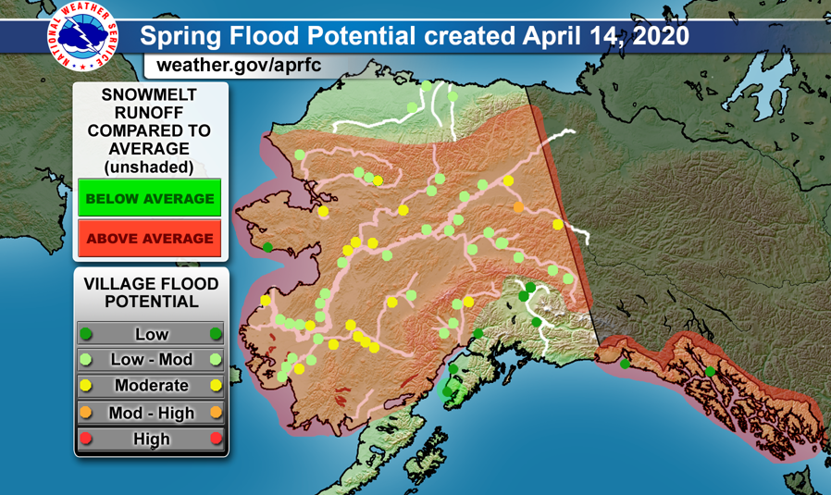
Spring Flood Potential

Slide 14
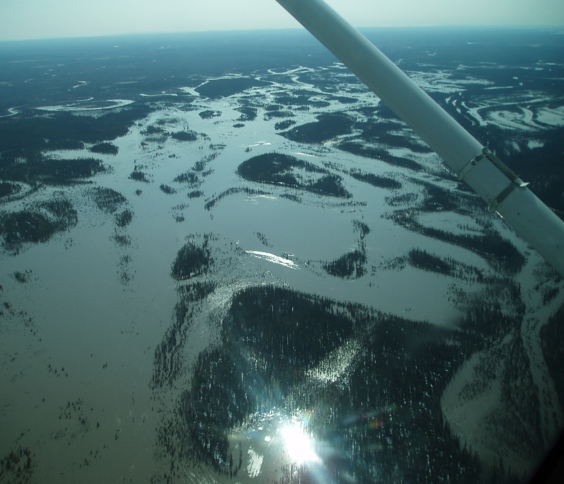
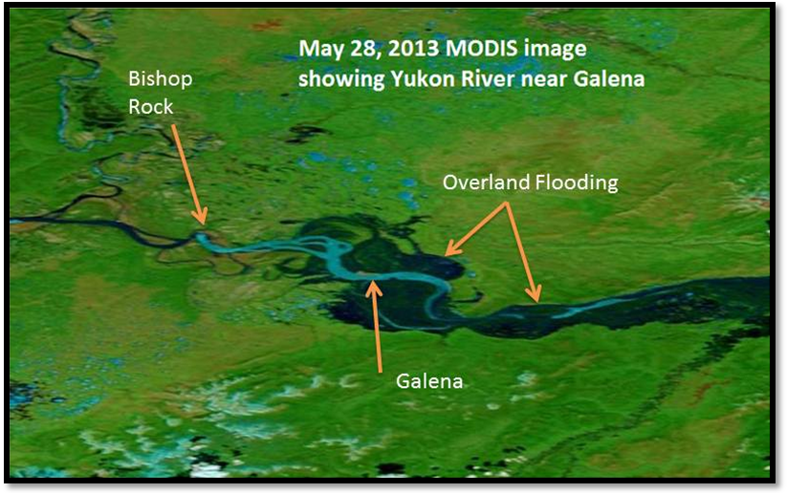
Galena 2013

Slide 15
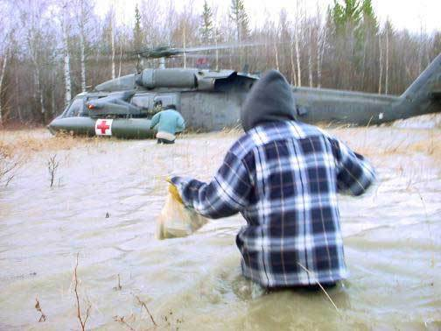
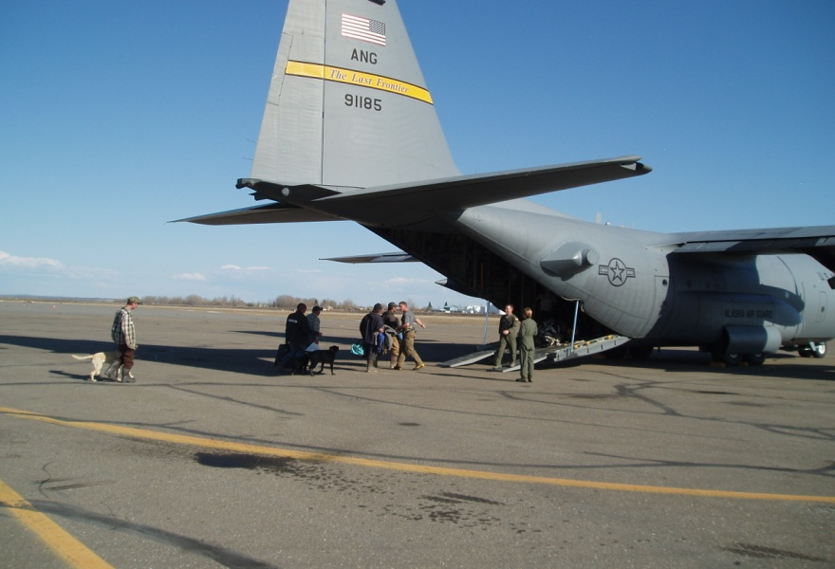
Evacuation of At-Risk Persons
Evacuation planning is an integral part of on-site technical assistance
Two thirds of Alaskan communities are in unorganized areas and may need help with evacuation planning
There is a difference between rescue and evacuation:
  Rescue – immediate life safety
  Evacuation – potential or expected life safety.
Old Minto Recovery Camp, 2008
Galena, 2013
Notes:
that involves assessing the threat, the area involved, and setting a workable timeframe
Recent evacuation efforts:
DHS&EM coordinated evacuations in Alakanuk, Koyukuk, Hughes, Emmonak and Alakanuk in 2006
An AKNG helicopter rescued several residents of the Old Minto Recovery Camp in May 2008
AKNG evacuated 38 persons from Galena following their catastrophic communitywide flooding in May 2013.

Slide 16
Claude Denver
Response Manager
Alaska Division of Homeland Security and Emergency Management
claude.denver@alaska.gov

