Slide 1



LEO Network Meeting
Winter 2021-22 Climate Review and Spring 2022 Outlook
Rick Thoman
Alaska Center for Climate Assessment and Policy
University of Alaska Fairbanks
March 15, 2022

Slide 2
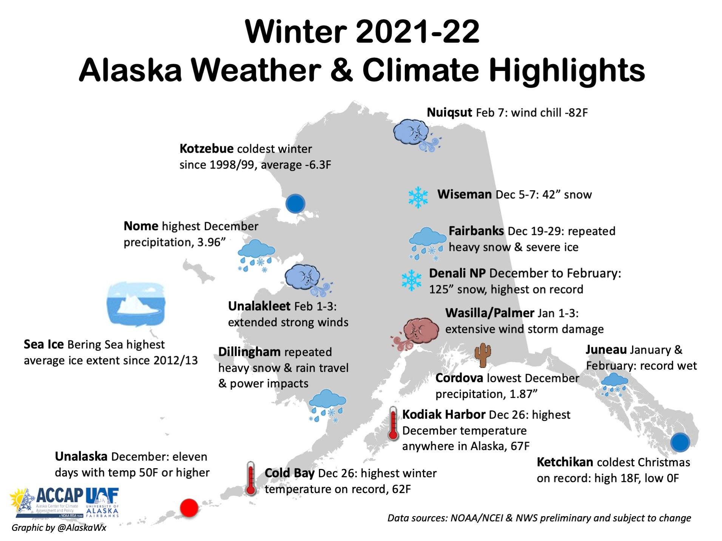

Slide 3
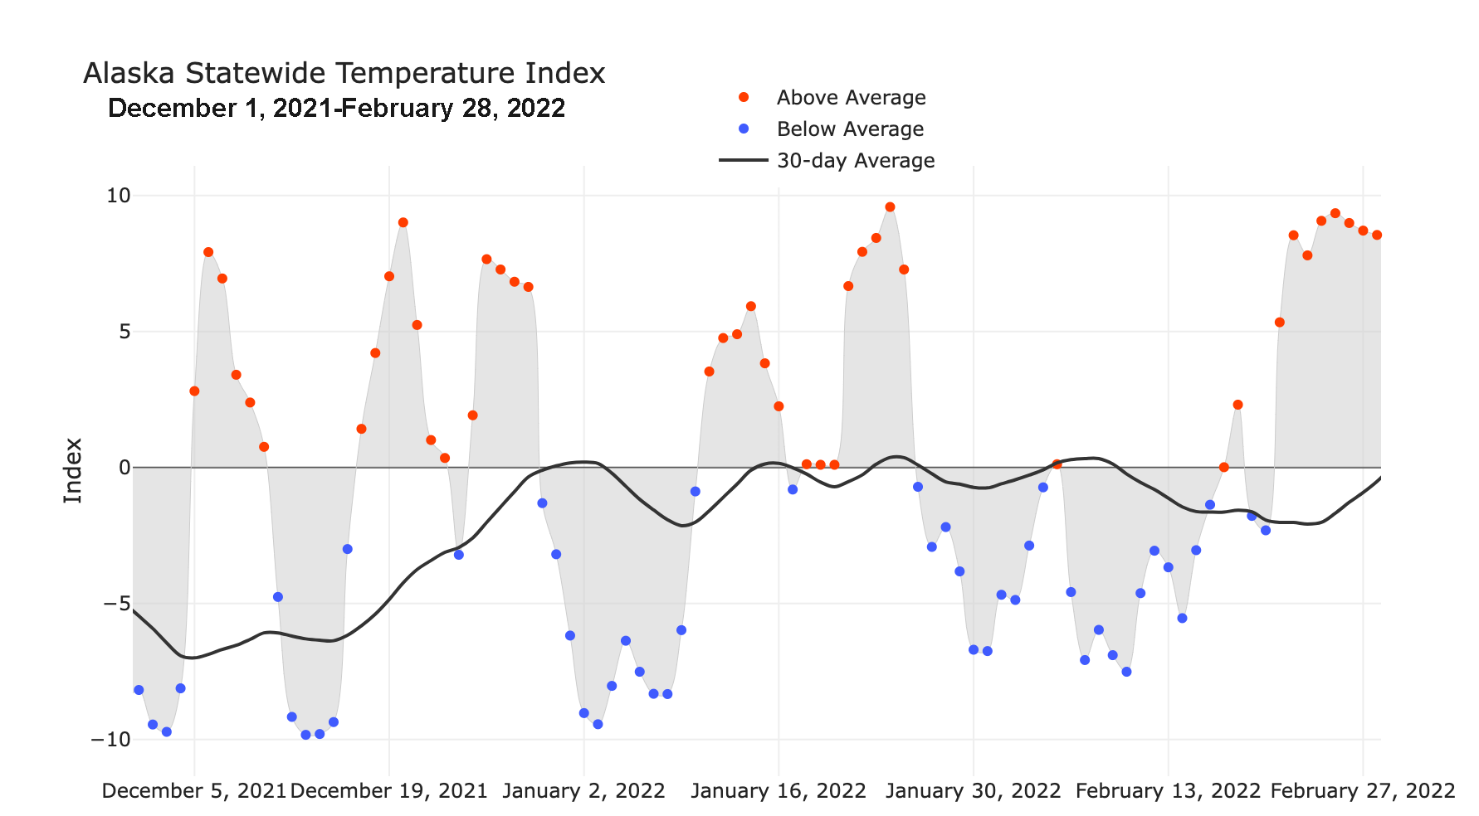

Alaska Daily Temperature Index
Online: http://accap.uaf.edu/tools/statewide-temperature-index

Slide 4
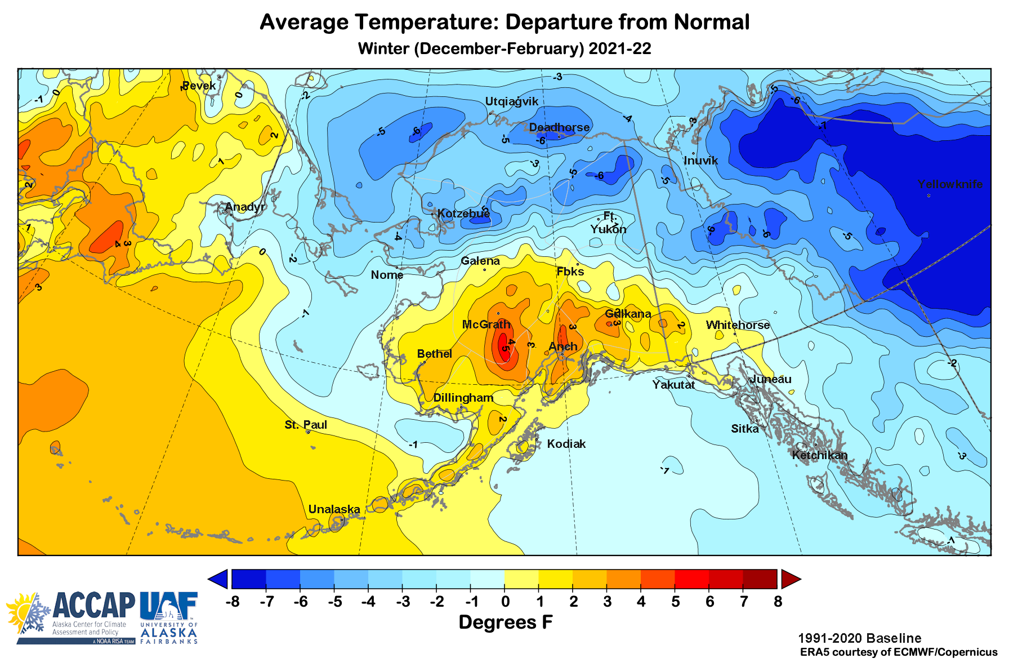
Winter Temperatures
Data: ERA5 courtesy of EMCWF/Copernicus
1991-2020 Baseline

Slide 5
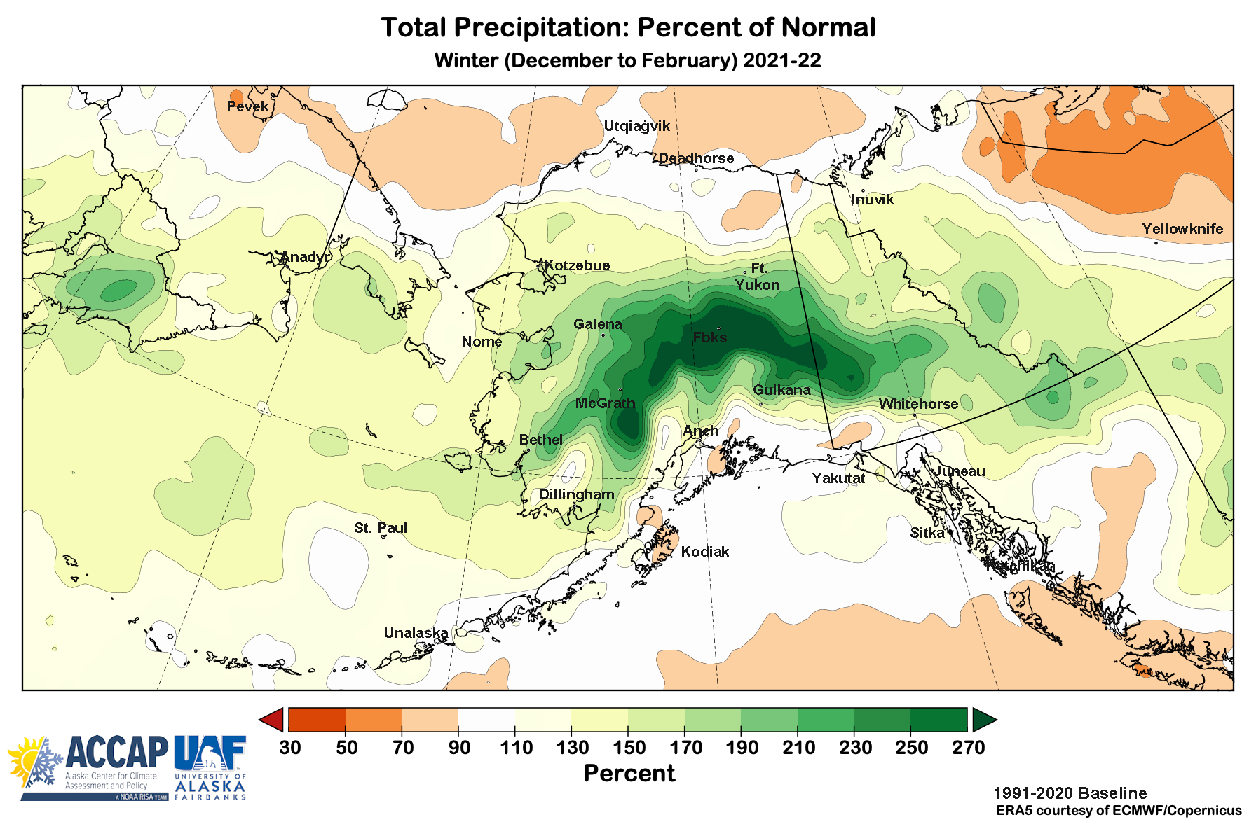
Winter Precipitation

Slide 6
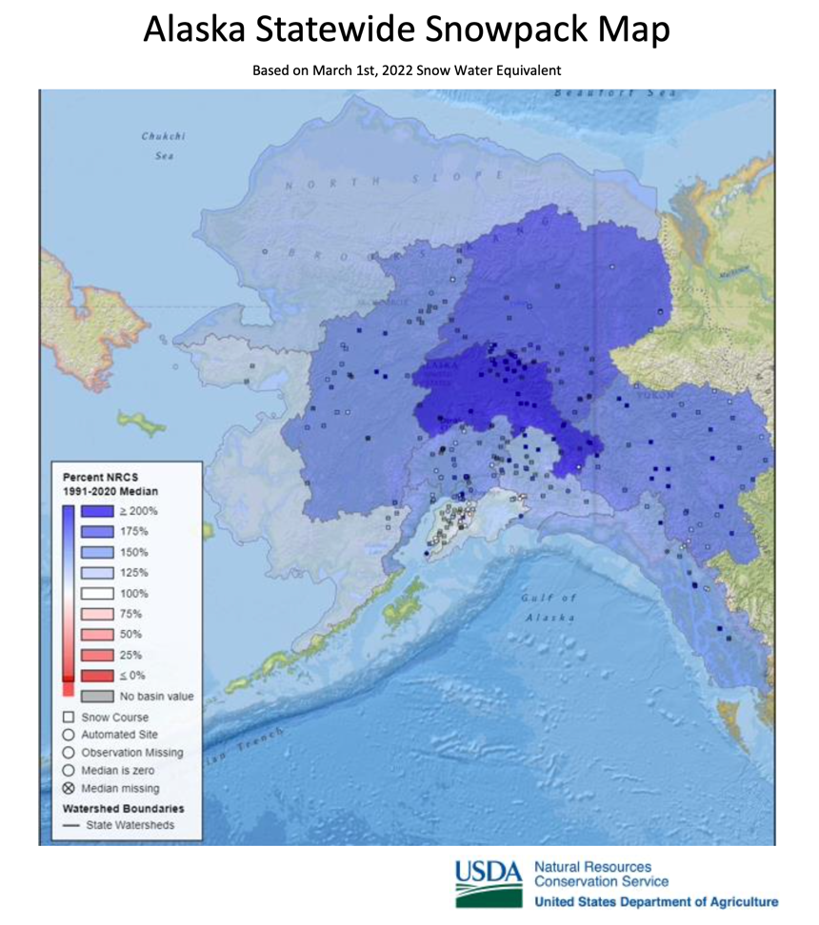
Snowpack is Very High

Slide 7
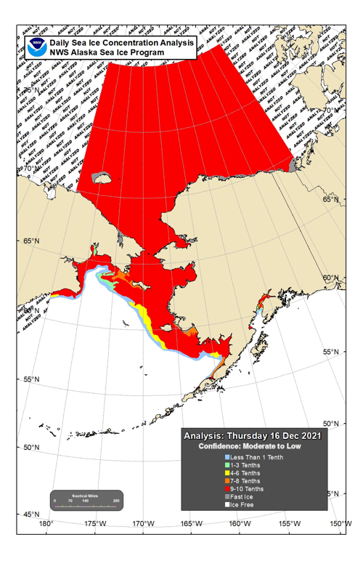
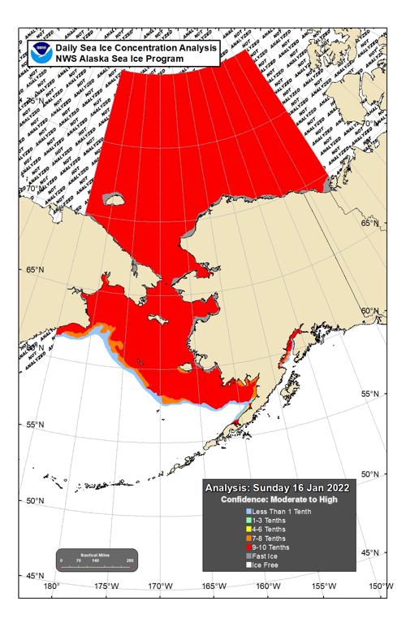

Sea Ice Winter 2021-22
Dec 16
Jan 16
Feb 15

Slide 8
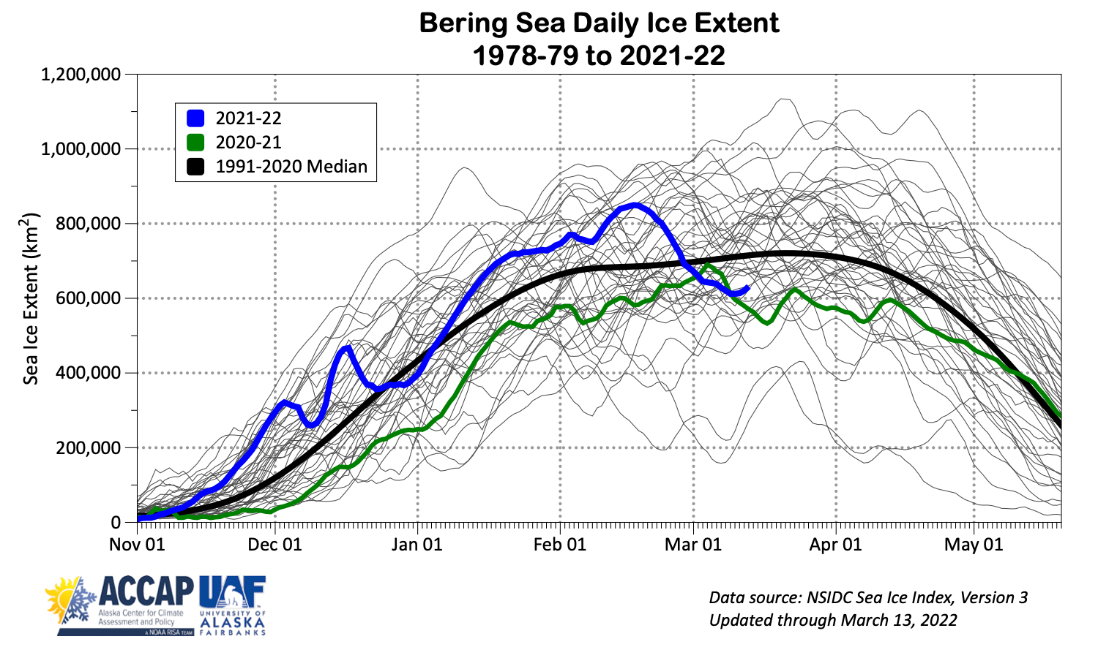
Bering Sea Ice Extent

Slide 9
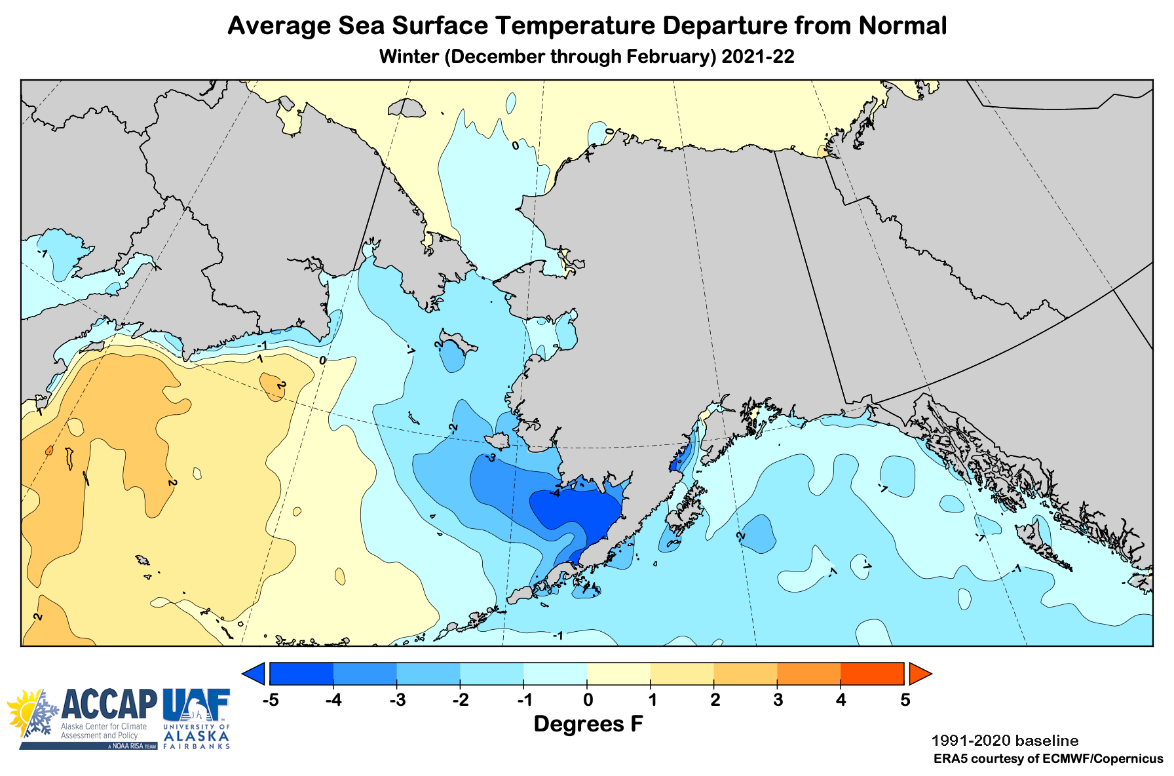
Winter 2021-22 Ocean Temperatures

Slide 10
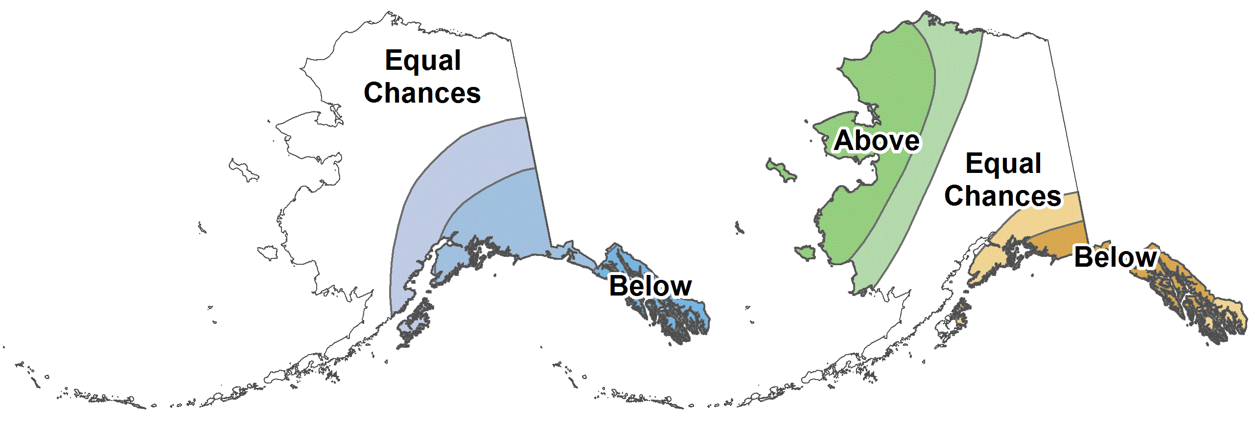



CPC March-May 2022 Outlook
33%
33%
33%
45%
33%
22%
33%
33%
33%
25%
33%
45%
12%
33%
55%
30%
33%
37%
33%
33%
33%
25%
33%
45%
30%
33%
37%
37%
33%
30%
Above%
Normal%
Below%

Slide 11
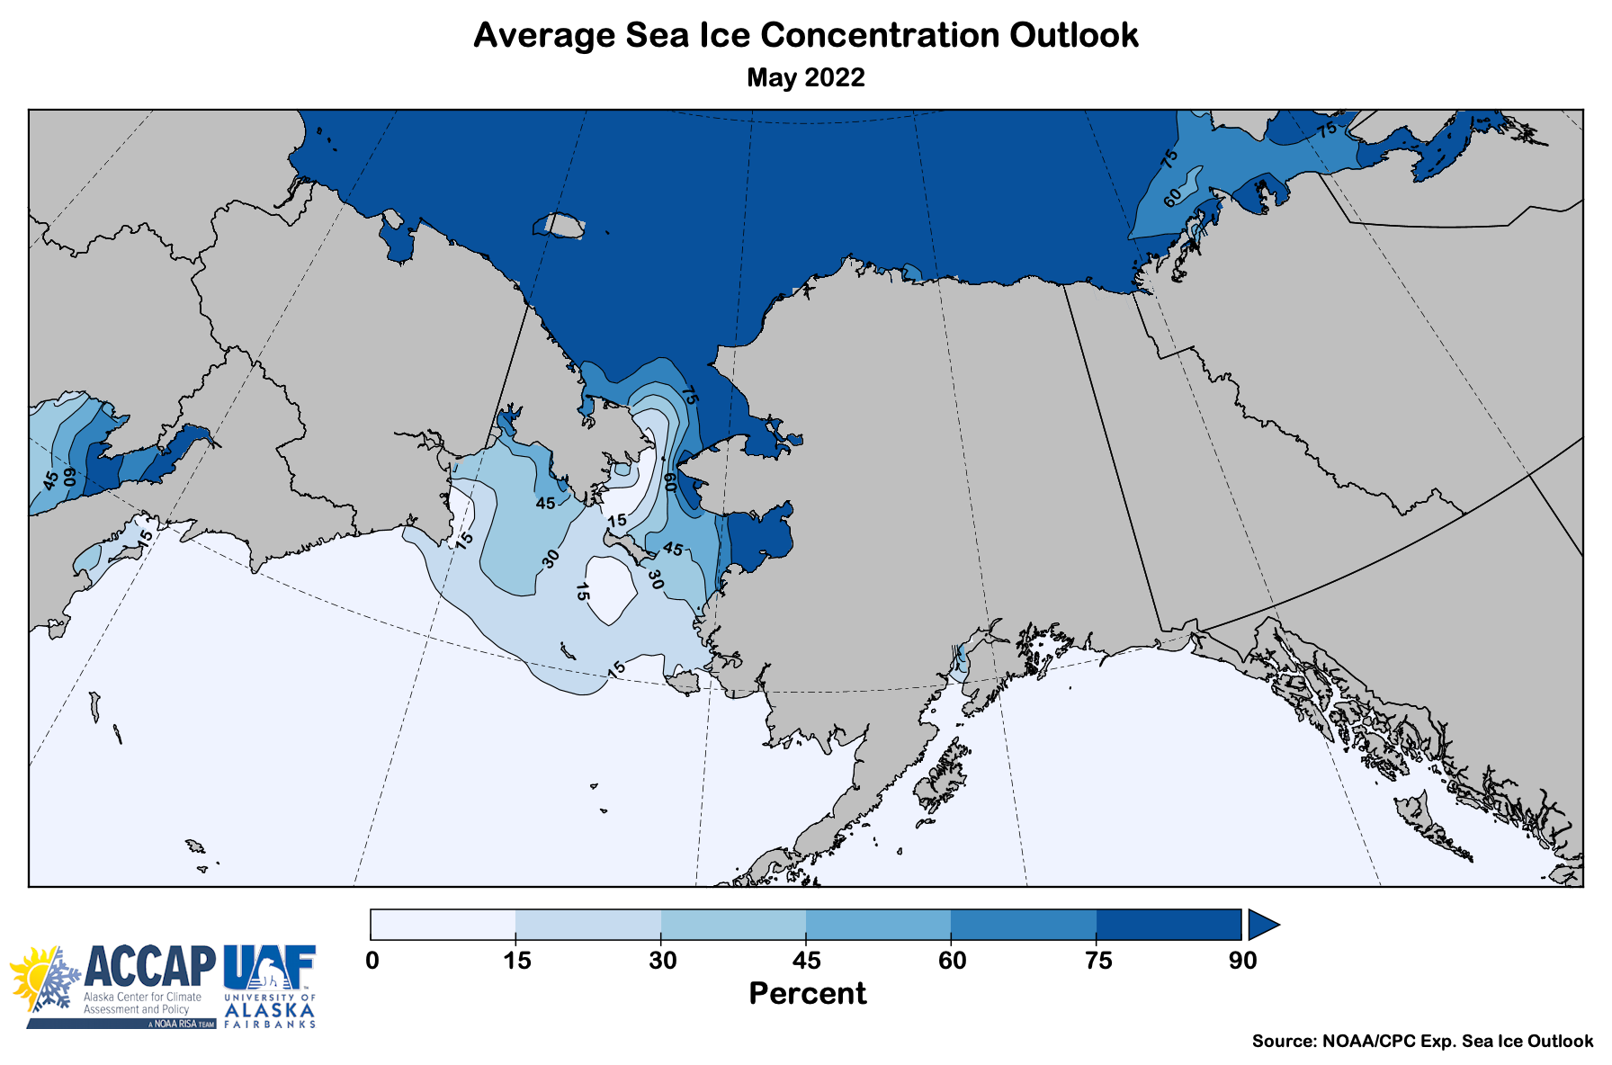
Spring 2022 Sea Ice Outlook
Data: NOAA/Climate Prediction Center Exp. Sea Ice Outlook

Slide 12
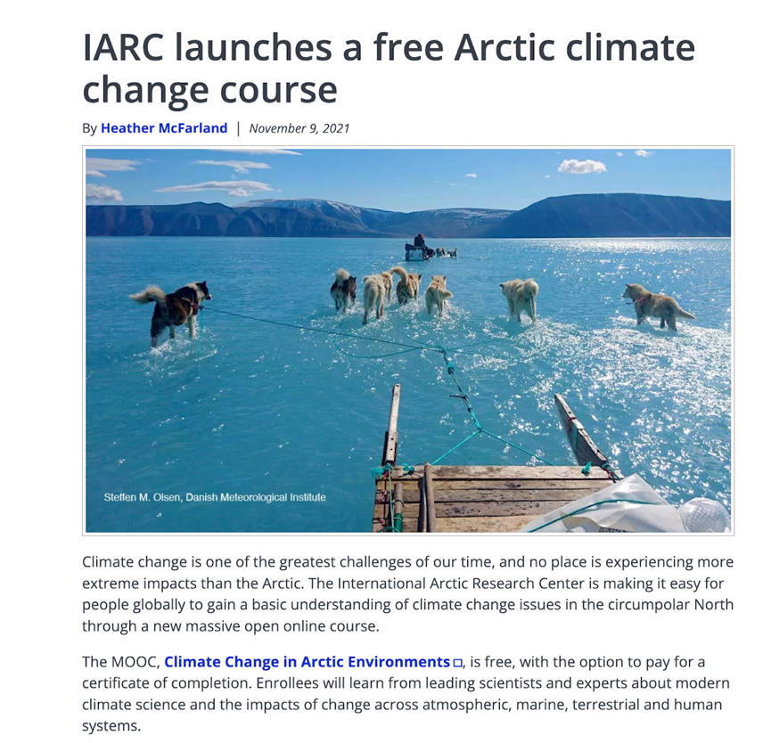
Promo:
Climate Change In Arctic Environments
Climate Change In Arctic Environments
  Online, free class
  Series of short videos from experts
  More than just physical science
  Open until May 17
https://www.edx.org/course/climate-change-in-arctic-environments

Slide 13
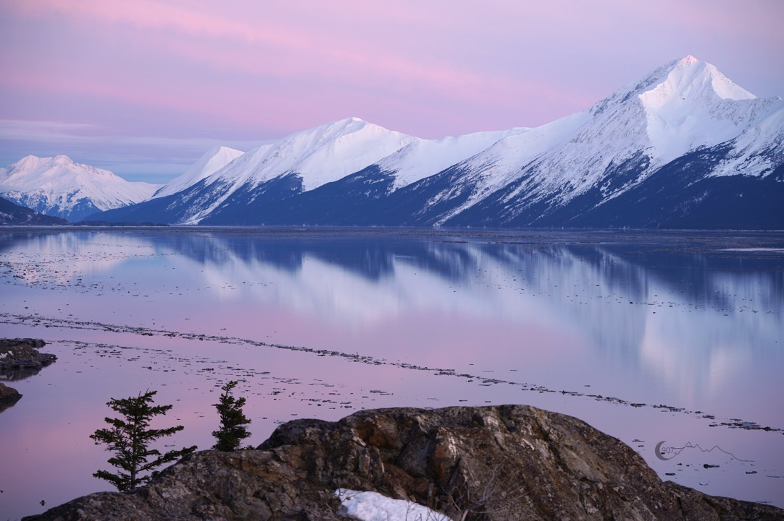
Thanks very much
Turnagain Arm
Photo by D. Moore, Feb 27, 2022

