Slide 1
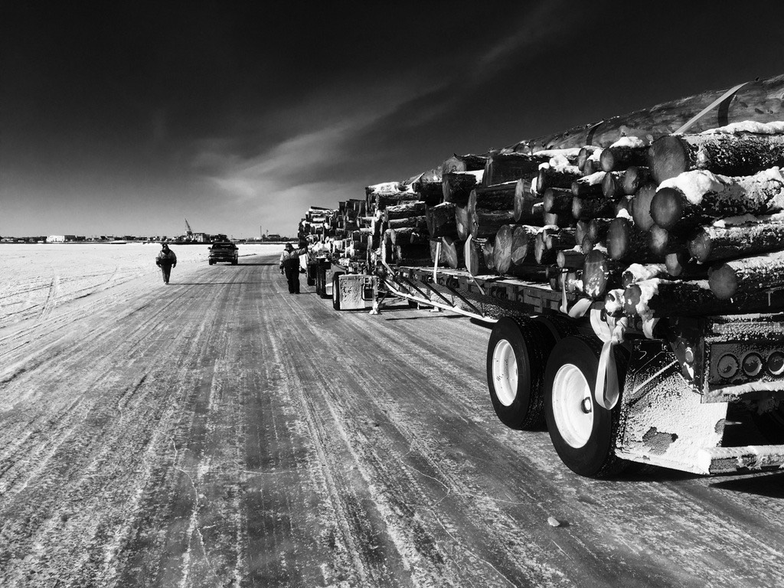

“Getting By on Less”
Traditional Knowledge & New Technology Combine to Keep Winter Travelers Safe on the Kuskokwim River
A Presentation to the
ANTHC LEO Network
February 19, 2019
Notes:
1

Slide 2
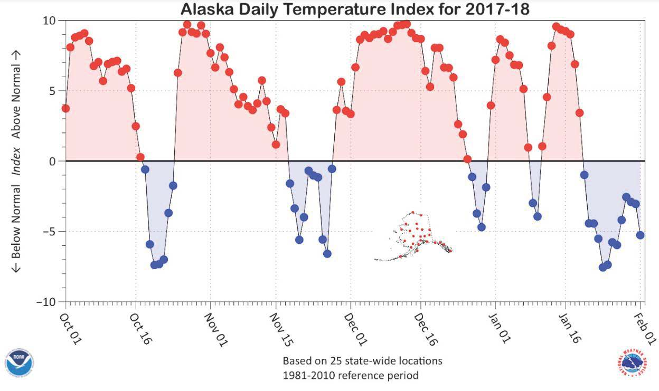
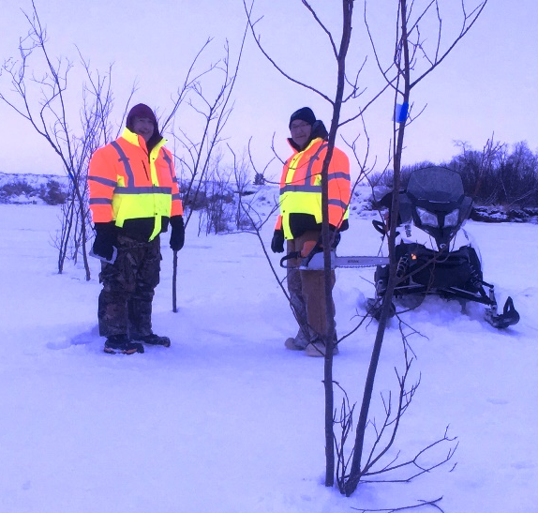
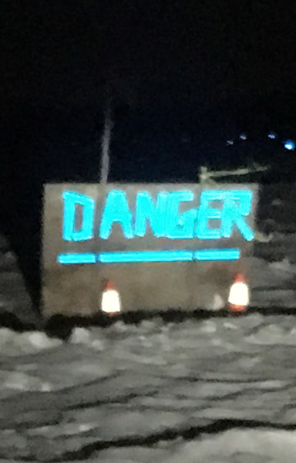
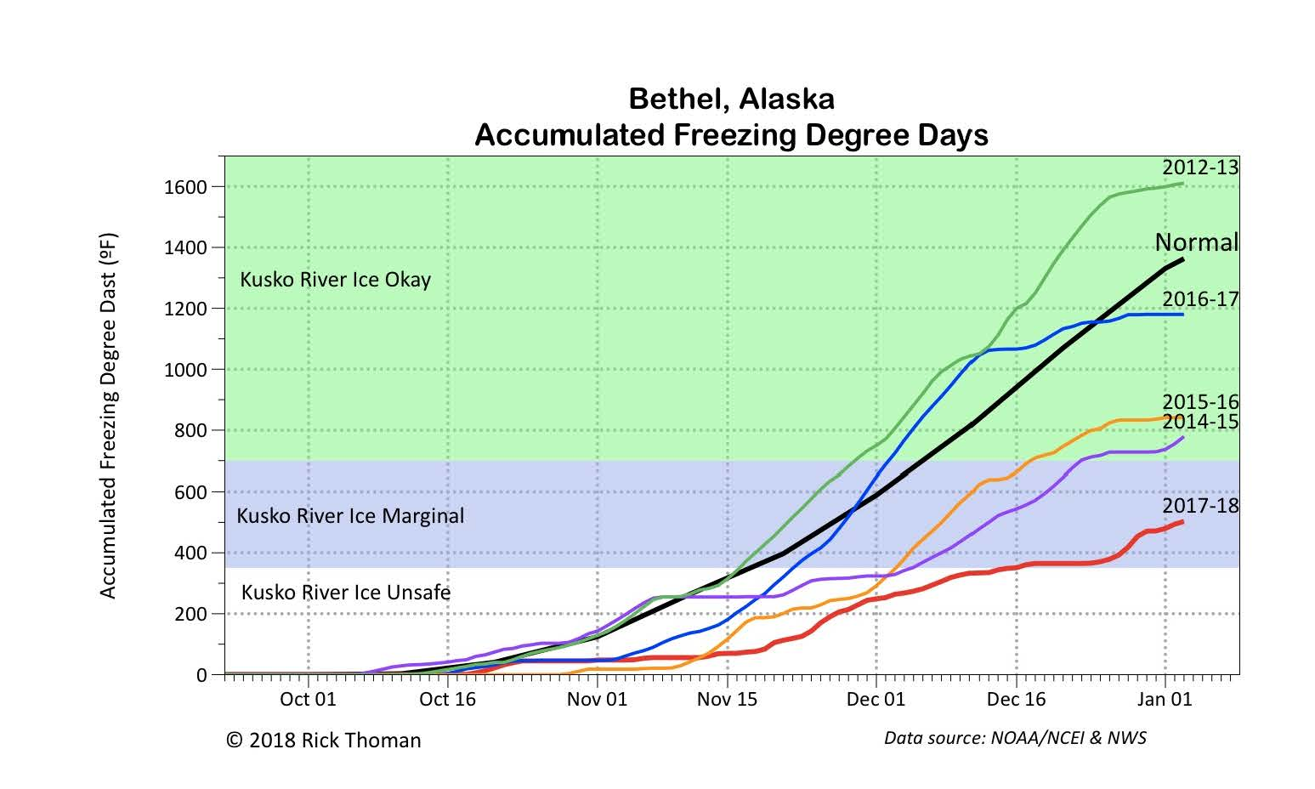

Slide 3
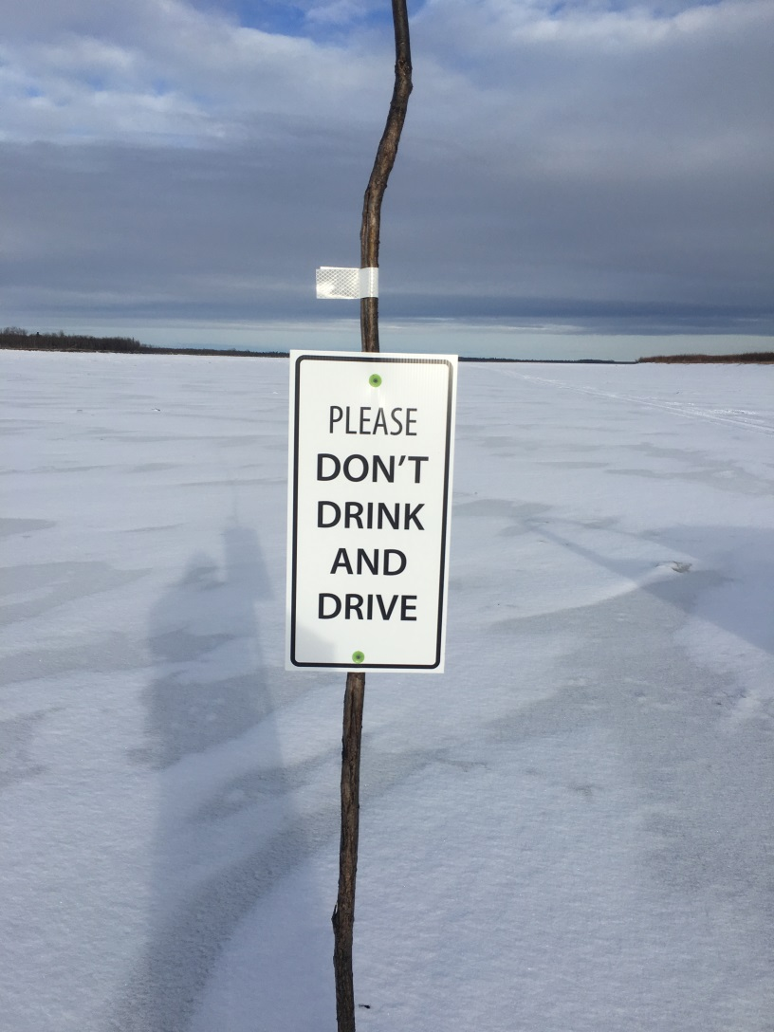
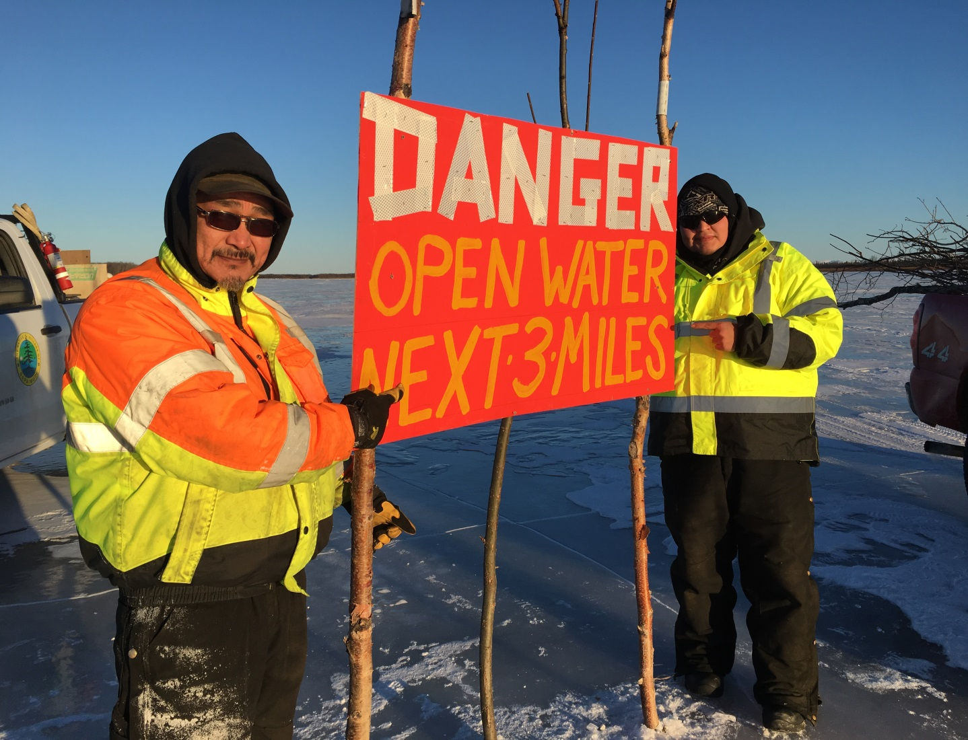
All the Good People that help us do what we do

Slide 4
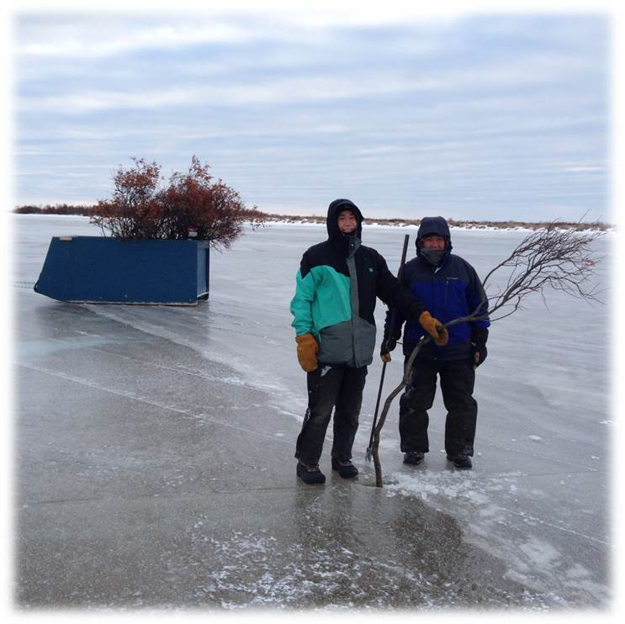
Every year People all along the Kuskokwim work hard to establish safe winter transportation routes:
Sometimes with nothing more than an ice pick and willows. This is the Johnson River ice road marking crew

Slide 5
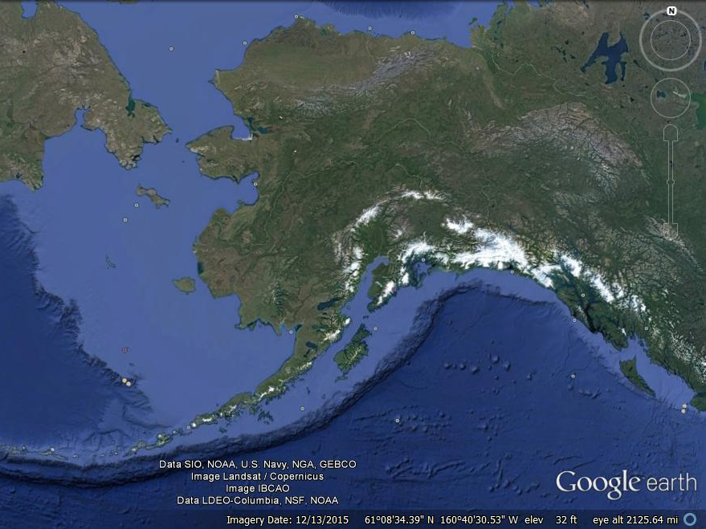
Back Ground:
Notes:
5

Slide 6
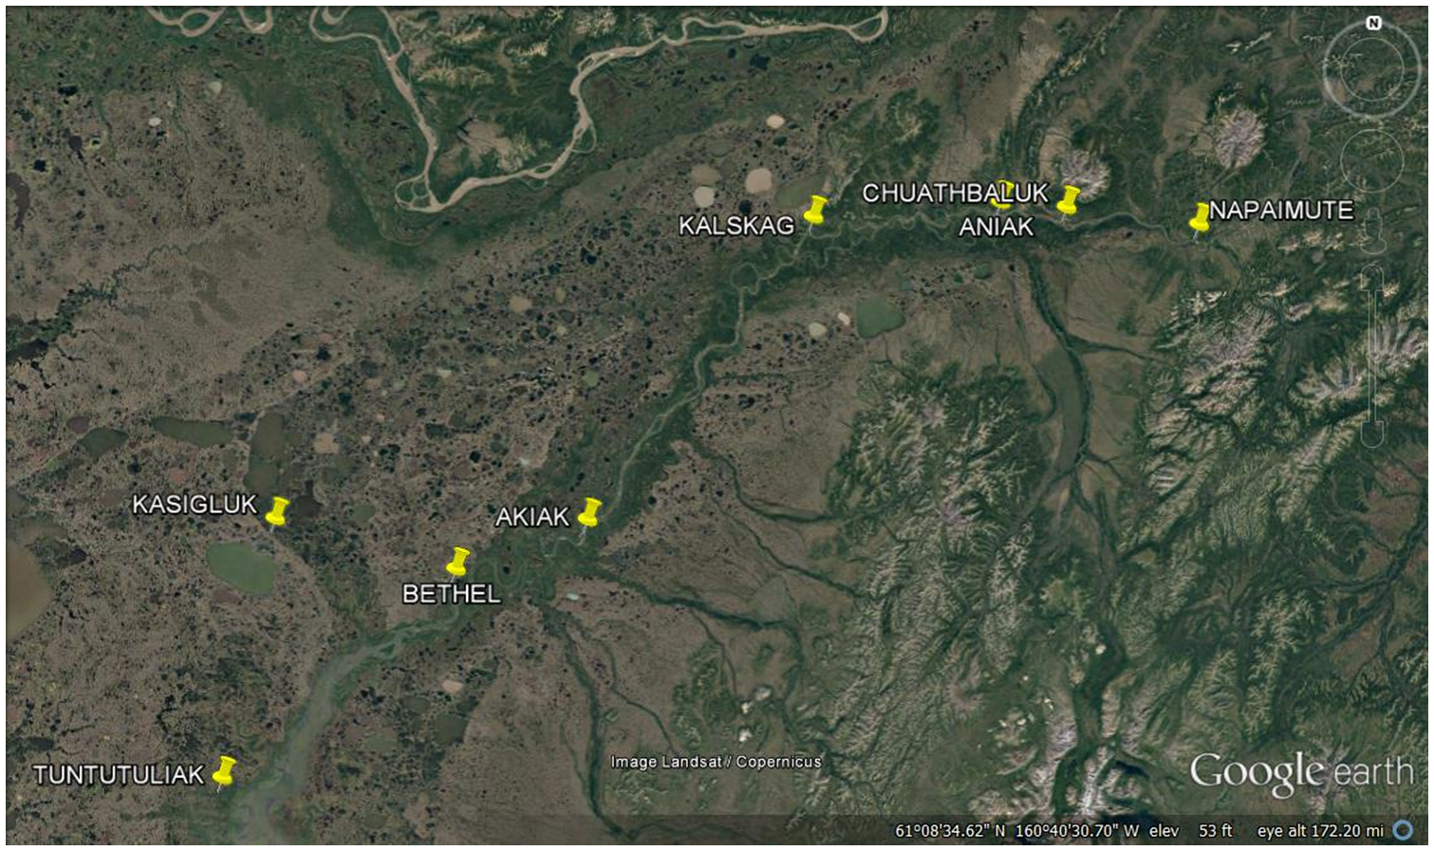

Our Region -The Lower & Middle Kuskokwim:
Over 15,000 People connected by over 250 miles of ice road and countless miles of winter trails - a region badly in need of better connectivity, economic development, affordable energy , affordable housing , and cheaper transportation
These ice roads and winter trails are our highways – our only highways - and they need to be treated as such with stable funding for annual establishment & maintenance
Notes:
6

Slide 7
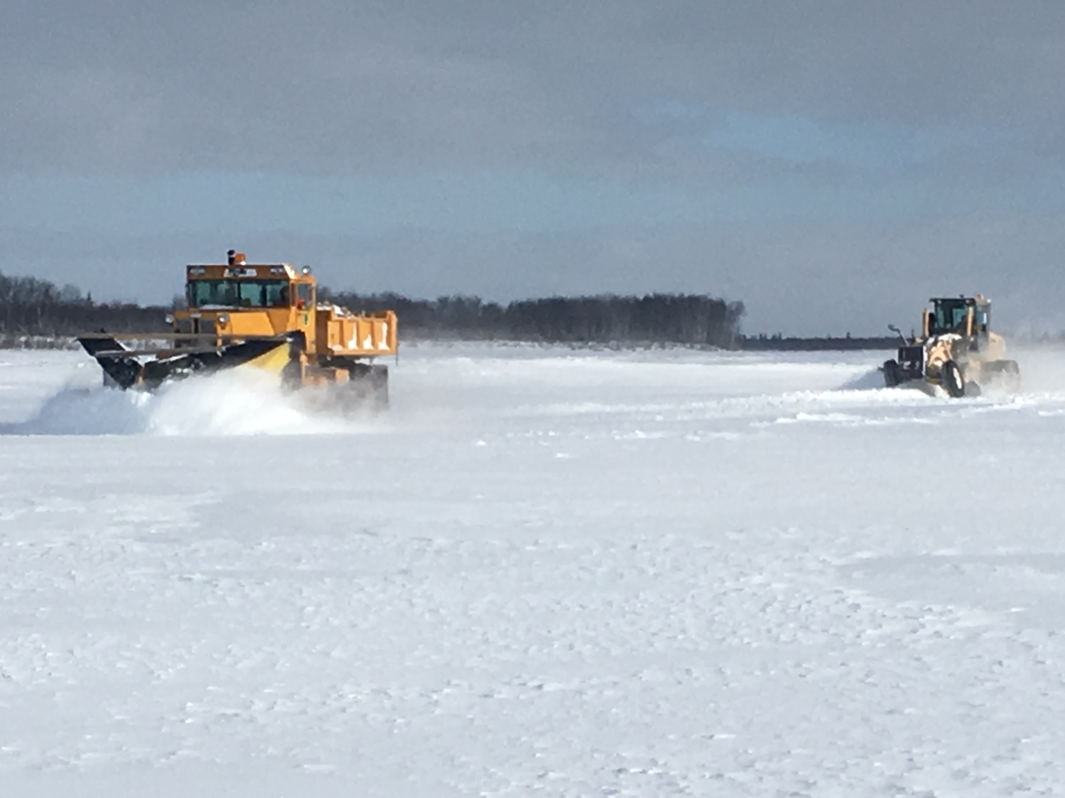
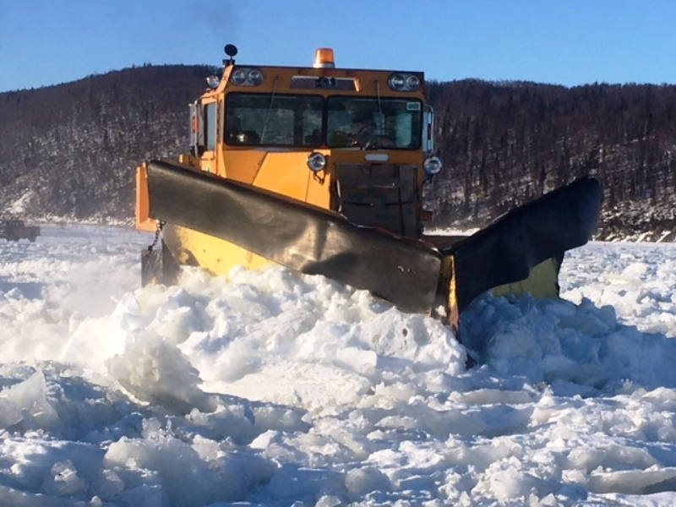
In Preparation for Measuring, Marking, &Plowing

Slide 8
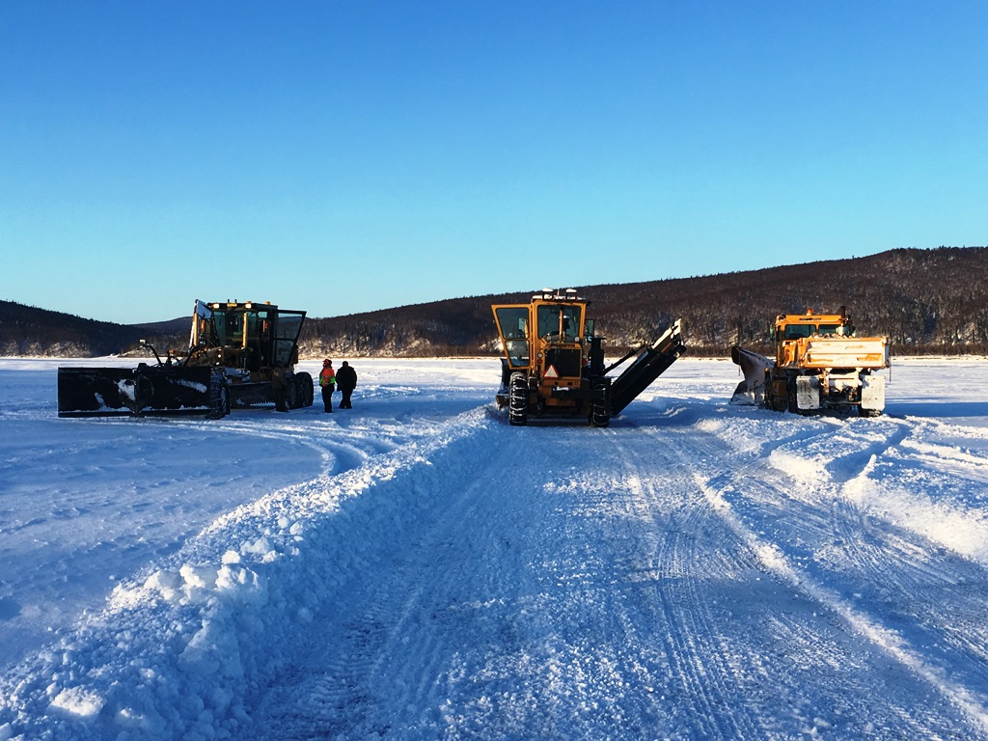
Meeting of the Minds:
Aniak, Kalskag, and Napaimute Ice Road Maintenance Crews Meet on the River
Small Meeting!

Slide 9
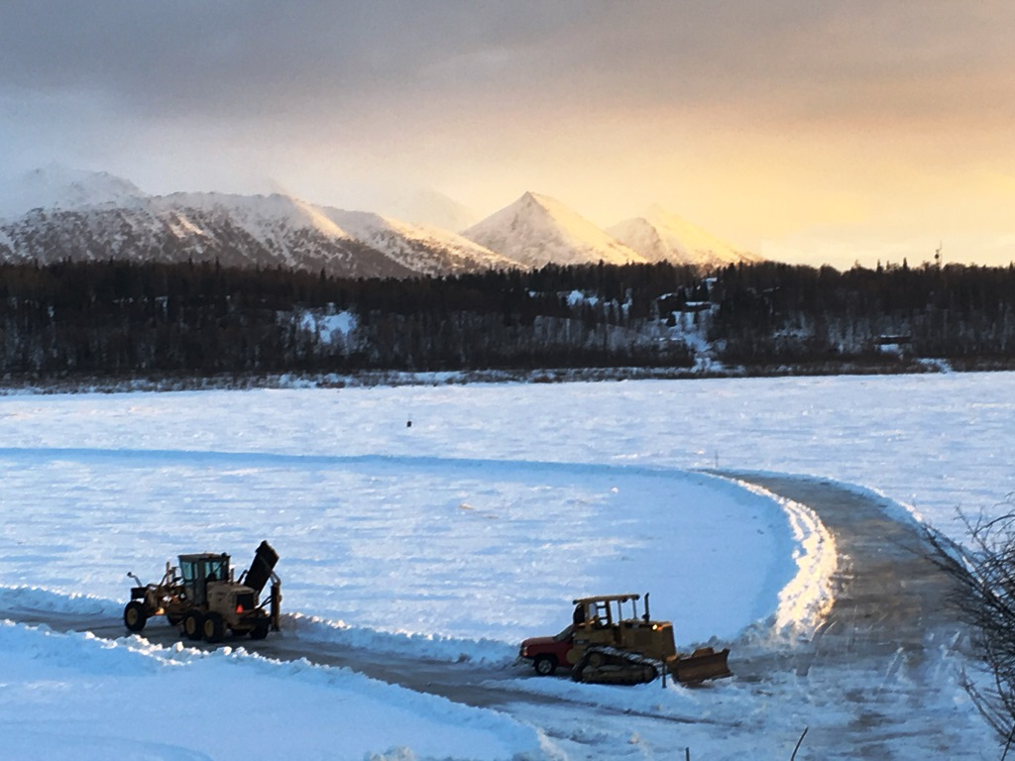

Slide 10
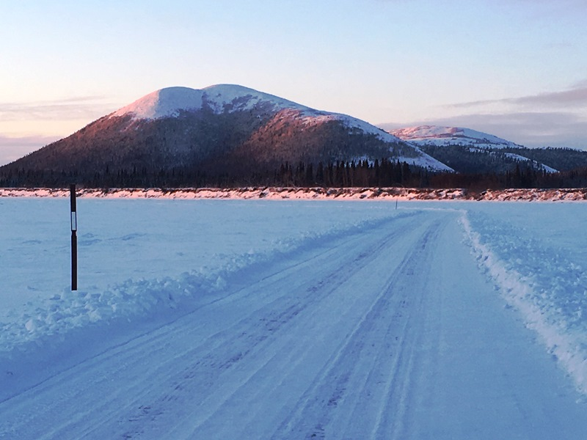
Mile Post 110 along Upriver Route 2 – between Kalskag &Aniak
Near Nulluq Hill

Slide 11
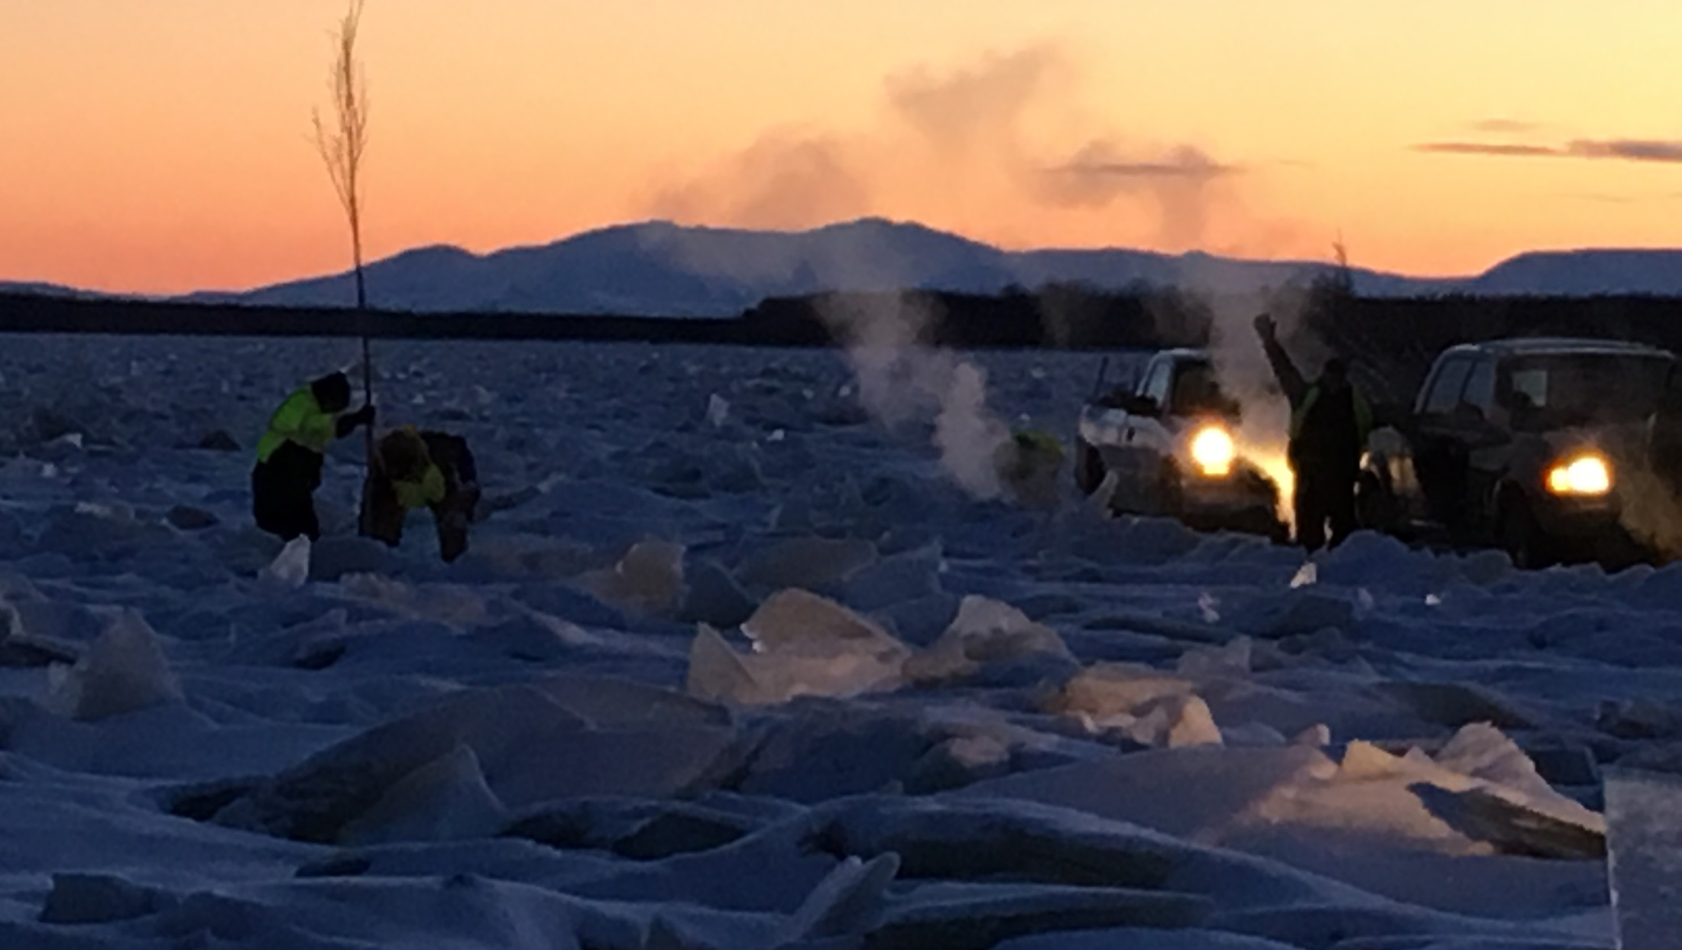
“Working together so others may live”
10:25 AM, December 21, 2016 – the shortest day of the year - temperature minus 10 – Middle Kuskokwim Tribal Transportation Safety crew installs ice road markers in the growing light
Notes:
11

Slide 12
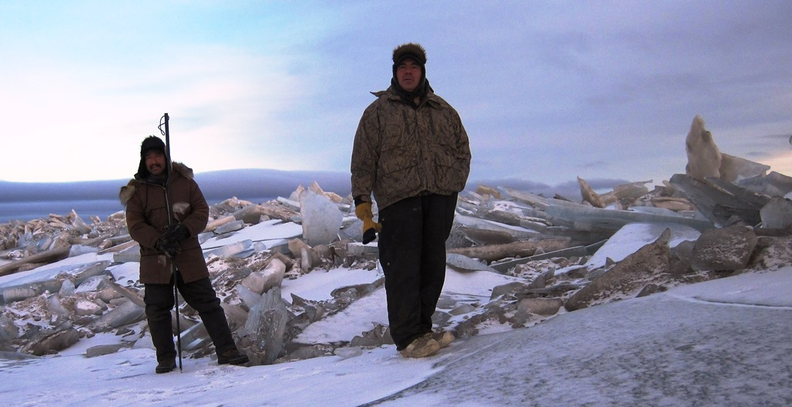
All along the Kuskokwim there are key People that watch the River closely throughout the year -especially during the critical times of freeze up and break up. These Observers get out on the River as soon as they can and communicate back and forth on what they see out there to start planning safe winter transportation routes. A lot of time is spent out checking conditions before any actual work starts

Slide 13
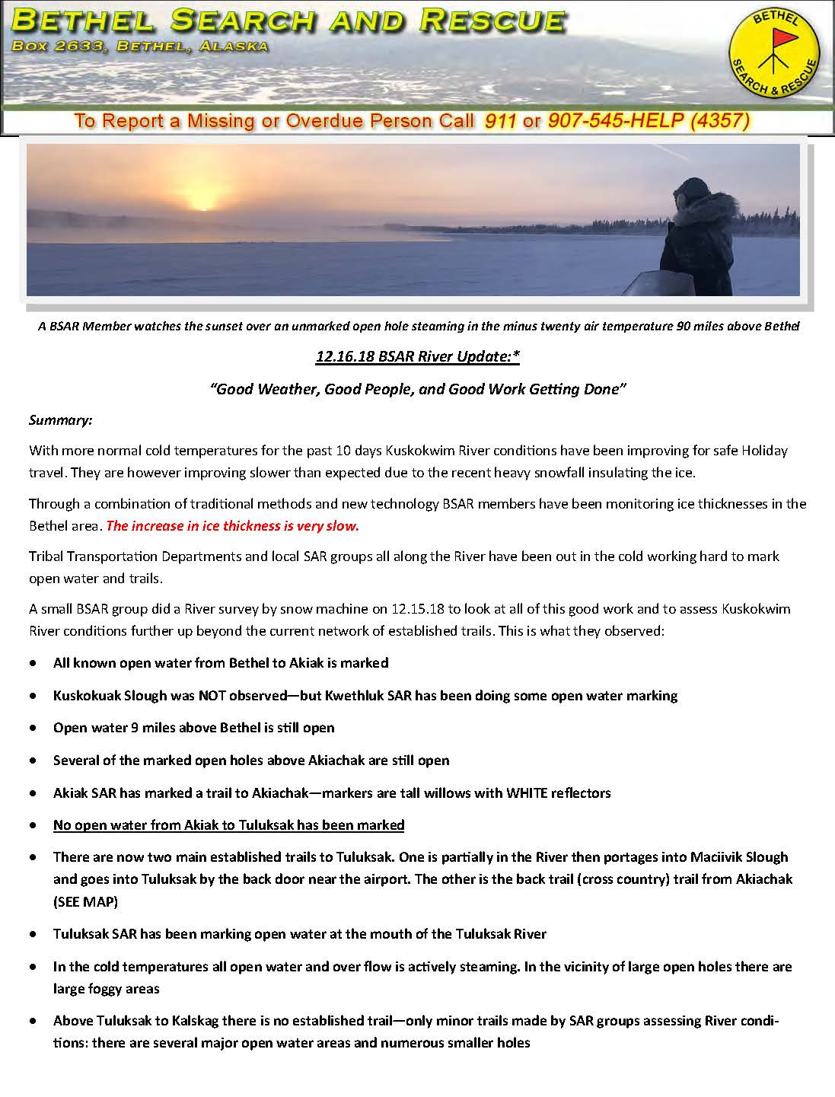
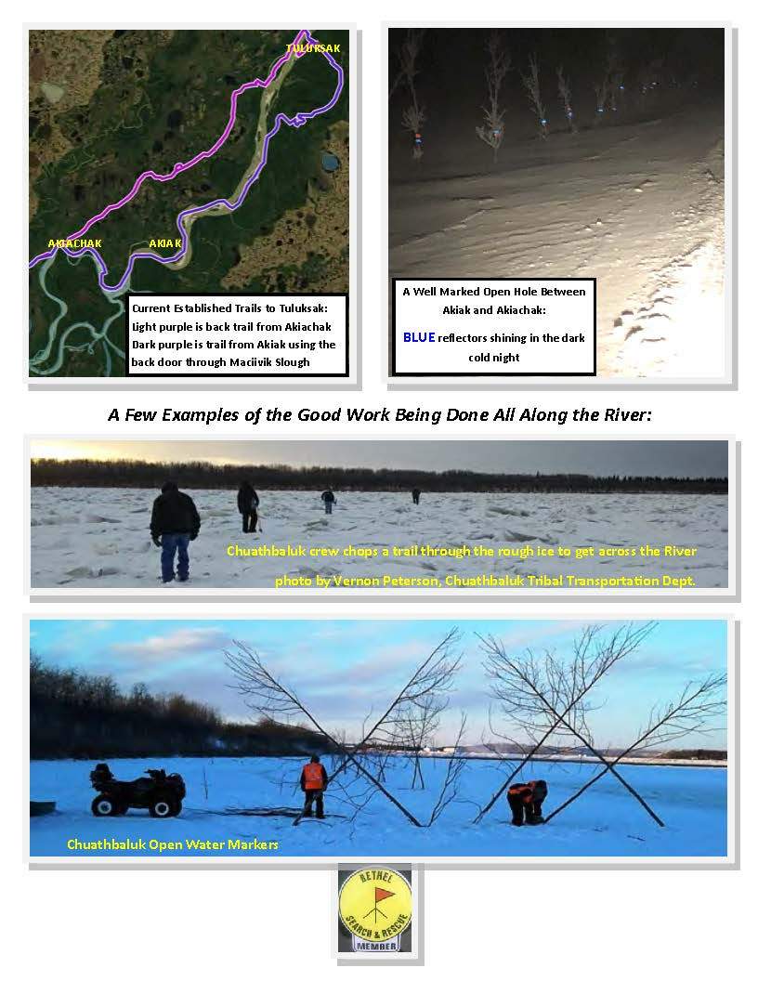

Slide 14
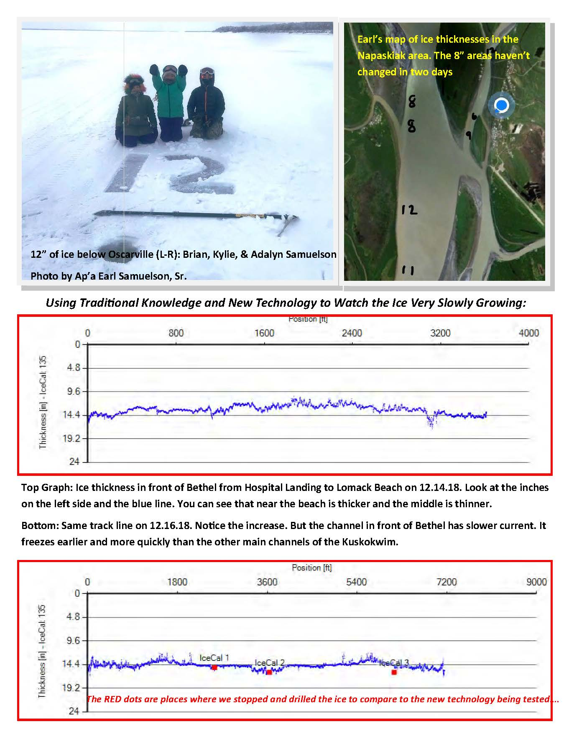
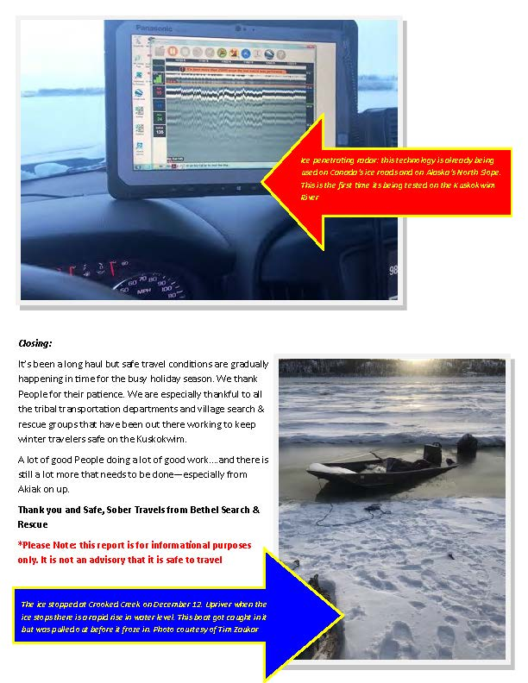

Slide 15
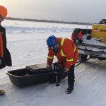
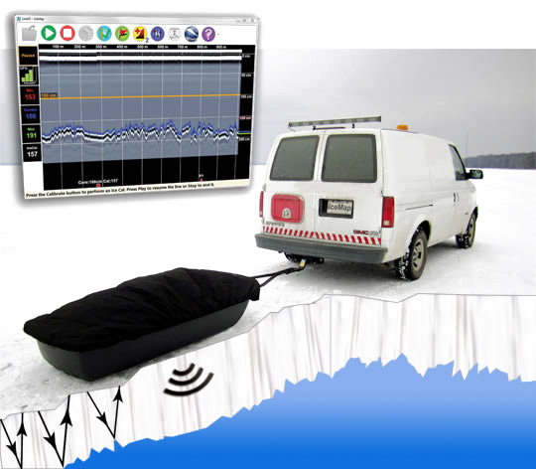
IceMap SmartTow™
What’s New for the Kuskokwim Ice Road in 2018-19?
IceMap SmartTow
NVN Tribal Transportation Program has invested in Ice Penetrating Radar with the goal of developing a smart phone application that can be used by anyone to check on current ice road conditions
This technology is already being used extensively in Canada and on Alaska’s North Slope
Real time ice thickness measurements

Slide 16
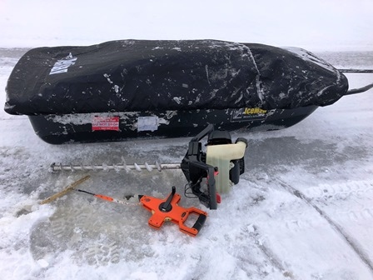

Slide 17
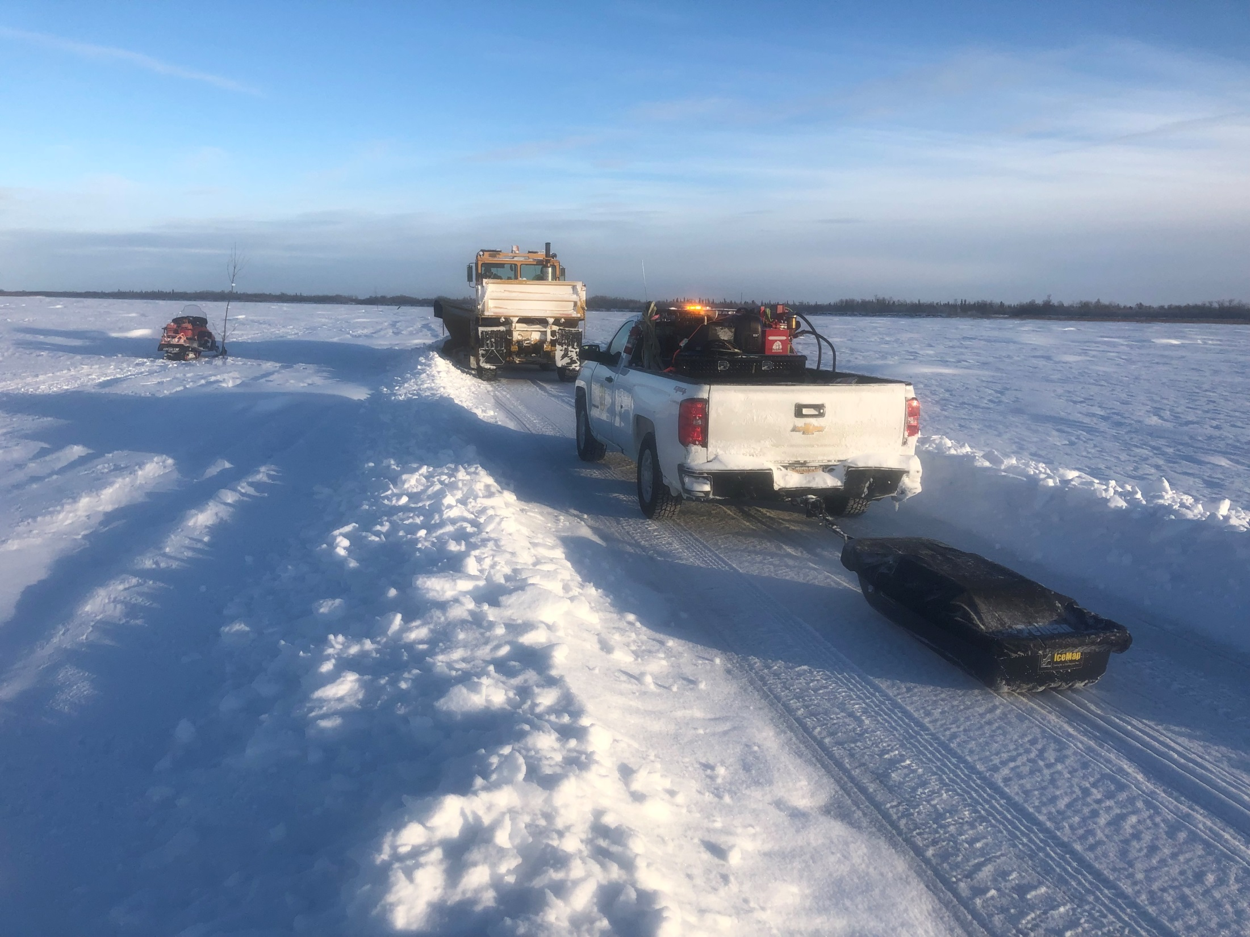
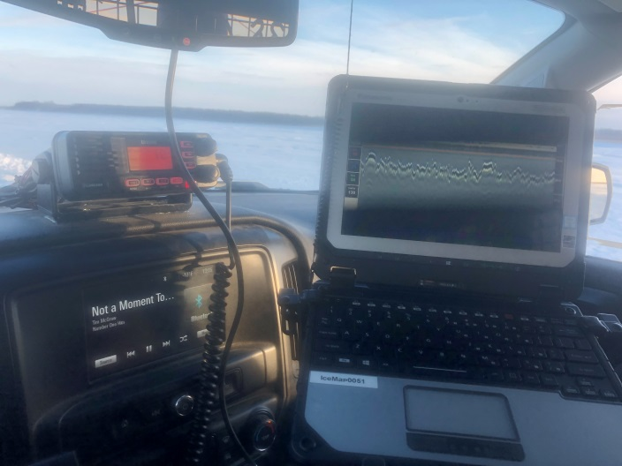
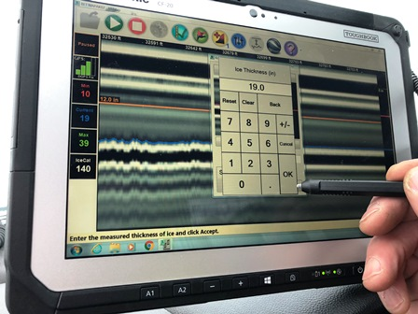

Slide 18
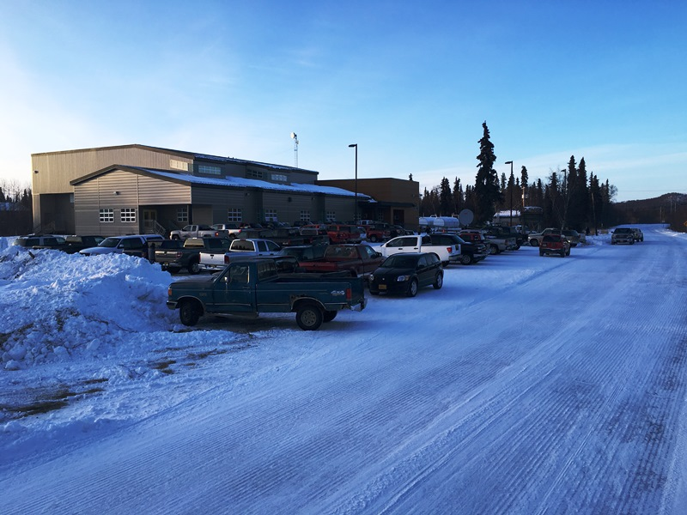
The Social &Economic Benefit of Having Safe, Maintained Winter Transportation Routes in Our Region is Huge
This was the Kalskag High School During the Regional Basketball Tournament in March – vehicles from all over the Kuskokwim were there

Slide 19
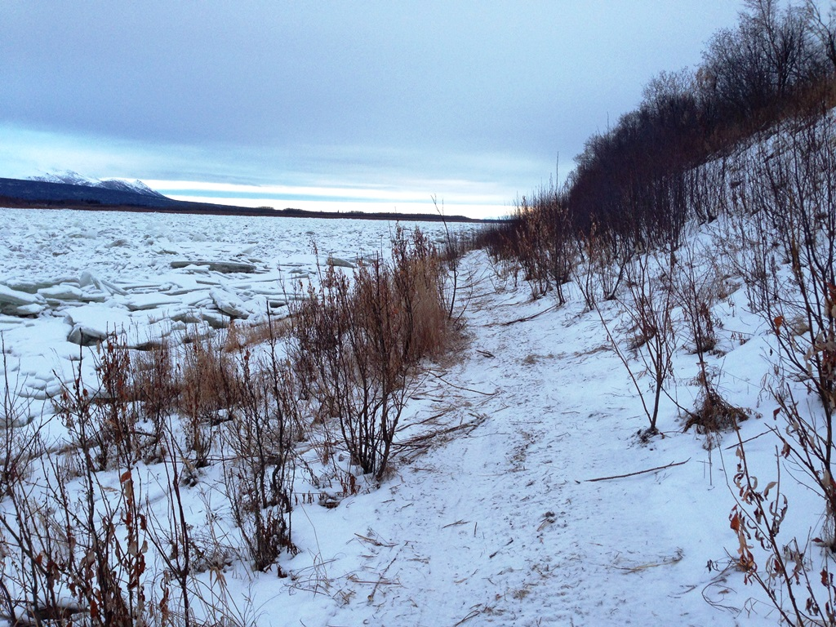
With out financial support for our winter transportation systems we are stuck with trails like this one between Aniak & Chuathbaluk a couple of years ago

Slide 20
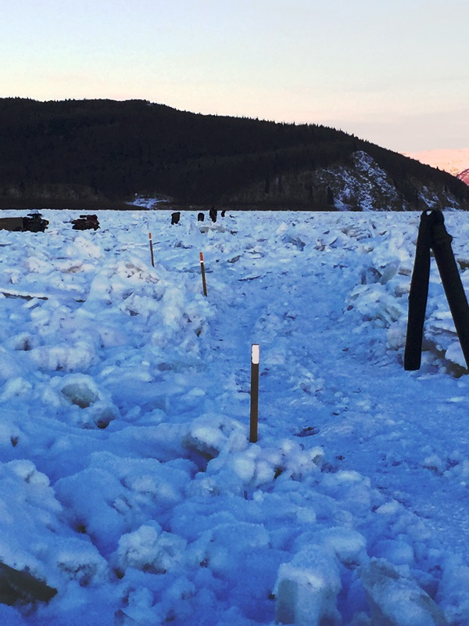
Chuathbaluk Crew physically chopping a trail through the Ice so they can get across the River

Slide 21
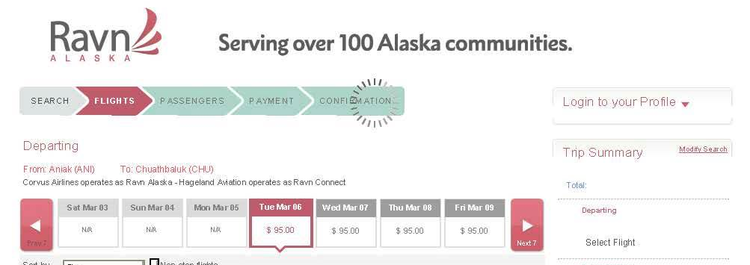
And we are stuck with an over dependence
on expensive air travel.
This is a ONE WAY air fare for a 10 mile flight from Chuathbaluk to Aniak - $95!
For a few dollars worth of gas you can make the same trip by truck carrying more people and more freight

Slide 22
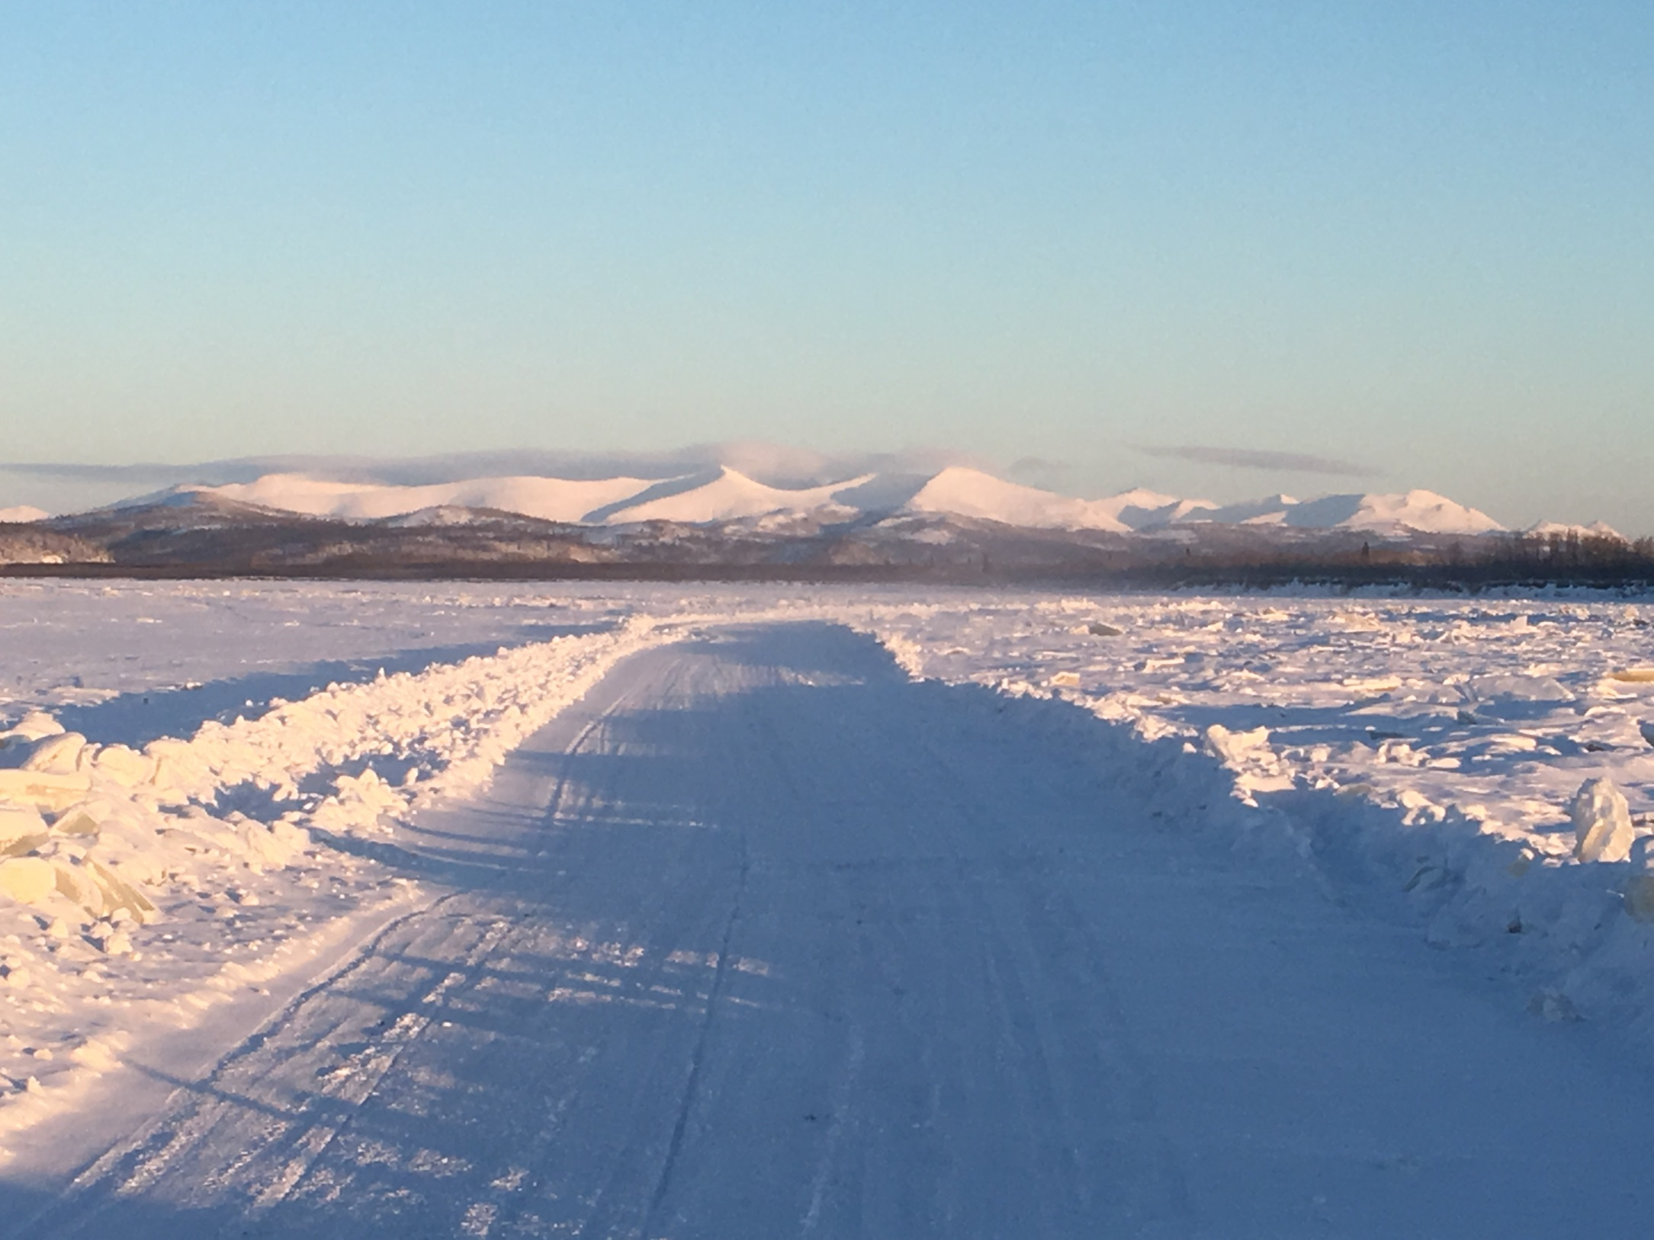
Thank you!

