Slide 1
LEO Network Meeting Summer 2021 Climate Review and Autumn 2021 Outlook
Rick Thoman
Alaska Center for Climate Assessment and Policy
University of Alaska Fairbanks
September 21, 2021

Slide 3
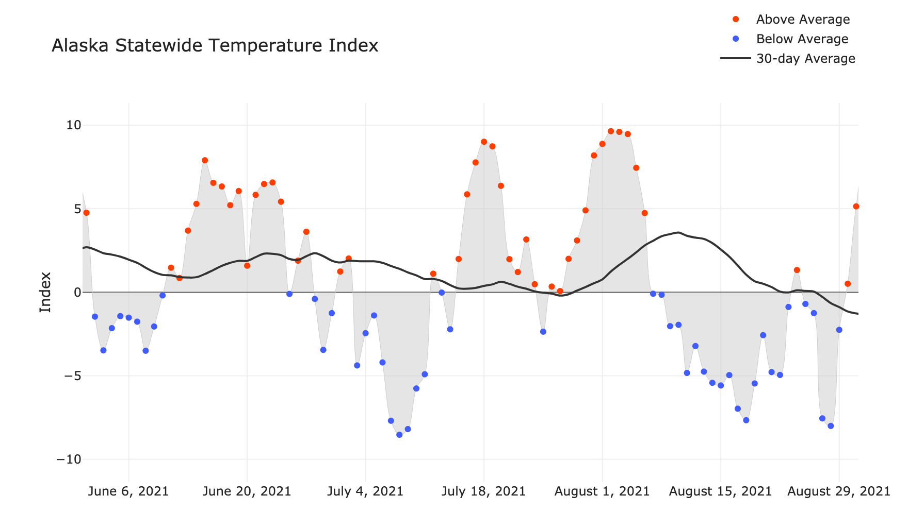
Alaska Daily Temperature Index
Now online: http://accap.uaf.edu/tools/statewide-temperature-index

Slide 4
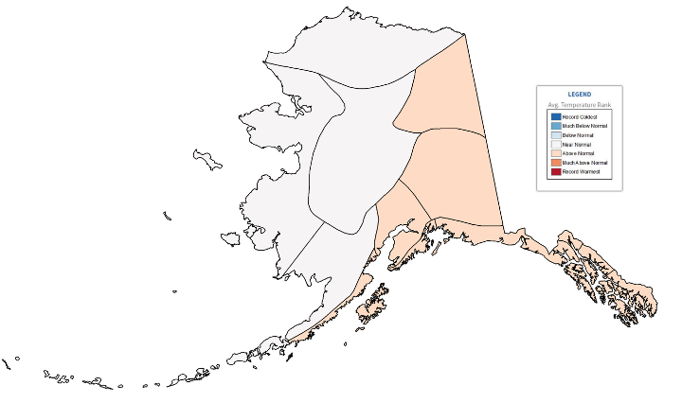
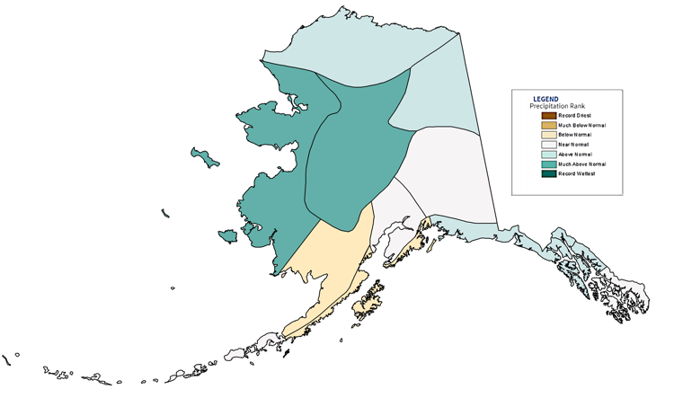
Alaska Regional Rankings Summer (June-August) 2021
NOAA Temperatures Since 1925
NOAA Precipitation Since 1925
Some differences between analyses

Slide 5
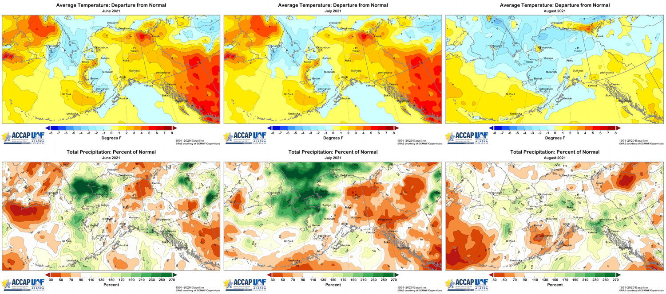
Monthly Temperature & Precipitation Summer 2021
June
July
August
Data: ERA5 courtesy of EMCWF/Copernicus
1991-2020 Baseline

Slide 6
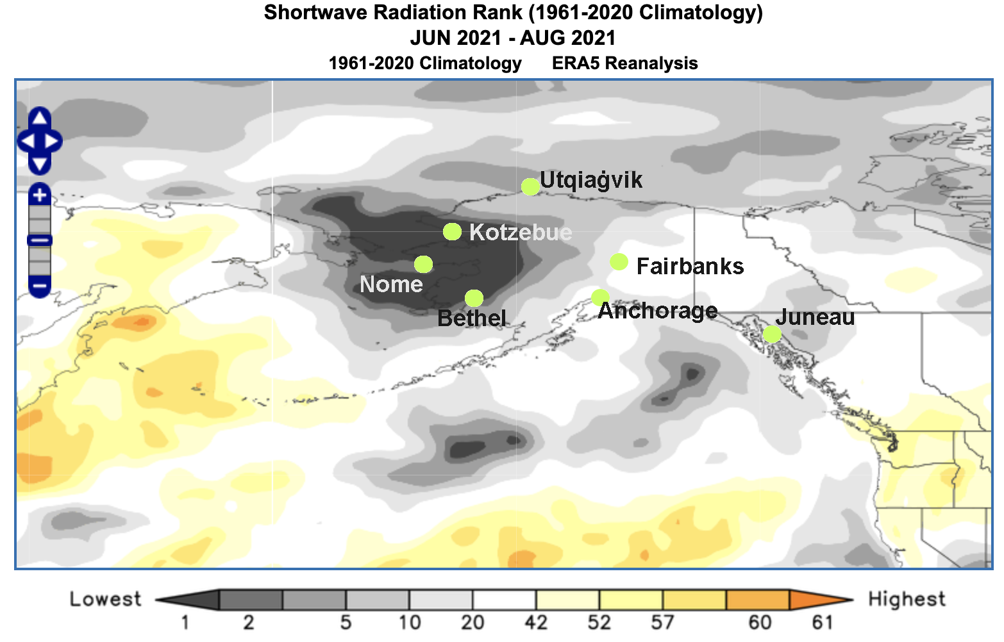
A Very Cloudy Summer

Slide 7
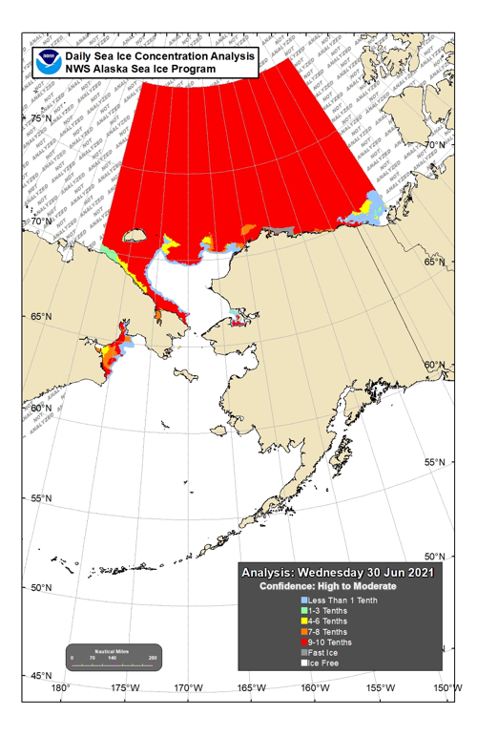
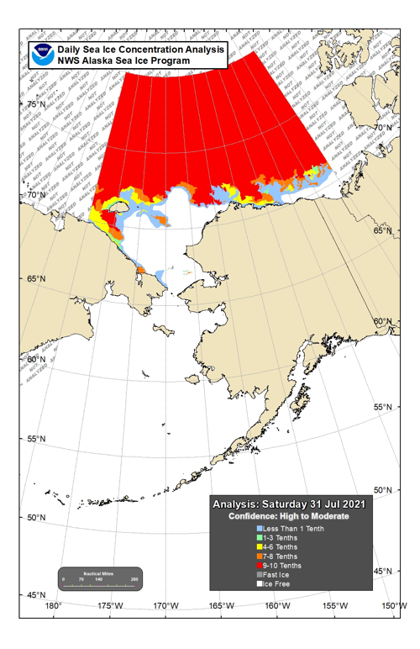
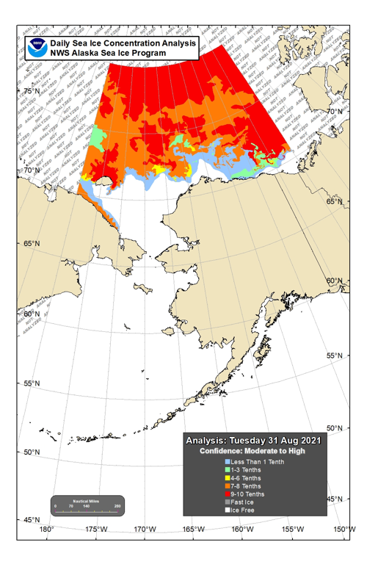
Sea Ice Summer 2021
June 30
July 31
August 31

Slide 8
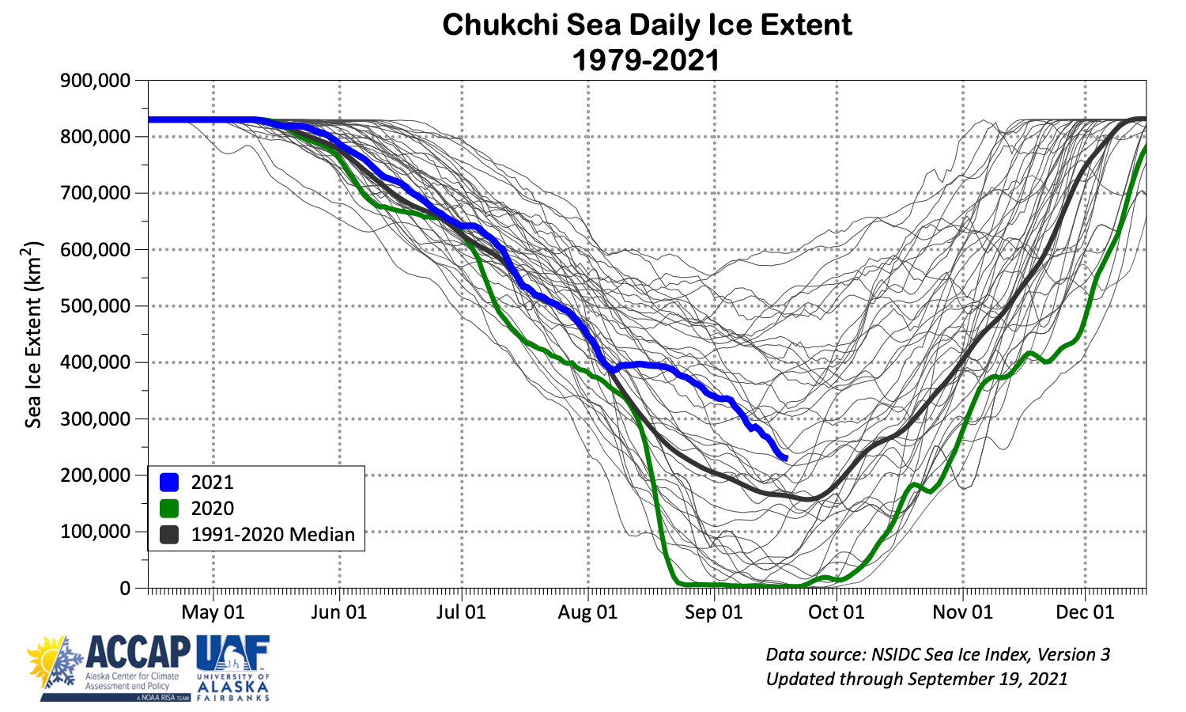
Summer Sea Ice Around Alaska

Slide 9
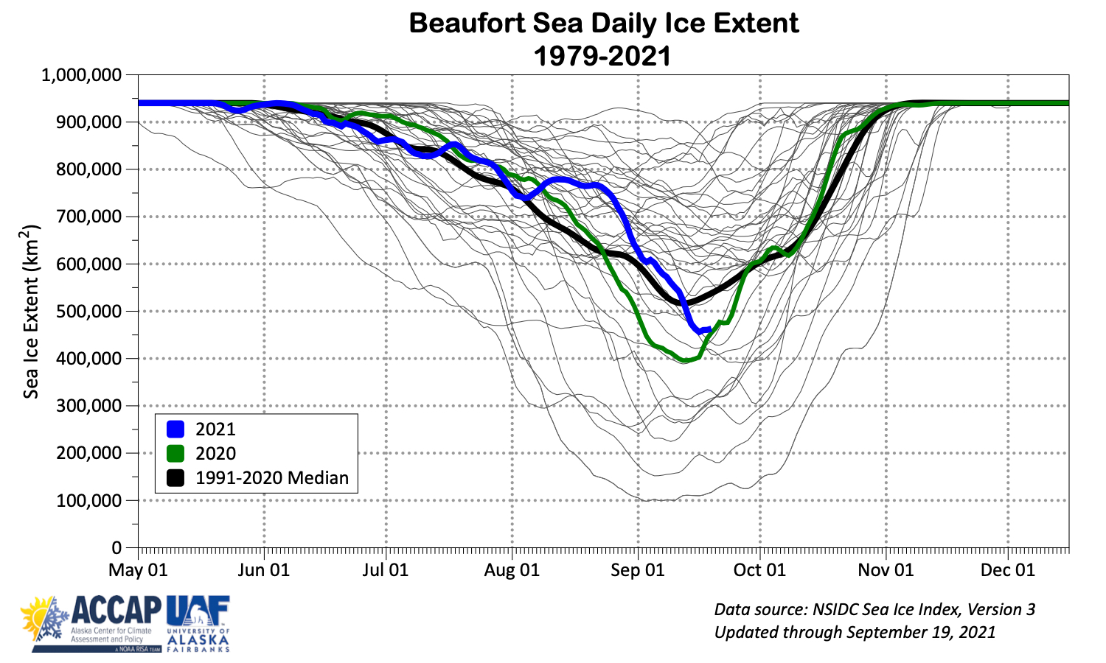
Summer Sea Ice Around Alaska

Slide 10
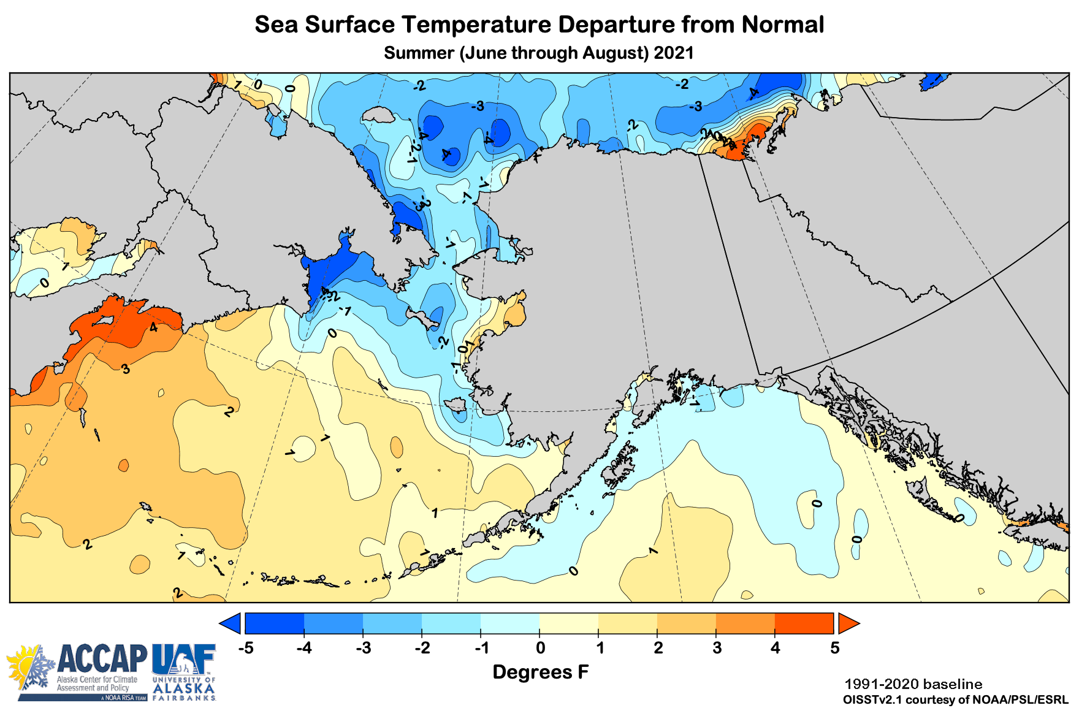
Summer 2021 Ocean Temperatures

Slide 11
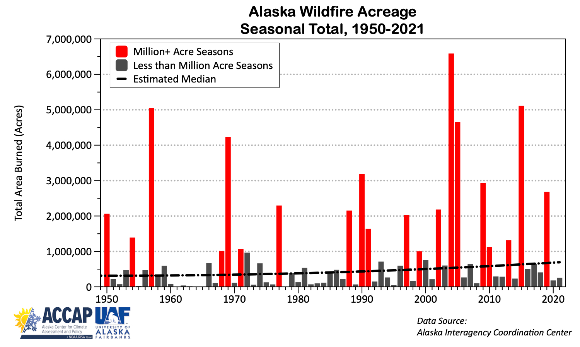
2021 North American Wildfire

Slide 12
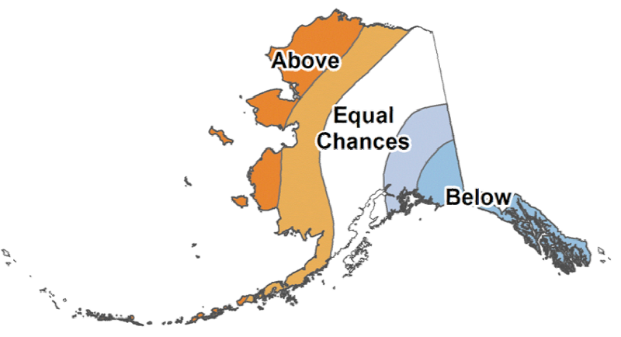
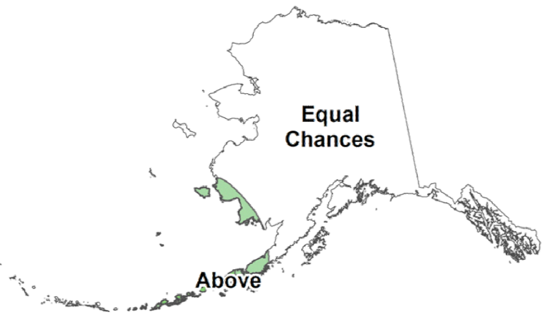
NOAA/Climate Prediction Center October-December 2021 Outlook
37%
33%
30%
33%
33%
33%
45%
33%
22%
33%
33%
33%
37%
33%
30%
30%
33%
37%
25%
33%
45%
Above%
Normal%
Below%

Slide 13
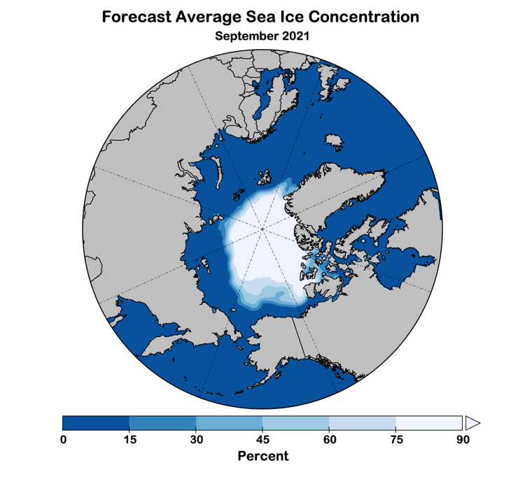
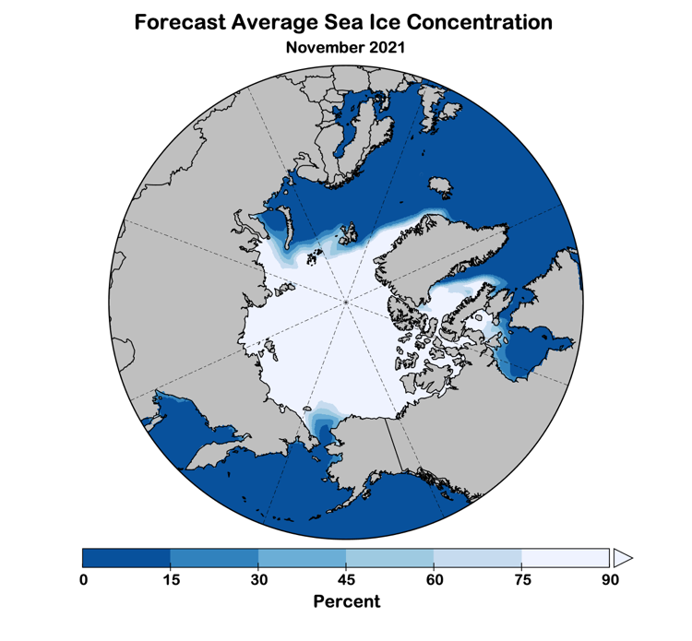
Autumn 2021 Sea Ice Outlook
Data: NOAA/Climate Prediction Center Exp. Sea Ice Outlook

Slide 14
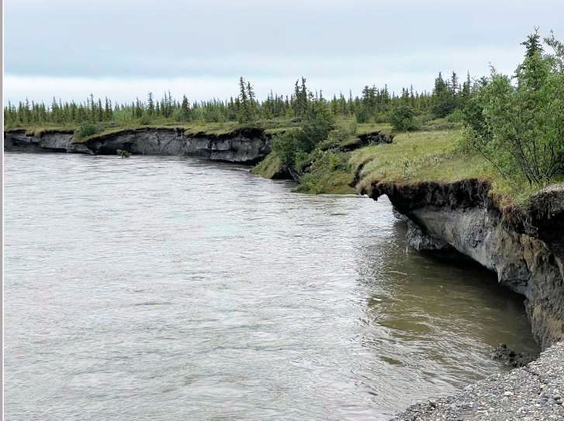
Noatak River Erosion July 2021
Photo credit: LEO/J. Luther

