Slide 1
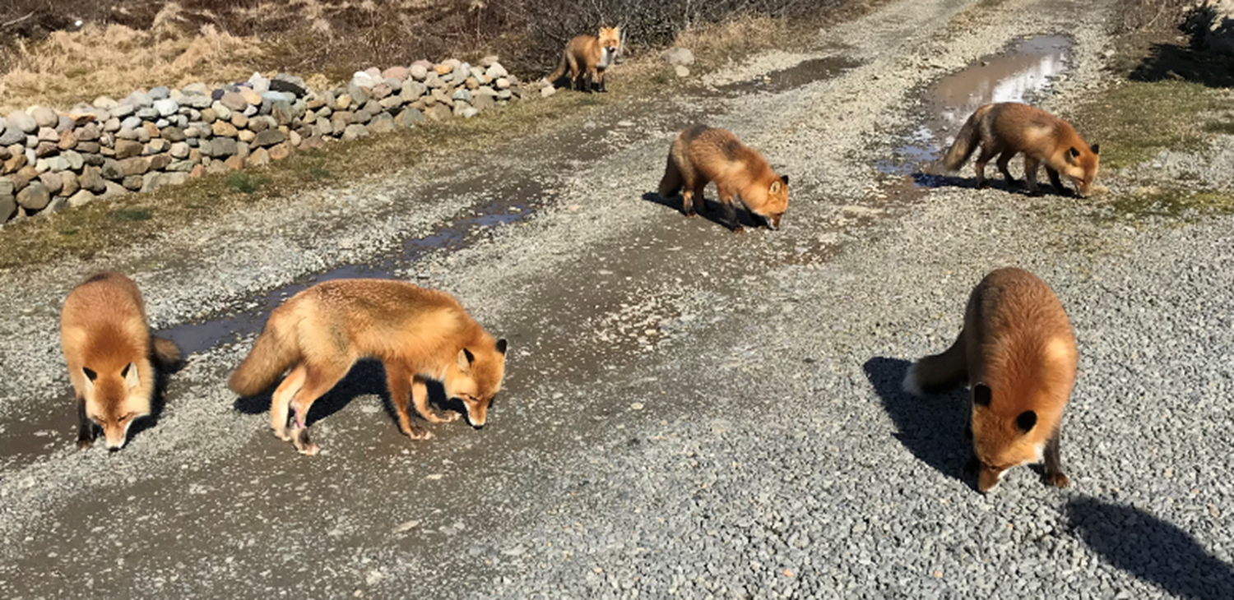
Rabies Prevention
Field Environmental health
Russ Cameron
Field Environmental Health, ANTHC

Slide 2
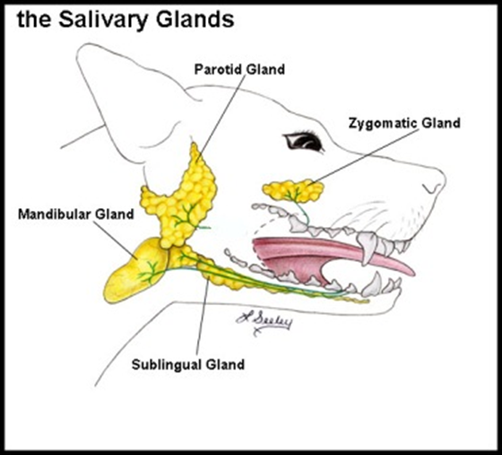
What is Rabies?
Virus that attacks the central nervous system
Any mammal can carry rabies
  Foxes (red & arctic)
  Dogs (commonly spread to humans)
  Wolves
  Bats
Notes:
Enzootic – always present at a certain level
Epizootics – outbreaks among animals
Epizootics occur every few years and follow the population cycles of the rodent populations upon which the fox feed.
Since 1971 rabies has been found in: caribou, cat, coyote, reindeer, river otter, wolf, wolverine, arctic fox, dog, bat, red fox,
Spread through saliva of infected animals
Bite Exposure
Non-Bite Exposure
Mucous membrane exposure to saliva, i.e. child licked on eyes/mouth
Contact with blood, urine, fur, feces NOT an exposure
Not spread human to human

Slide 3
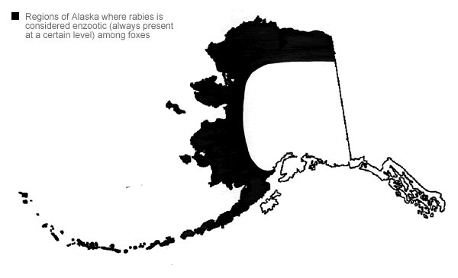
Rabies Enzootic Regions

Slide 4

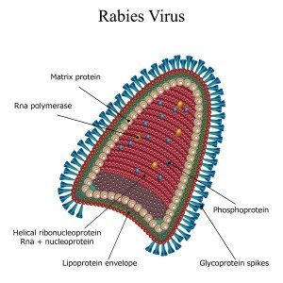
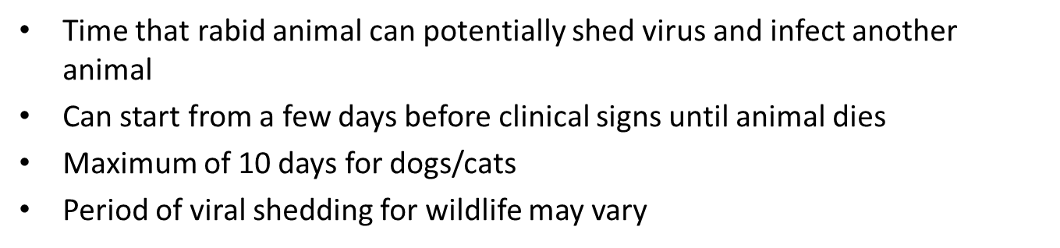
Incubation Period
Time from exposure to virus until development of symptoms
Typically 3-8 weeks
Can be as short as 9 days or as long as 17 years
Depends on the bite site and proximity to brain
No symptoms during incubation period
Infectious Period
Notes:
First emphasis is on 10 days. The speed of the infection spread depends on the bite size and proximity to the brain.

Slide 5
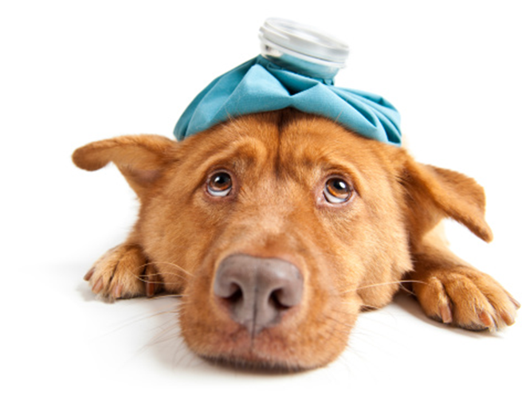
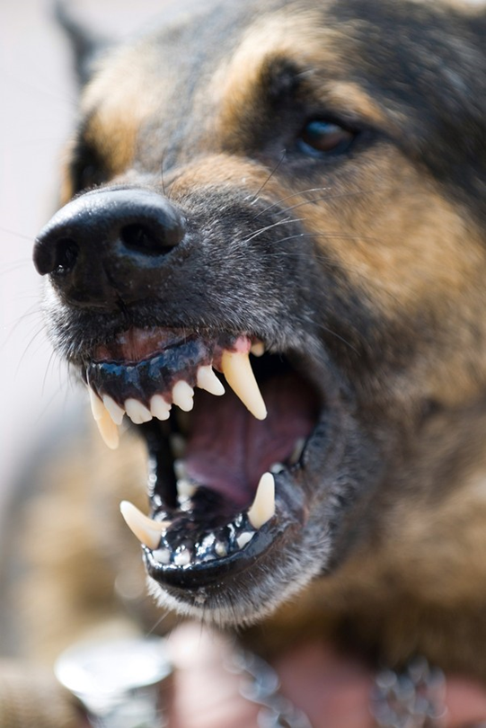

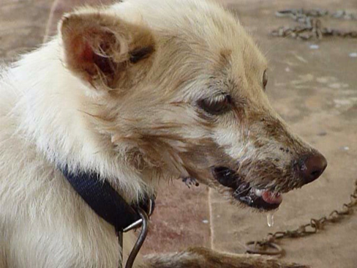
Symptoms in Animals
Stage 1
  Anxiety, fear, fever, personality change
Stage 2
  Furious state
Stage 3
  Paralytic stage
Notes:
Here are the stages to look for once an animal has been in home quarantined.
Stage one: personality change
Understand and educate community how to handle the animal
Consultation with Alaska Section of Epidemiology
Encourage prophylaxis in “high risk” wounds
High risk wounds
All “unprovoked” animal attacks
Domestic animal develops symptoms of rabies within 10 days of attack
Bite from high risk animal (foxes in AK) or unknown status (wild dog and ran off)

Slide 6
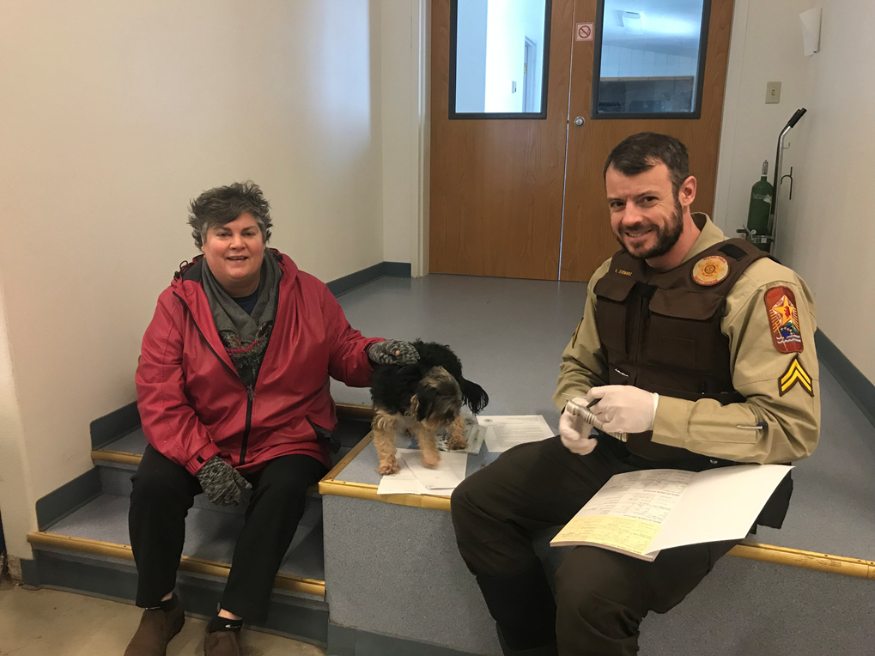
How can I help?
Immunize all dogs
Stress hunting safety and rabies awareness, especially for younger hunters
Encourage reporting all bites, animal scratches
Control stray, wild dogs. Keep dogs on leashes.
The goal of the LV program is to minimize human exposures to rabies by certifying community trained vaccinators such as CHA’s and VPSO’s in rabies endemic areas.
Notes:
In the photo, Clair Frederic with her dog Ozzie and VPSO and new LV Chris Stewart.

Slide 7
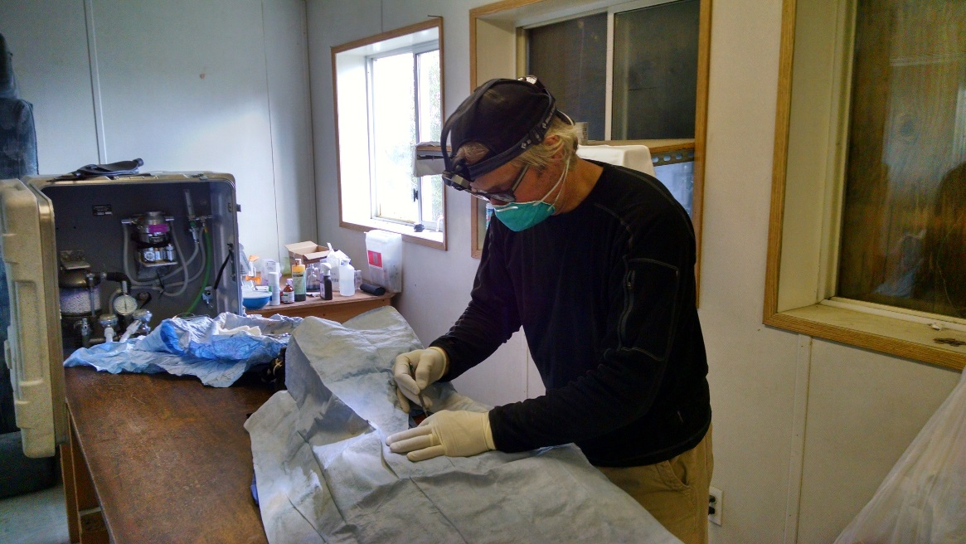
Healthy Pets, Healthy Communities
Cooperation between ANTHC, Tribal Health Organizations and various Non-Profits
  Coordinates and conducts spay and neuter clinics
  Gather Data and evaluate interventions
    Stool, oral and blood samples
    Non-invasive sterilizations
    Community surveys

Slide 8
More Rabies Resources
Alaska Rabies Prevention and Control Manual
Regional OEH
Rabies section of eCHAM
Alaska Section of Epidemiology
Main phone number: 907-269-8000; after hours: 800-478-0084 or www.epi.alaska.gov

Slide 9
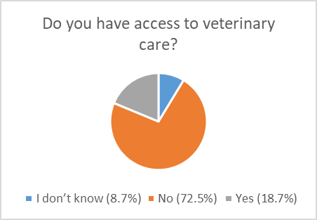
Access to Veterinary Care in Rural Alaska
Summary of Survey Results
To participate in the survey, visit surveymonkey.com/r/HealthyDogHealthyCommunityResidentSurvey
Notes:
There is very little veterinary care available in rural Alaska. This is a threat to both human and animal health. In fact, Alaska Native children are hospitalized from dog bites more than anyone else in the Indian Health Service system.
To increase the understanding of this issue, ANTHC’s Office of Community Environment and Health has been using an online survey for the last three years. Our goal is to measure access to veterinary care and learn how Alaska Native people think this lack of access affects their safety, physical and mental health.

Slide 10
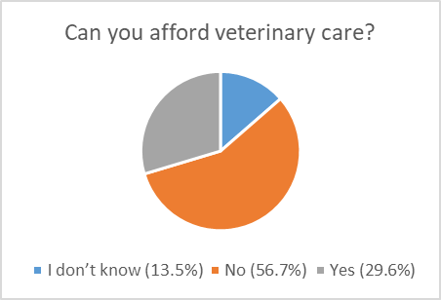
Access to Veterinary Care in Rural Alaska
Summary of Survey Results
To participate in the survey, visit surveymonkey.com/r/HealthyDogHealthyCommunityResidentSurvey
Notes:
There is very little veterinary care available in rural Alaska. This is a threat to both human and animal health. In fact, Alaska Native children are hospitalized from dog bites more than anyone else in the Indian Health Service system.
To increase the understanding of this issue, ANTHC’s Office of Community Environment and Health has been using an online survey for the last three years. Our goal is to measure access to veterinary care and learn how Alaska Native people think this lack of access affects their safety, physical and mental health.

Slide 11
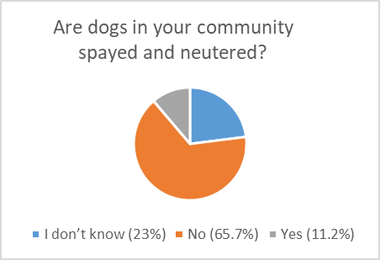
Access to Veterinary Care in Rural Alaska
Summary of Survey Results
To participate in the survey, visit surveymonkey.com/r/HealthyDogHealthyCommunityResidentSurvey
Notes:
There is very little veterinary care available in rural Alaska. This is a threat to both human and animal health. In fact, Alaska Native children are hospitalized from dog bites more than anyone else in the Indian Health Service system.
To increase the understanding of this issue, ANTHC’s Office of Community Environment and Health has been using an online survey for the last three years. Our goal is to measure access to veterinary care and learn how Alaska Native people think this lack of access affects their safety, physical and mental health.

Slide 12
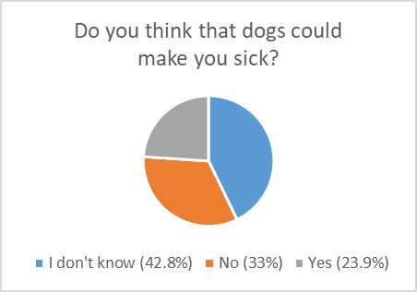
Access to Veterinary Care in Rural Alaska
Summary of Survey Results
To participate in the survey, visit surveymonkey.com/r/HealthyDogHealthyCommunityResidentSurvey
Notes:
There is very little veterinary care available in rural Alaska. This is a threat to both human and animal health. In fact, Alaska Native children are hospitalized from dog bites more than anyone else in the Indian Health Service system.
To increase the understanding of this issue, ANTHC’s Office of Community Environment and Health has been using an online survey for the last three years. Our goal is to measure access to veterinary care and learn how Alaska Native people think this lack of access affects their safety, physical and mental health.

Slide 13
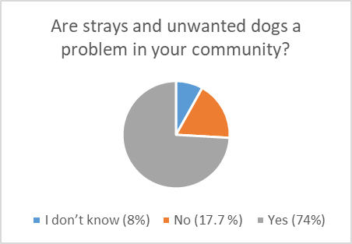
Access to Veterinary Care in Rural Alaska
Summary of Survey Results
To participate in the survey, visit surveymonkey.com/r/HealthyDogHealthyCommunityResidentSurvey
Notes:
There is very little veterinary care available in rural Alaska. This is a threat to both human and animal health. In fact, Alaska Native children are hospitalized from dog bites more than anyone else in the Indian Health Service system.
To increase the understanding of this issue, ANTHC’s Office of Community Environment and Health has been using an online survey for the last three years. Our goal is to measure access to veterinary care and learn how Alaska Native people think this lack of access affects their safety, physical and mental health.

Slide 14
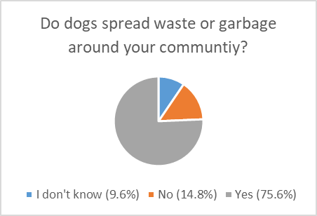
Access to Veterinary Care in Rural Alaska
Summary of Survey Results
To participate in the survey, visit surveymonkey.com/r/HealthyDogHealthyCommunityResidentSurvey
Notes:
There is very little veterinary care available in rural Alaska. This is a threat to both human and animal health. In fact, Alaska Native children are hospitalized from dog bites more than anyone else in the Indian Health Service system.
To increase the understanding of this issue, ANTHC’s Office of Community Environment and Health has been using an online survey for the last three years. Our goal is to measure access to veterinary care and learn how Alaska Native people think this lack of access affects their safety, physical and mental health.

Slide 15
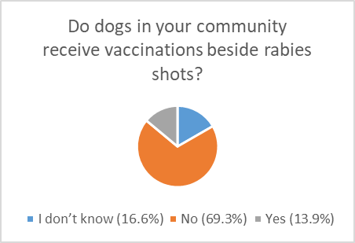
Access to Veterinary Care in Rural Alaska
Summary of Survey Results
To participate in the survey, visit surveymonkey.com/r/HealthyDogHealthyCommunityResidentSurvey
Notes:
There is very little veterinary care available in rural Alaska. This is a threat to both human and animal health. In fact, Alaska Native children are hospitalized from dog bites more than anyone else in the Indian Health Service system.
To increase the understanding of this issue, ANTHC’s Office of Community Environment and Health has been using an online survey for the last three years. Our goal is to measure access to veterinary care and learn how Alaska Native people think this lack of access affects their safety, physical and mental health.

Slide 16
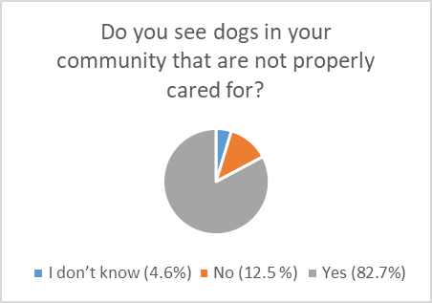
Access to Veterinary Care in Rural Alaska
Summary of Survey Results
To participate in the survey, visit surveymonkey.com/r/HealthyDogHealthyCommunityResidentSurvey
Notes:
There is very little veterinary care available in rural Alaska. This is a threat to both human and animal health. In fact, Alaska Native children are hospitalized from dog bites more than anyone else in the Indian Health Service system.
To increase the understanding of this issue, ANTHC’s Office of Community Environment and Health has been using an online survey for the last three years. Our goal is to measure access to veterinary care and learn how Alaska Native people think this lack of access affects their safety, physical and mental health.

Slide 17
Introducing:
The Environmental Health Explorer Activity Book
What is it?
Who is it for?
How do I get them?
Christy McDonald
Field Environmental Health, ANTHC

Slide 20
Programming:
Give out the books
Tell kids to return with completed activities
Complete pledge and certificate and give out reward (if available)
Feel free to adapt programming to better fit your community, audience, or lesson plans.

Slide 21
Pledge and Certificate
Empower participants
Promote feeling of ownership
Make it a “thing”

Slide 22
Educator Guide and Answer Sheet

Slide 23
How to access the books?
There is a PDF available for download on the ATCEM Community Resources page under Environmental Health Youth Outreach
http://www.atcemak.com/environmental-health-youth-outreach/
Physical copies are available at request for communities in AK.

Slide 24

Book Request Logistics
Books are free.
We can work with you to arrange a pick up if you are in town or if we are traveling out your way.
We can mail them if you cover shipping costs.

Slide 25
How to request physical copies?
Email – ceh@anthc.org
Call – 907-729-4043
Provide information:
  Your name and contact info (email/phone)
  Community name
  Number of books you need
  Best method to get them to you (handoff in ANC, by mail, …)
  If mailing, an address

Slide 26
Thank You
Russ Cameron
Assistant Environmental Health Consultant
rdcameron@anthc.org / 907-729-5612
Christy McDonald
Assistant Environmental Health Consultant
mcmcdonald1@anthc.org / 907-729-3640

Slide 27
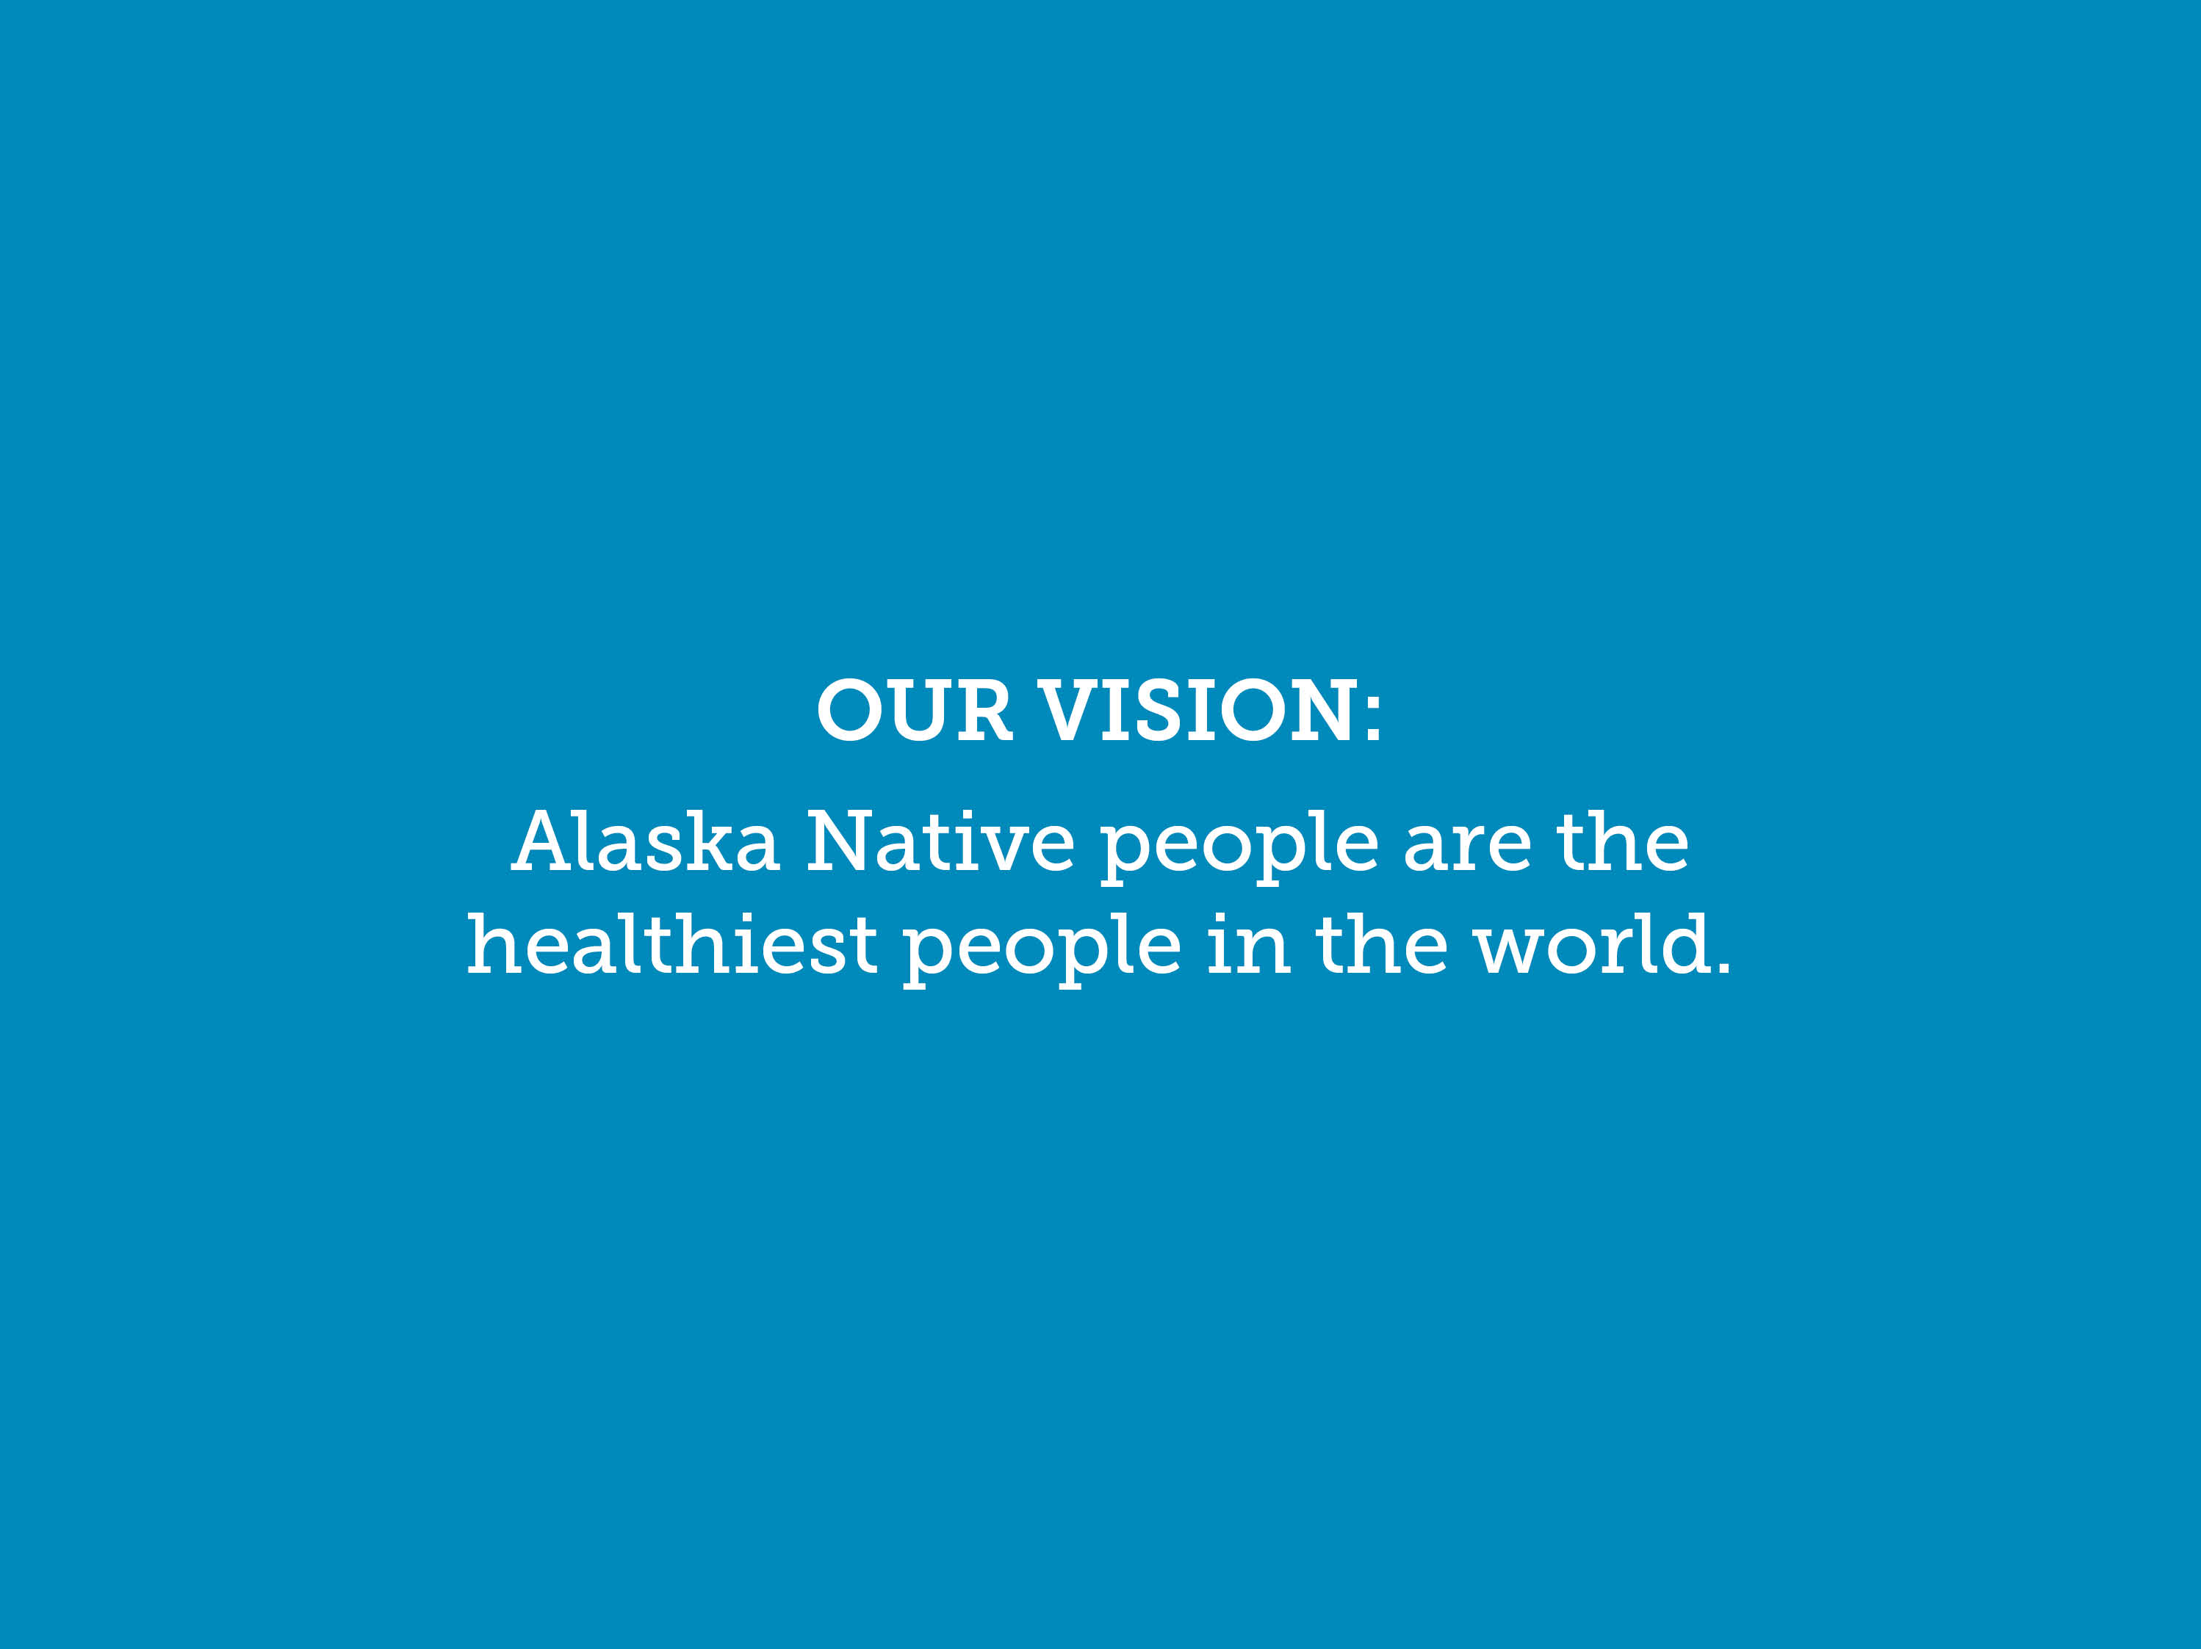

Slide 28


