Slide 1
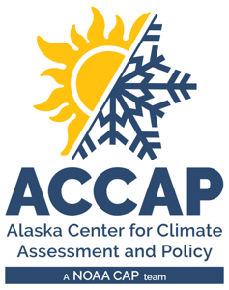
LEO Alaska Webinar Autumn 2024 Climate Review Winter 2024-25 Climate Outlook
Rick Thoman
Alaska and Arctic Climate Specialist
rthoman@alaska.edu
December 17, 2024

Slide 2
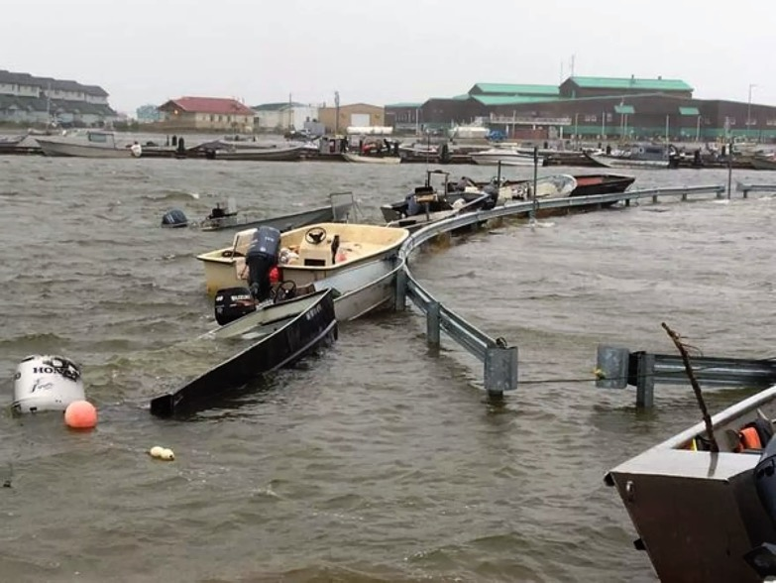
Autumn 2024 Alaska Highlights
North Slope
Utqiaġvik average temperature 28.5°F, third warmest autumn on record
Western Alaska
Coastal flooding Oct 20-22. Kotzebue: Worst flooding in living memory. Also significant flooding at Shishmaref, Scammon Bay and Nunam Iqua
Interior
Fairbanks area Slushmaggdon Oct 20-21. Thousands without power for days
Southcentral
Anchorage: Oct 28-31, 21” snow: highest 4-day total snow before December
Kotzebue
October 21, 2024
Photo credit: NW Arctic Borough EM

Slide 3
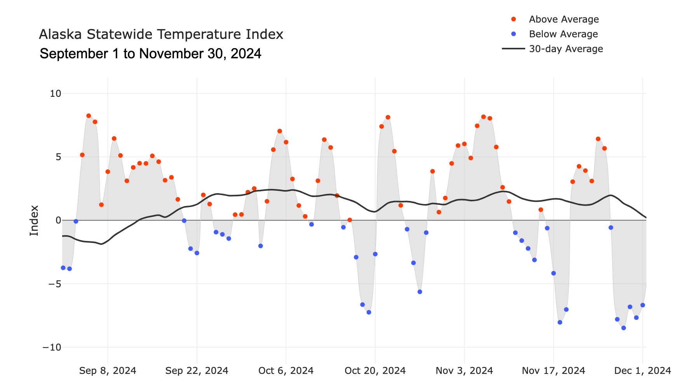
Alaska Daily Temperature Index

Slide 4
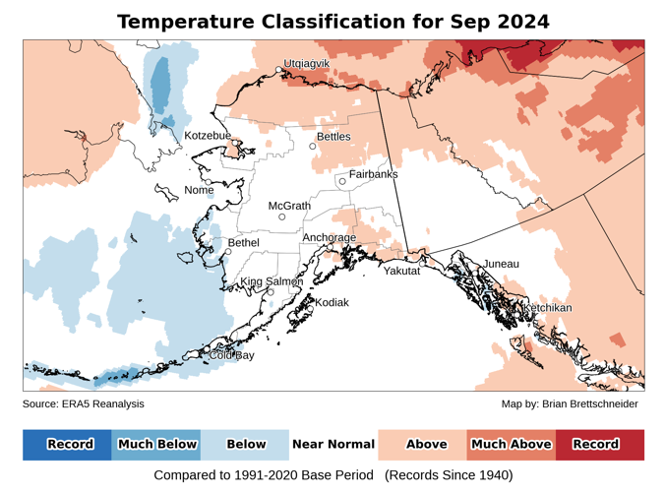
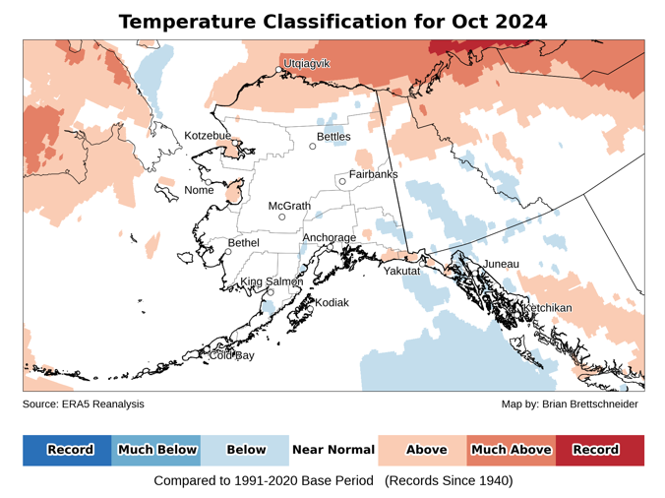
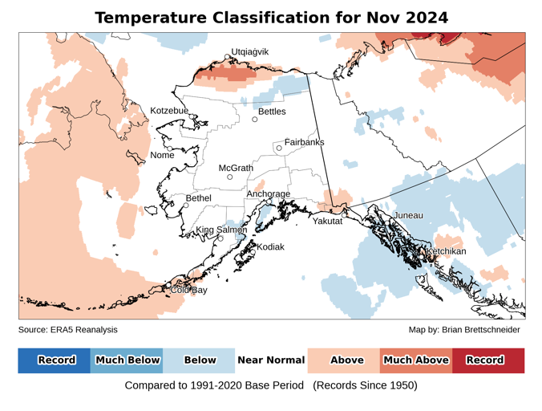
Autumn 2024 Temperature
Data: ERA5 courtesy of EMCWF/Copernicus
1991-2020 Baseline
Notes:
AK Summer: 45% of Alaska land area temp above normal, first summer since 2014 with less than half of the state warmer than normal
YT Summer: 4th summer in a row 100% above normal
NWT Summer: 99% above normal but lowest since 2021
AK Summer: 83% of Alaska land area above normal precipitation. Highest since 1998

Slide 5
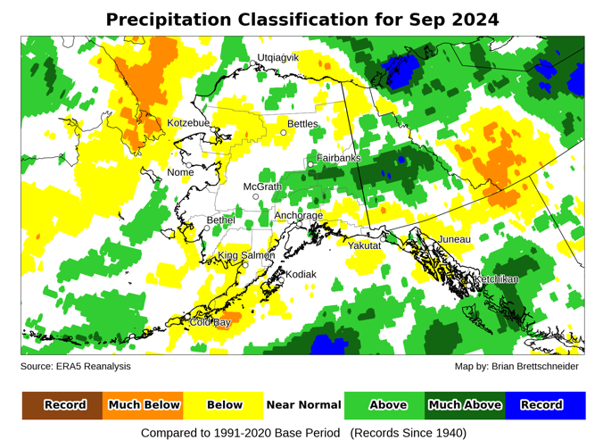
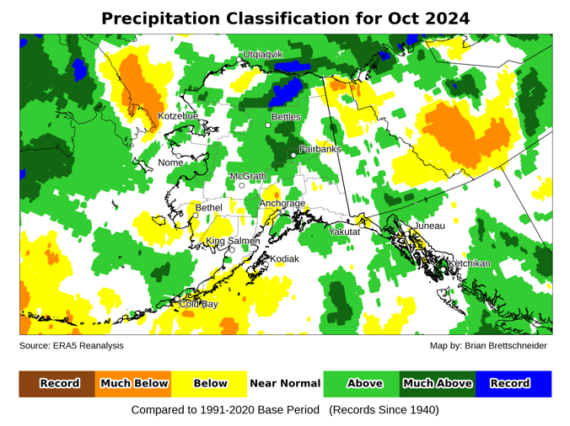
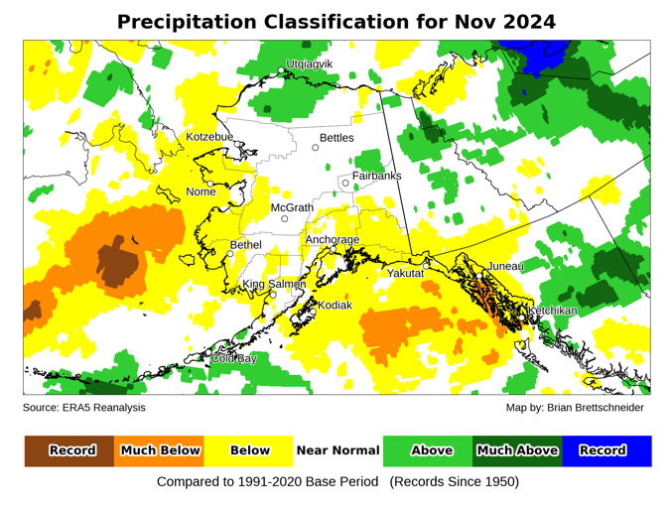
Autumn 2024 Precipitation
Data: ERA5 courtesy of EMCWF/Copernicus
1991-2020 Baseline
Notes:
AK Summer: 45% of Alaska land area temp above normal, first summer since 2014 with less than half of the state warmer than normal
YT Summer: 4th summer in a row 100% above normal
NWT Summer: 99% above normal but lowest since 2021
AK Summer: 83% of Alaska land area above normal precipitation. Highest since 1998

Slide 6
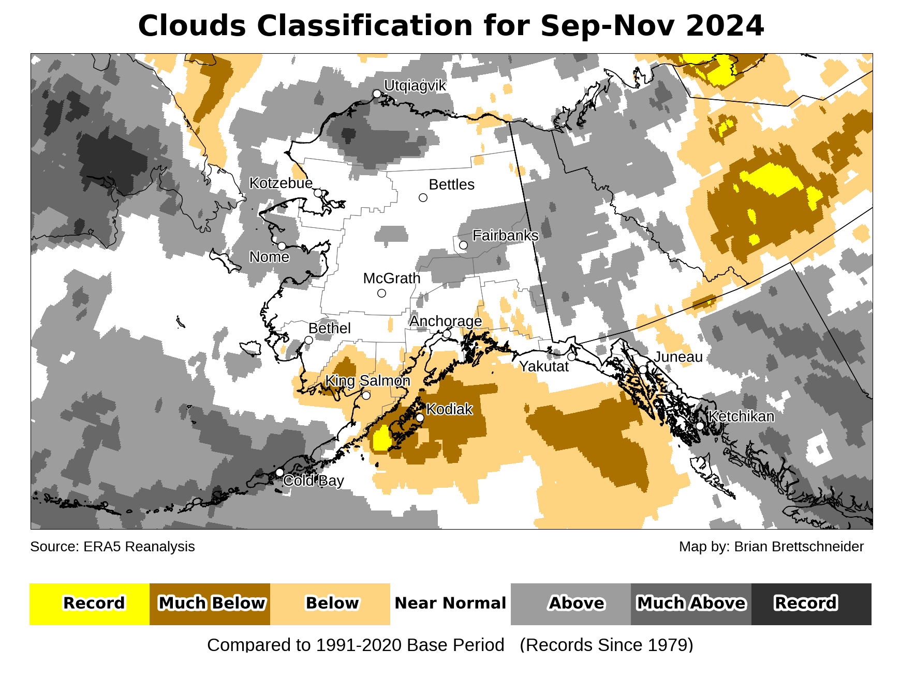
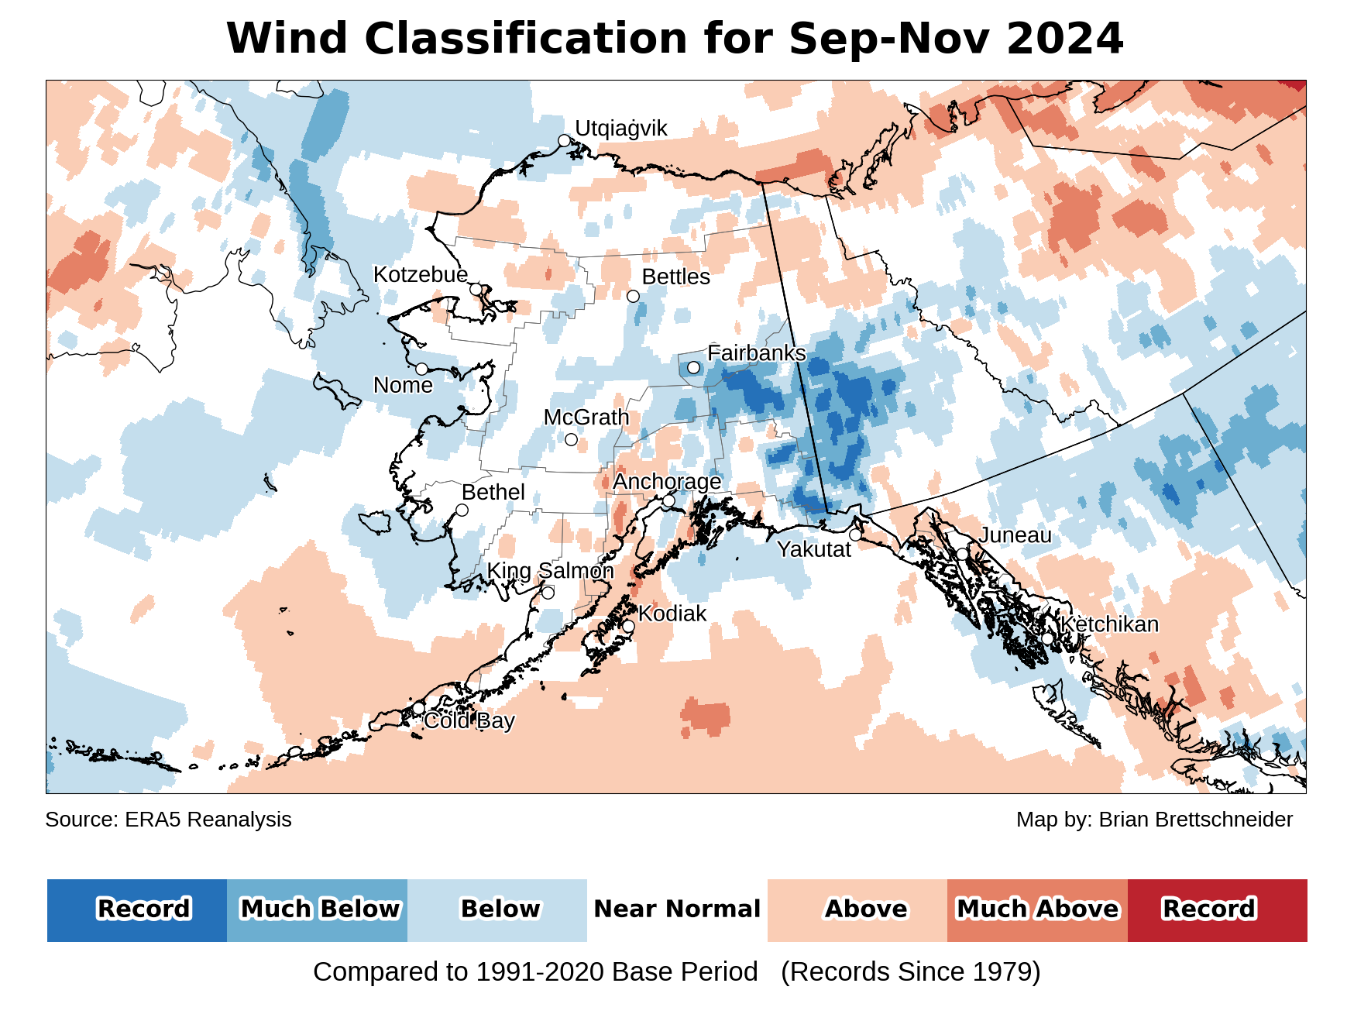
Autumn 2024 cloudiness & wind
Data: ERA5 courtesy of EMCWF/Copernicus
1991-2020 Baseline
Notes:
AK Summer: 45% of Alaska land area temp above normal, first summer since 2014 with less than half of the state warmer than normal
YT Summer: 4th summer in a row 100% above normal
NWT Summer: 99% above normal but lowest since 2021
AK Summer: 83% of Alaska land area above normal precipitation. Highest since 1998

Slide 7
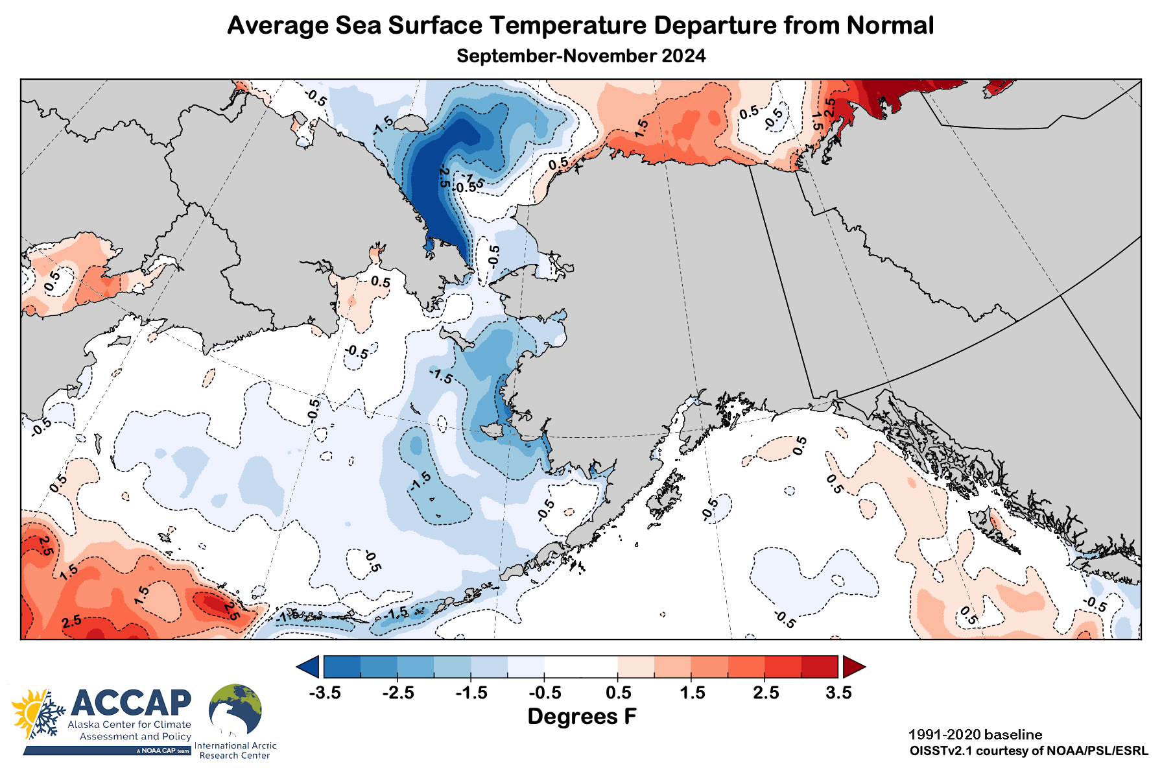
Autumn 2024 sea surface temperatures

Slide 8
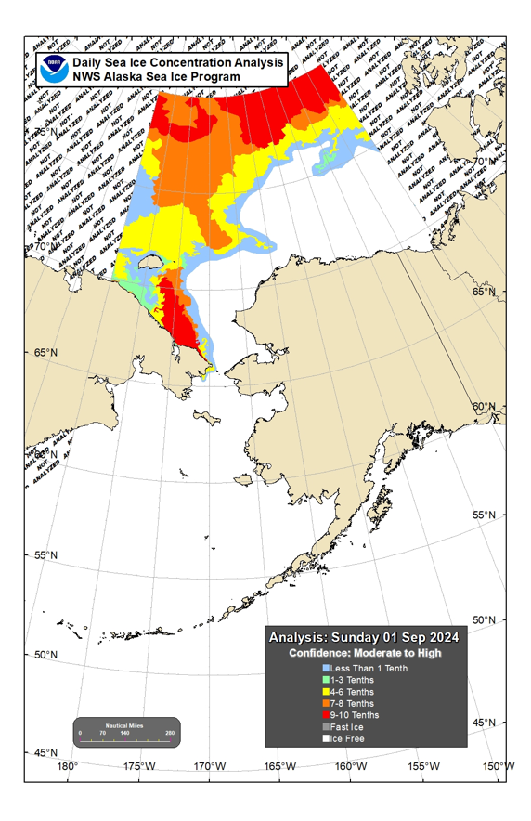
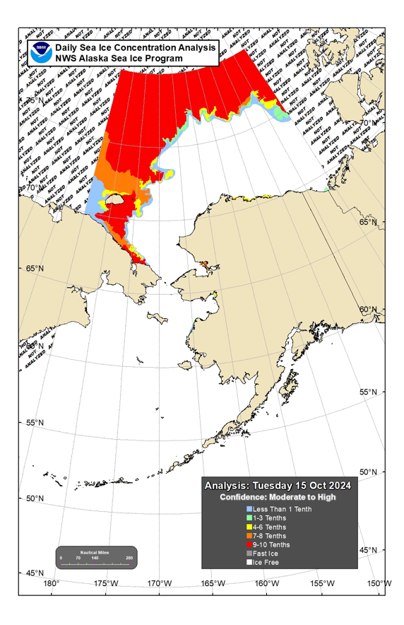
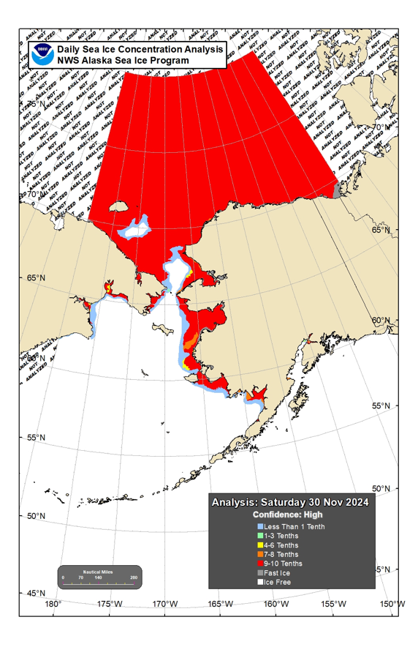
Sea Ice Extent: Autumn 2024
September 1
October 15
November 30

Slide 9
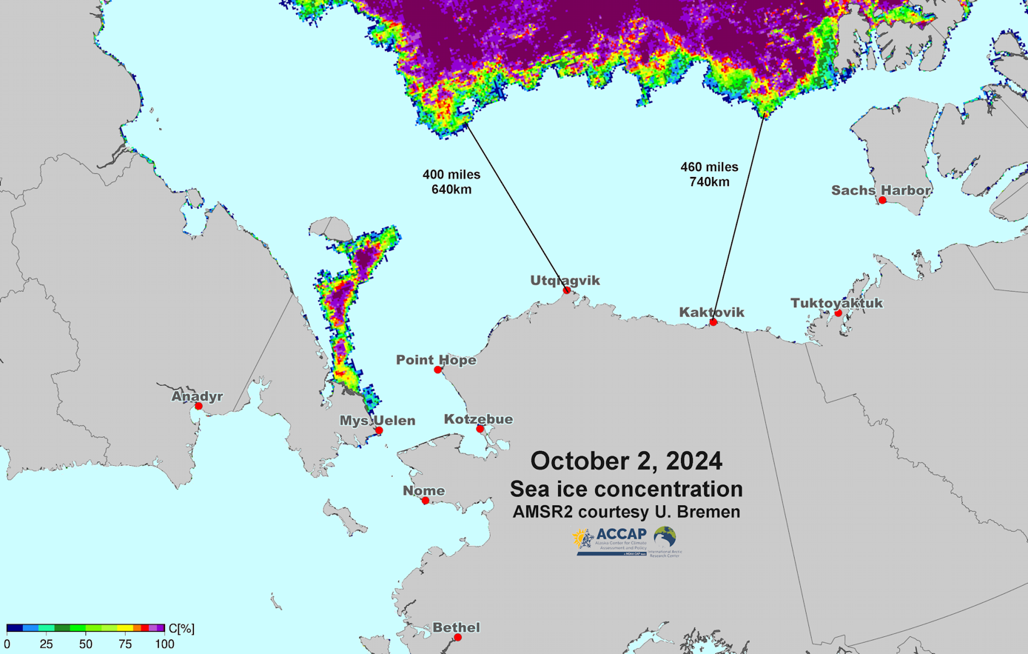
Ice distant from Alaska

Slide 10
Winter 2024-25 Outlooks
Arctic Sea Ice Experimental Outlook
NOAA/Climate Prediction Center
Alaska and past La Niñas
Autumn Temperature and Precipitation

Slide 11
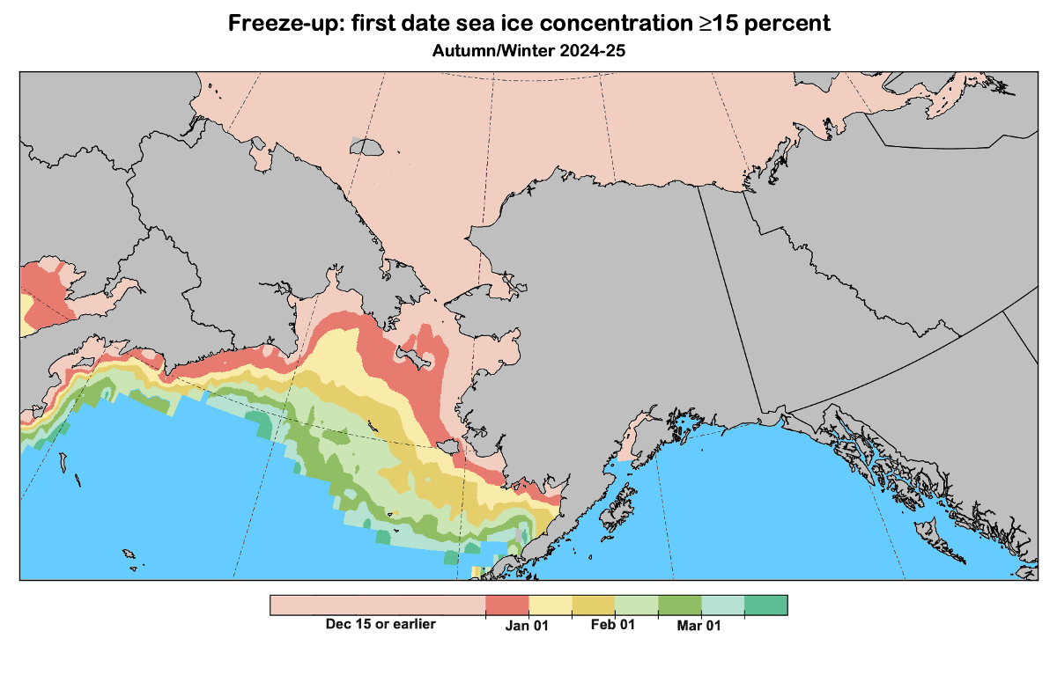
Sea Ice Outlook: Fall/Winter 2024
Data: NOAA/Climate Prediction Center Exp. Sea Ice Outlook
Outlook produced from late November 2024 data

Slide 12
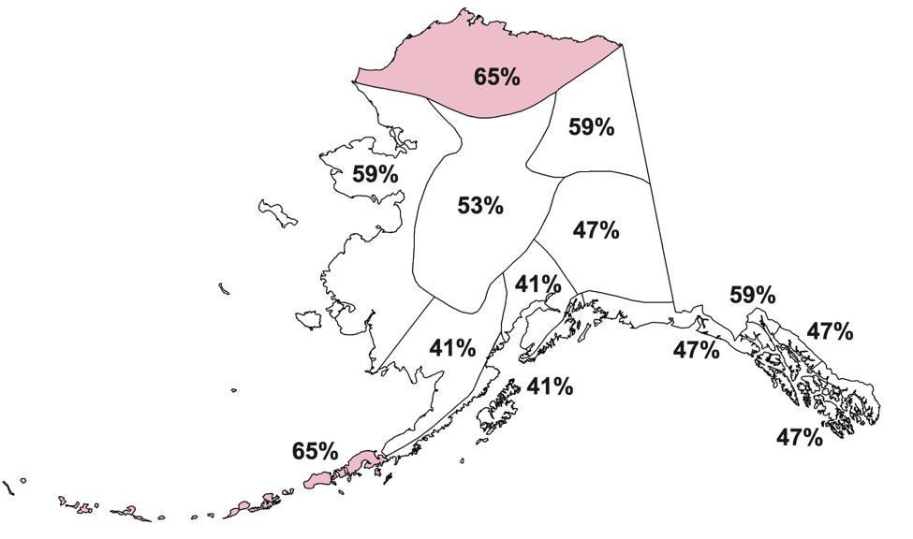
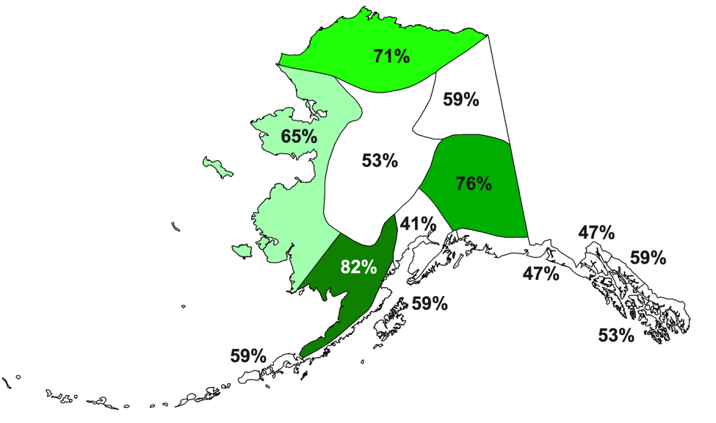
La Niña and Alaska Winters
Temperature
Percent seasons above normal
Precipitation
Percent seasons above normal
17 La Niña winter since 1976

Slide 13
Winter 2024-25 NOAA Climate Prediction Center Outlooks
Average Temperature
Total Precipitation
December 2024 through February 2025

Slide 14
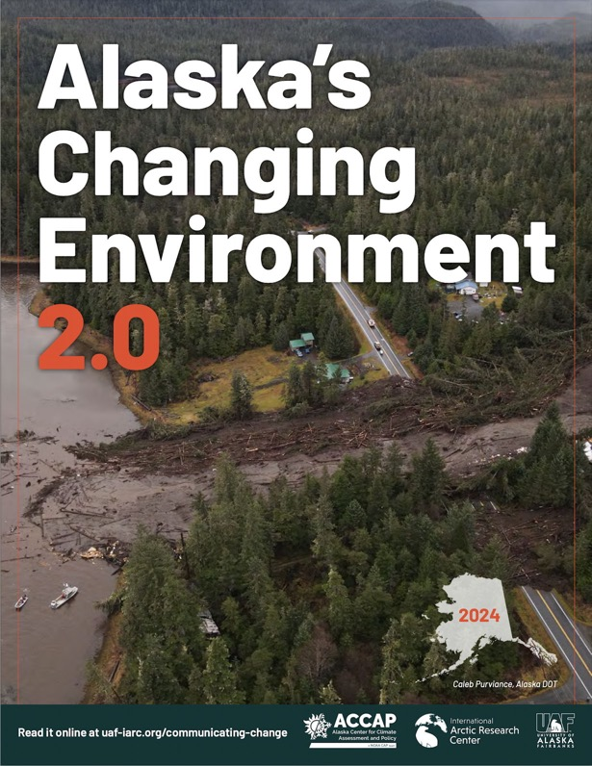
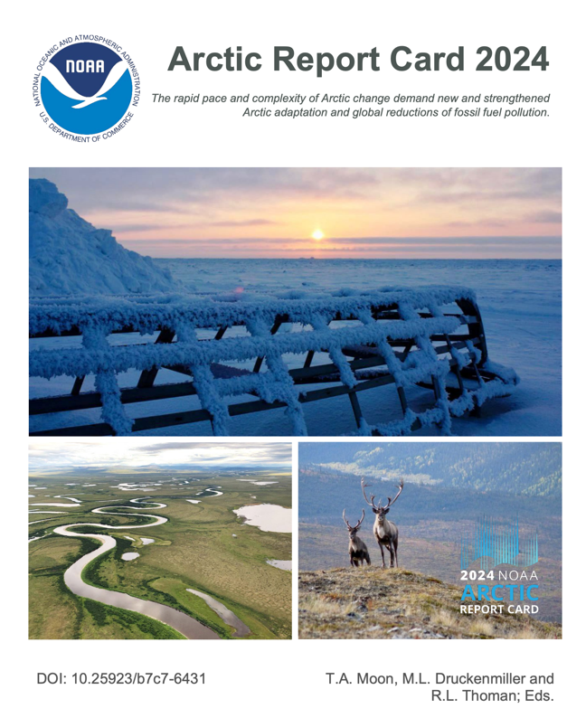
Two brand new climate reports
https://uaf-accap.org/alaskas-changing-environment/
https://arctic.noaa.gov/report-card/report-card-2024/

Slide 15
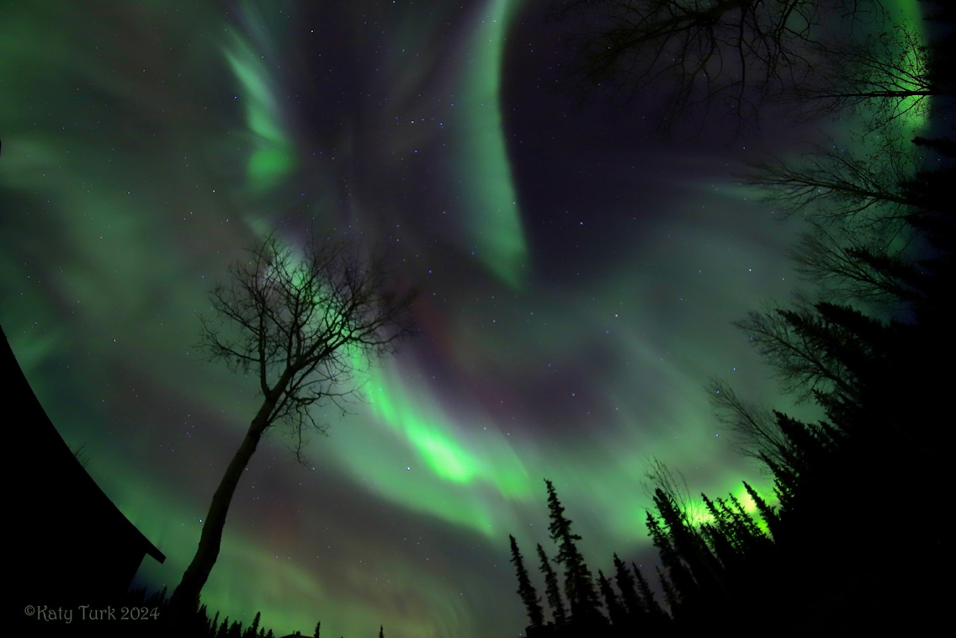
Thanks very much Questions?
Sep 28th
Aurora at Tok
Credit: K. Turk

