Slide 1


FALL STORMS AND IMPACTS
By: Eric Drewitz and Eddie Zingone

Slide 2
COASTAL FLOODING
Coastal flooding is a major impact of fall storms, especially east and south of the center of the low as in these areas onshore flow is the strongest and ‘fetch’ of the waves is longest.
Four main things to take into account when forecasting coastal flooding:
  The track of the low (this determines the wind direction and speed at a given location).
  Fetch - the distance the waves have over open water to build.
  Tides (i.e. Are we at high or low tide? Is the tide coming in or ebbing?)
  Coastal geometry
    Is the coastline concave or convex? Are there any “conical” shaped inlets?
    Bathymetry of the coast

Slide 3
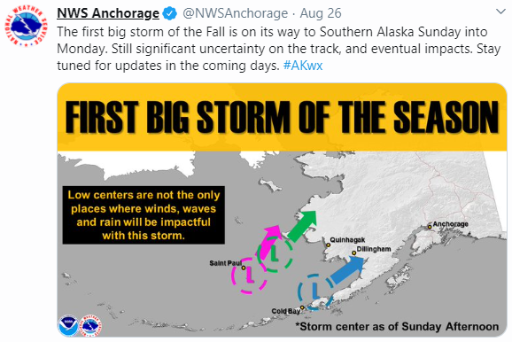
Storm Track
Notes:
The low track makes a huge difference as to whether any storm surge makes it into Bristol Bay or Kuskokwim Bay. The Pink and Green tracks can bring in a storm surge while the blue track will not.

Slide 4
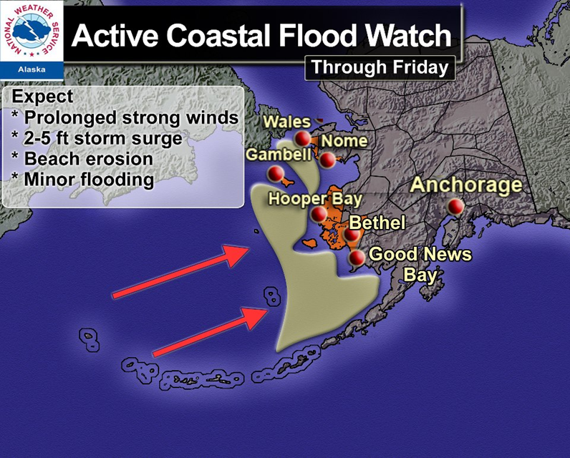
From 2012 - Not a current product!!!!

Slide 5
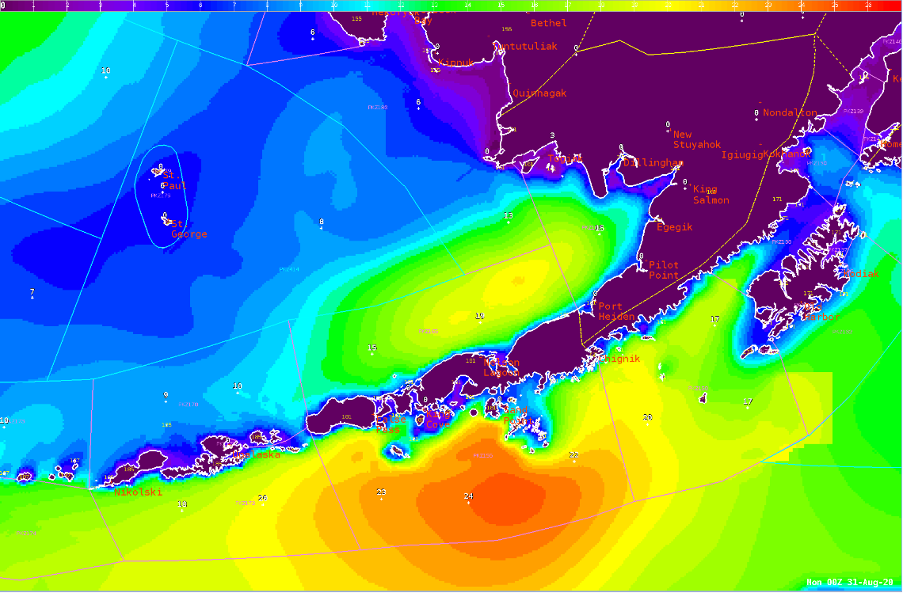
Wave Heights
L
Notes:
The importance of fetch. In spite of the strong low near Cape Newenham, the presence of the Alaska Peninsula keeps the highest seas out of the Bering Sea and south of the Peninsula. The seas that will produce a storm surge have to begin building again and can only reach about 15 feet instead of nearly 25 feet. Arrows denote the direction waves are moving.

Slide 6
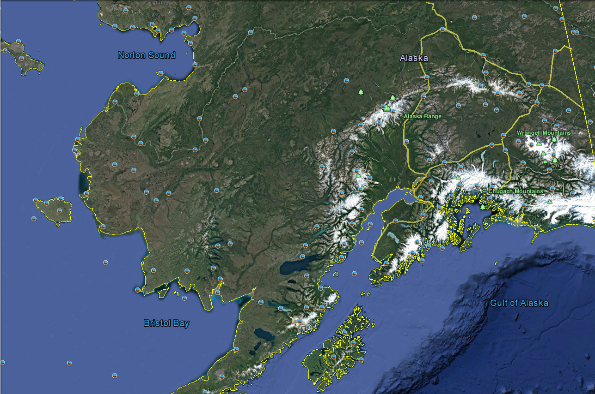
COASTAL GEOMETRY
Areas with a concave (where the coast caves inward) coastline (Kuskokwim Delta, Bristol Bay, etc.) are more prone to enhanced coastal flooding as the water will funnel into those areas, especially if the inlet has a conical shape.
Areas with a convex (where the coast juts outward) coastline (Cape Newenham) are less prone to enhanced coastal flooding.

Slide 7
EXTRA-TROPICAL STORM SURGE (ETSS) GUIDANCE
Is a good tool to use when forecasting storm surge and coastal flooding.
Has both an operational and probabilistic mode.
  Operational mode forecasts the water level for a given point at a given time.
  Probabilistic mode forecasts the probability of the water level reaching a certain height.
Takes tides into account.
ETSS Guidance can be found at: https://slosh.nws.noaa.gov/etsurge2.0/

Slide 8
USEFUL DEFINITIONS
Mean Higher High Water (MHHW) – the average of the higher two high tide cycles during a 24-hour period. This equates to the average of the highest daily tides during normal conditions.
Highest Astronomical Tide (HAT) -- the highest expected tide over the period of measurement (often several years) due to forces of the sun and moon alone.
Mean Lower Low Water (MLLW) – the average of the lower two low tide cycles during a 24-hour period. This equates to the average of the lowest daily tides during normal conditions.

Slide 9
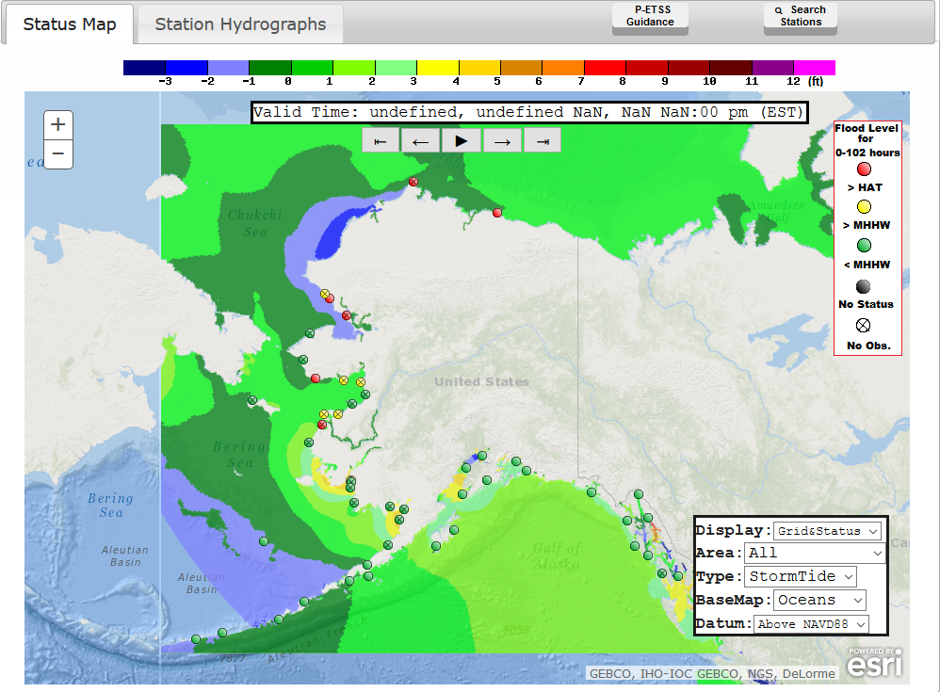
EXTRA-TROPICAL STORM SURGE (ETSS) MAP
Green means the highest water level is lower than the MHHW.
Yellow means the highest water level is higher than the MHHW but lower than HAT.
Red means the highest water level is higher than HAT.

Slide 10
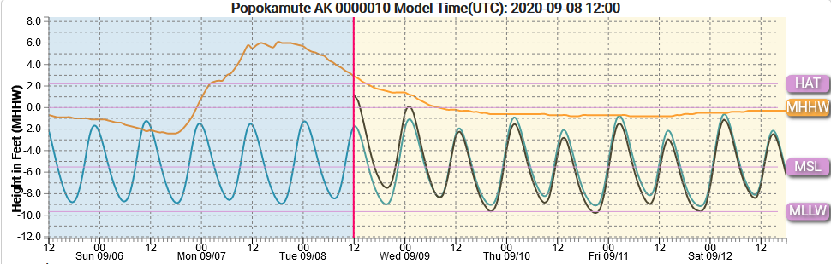
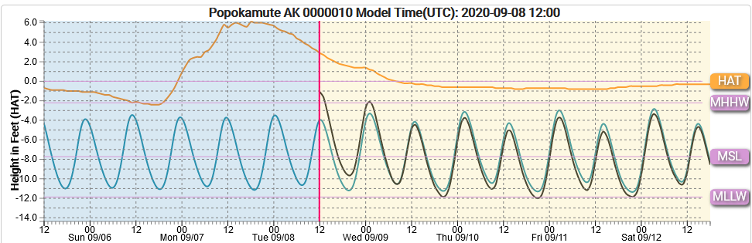
EXTRA-TROPICAL STORM SURGE (ETSS) HYDROGRAPHS
You can change your water level reference by clicking on the different options on the right (MLLW, MSL, MHHW and HAT)

Slide 11
TYPES OF COASTAL FLOOD WARNINGS AND ADVISORIES COASTAL FLOODING
Coastal Flood Advisory: Designed to address the threat of coastal flooding to those in areas that are impacted when water levels exceed Highest Astronomical Tide by about 2-4 feet.
Coastal Flood Warning: Designed to address the threat of coastal flooding to those in areas that are impacted when water levels exceed Highest Astronomical Tide exceed 4 feet.
A forecasted prolonged event in the Coastal Flood Advisory criteria may necessitate being upgraded to a Coastal Flood Warning due to water column stacking along the coast.

Slide 12
TYPES OF COASTAL FLOOD WARNINGS AND ADVISORIES HIGH SURF
High Surf Advisory: Designed mainly to address the threat of erosion due to high surf and to those in the surf zone (the area where the waves break) of the potential threat to life and property. Usually issued when water levels are forecast to exceed Highest Astronomical Tide by 1-2 feet and significant breaking waves are expected.
High Surf Warning: A High Surf Warning is issued when breaking wave action results in an especially heightened threat to life and property along the coast. These are rarely issued as in these situations a Coastal Flood Warning is typically more appropriate.

Slide 13
RIVER FLOODING
Heavy rain associated with these storms can cause river flooding.
Fall storms can tap into an ‘Atmospheric River’ which brings in a large amount of rainfall to a region.
Water levels in rivers and streams can be measured with hydrographs.
There are four common terms with respect to river flooding:
  Action Stage
  Minor Flood Stage
  Moderate Flood Stage
  Major Flood Stage

Slide 14
Atmospheric Rivers
Atmospheric Rivers are relatively long, narrow regions in the atmosphere – like rivers in the sky – that transport most of the water vapor outside of the tropics.
They can occur in Alaska any time of year, but are most common in the Fall.
The Atmospheric river on the following True-Color Satellite Image was taken on Thursday, September 17, 2020 from GOES-17.
  The front at the southern end of the system begins around 35N and heads unimpeded into Southern Alaska.

Slide 15
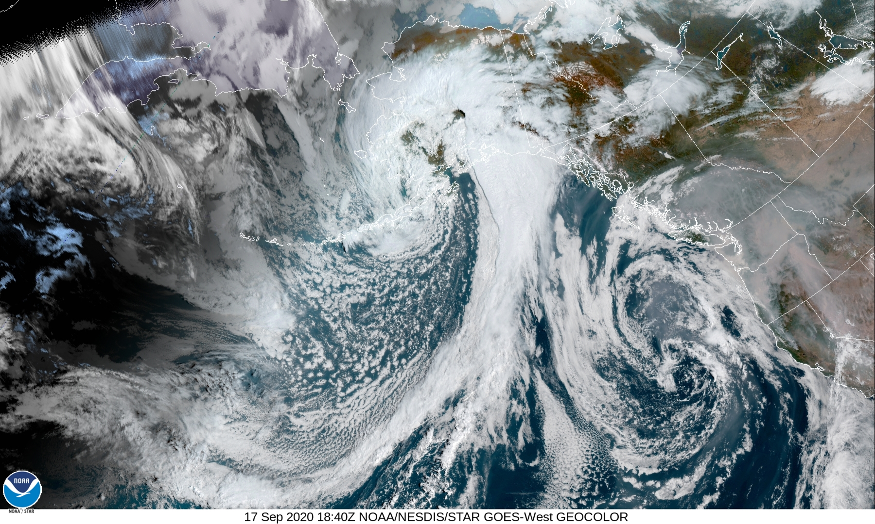
Atmospheric River

Slide 16
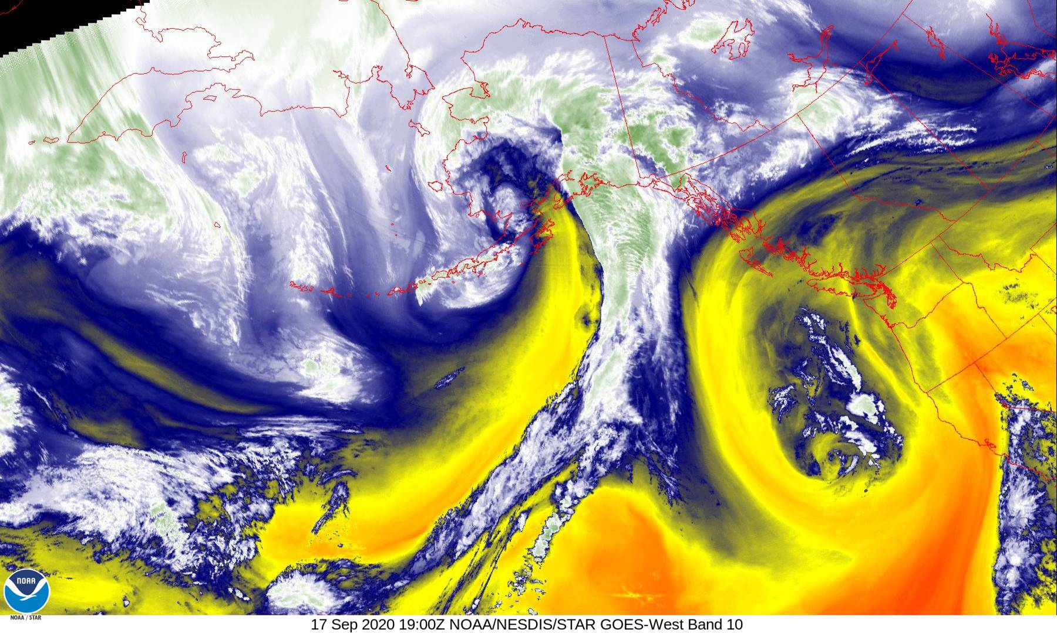

Slide 17
ACTION STAGE
This is when a river is at the maximum capacity of water that it can hold without flooding the surrounding areas. This is the level where people near the affected area take action in preparation for possible significant hydrologic activity.
The type of action taken varies for each gage location. Gage data should be closely monitored by any affected people if the stage is above action stage.

Slide 18
MINOR FLOOD STAGE
Defined to have minimal or no property damage, but possibly some public threat.
A Flood Advisory product is often issued to advise the public of flood events that are expected not to exceed the minor flood category, although a Flood Warning may be issued for minor flooding in heavily populated areas.
Examples of conditions that would be considered minor flooding include:
  Water over banks and in yards
  No building flooded, but some water may be under buildings built on stilts (elevated).
  Water overtopping roads, but not very deep or fast flowing
  Water in campgrounds or on bike paths
  Inconvenience or nuisance flooding
  Small part of the airstrip flooded, and aircraft can still land
  One or two homes in the lowest parts of town may be cut off or get a little water in the crawl spaces or homes themselves if they are not elevated.

Slide 19
MODERATE FLOOD STAGE
Defined to have some inundation of structures and roads near the stream.
Some evacuations of people and/or transfer of property to higher elevations may be necessary.
A Flood Warning should be issued if moderate flooding is expected during the event.

Slide 20
EXAMPLES OF MODERATE FLOOD STAGE
Several buildings flooded with minor or moderate damage.
Various types of infrastructure rendered temporarily useless (i.e. fuel tanks cannot be reached due to high water, roads flooded that have no alternates, generator station flooded).
Personal property in low lying areas needs to be moved or it will get wet.
Elders and those living in the lowest parts of the village are evacuated to higher ground.
Access to the airstrip is cut off or requires a boat.
Water over the road is deep enough to make driving unsafe.
Gravel roads likely eroded due to current moving over them.
Widespread flooding, but not deep enough to float ice chunks through town.
Water deep enough to make life difficult, normal life is disrupted and some hardship is endured.
Airstrip closed.
Travel is most likely restricted to boats.

Slide 21
MAJOR FLOOD STAGE
Defined to have extensive inundation of structures and roads.
Significant evacuations of people and/or transfer of property to higher elevations are necessary.
A Flood Warning should be issued if major flooding is expected during the event.

Slide 22
EXAMPLES OF MAJOR FLOOD STAGE
Many buildings flooded, some with substantial damage or destruction.
Infrastructure destroyed or rendered useless for an extended period of time.
Multiple homes are flooded or moved off foundations.
Everyone in threatened area is asked to evacuate.
National Guard units assist in evacuation efforts.
Erosion problems are extreme.
The airstrip, fuel tanks, and the generator station are likely flooded.
Loss of transportation access, communication, power and/or fuel spills are likely.
Fuel tanks may float and spill and possibly float downstream.
Ice chunks floating through town that could cause structural damage.
High damage estimates and high degree of danger to residents.

Slide 23
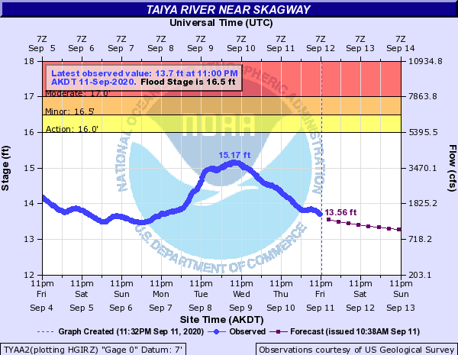
HYDROGRAPHS
Hydrographs can be found at: https://www.weather.gov/aprfc/AHPSMonitor
The blue line is observed water levels and the purple line is the forecast water levels from the River Forecast Center.
The yellow, orange and red areas at the top correspond to action stage, minor flood and moderate flood stage.
Hydrographs are real-time guidance to monitor river flooding.

Slide 24
HIGH WINDS
Another hazard associated with fall storms are high winds.
Areas such as inlets, channels, fjords, Turnagain Arm are likely to have enhanced winds due to localized funneling between the terrain.

Slide 25
HIGH WIND WARNINGS
High Wind Warnings are issued if the forecast sustained wind and/or wind gusts are greater than or equal to 75mph.

Slide 26
HOW TO SUBMIT STORM REPORTS
Reports can be submitted at: https://www.weather.gov/aprfc/submit?site=afc
Reports can also be submitted by phone: (907)266-5105.
Email: anchorage.weather@noaa.gov

