Slide 1
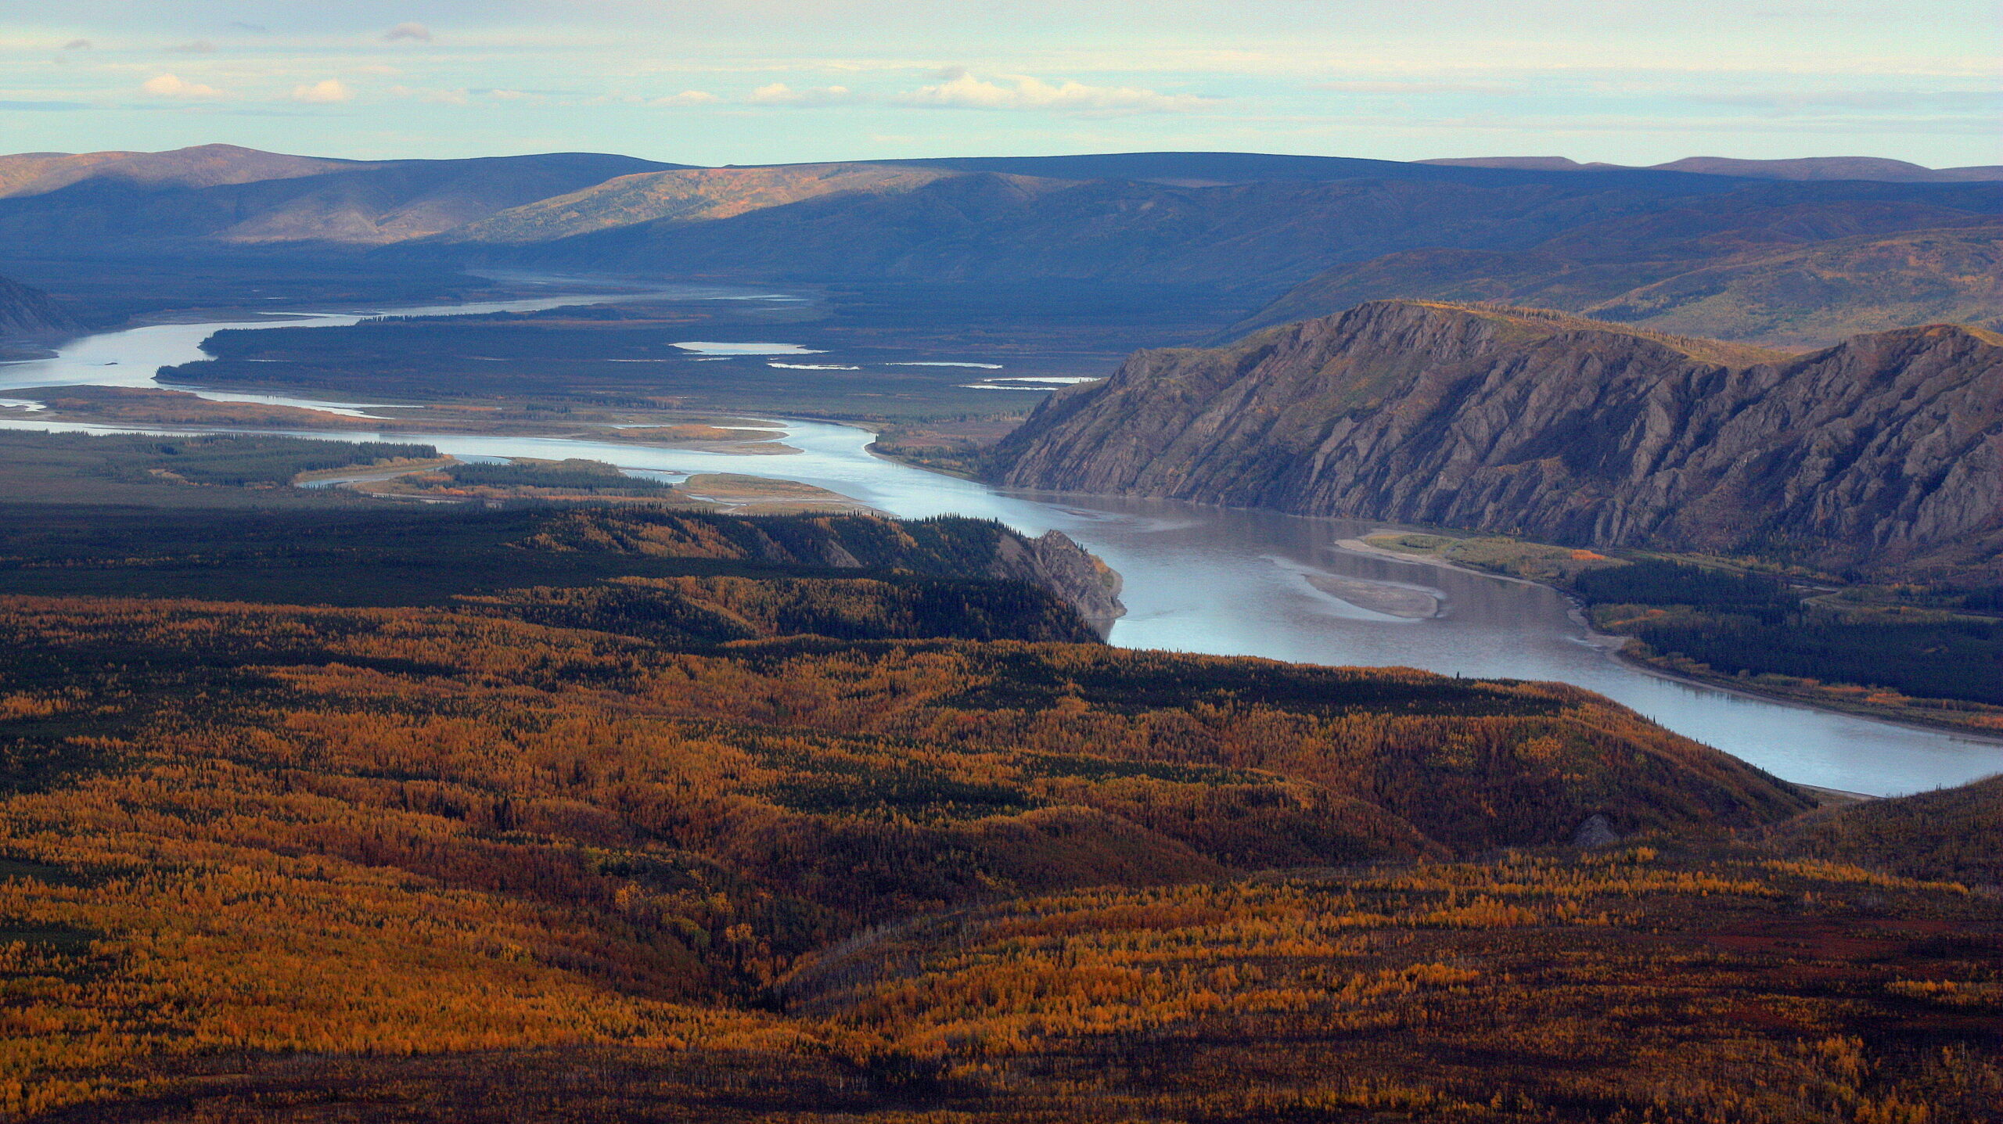

LEO Network Training: Community Perspectives on the Yukon
Presenters
Charles Peterson – Journey Along the Yukon
Travis Kassaiuli – Documenting Environmental Change Through Video
Agenda
02:00 Welcome to LEO Training Recording Recognition, Agenda Review
02:05 Traveling the Yukon: Stories and Environmental Observations from Nenana to Nome --Charles Peterson, Nome, Alaska
02:40 Observations from Emmonak
02:55 Wrap Up and Webinar Survey
03:00 Adjourned
Next Webinar: September 2026 Next Training: August 2026
Notes:
https://i.pinimg.com/originals/17/0c/99/170c9943658b82486a2614f426d5fbe1.png

Slide 2
Shared Learning Outcomes
Participants will:
Appreciate the importance of community observations as an early source of information about environmental change.
Explore different ways to document and communicate observations, from storytelling to photography and video.
Recognize the value of combining local knowledge with technology to strengthen environmental monitoring.
Build confidence in contributing observations that can support communities, researchers, and decision-makers.

Slide 3
Charles Peterson – Journey Along the Yukon
Explore how traveling across a large geographic area provides a broader perspective on environmental change.
Understand how storytelling can communicate environmental observations in ways that are meaningful and accessible to communities.
Recognize connections between changes occurring in different regions and the value of observations made across landscapes.
Discuss how individual observations can contribute to a larger network of shared knowledge through the LEO Network.

Slide 4
Travis Kassaiuli– Documenting Environmental Change Through Video
Learn how video and digital media can be used to document and communicate environmental observations.
Explore practical online tools that support community-based observation and knowledge sharing
Understand how visual documentation can complement written observations submitted to the LEO Network.
Encourage participants to become active observers by using accessible technology to record and share environmental change.

Slide 5
Questions:
Any historical weather, stories or observations you would like to share? Any unusual changes during summer? Any changes in the berries, fish, or plants?
Let’s open up LEO and check out a few observations and events along the Yukon.

