Slide 1
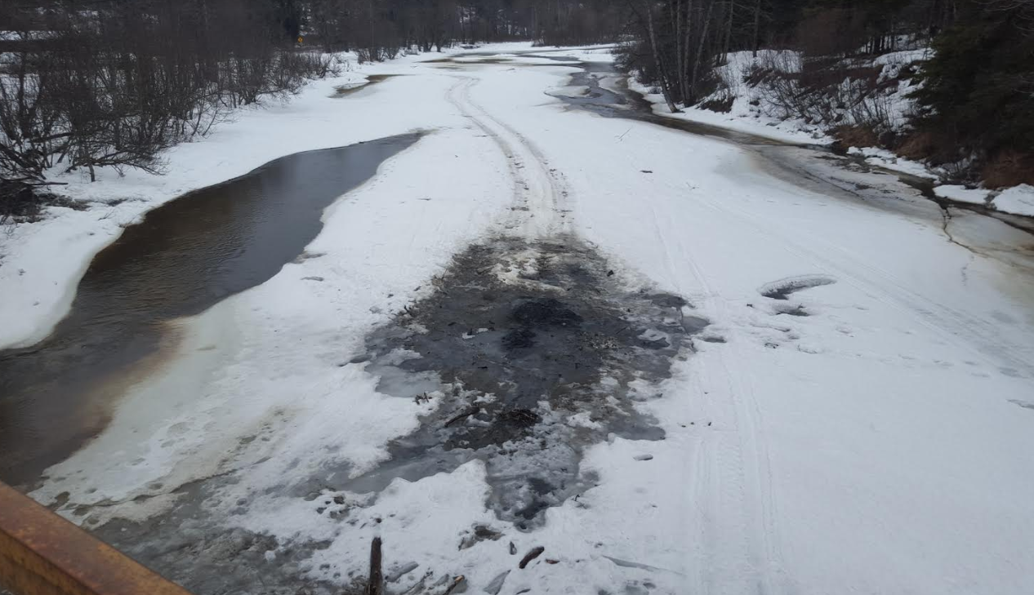
Alaska Pacific River Forecast Center March Spring Flood Outlook
Crane Johnson
Alaska Pacific River Forecast Center
March 19th 2019

Slide 2
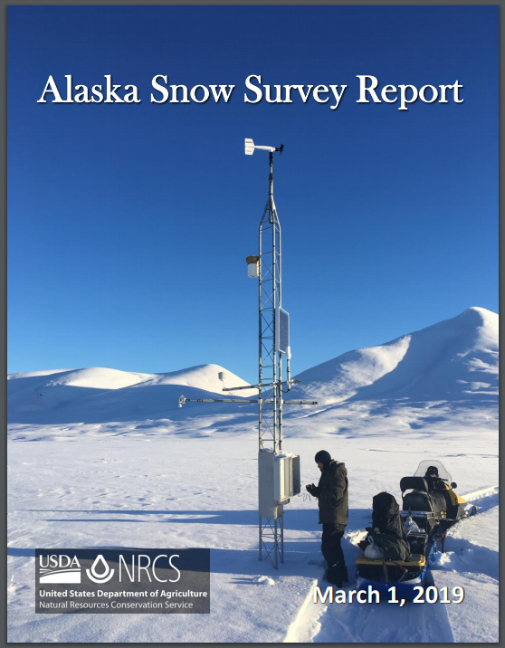
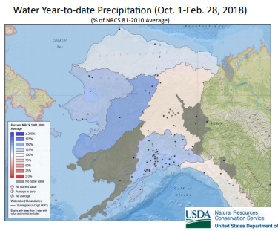
March 1st Winter Precipitation

Slide 3
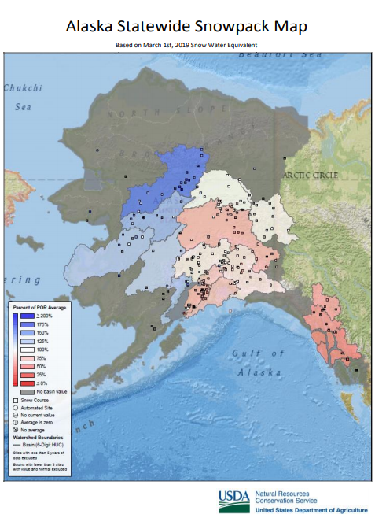
March 1st Snowpack Update

Slide 4
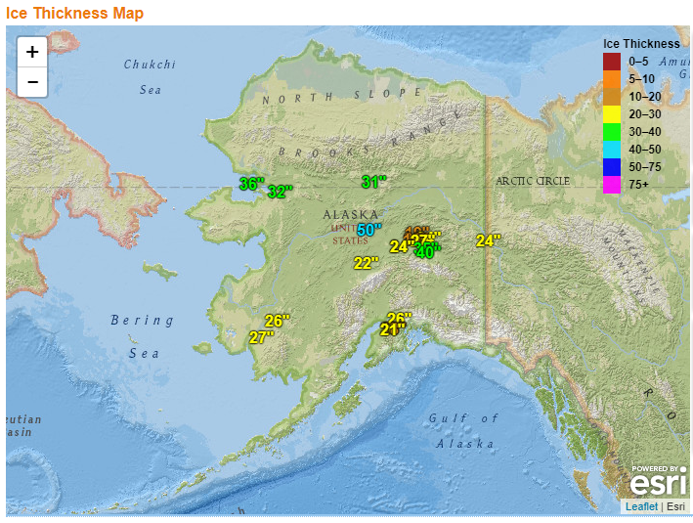
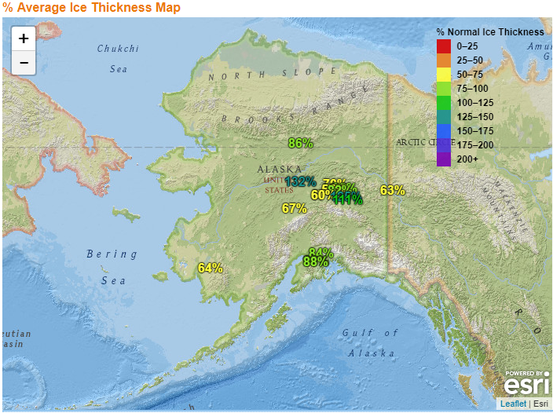
March 1st Ice Conditions

Slide 5
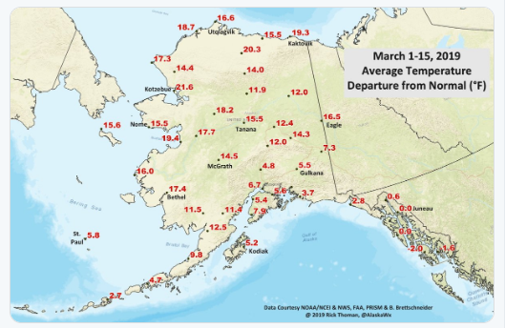
Average Temperatures above Normal

Slide 6
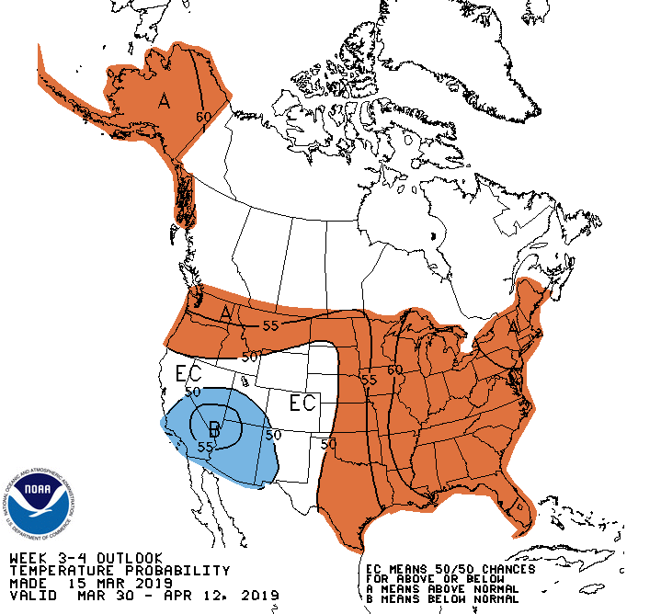
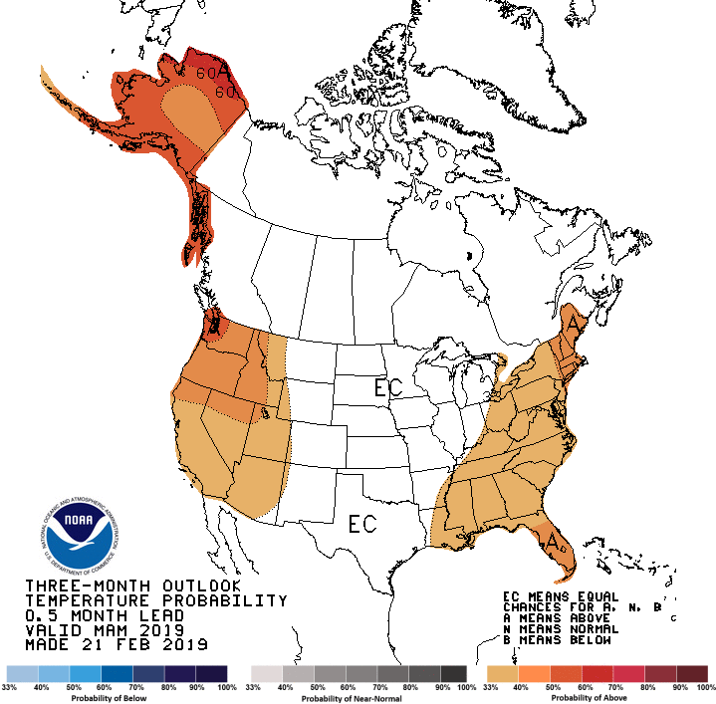
Temperature Outlook
Early April
March-April-May

Slide 7
Summary
Based on current conditions and forecast temperatures, spring breakup flood potential in Alaska is forecast to be average to below average.
It is still early in the season and this outlook could change based on current weather conditions.
A more detailed breakup outlook will be issued on April 10th.
River Forecast Center Group email (ANC)
nws.ar.aprfc@noaa.gov
907-266-5160
Crane Johnson
Alaska Pacific River Forecast Center
Benjamin.johnson@noaa.gov

