Slide 1
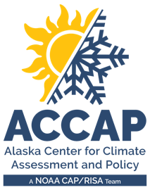
LEO Alaska Webinar Spring 2024 Climate Review Summer 2024 Climate Outlook
Rick Thoman
Alaska and Arctic Climate Specialist
rthoman@alaska.edu
June 18, 2024

Slide 2
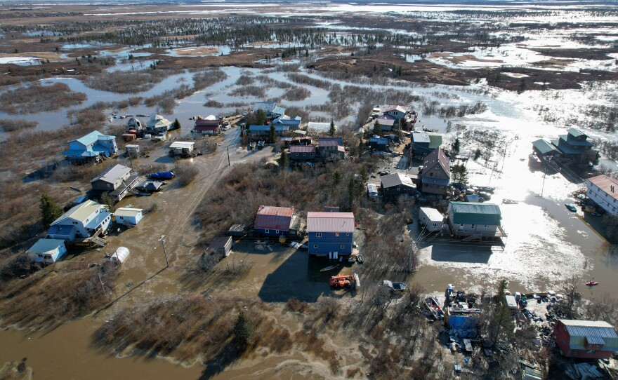
Spring 2024 Alaska Highlights
Western Alaska
Half a dozen storms late March to mid-April
Excessive snow some areas
North Slope
March: Lowest temperatures of the season, early April also very cold
YK Delta
Early to mid-May: significant ice jam and snow melt flooding
Kodiak
Heavy rain April 17-18, landslide near town
May 9 flooding in Bethel neighborhood
Credit: MaryCait Dolan/KYUK

Slide 3
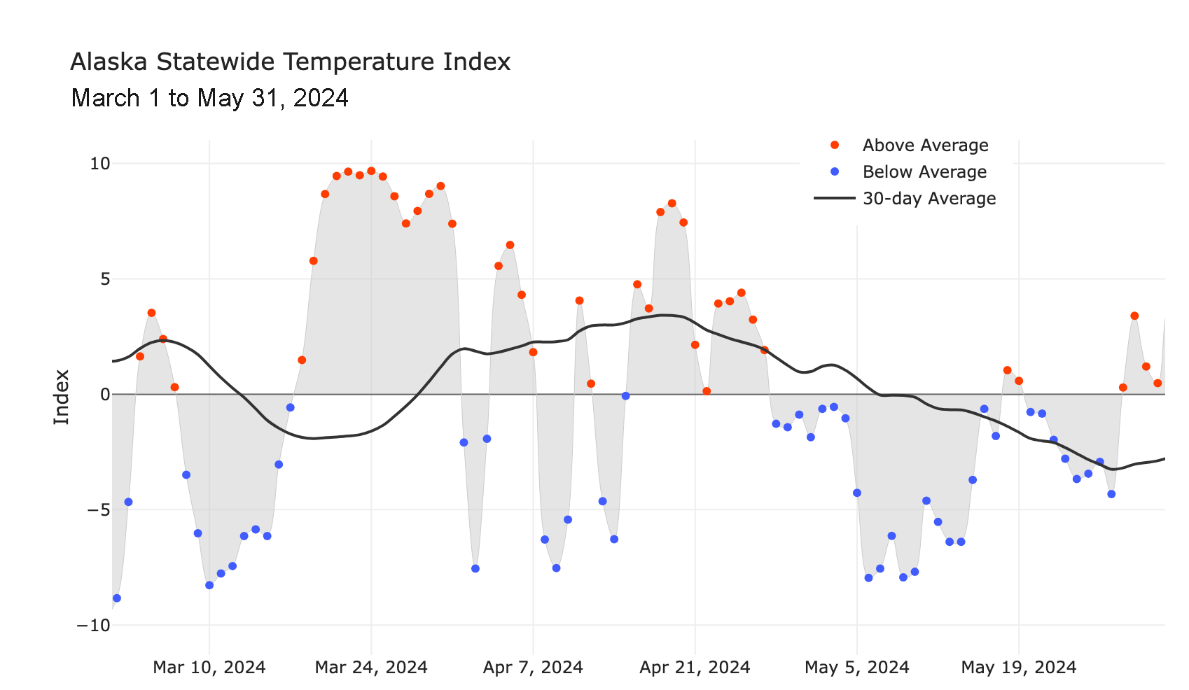
Alaska Daily Temperature Index
https://accap.uaf.edu/tools/statewide-temperature-index

Slide 4
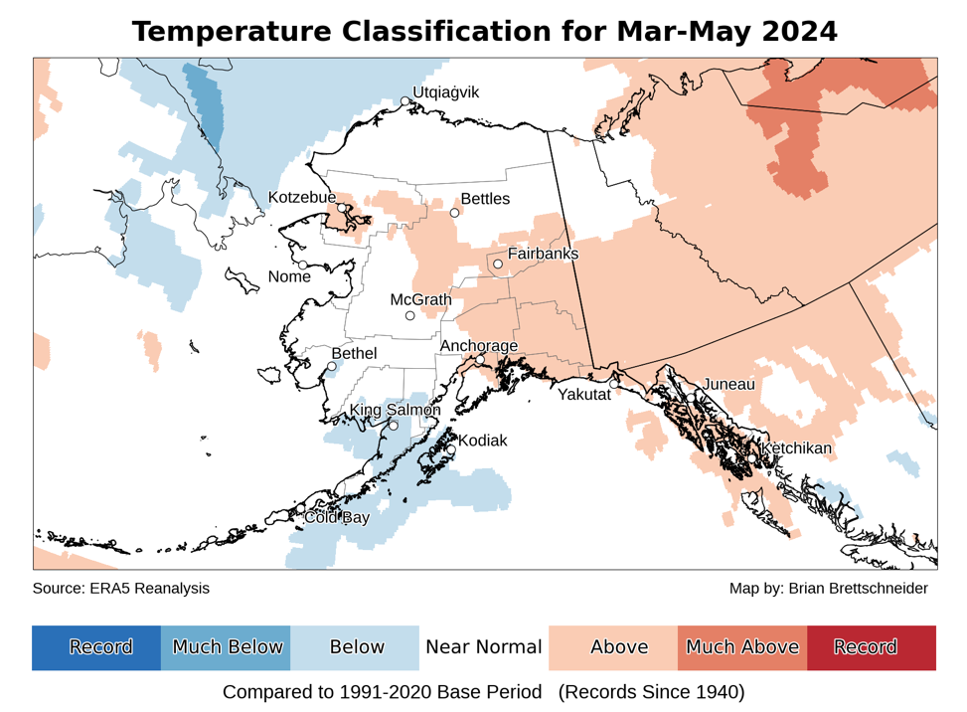
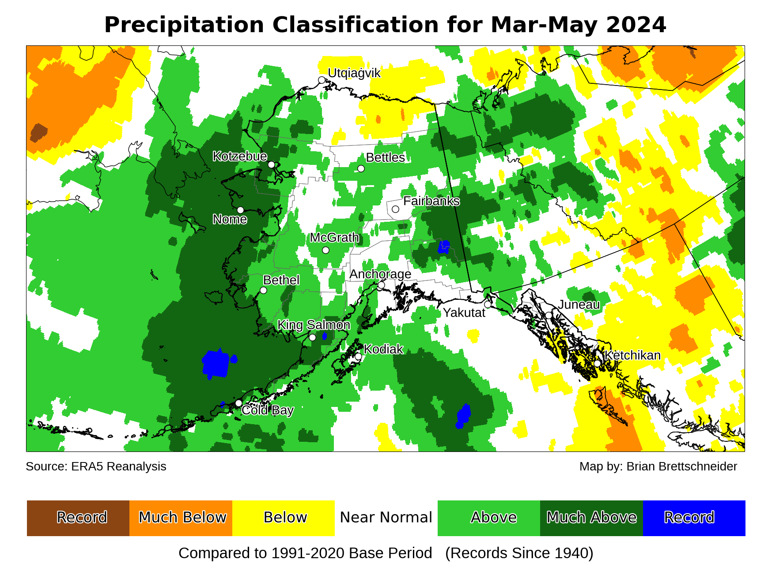
Spring 2024 Temp and Precipitation
Data: ERA5 courtesy of EMCWF/Copernicus
1991-2020 Baseline

Slide 5
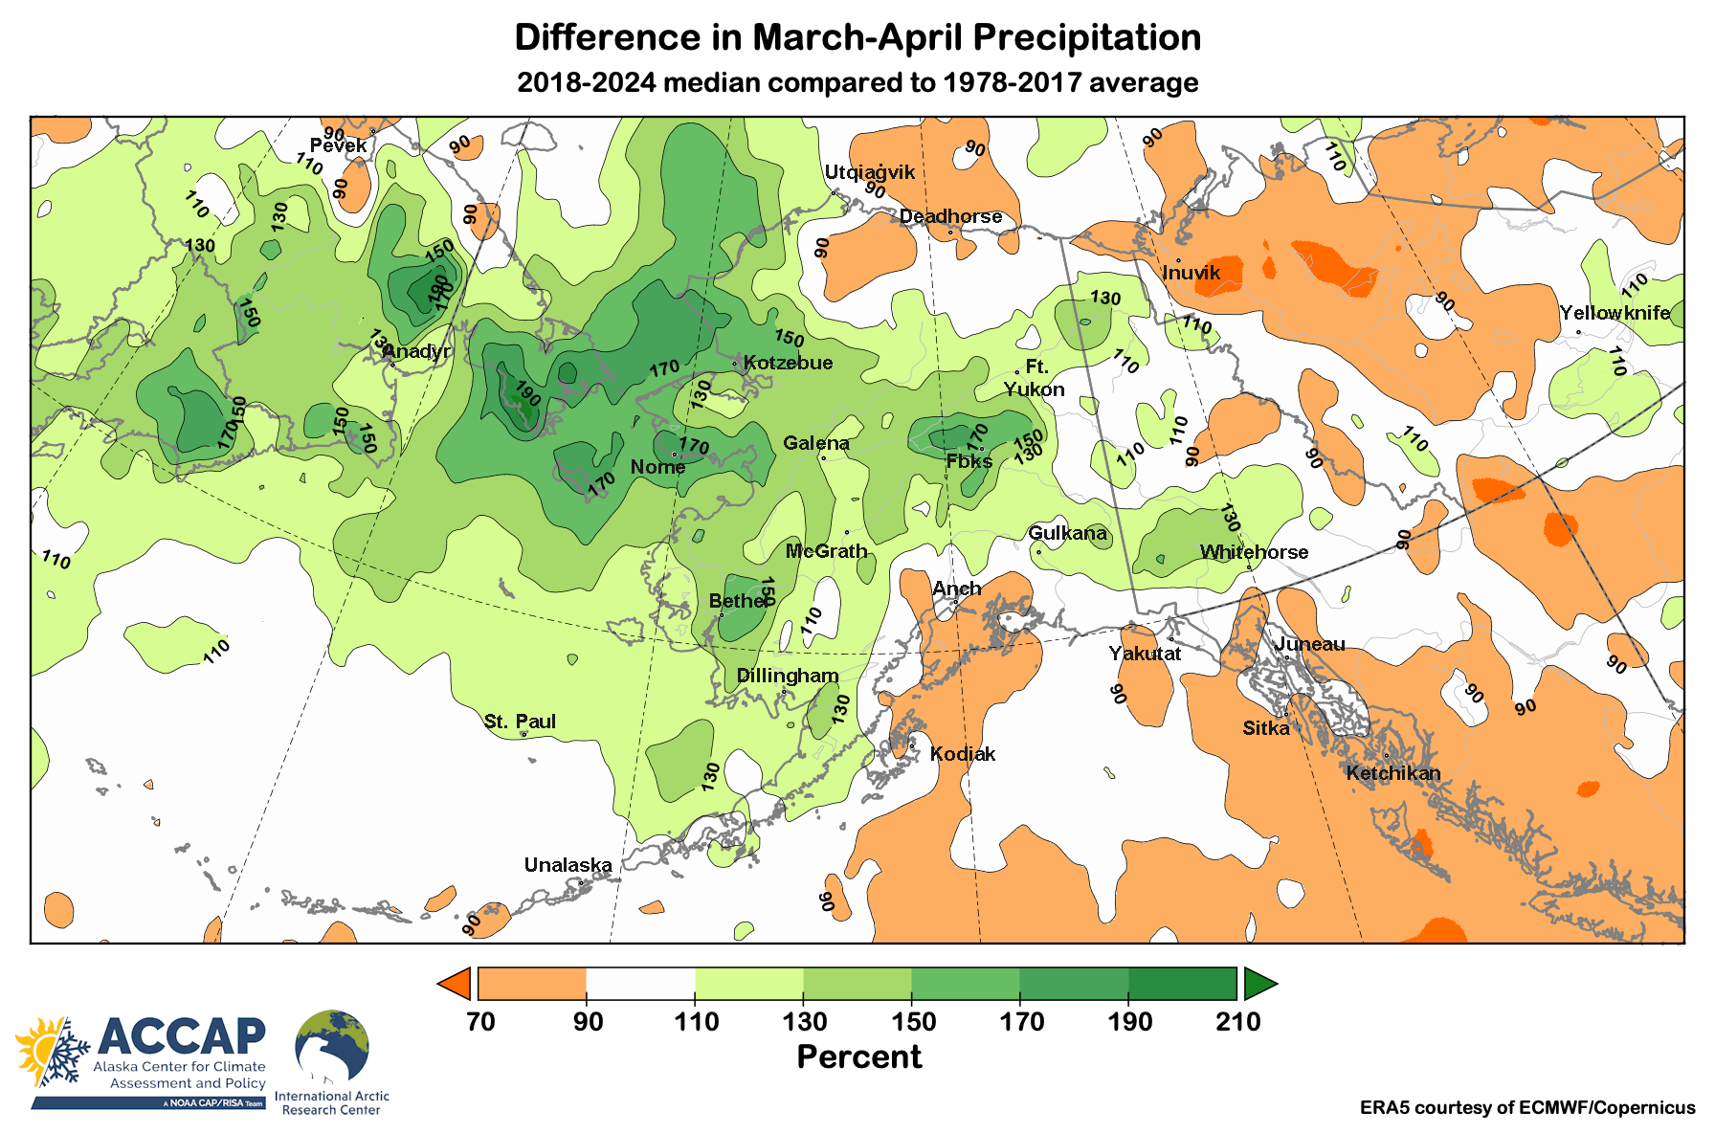
Recent Early Spring Precipitation

Slide 6
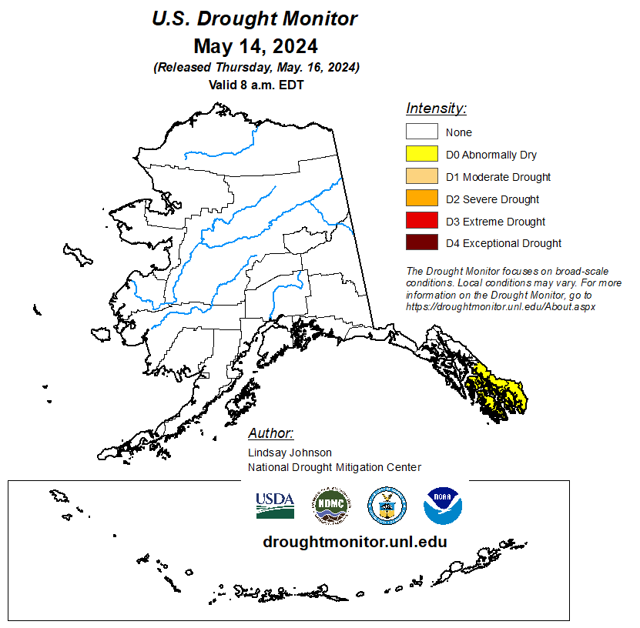
US Drought Monitor
“Abnormal Dryness”
Southern Southeast since early April

Slide 7
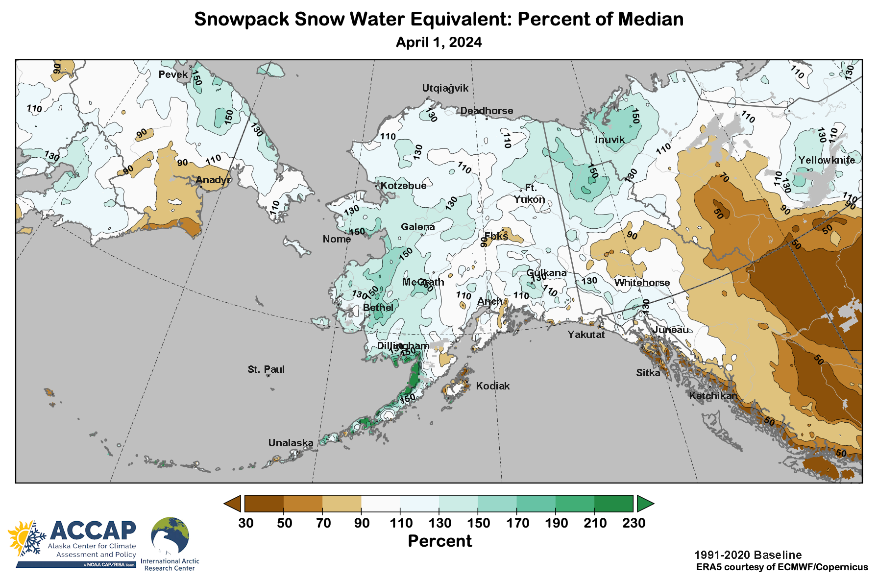
Spring 2024 Snowpack

Slide 8
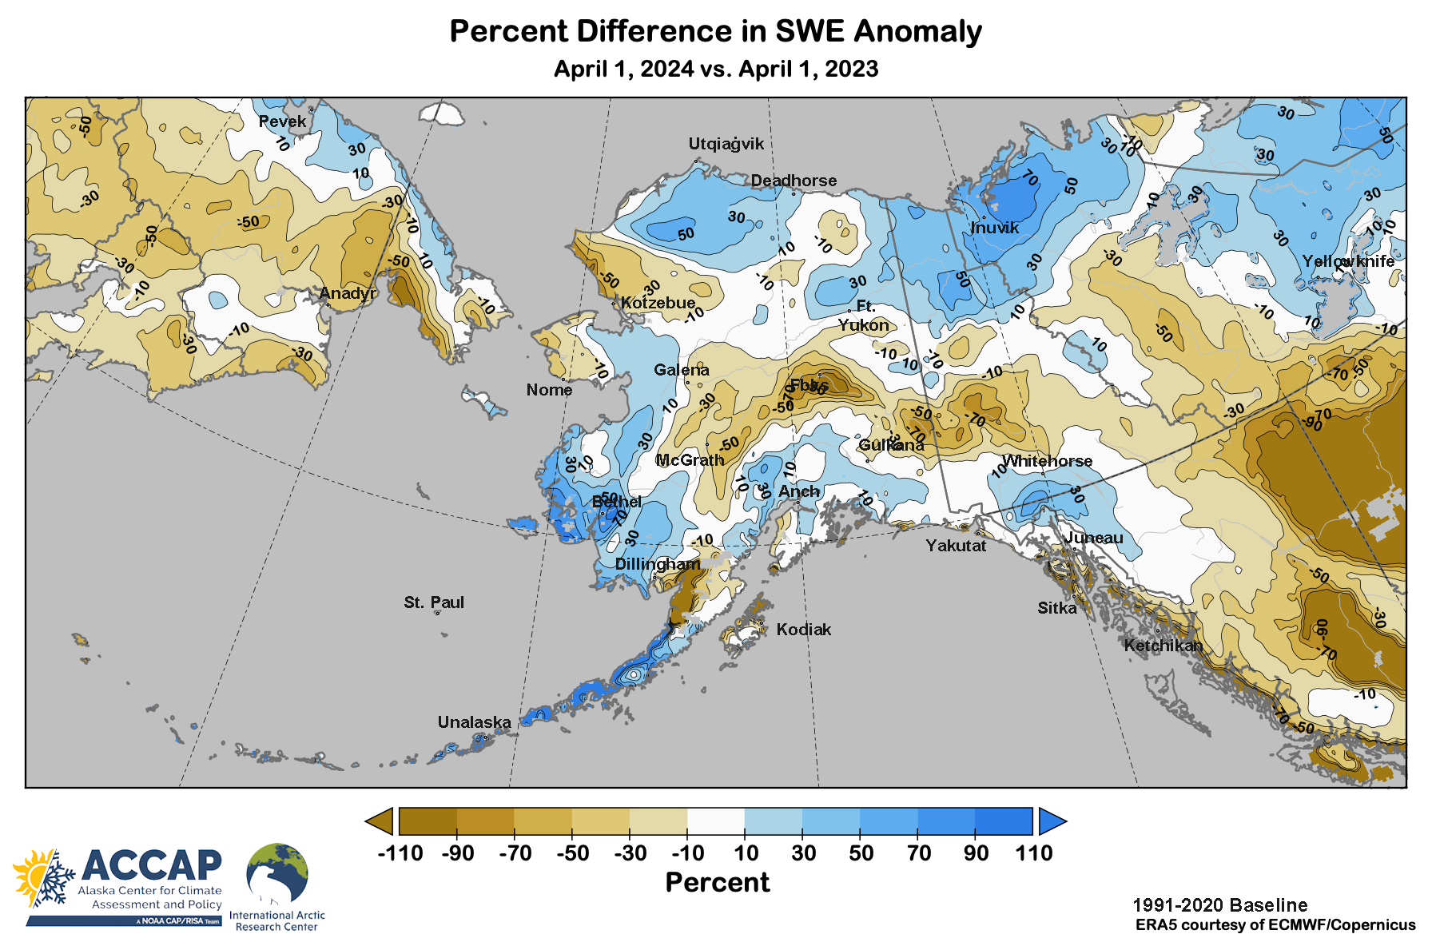
Spring 2024 Snowpack Difference from 2023

Slide 9
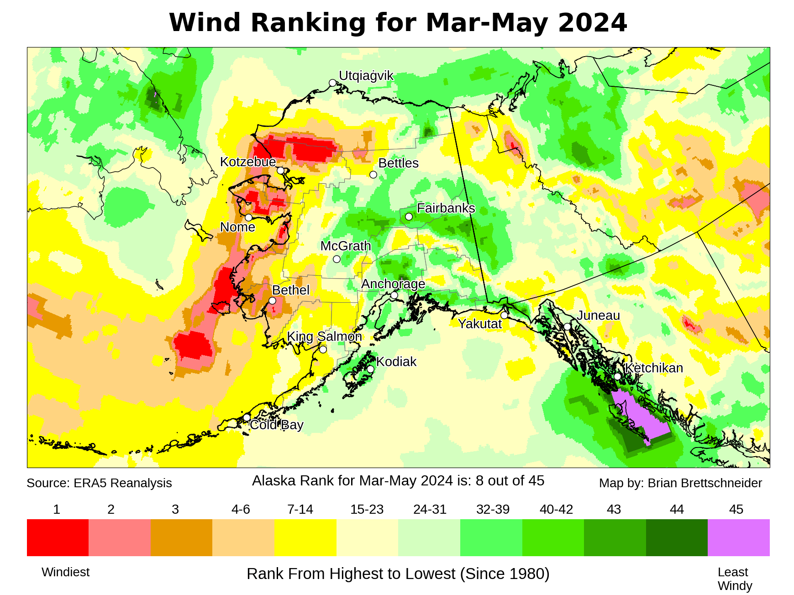
Spring 2024 Winds

Slide 10
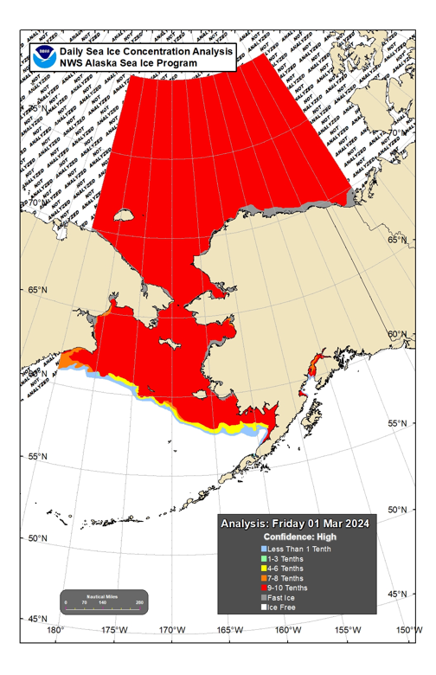
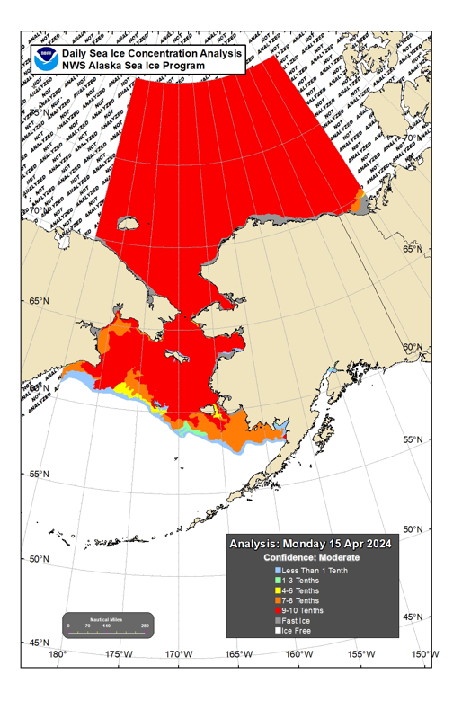
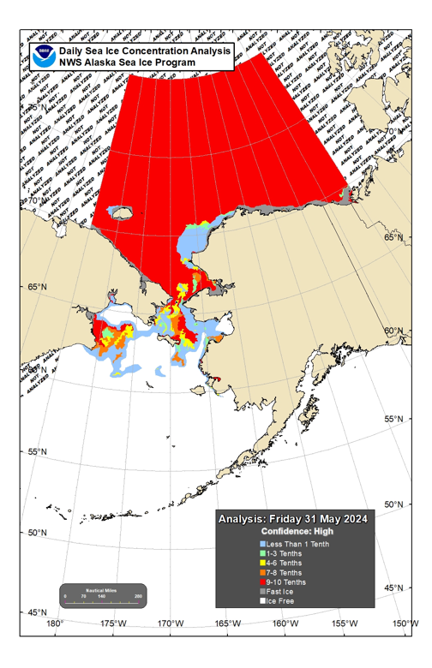
Sea Ice Extent: Spring 2024
March 01
April 15
May 31

Slide 11
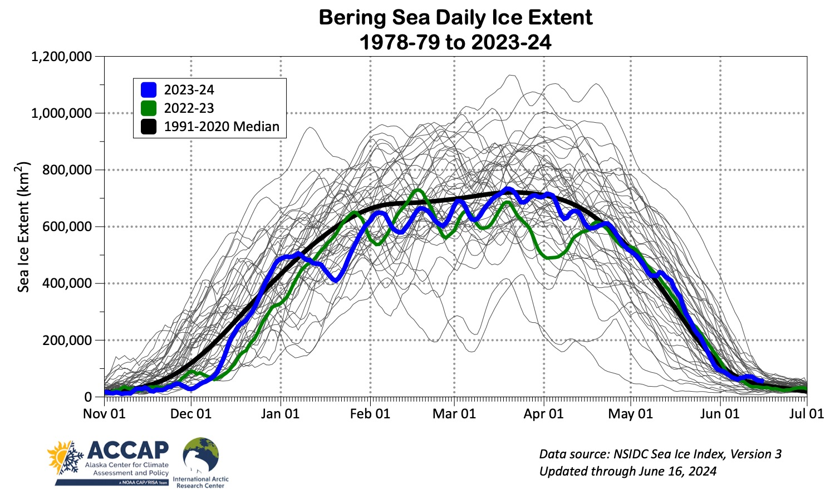
Bering Sea Ice Extent

Slide 12
Summer 2024 Outlooks
Arctic sea ice experimental outlook
NOAA/Climate Prediction Center
Sea surface temperature outlook
Copernicus C3S (Climate Change Service)
Alaska Outlooks
NOAA/Climate Prediction Center

Slide 13
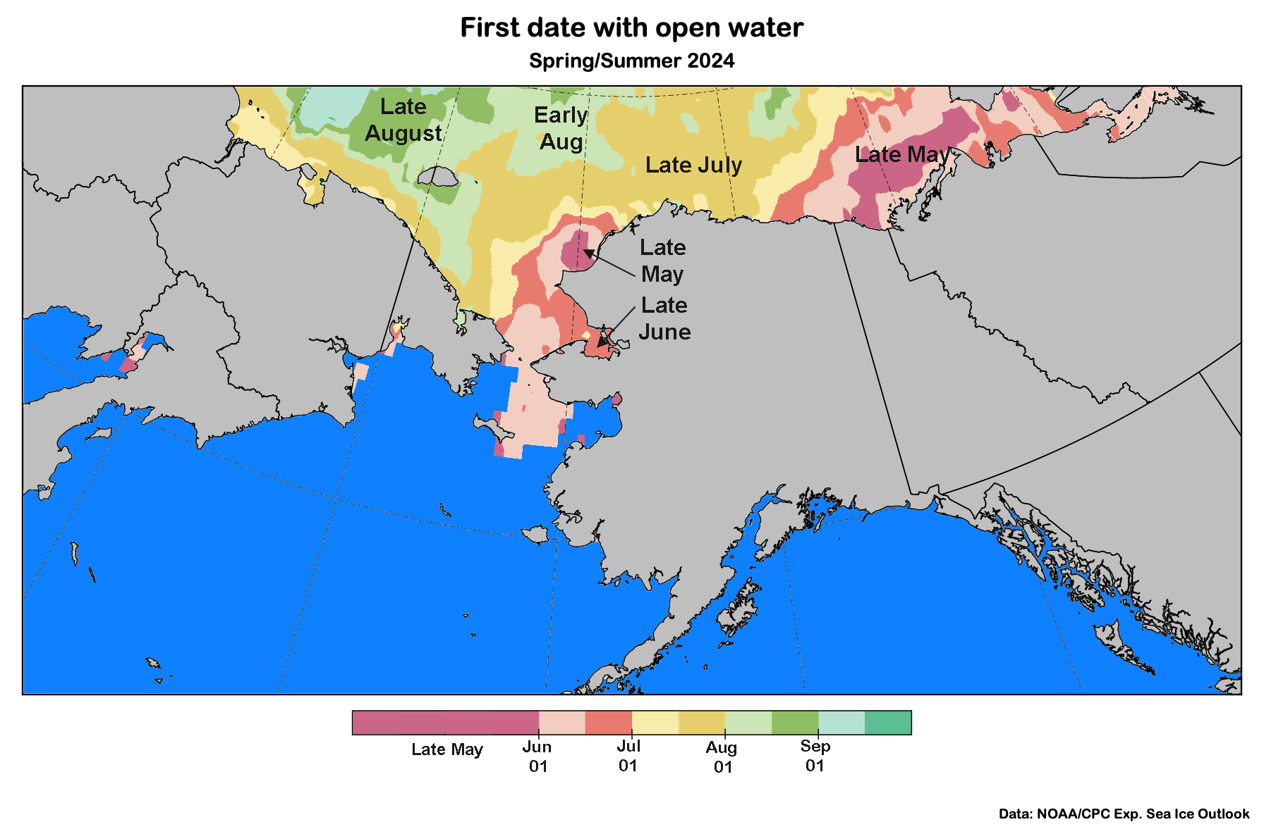
Sea Ice Outlook: Summer 2024
Data: NOAA/Climate Prediction Center Exp. Sea Ice Outlook
Outlook produced from late May 2024 data

Slide 14
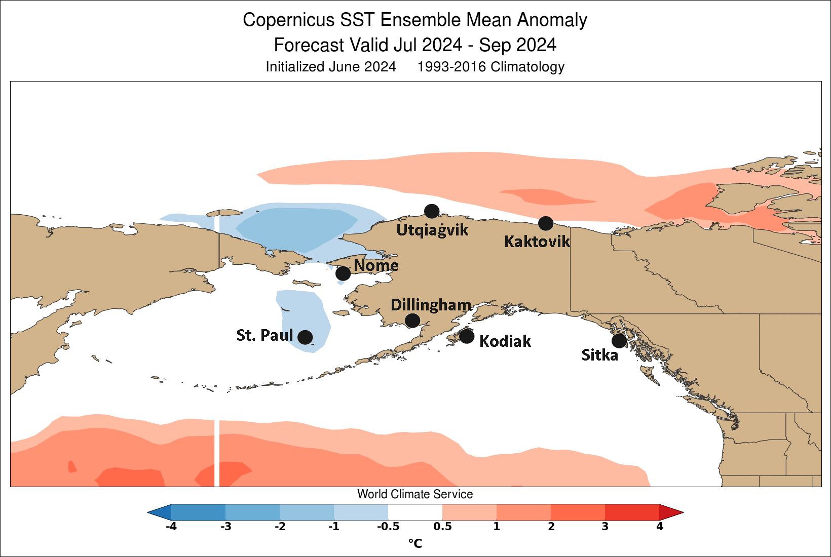
Sea Surface Temperature Outlook: Summer 2024
Outlook data: Copernicus C3S (Climate Change Service)
Graphic: World Climate Service

Slide 15
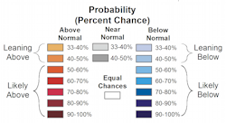
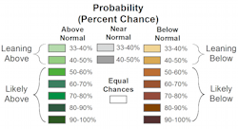
Summer 2024 Alaska Temperature and Precipitation Outlooks
Outlooks courtesy NOAA/Climate Prediction Center

Slide 16
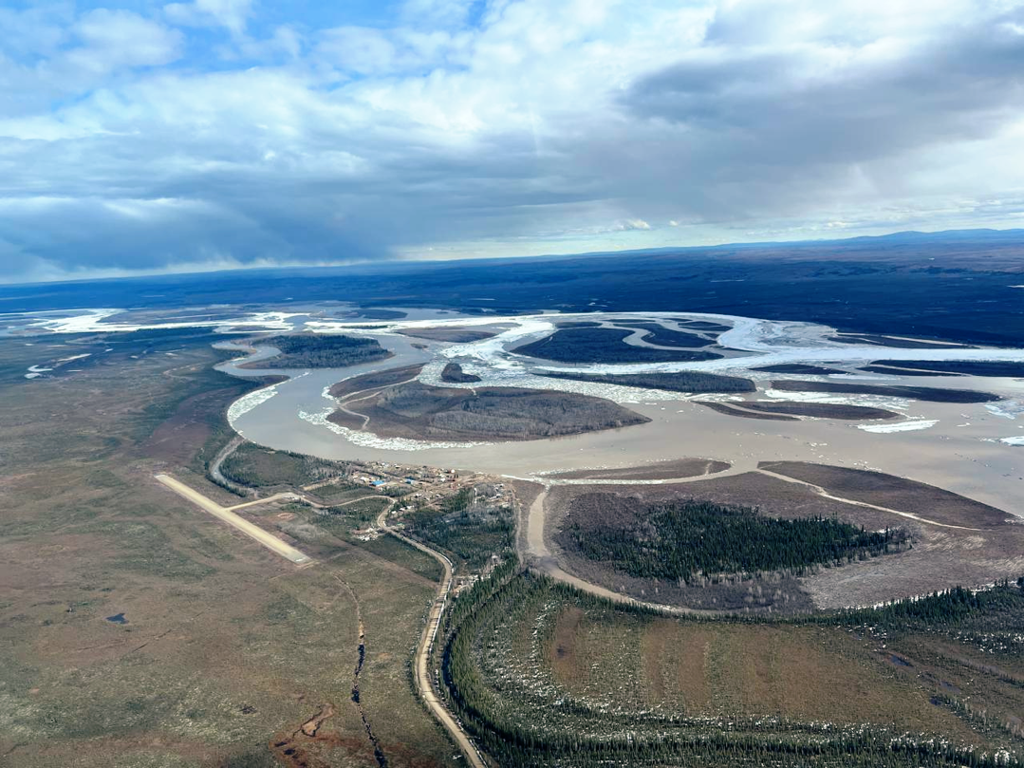
Thanks very much Questions?
NWS RiverWatch
Circle, Alaska
May 9, 2024

